Slide 1

NERC EMSWG Update
Wei Qiu, NERC EA
ERCOT TWG Conference Call
May 18, 2023

Slide 2
2023 Monitoring and Situational Awareness Technical Conference
Location: WECC, Salt Lake City, UT
Date and Time:
  Tuesday, October 3, 2023
  Wednesday, October 4, 2023

Slide 3
EMS Lessons Learned
In-process
Loss of Communication to Transmission Substations
    A loss of ‘Path A’ (fiber optic) impacted several communication circuits due to previously rerouted circuits during an ongoing planned outage on ‘Path B’ (microwave). This resulted in loss of monitoring and control for several remote substations. Both analog communications and digital SCADA communications were interrupted for 11 hours and 30 minutes
Loss of Monitoring due to a “Half Failed” High Availability Switch Pair
    An entity experienced intermittent Inter-Control Center Communications Protocol (ICCP) data failures and data quality issues in the Energy Management System (EMS) and Plant Information (PI) applications. In the event, there were effectively two major issues: the initial, spontaneous failover event that did not failover as planned/designed (resulting in a situation where some of the system was working and some of the system was not working); and the resulting response of that “half failed” situation by the attached assets

Slide 4
BES Cloud Ops - Update
Paper is being reviewed internally at NERC
Recommendations for addressing barriers to adoption from NERC CIP compliance are being reviewed for final edits. Otherwise, the paper is in final draft form.
NERC internal staff (legal and compliance) will be assisting the SITES cloud team to set up the recommendations including prospective SAR or ROP modifications for the best chance of success
Expectation is to go to RSTC for approval in September. Paper to be published immediately following the approval.

Slide 5
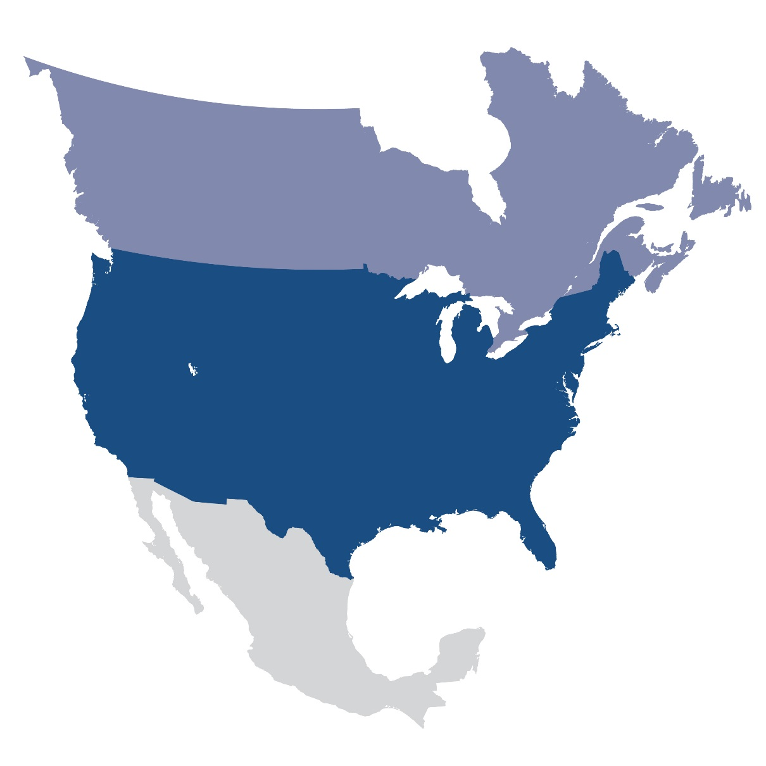
Questions and Answers
Contact Information:
wei.qiu@nerc.net

