Slide 1
ERCOT Technology Working Group (TWG)
May 18, 2023

Slide 2
ERCOT TWG – Venkat Tirupati
WELCOME

Slide 3
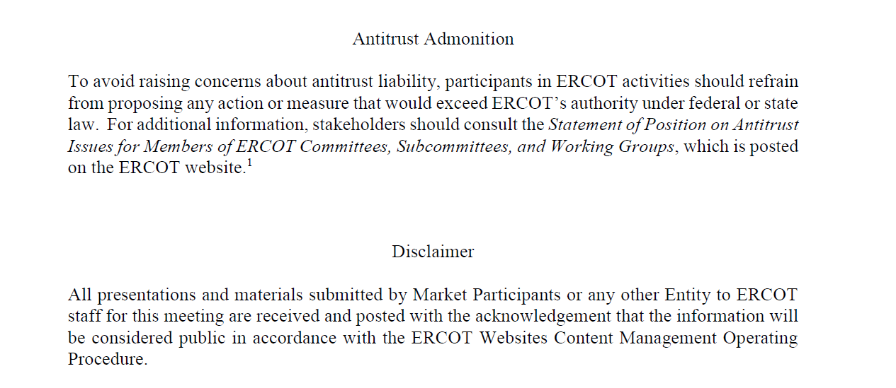
ERCOT TWG

Slide 4
ERCOT TWG Agenda
Item # | Item Description | Presenter
1 | Antitrust admonition | Venkat Tirupati
2 | Project Update | Troy Anderson
3 | Review of ECRS | Matt Mereness/Sathya Krishnan
4 | Details on IT incidents M-A050323-03 ERCOT network issues that were impacting MMS UI, OS UI and External Web Services (EWS) are fixed. M-B041323-01A ERCOT experienced an unexpected outage affecting all ERCOT websites | Kevin Widner
5 | NERC update – EMSWG/BES Cloud Ops | Venkat Tirupati
6 | Public API and API improvements | Mike A./Omar S./Ajay M.
7 | Developer Portal Updates | Brandon J./Ajay M.
8 | ERCOT WAN Provider Update | Jason Chambers/Todd Jaksch
9 | Updates for Awareness CIM 16 Upgrade ERCOT EMS Upgrade Project Operator Real-Time Messaging SCR820 NERC Project 2015-09 | ERCOT Staff
10 | Future Topics of Interest | Venkat Tirupati
 | Adjourn | Venkat Tirupati

Slide 5
ERCOT TWG – Troy Anderson
Project Update

Slide 6
ERCOT TWG – Matt Mereness/Sathya K.
Ercot Contingency Reserve Service (ECRS) Market Readiness

Slide 7
ERCOT TWG – Kevin Widner
Review of IT Incidents

Slide 8
ERCOT TWG – NERC Update
EMSWG Update
BES Cloud Ops

Slide 9
ERCOT TWG – Mike A./Omar S./Ajay M.
Public API & API Improvements

Slide 10
ERCOT TWG – Brandon Johnson/ Ajay Mannepalli
Developer Portal

Slide 11
ERCOT TWG – Jason Chamber/Todd Jaksch
WAN Provider Update

Slide 12
ERCOT TWG – ERCOT Staff
CIM 16 Upgrade
ERCOT EMS Upgrade Project
NERC Project 2015-09
Operator Real-Time Messaging SCR820

Slide 13
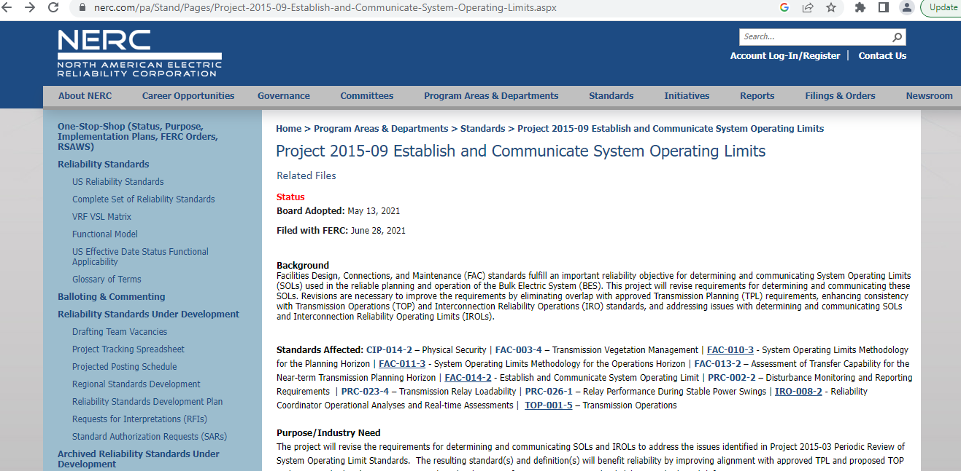
ERCOT TWG – NERC Project 2015-09

Slide 14
ERCOT TWG - FAC-011 R7
Each Reliability Coordinator shall include in its SOL methodology a risk-based approach for determining how SOL exceedances identified as part of Real-time monitoring and Real-time Assessments must be communicated and if so, the timeframe that communication must occur. The approach shall include: [Violation Risk Factor: High] [Time Horizon: Operations Planning]
7.1. A requirement that the following SOL exceedances will always be communicated, within a timeframe identified by the Reliability Coordinator.
  7.1.1 IROL exceedances;
  7.1.2 SOL exceedances of stability limits;
  7.1.3 Post Contingency SOL exceedances that are identified to have a validated risk of instability, Cascading, and uncontrolled separation;
  7.1.4 Pre-Contingency SOL exceedances of Facility Ratings; and
  7.1.5 Pre-Contingency SOL exceedances of normal minimum System Voltage Limits.
7.2. A requirement that the following SOL exceedances must be communicated, if not resolved within 30 minutes, within a timeframe identified by the Reliability Coordinator.
  7.2.1 Post-Contingency SOL exceedances of Facility Ratings and emergency System Voltage Limits, and
  7.2.2 Pre-Contingency SOL exceedances of normal maximum System Voltage Limits.

Slide 15
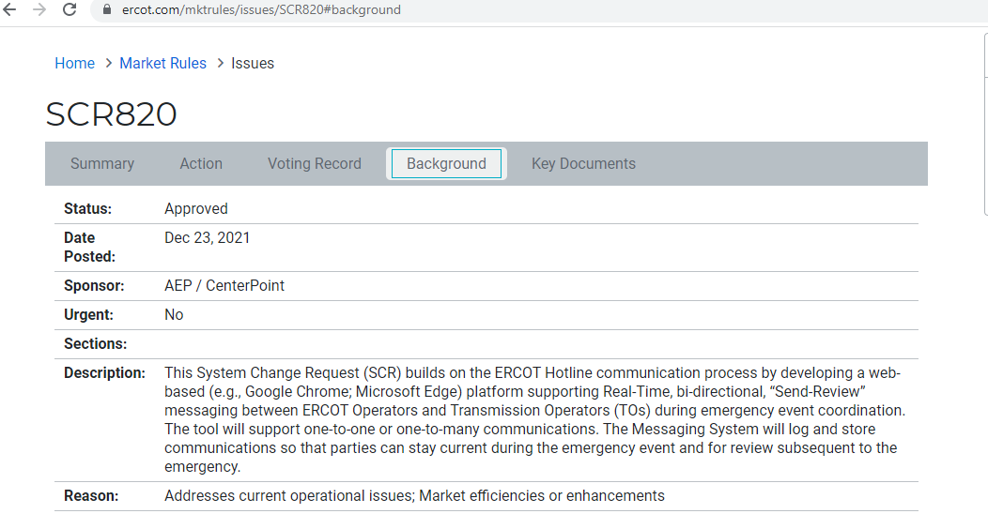
ERCOT TWG – SCR 820

Slide 16
ERCOT TWG – Leadership Update
Thank you, Kevin..

Slide 17
ERCOT TWG – Open Forum
Q & A

Slide 18
ERCOT TWG
Thank You

