Slide 1
OWG - NOGRR245 – Alternative Framework Proposal
Stephen Solis – Principal, System Operations Improvement
May 18th, 2023

Slide 2
Overview
ERCOT has experienced multiple events where Inverter Based Resources (IBRs) have failed to ride-through the disturbance. The magnitude of these events have increased as the levels of IBRs synchronized to the ERCOT System have increased.
ERCOT received a recommendation as part of the 2021 Odessa Disturbance Report. “ERCOT should ensure that the recommendations contained within the NERC reliability guidelines are comprehensively reviewed and adopted to ensure mitigating actions are put in place to prevent these types of issues in the future. Many of the performance issues in this event could have been mitigated if appropriate performance requirements were established for these resources and interconnection studies were performed to ensure conformance with those requirements”
EPRI gap assessment of IEEE 2800 vs ERCOT Protocols and Guides recommended that ERCOT improve Inverter Based Resource (IBR) Ride-Through requirements to align with IEEE 2800 ride-through requirements which could mitigate some recent failure mode causes.
Feedback at ERCOT IBRTF was to prioritize ride through requirement changes over other changes.
NOGRR enhances clarity and specificity of frequency and voltage ride through requirement sections for IBRs while aligning with most relevant IEEE 2800 standard and NERC Reliability Guidelines.

Slide 3
Disclaimer
ERCOT is presenting an alternative framework in an attempt to provide an alternative that considers stakeholder feedback while attempting to still mitigate the reliability risk imposed by IBR ride through performance failures.
This presentation is meant to facilitate discussion and solicit additional feedback to determine if this framework merits the more extensive language changes necessary to accommodate them prior to making such changes.
Nothing in this proposal is to be interpreted as a final position of ERCOT and ERCOT maintains the discretion to not support this framework based on feedback and additional information presented to ERCOT.

Slide 4
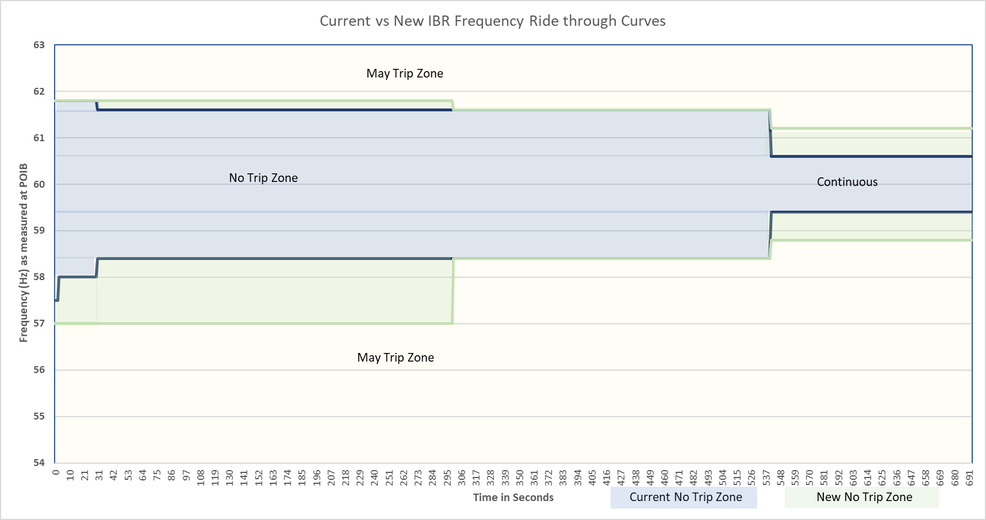
IBR - Frequency-ride through (FRT) requirements
Alternative framework proposes to move forward with the IEEE 2800 FRT requirements for all IBRs by 12/31/25 as drafted in the last ERCOT submitted comments for NOGRR 245
Feedback seems that these changes are feasible

Slide 5
IBR – VRT Framework Summary
NOGRR 245 passed – All new IBRs comply with IEEE 2800
3/1/24 - Pre-2014 IBRs able to comply or retrofit?
12/31/25 maximize capability and comply with NOGRR 245 with current VRT curves
5/23
12/25
Pre-2014 IBRs
Must comply with current VRT curves and requirements
2014 – 2023 IBRs
Must comply with current VRT curves and requirements
2023 - future IBRs
Must comply with IEEE 2800 curves and requirements
12/31/27 – Pre-2014 IBRs that retrofit must meet IEEE 2800 curves and requirements
1/26
Pre-2014 IBRs
Must comply with current VRT curves and new specificity from NOGRR 245
2014 – 2024 IBRs
Must comply with current VRT curves and new specificity from NOGRR 245
New and retrofitted IBRs
Must comply with IEEE 2800 curves and requirements

Slide 6
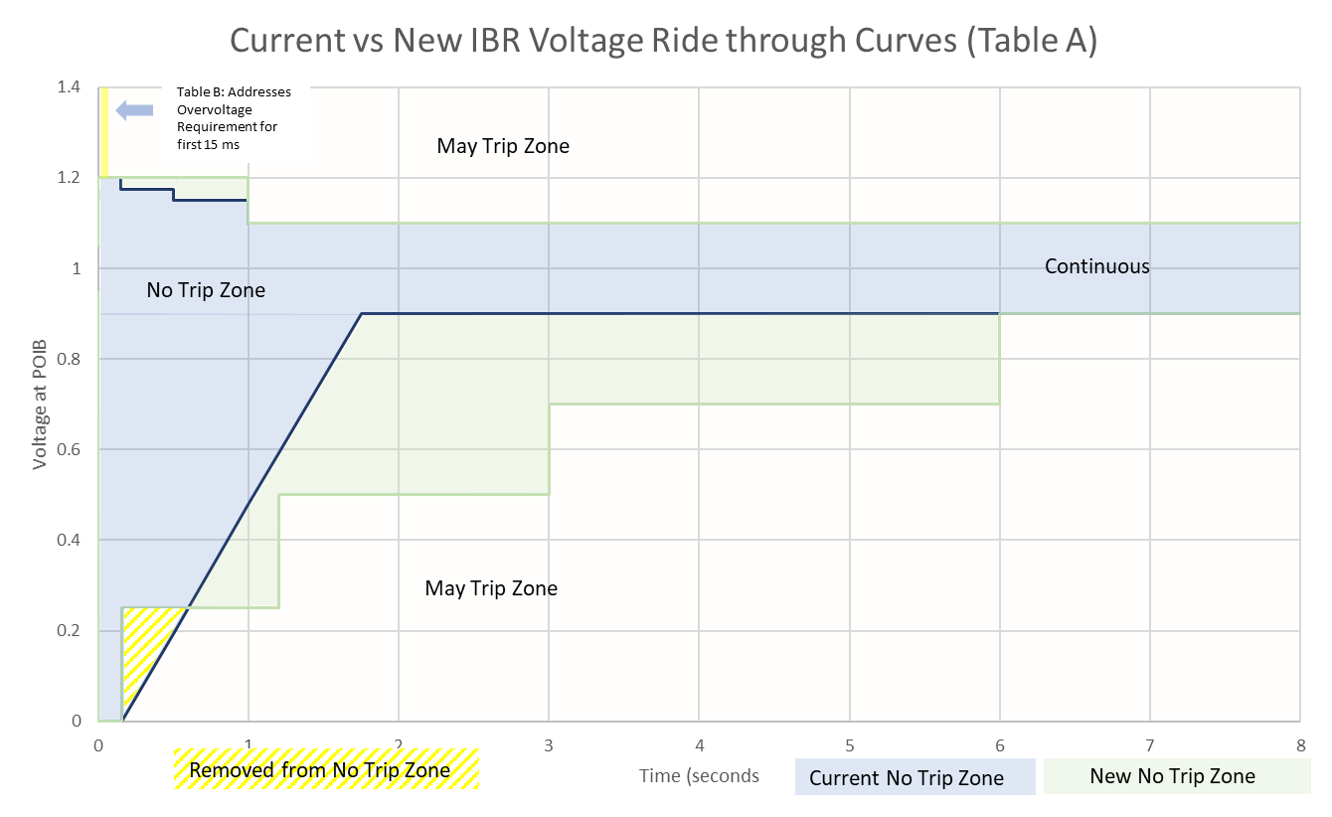
IBR – Voltage Ride-through (VRT) requirements
ERCOT is considering the following alternative framework:
All new IBRs with signed Interconnection Agreement on or after NOGRR 245 approval must meet IEEE 2800 requirements to interconnect
All existing IBRs with signed Interconnection Agreement before NOGRR 245 approval must maximize their current ride through capability to meet or exceed the current, in effect VRT curves (blue zone below) as soon as practicable but no later than 12/31/25. *No exemptions/ grandfathering.
Includes all NOGRR 245 specificity but applied to the current VRT blue zone below only.
All existing IBRs must install DFRs and PMUs if not already installed(IEEE 2800 Table 19)

Slide 7
IBR – Restrictions for performance failures
Between NOGRR 245 effective date and 12/31/25:
Any existing IBR performance failures vs the current, in effect VRT curves may have restrictions applied until the issue is mitigated
Includes IBRs with current exemptions/grandfathering which must perform to the current, in effect VRT curves (i.e. exemptions are removed).
Momentary cessation or poor/no reactive response is not allowed.
By 3/1/24, any IBR that determines it cannot meet the current, in effect VRT curves with additional requirements in NOGRR 245 by 12/31/25, must identify if it plans to maximize the VRT capability and or retrofit after 12/31/25.
Retrofit/replacement elections must meet the IEEE 2800 requirements and latest reactive capability requirements by 12/31/27 (e.g. GINR process).
Retrofit/replacement election may continue to operate without restriction after 12/31/25 until 12/31/27 so long as the IBR continues the GINR process and does not have a ride through performance failure at which time restrictions may be applied. Restrictions may be lifted when the issues is mitigated to allow them to meet the current, in effect VRT curves.
After 12/31/27, if the IBR has not completed its retrofit or cannot meet the IEEE 2800 requirements, it shall be restricted to the output that can meet the requirements.
Any new IBRs after NOGRR 245 effective date must meet the IEEE 2800 requirements.

Slide 8
IBR – Restrictions for performance failures
After 1/1/26 :
All existing IBR performance failures vs the current, in effect VRT curves with NOGRR 245 specificity may have restrictions applied until the issue is mitigated
After 1/1/28:
Any IBR performance failures vs the IEEE 2800 requirements by retrofitted/replaced IBRs may have restrictions applied until the issue is mitigated.
If the IBR did not completed its retrofit or cannot meet the IEEE 2800 requirements, it shall be restricted to the output that can meet the requirements.
Any new IBRs after NOGRR 245 approval date must meet performance vs the IEEE 2800 requirements and may have restrictions applied for any performance failure until the issue is mitigated

Slide 9
Additional considerations
Alternative framework hinges on performance failure restrictions and removal of exemptions to allow additional time frames and reduction of requirements for the majority of existing IBRs.
All IBRs will need to have PMU and DFR for performance validation during disturbances.
Retrofit decisions must be made in early 2024 to allow for implementation time based on feedback and full GINR process.
If any modifications resulting from activities such as retrofit/repowers are applicable to Planning Guide Section 5.2.1, IBRs will need to follow the GINR process and must meet IEEE 2800 and latest reactive capability requirements.
Assumes all IBRs without exemptions can comply with the existing rules.
Restrictions will clarify that if an IBR can comply with ride through requirements by limiting its maximum output, this would be an acceptable mitigation.
Entities should not wait and should maximize ride-through capabilities as soon as practicable as more substantive changes will require model validation and studies prior to implementation (could take months depending on magnitude of changes).

Slide 10
Questions?

