Slide 1
Probabilistic Reserve Risk Model Results, Summer 2023
Pete Warnken
Resource Adequacy
May 19, 2023

Slide 2
EEA Risk Measure: Capacity Available for Operating Reserves (CAFOR)
CAFOR Formula:
  = Seasonal Maximum Expected Resource Generation Capability
  – Demand
  – Uses of Reserves*
  + Pre-EEA Resources if CAFOR < 3,000 MW
  + EEA Resources if CAFOR < 2,300 MW
* Uses of Reserves:
  Higher-than-expected peak demand
  Thermal unit outages
  Renewable generation below expected values

Slide 3
Probabilistic Version of CAFOR
CAFOR Formula:
  = Seasonal Maximum Expected Resource Generation Capability for Thermal and Hydro Resources
  + Random draw from hourly capacity probability distributions for the following resources:
  Wind and Solar
  PUN generator net imports
  ‒ Net Peak demand, random draw from hourly capacity probability distribution less Price Responsive Demand from supply schedule
  ‒ Unplanned thermal outages, random draw from daily capacity probability distribution
  + Pre-EEA Resources* if CAFOR < 3,000 MW
  + EEA Resources if CAFOR < 2,300 MW
* Random draws for remaining DC tie net imports and emergency requests for Switchable Generation Resources capacity committed to other grids

Slide 4
Model Updates
Included hour-ending 9 PM to show the reserve risk when solar production is negligible
Assumed that a portion of 4CP participation as documented in the 2022 Annual Report of Demand Response is not reflected in the summer 2023 load forecast, and is available to further reduce load during peak demand days
  Range of Price Responsive Demand in the model is 419 MW to 3,192 MW
Created a version of the model with the proposed new EEA triggers in NPRR1176
Model aligns with the summer-rated thermal resource capacity in the Summer 2023 SARA report; wind and solar profiles scaled to match SARA installed capacities
  New synthetic hourly wind and solar profiles, which include those reflecting 2022 weather, are nearly ready for use; a final set of profiles is expected by the end of May

Slide 5
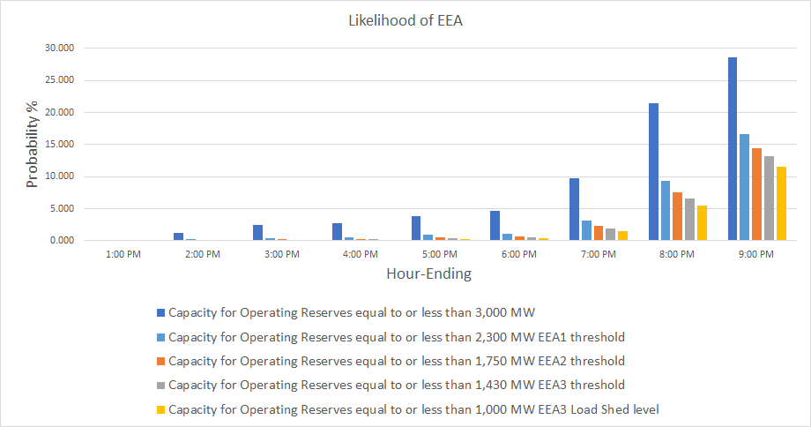
Energy Emergency Alert Risk Profile

Slide 6
Impact of Applying New EEA Triggers (NPRR1176)
Current Triggers
New NPRR1176 Triggers

Slide 7
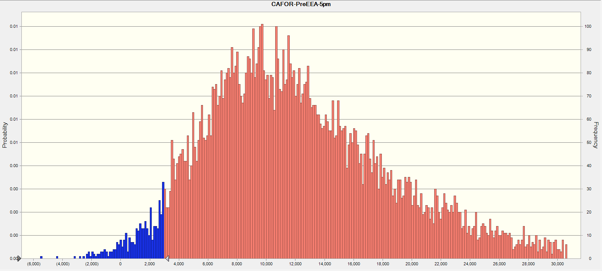
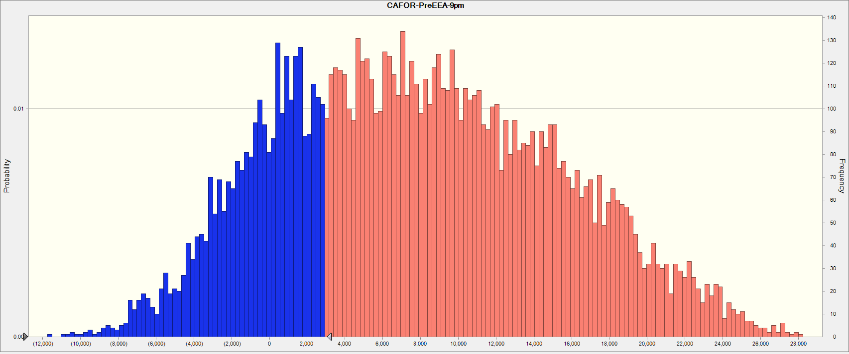
CAFOR “Pre-EEA” Outcomes, HE 5 PM and 9 PM
These CAFOR outcomes only include pre-EEA resources:
ERS
Distribution voltage reduction
LFL curtailment
Remaining DC tie import capability
HE 5 PM
CAFOR Outcomes <= 3,000 MW
CAFOR Outcomes <= 3,000 MW
HE 9 PM

Slide 8
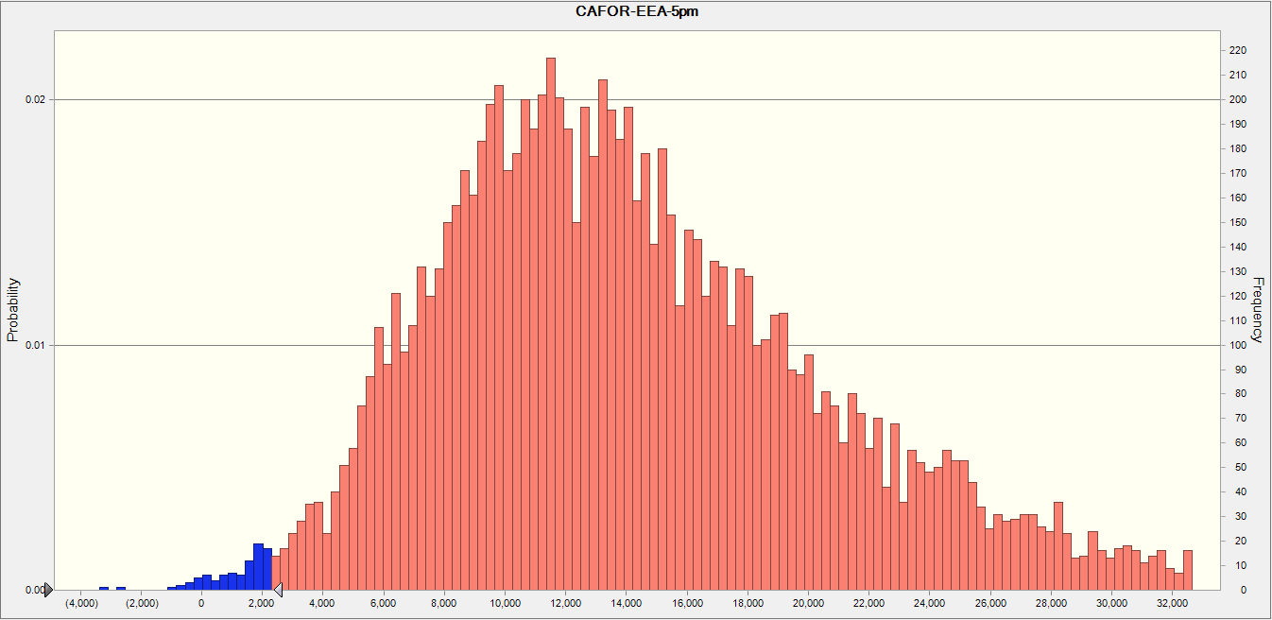
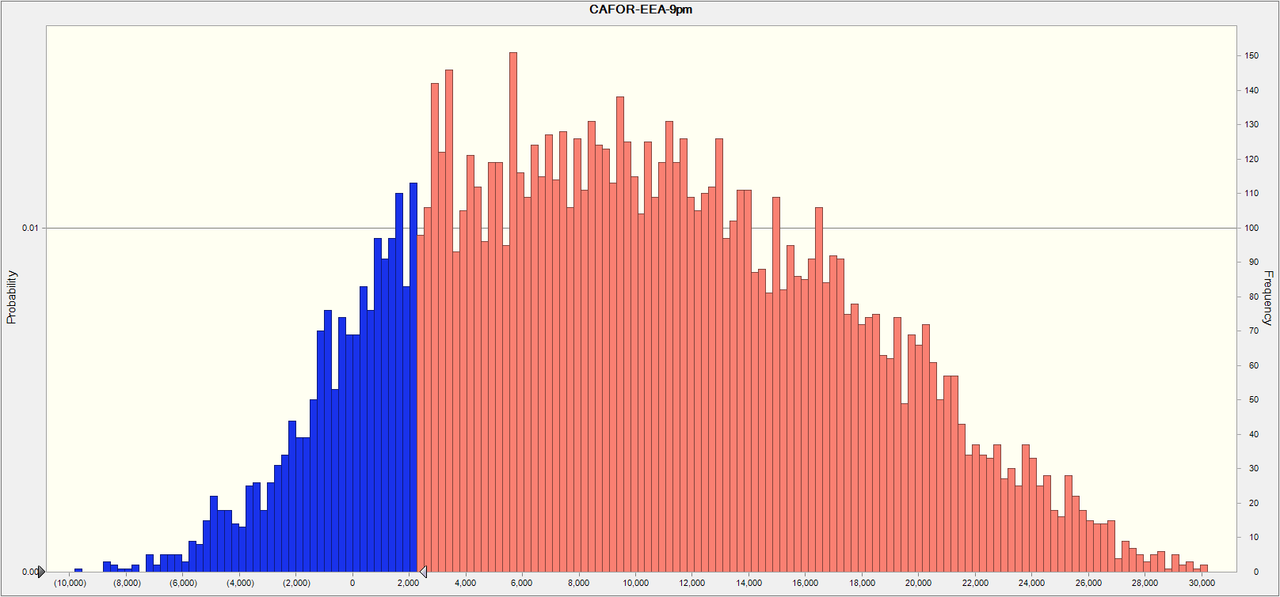
CAFOR “EEA” Outcomes, HE 5 PM and 9 PM
HE 5 PM
CAFOR Outcomes <= 2,300 MW
These CAFOR outcomes include all EEA resources
CAFOR Outcomes <= 2,300 MW
HE 9 PM

Slide 9
CAFOR Risk Profile, HE 5 PM

Slide 10
CAFOR Risk Profile, HE 9 PM

Slide 11
Observations and Next Steps
Hour-ending 9 PM is now the hour with the most capacity scarcity risk due to more installed solar
  Installed utility-scale solar capacity increased by 4,647 MW relative to the solar capacity forecast for the Summer 2022 SARA (16,130 MW vs. 11,483 MW)
Inclusion of Price Responsive Demand is a major difference between the model and the SARA report, and helps explain why the SARA high/extreme scenario outcomes are more severe than the modeled CAFOR outcomes
  Variability of peak demand outcomes is reduced because more PRD is selected when the gross peak demand selected is higher
  Validation of PRD availability estimates needed
The model uses a static amount of battery storage energy availability for all hours; an analysis is needed to determine how to best represent hourly State of Charge available for energy in the model

