Slide 1
Annual Distributed Generation Estimate
May 2, 2023

Slide 2
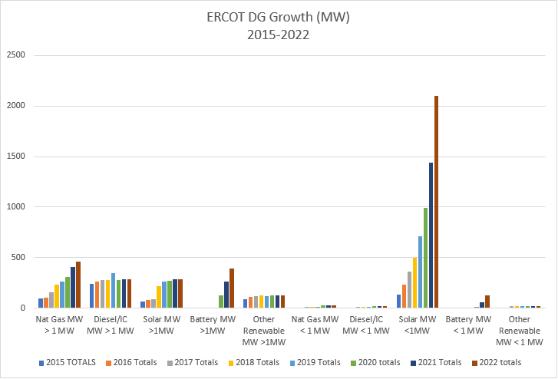
ERCOT Estimated Total DG Growth 2015-2022 (MW)
181%
MW
31%
Notes:
Major areas of DG growth in ERCOT
Solar PV <1 MW
Natural gas > 1 MW (co-located with load)
DGR Energy Storage> 1 MW
Detail for Systems > 1 MW
Increased Growth in Distribution connected batteries
Continuation of upward trend for Nat Gas
Very limited growth for solar > 1 MW
Detail for Systems < 1 MW
Accelerating Solar PV trend in line with projections
Lack of reporting on residential energy storage from most NOIEs.

Slide 3
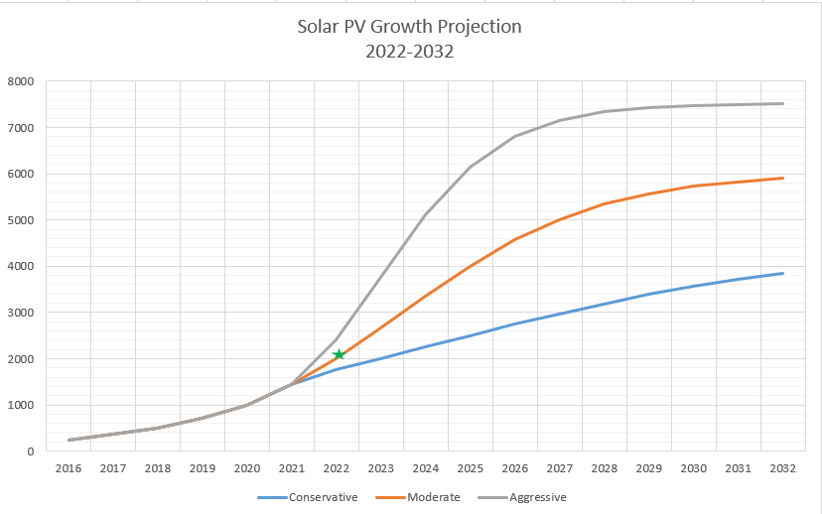
ERCOT Solar PV Rooftop Projections vs Actual 2022
181%
MW
31%
Notes:
Major areas of DG growth in ERCOT
Solar PV <1 MW
Natural gas > 1 MW (co-located with load)
DGR Energy Storage> 1 MW
Detail for Systems > 1 MW
New applications for Energy Storage
Continuation of upward trend for Nat Gas
Very limited growth for solar > 1 MW
Stagnant Diesel growth
Declining Landfill Gas, Hydro, Wind
Detail for Systems < 1 MW
Accelerating Solar PV trend in line with projections
Lack of reporting on residential energy storage from most NOIEs.

Slide 4
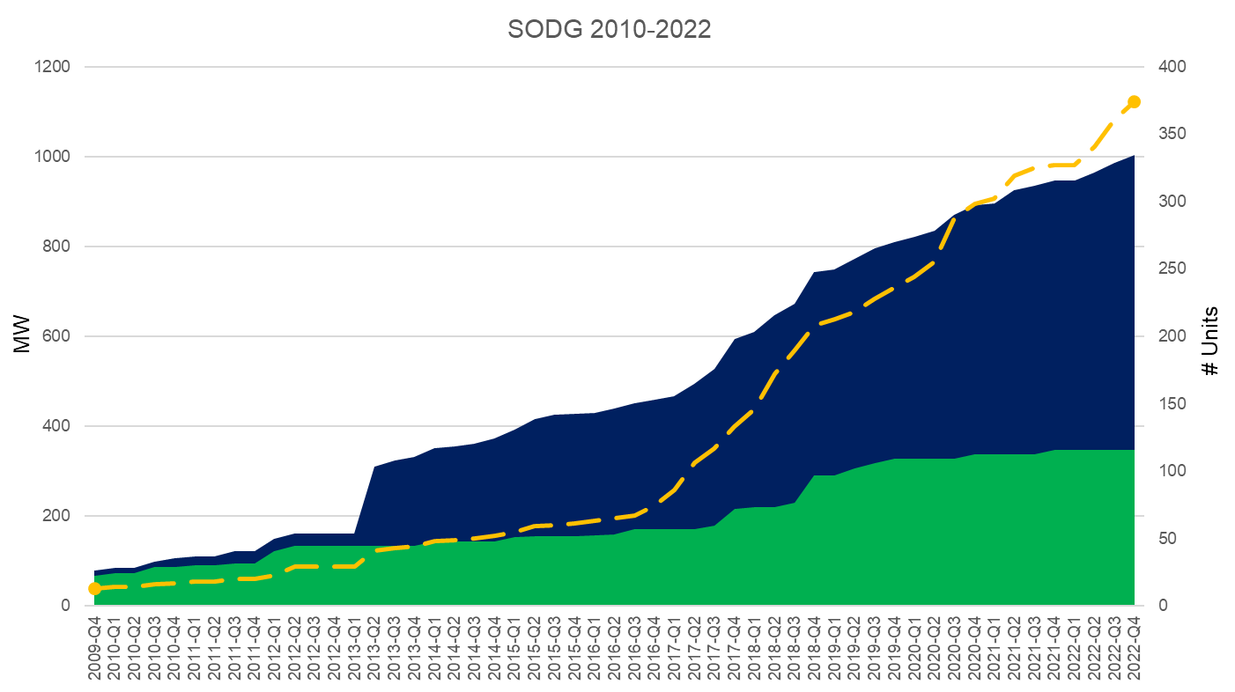
Settlement-Only Distributed Generation in ERCOT 2010-2022
SODGs
# Units
MW
Non-Renewable
314
656
Renewable + Storage
60
348*
TOTALS
374
1004
Accumulated Count
SODGs are:
<10 MW
If >1 MW and inject to grid, must register with ERCOT
If <1 MW, registration optional
Non-renewables
Renewables
Renewables
*Note that 0 MW of SODG Renewables added in 2022

