Slide 1
ERCOT Frequency Events
April 2023
ERCOT
Operations Planning
PDCWG |May 17th, 2023

Slide 2
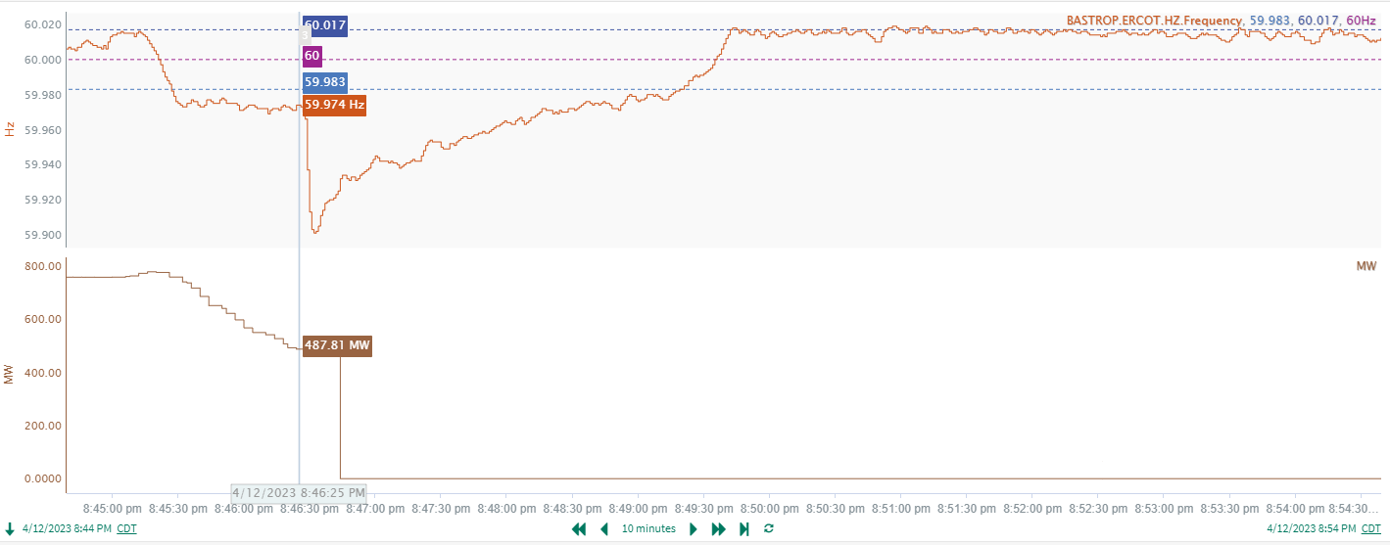
4/12/2023 20:46:25 (Non-FME)
Notes:
A unit had a runback of 289 MW and then tripped offline while carrying approximately 487 MW gen
Starting Frequency: 59.974Hz
Minimum Frequency: 59.901 Hz
A-C Time : 7 seconds
Recovery Time(back to deadband): 2 minutes 54 seconds
RRS Released: 382 MW
Trip Reason: Due to an auxiliary transformer issue.
Contextual Information: A total of 214 MW of regulation Up was deployed during the event
A 350 MW SCED offset was applied as well.

Slide 3
Questions?
Thank you!

