Slide 1
Proposed Changes to ERCOT Credit Forms (and updates from April 21, 2023 discussion)
Katherine Gross
Senior Corporate Counsel
ERCOT Public
Credit Finance Sub Group
May 17, 2023

Slide 2
Types of ERCOT Credit Forms
1) Letter of Credit (Secured; Changes Proposed on slides 3 and 4)
2) Surety Bond (Secured; Changes Proposed on slide 5)
3) Guarantee Agreements* (Unsecured; Elimination discussed below)
Guarantee Agreement (Domestic Affiliated Guarantor)
Third-Party Guarantee Agreement (Domestic Non-Affiliated Guarantor)
Foreign Guarantee Agreement (Foreign Affiliated Guarantor)
Third-Party Foreign Guarantee Agreement (Foreign Non-Affiliated Guarantor)
* Currently, Guarantee Agreements serve one of two purposes:
to obtain unsecured credit of up to a maximum of $50 million (will cease to exist in October 2023 due to NPRR 1112); or
to satisfy the financial statement requirement in the Protocols by providing the Guarantor’s financials (proposed to be eliminated with NPRR 1165).
- Given the above red text, ERCOT is proposing to eliminate the Guarantee Agreements on the later of either the effective date of NPRR 1165 or on October 1, 2023.

Slide 3
Letter of Credit Form – Proposed Changes:
Tighten collection timeline from “next Business Day”?
Fix an error in Exhibit 1 that inaccurately reflects where payment should be deposited
Clarify Exhibit V to better describe replacement of Letter of Credit
Revise Exhibits IV and VI to be templates for Issuers, rather than templates for ERCOT
Update Met Center address
Incorporate email addresses where fax mentioned

Slide 4
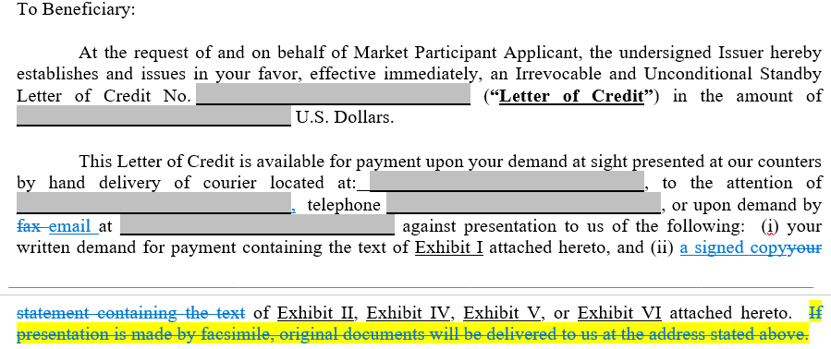
Letter of Credit Form – Proposed Changes (update from April CFSG meeting):
Tighten collection timeline from “next Business Day”?
Updates in two spots to reflect lessons learned during Covid:

Slide 5
Surety Bond Form – Proposed Changes:
Update Met Center address
Incorporate email addresses where fax mentioned

