Slide 1
South Texas SSO Event:
March 10th, 2023
IBRTF Meeting
May 12th, 2023

Slide 2
South Texas SSO Event Summary
On March 10, 2023, at 4:48 AM CDT, the high-side of a thermal Generator’s Main Power Transformer (MPT) in the West Valley area experienced a Phase-C to ground fault
One minute later, the high-side of another MPT at the same site experienced a Phase-C to ground fault
Sub-synchronous oscillations (SSO) observed in the Laredo area (due to the first fault isolating the circuit where the oscillations originated)
The event resulted in a loss of approximately 295 MW of IRR generation
All lost IRR generation was from Wind Generation Resources
The thermal site where the fault occurred was not generating at the time
System frequency dropped to 59.957 Hz and returned to 60 Hz within 37 seconds
SSO ended after nearby series capacitors were bypassed
Notes:
First fault cleared in 3.5 cycles
Second fault cleared in 4 cycles
Loss of generation was not large enough to be NERC reportable, but we still would have expected the resources to ride through
(other equipment tripped at the time so we are reporting this as a NERC Category 1 I event)

Slide 3
Loss of Generation
Unit | Number of Affected Turbines | Total MW Loss | Outage Duration
FACILITY1_UNIT1 | 1 | 6 MW | 1 minute
FACILITY1_UNIT2 | 98 | 83 MW | 22 minutes
FACILITY2_UNIT1 | 34 | 24 MW | 22 minutes
FACILITY2_UNIT2 | 32 | 21 MW | 22 minutes
FACILITY2_UNIT3 | 13 | 9 MW | 22 minutes
FACILITY3_UNIT1 | 1 | 9 MW | 9 minutes
FACILITY3_UNIT2 | 7 | 22 MW | 9 minutes
FACILITY3_UNIT3 | 4 | 7 MW | 9 minutes
FACILITY4_UNIT1 | 78 | 6 MW | 9 minutes
FACILITY5_UNIT1 | 90 | 16 MW | 9 minutes
FACILITY6_UNIT1 | 10 | 10 MW | 9 minutes
FACILITY7_UNIT1 | 31 | 36 MW | 14 hours 20 minutes
FACILITY7_UNIT2 | 34 | 46 MW | 14 hours 20 minutes
Notes:
Mention that only Facility 7 experienced a full trip
Low wind in the area
Event may have had a larger impact if there was more wind generation, cannot say for certain because the low wind speed can make turbines unstable

Slide 4
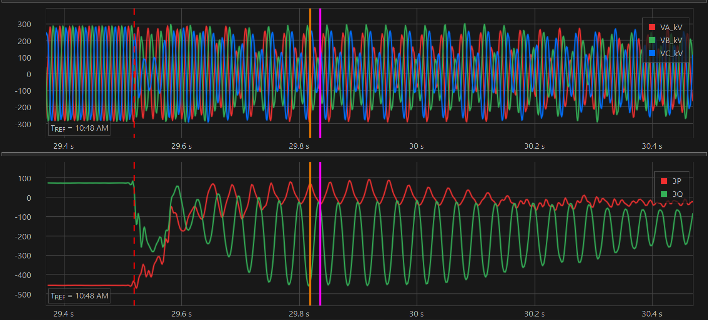
Sub-synchronous oscillation
Lasted for approximately 1.2 seconds, started damping near the end
Largest peak-to-peak MW swing was 1275 MW
Largest peak-to-peak voltage swing was approximately 186 kV
Notes:
We have some hypotheses for why these oscillations occurred, but want to be able to prevent IRRs from tripping or reducing during events like these
DFR data from the TSP (do not say name of TSP)
Frequency was 30 Hz
Largest swing not shown here

Slide 5
Sub-synchronous oscillation
Lines | Max PP VM | Max PP MW | Max PP MVAR
Line1 | 134.5 | N/A | N/A
Line2 | 132.5 | 150 | 425
Line3 | 159.5 | 410 | 391
Line4 | 185.5 | 406.5 | 395
Line5 | 174.5 | 640 | 570
Line6 | 183 | 388 | 423
Line7 | 59.5 | 1275 | 877
Line8 | 62 | 241 | 161
Line9 | 65 | 130 | 170
Line10 | 44.4 | 1046 | 899
Line11 | 46 | 108 | 61
Line12 | 46 | 492 | 522
Line13 | 45 | N/A | N/A
Line14 | 45 | N/A | N/A
Line15 | 16.5 | 66.5 | 51
Line16 | 18 | 149 | 124
Notes:
Peak-to-peak voltage, real and reactive power swings
We’re going to be reviewing this

Slide 6
Event Analysis Progress
NERC Brief report is complete
Will be submitted to Texas RE today
Next Steps:
Conduct follow up calls with impacted Resource Entities
Review event with TSP and determine if any mitigating measures need or should be taken

Slide 7
Questions?

