Slide 1
ERCOT IBRTF: NERC and Other Industry Updates
Julia Matevosyan
Chief Engineer
ESIG
05/12/2023

Slide 2
Agenda
NERC Industry Webinar Series Inverter-Based Resources
NERC BESS and Hybrid Reliability Guideline, Update
NERC Defining GFM Capability for BPS-Connected BESS

Slide 3
Webinar Series: Inverter Based Resources
NERC webinar series discussing BPS-connected IBR and NERC’s risk mitigation strategy in this area. The series will provide a complete overview of IBRs – from a fundamental understanding of IBR technology to tackling the more complex and emerging risk issues. - June 6 – July 13, 2023 | 4:00 – 5:00 pm Eastern Time
Introduction to Inverter-Based Resources
NERC Disturbance Reports and Lessons Learned
Inverter-Based Resource Performance Issues
Establishing and Enhancing Interconnection Requirements
Modeling Part 1 – Modeling Requirements, Model Creation, Model Usability
Modeling Part 2 – Model Quality, Model Benchmarking
Studies – EMT, Special Studies, Interconnection Studies
Interconnection Process
Commissioning
IBR Registration and Reliability Standards Enhancements
Overview of IBR Risk Mitigations and Next Steps
Register Here: : https://www.nerc.com/comm/RSTC/Documents/IBR_Webinar_Series_Fyler.pdf

Slide 4
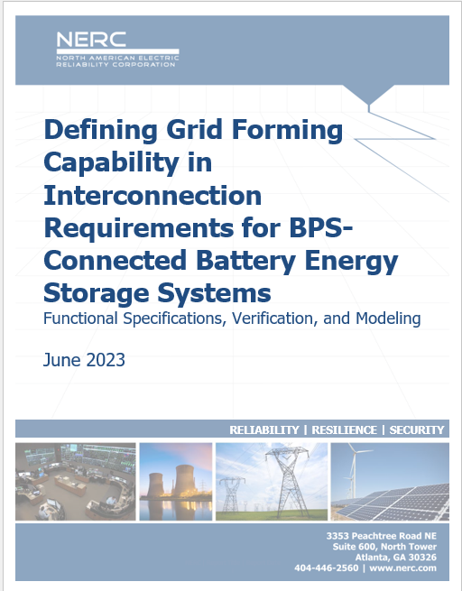
Defining GFM Capability for BPS-Connected BESS
Executive Summary
Key Takeaways and Recommendations
Introduction
Chapter 1 : Functional Specifications for GFM BESS
Functional Specifications for GFM and GFL Battery Energy Storage
Functional Specifications Defining Grid Forming BESS
Blackstart Considerations
Additional Considerations
Chapter 2 : Verifying GFM Functionality
Model Quality Fundamentals
Description of GFM Functional Test System
Description of GFM Functional Tests and Success Criteria (3 Tests)
Example Conducting GFM Functional Tests
Illustration of GFM versus GFL Performance in Functional Tests

Slide 5
NERC BESS and Hybrids Reliability Guideline Update
Updated references
References to IEEE2800
Updated information on Modeling

Slide 6
Julia Matevosyan
julia@esig.energy

