Slide 1
May 12, 2023 DSWG Meeting
ERCOT staff

Slide 2
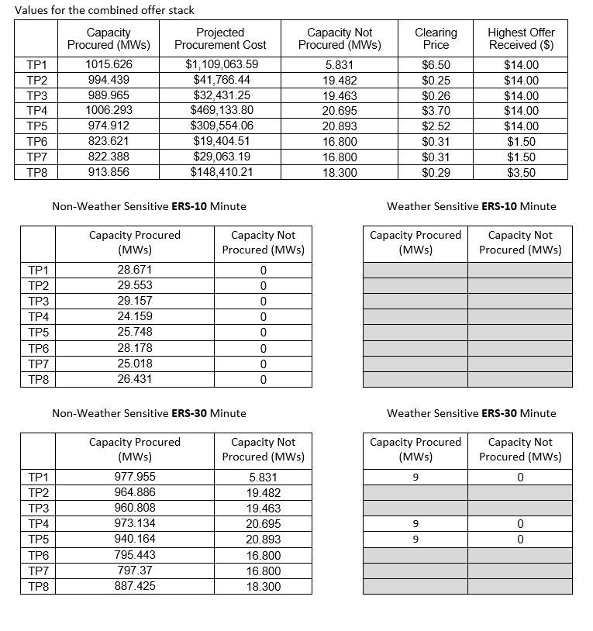
ERS Procurement Summary for AprMay23

Slide 3
ERS Procurement Summary for AprMay23
Time Period | TP Spend Limit | Clearing Price | Procured Capacity (MW) | Delta Clearing Price | Delta Capacity (MW) | % Reduction in Clearing Price | % Reduction in Capacity Procured | Procurement Cost Savings
TP1 | $1,729,832.34 | $6.50 | 1015.626 | $3.17 | 4.7 | 32.78% | 0.46% | $548,517.21
TP2 | $115,322.16 | $0.25 | 994.439 | $0.40 | 15 | 61.54% | 1.49% | $68,464.30
TP3 | $86,491.62 | $0.26 | 989.965 | $0.41 | 15.2 | 61.19% | 1.51% | $52,424.78
TP4 | $1,297,374.25 | $3.70 | 1006.293 | $6.17 | 20 | 62.51% | 1.95% | $807,184.70
TP5 | $864,916.17 | $2.52 | 974.912 | $4.20 | 20.2 | 62.50% | 2.03% | $533,027.17
TP6 | $52,169.55 | $0.31 | 823.621 | $0.45 | 14.8 | 59.21% | 1.77% | $29,022.69
TP7 | $78,254.32 | $0.31 | 822.388 | $0.50 | 15 | 61.73% | 1.79% | $48,261.22
TP8 | $384,407.19 | $0.29 | 913.856 | $0.44 | 14.9 | 60.27% | 1.60% | $173,963.71
 | $4,608,767.60 |  |  |  |  |  |  | $2,260,865.78

Slide 4
Update on LR participation in Non-Spin
NPRRs 1093 and 1101 allowed interruptible LRs to provide Non-Spin
Dispatched with the Off-line Generation Resources (GRs)
Mixed groups of GRs and non-Controllable Load Resources (NCLRs) of about 500 MW
Went into production systems in June 2022
First units qualified in October 2022
Currently have:
3 CLRs with 109 MW of qualified capacity
18 NCLRs with 473.1 MW of qualified capacity

Slide 5
Update on LR participation in Non-Spin (cont)
Most significant issue to date has been understanding how deployed MW value is calculated
First 30 minutes calculated off of real time telemetry
Second half of the hour calculated using the next hour’s Current Operating Plan (COP)
Can get deployment instruction with a ramp completion time in the next hour (even if currently showing no responsibility)
Deployed and recalled using XML only – no verbal instructions
Need to also be aware that relay cannot be armed
Need to remain deployed until recalled

Slide 6
ECRS Implementation Update (from 5/9/23 weekly mtg)
ECRS Technical Specs – Sept 29, 2022 Technology Working Group (TWG) meeting
Market Readiness and Qualification Workshop (Monday April 3, 2023)
Friday April 14, 2023 – Deadline for QSE Declaration of Resources
Thursday, April 20, 2023 – MOTE deployed for QSEs to test
Tuesday, April 23, 2023 – Begin Weekly Market Readiness WebEx meetings
Current activity
For ECRS QSE qualification, TELEMETRY/ICCP is most important next step
For all QSEs, scorecards begin for current MOTE activity
June 6-8, 2023 Go-Live (first ECRS Operating Day (OD) planned for June 10, 2023)
May 12, 2023 DSWG Meeting

Slide 7
Qualification and Telemetry for ECRS
Six QSEs and 63 Individual Load Resources have requested provisional qualification
New ECRS qualification test procedure for Load Resources will be posted to the ERCOT Website soon: https://www.ercot.com/services/programs/load/laar
ERCOT is proceeding through Qualification Requests on a first-in-first-out basis
Telemetry should have been requested by 4/28/23
If telemetry is not requested and ready, ERCOT will move to next QSE
Most ICCP telemetry is in place, but the new values for ECRS are not populated with values by the QSEs
ERCOT’s ICCP handbook was updated to include the various telemetry changes that are being put in place to support implementation of ECRS
Follow normal process for requesting new ICCP Service Request
May 12, 2023 DSWG Meeting

Slide 8
Additional Activities for ECRS
Stay up to date on latest implementation details during weekly meetings – next meeting is 5/16/23 at 10:00 am
Next meeting to focus on qualification testing, results of MOTE testing by market participants and market cutover on June 6-10
After go-live, priority will be given to qualification testing for the QSEs that requested provisional qualifications prior to go-live
ERCOT expects to test each QSE and at least one of their LRs to confirm telemetry and response meets Protocol and Operating Guide requirements
If you have questions on the ECRS implementation, contact your ERCOT Account Manager and the Demand Response team at ERCOTLRandSODG@ercot.com
May 12, 2023 DSWG Meeting

Slide 9
Reinstating ERS Suspensions
It is ERCOT’s desire to reinstate suspensions starting with the Dec23Mar24 SCT.
Language granting ERCOT the authority to suspend is currently in the protocols so no NPRR required.
Due to current staffing changes within the Demand Integration team and required ERS code modifications this start date may need to be adjusted. We will keep the ERS providers updated as the year progresses.
Details will follow but at a high level:
Resources will be suspended with the 4th consecutive test failure
Suspension period – 6 months
Reinstatement process may be initiated by QSE once suspension period has ended.
Suspensions are also being considered for availability and event performance failures (more details to come)
Any resource that is standing on 4 or more test failures heading into the procurement for the Dec23Mar24 SCT should not be included in the ERID pertaining to that procurement.

