Slide 1
Analysis of Crypto-mining Demand/Price Response 2021 - 2023
Carl L Raish
Principal Load Profiling and Modeling
Wholesale Market Subcommittee – May 3, 2023

Slide 2
Analysis Background
Analysis population is ESIIDs identified as crypto-mining
  In competitive areas of ERCOT
  Some Registered Load Resources in NOIE area
  Excluded in NOIE area:
    Existing - 6 customers, 214 MW
    Under study – 7 customers
High price days defined as real time prices > $70/MWH for 4 or more consecutive intervals
With this price threshold, all 2022 4CP/NearCP days were high price days
Baseline methodology – Meter Before Meter After
  On days when high prices started early in the day, the meter before was average from two closest non-high price days

Slide 3
Crypto-mining Total Load Peak MW
2021 - 2023

Slide 4
Crypto-mining Total Daily Energy GWH
2021 - 2023

Slide 5
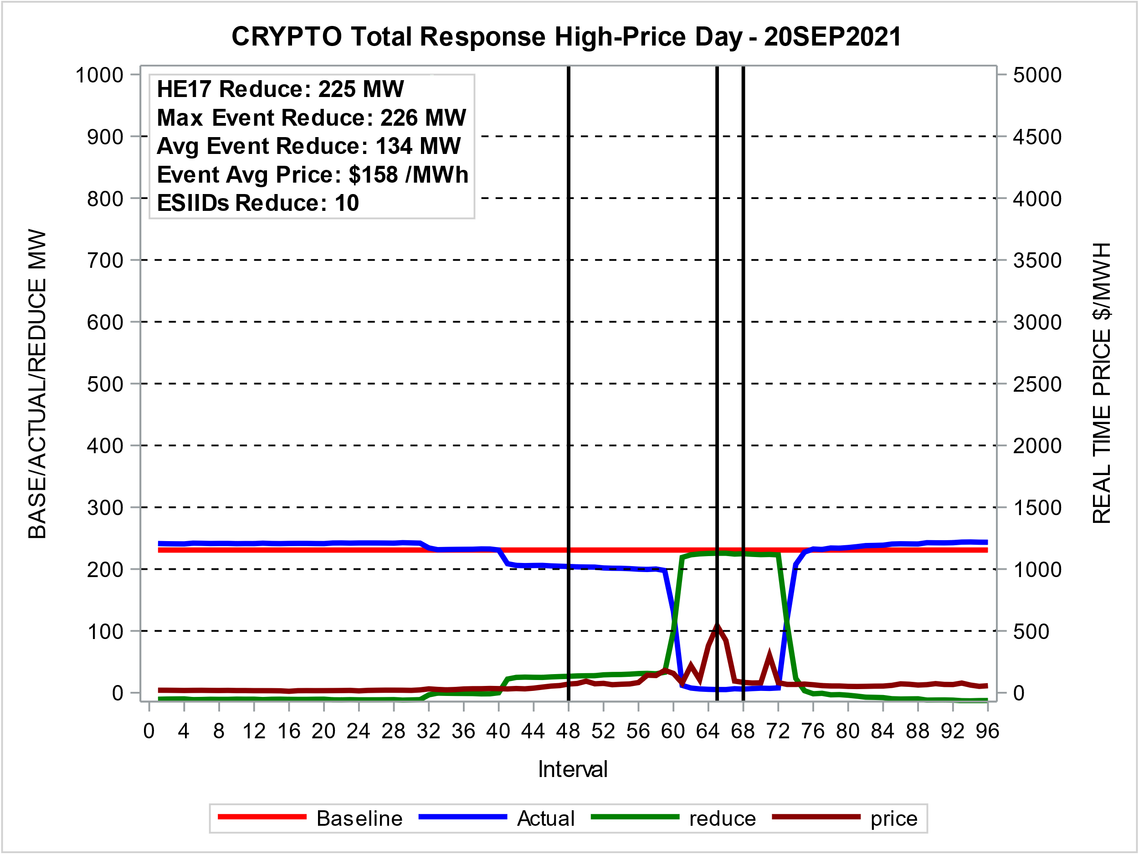
Highest Response Day - 2021
Near-CP Day

Slide 6
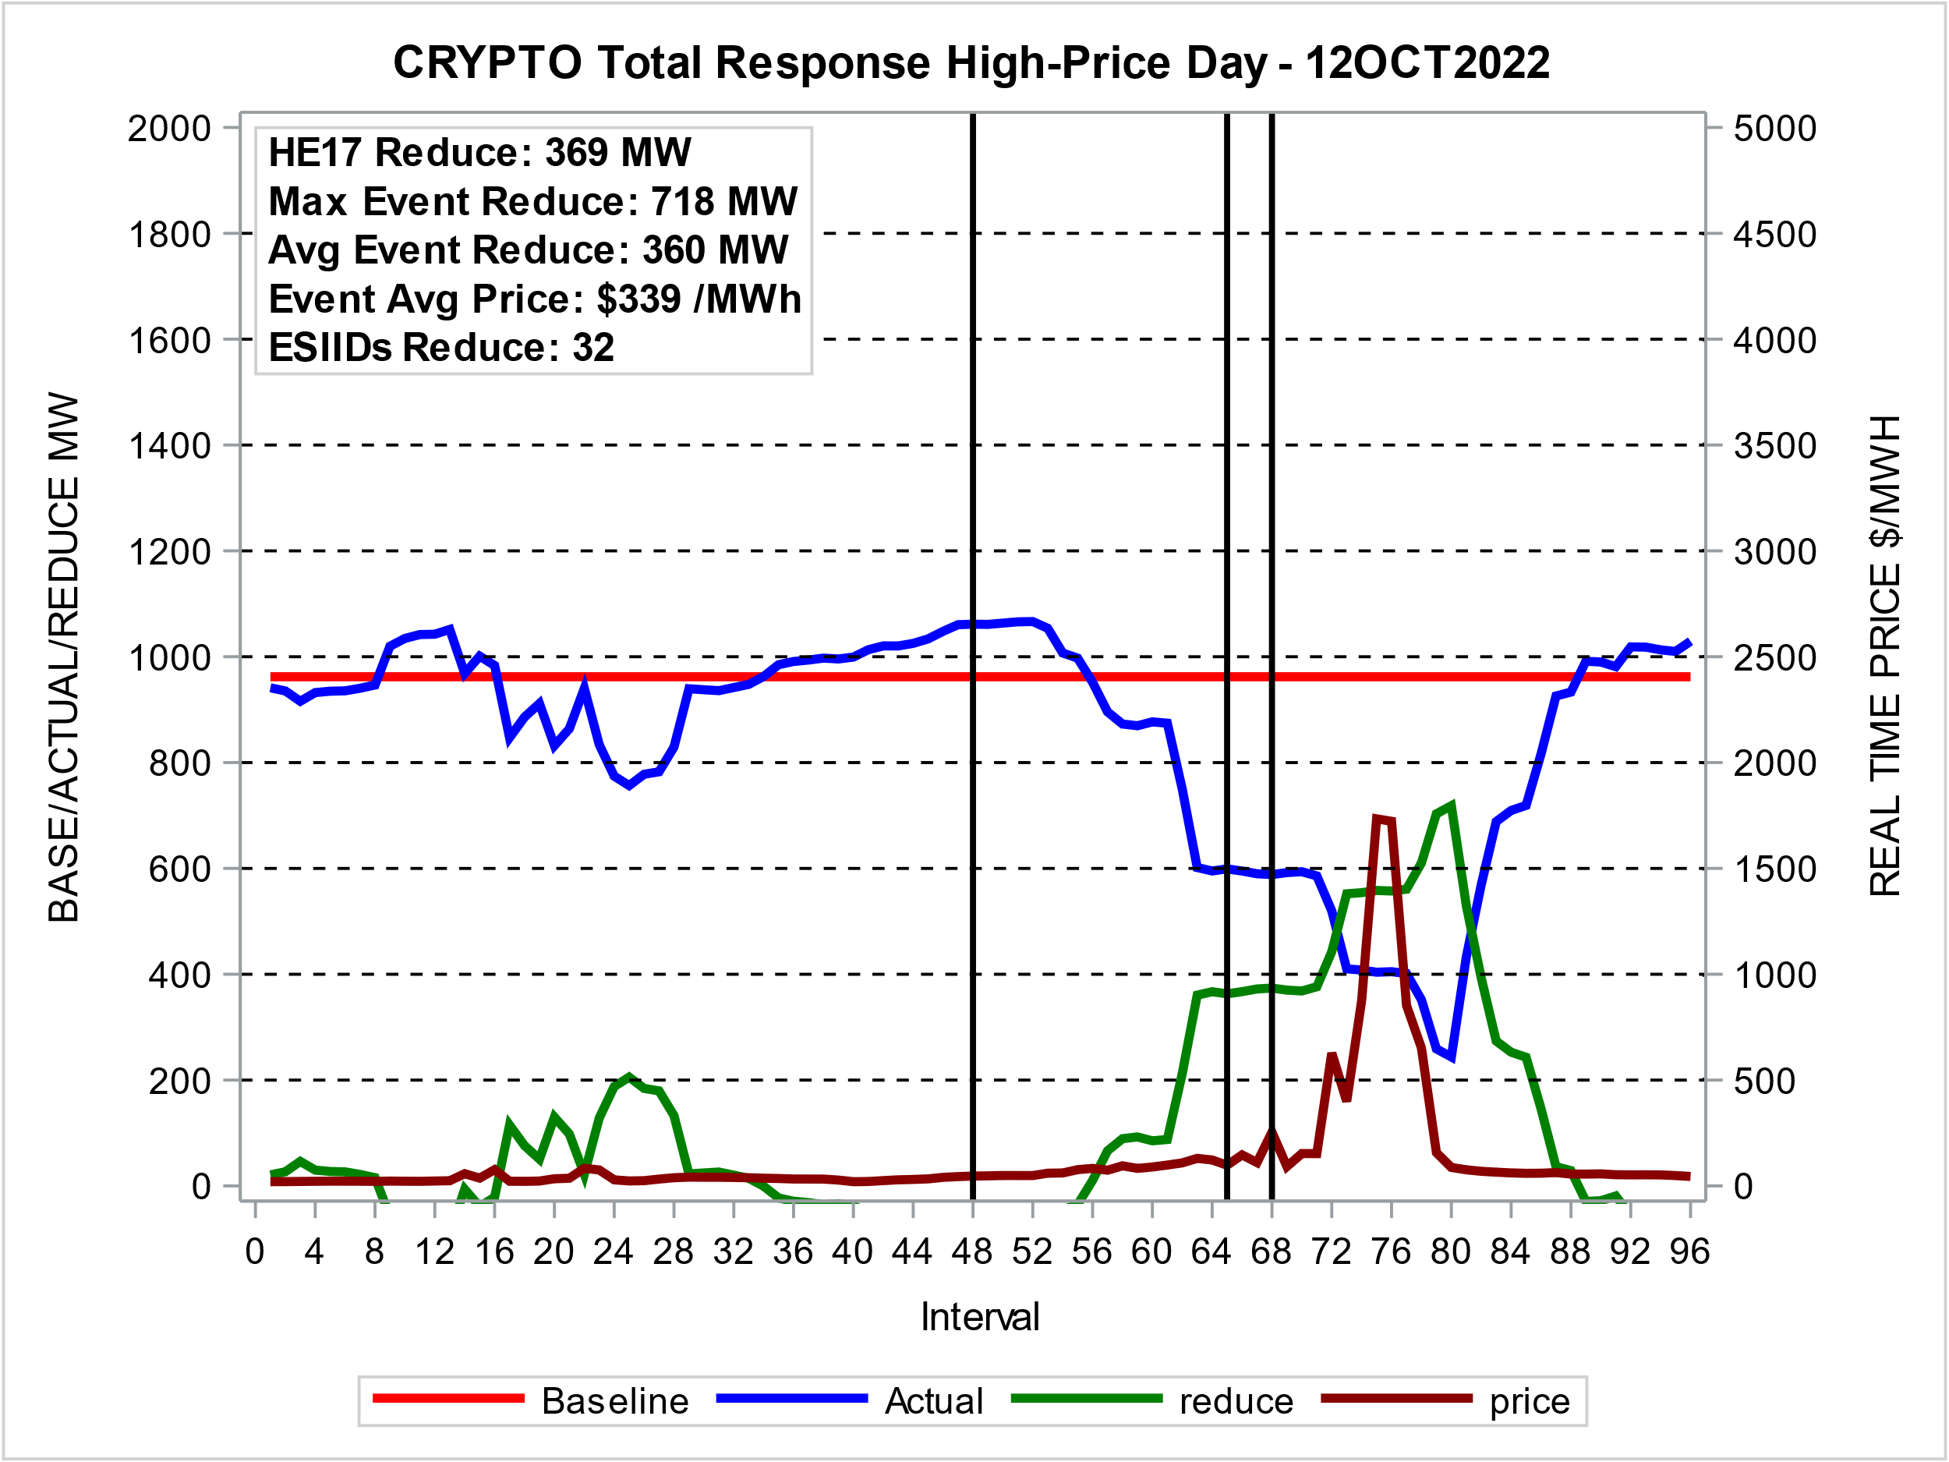
Highest Response Day – 2022
Non-Summer Day

Slide 7
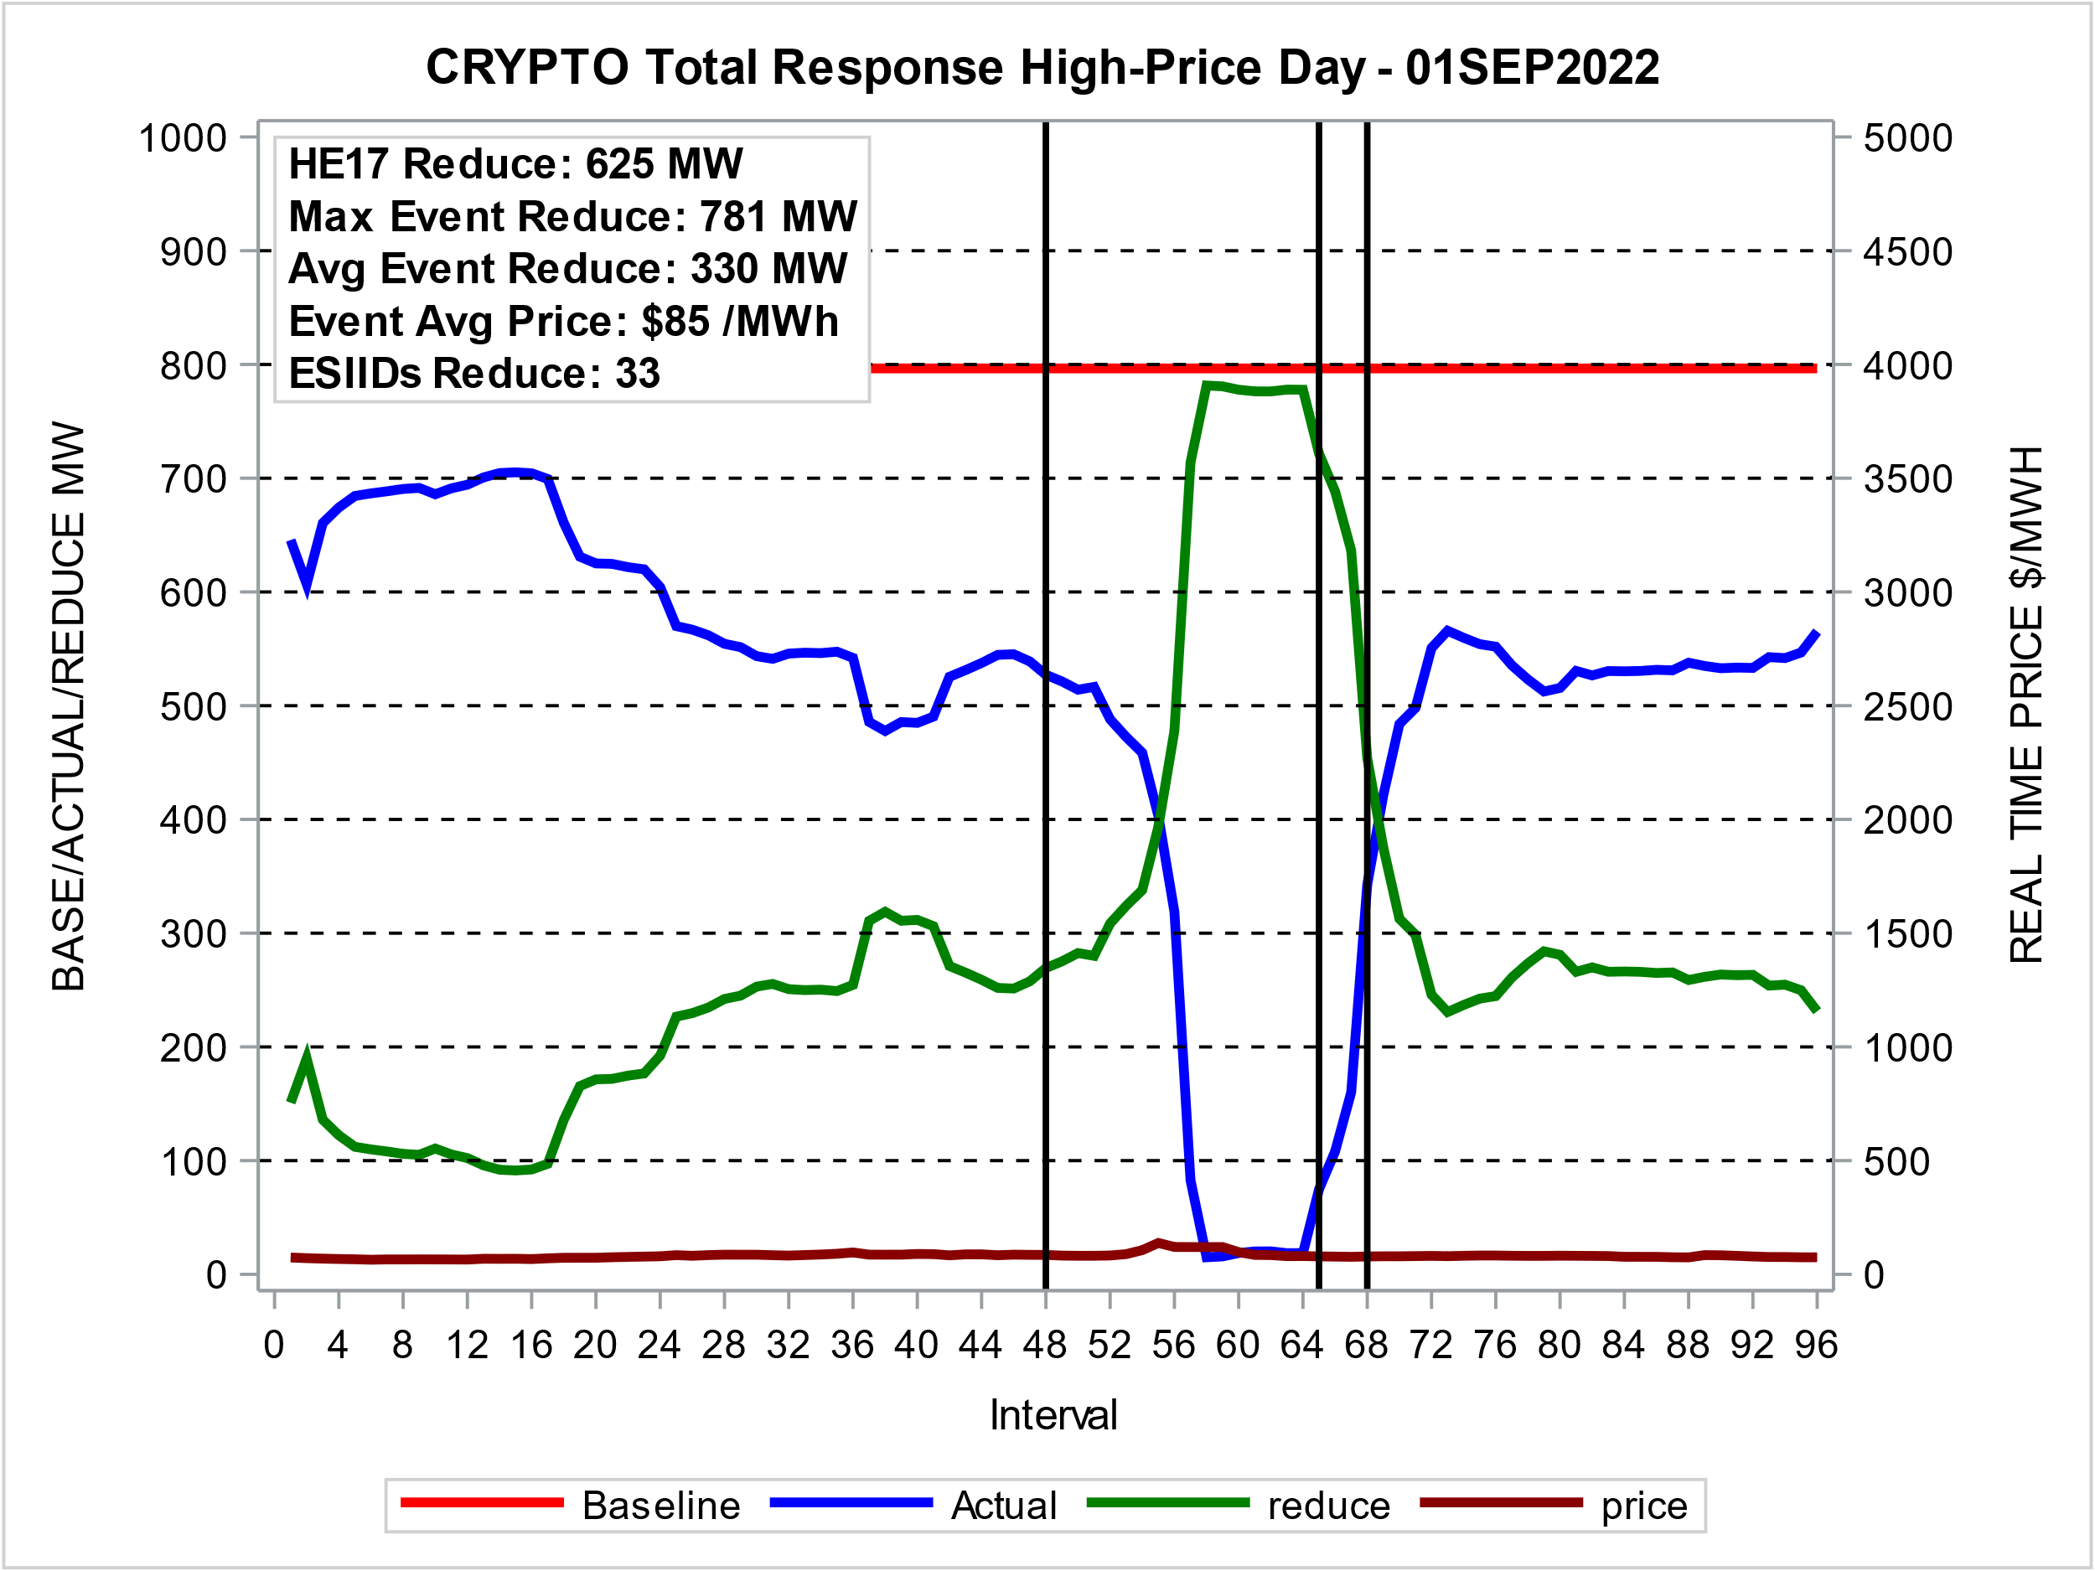
Highest Response Day – 2022
Summer Day
Near-CP Day

Slide 8
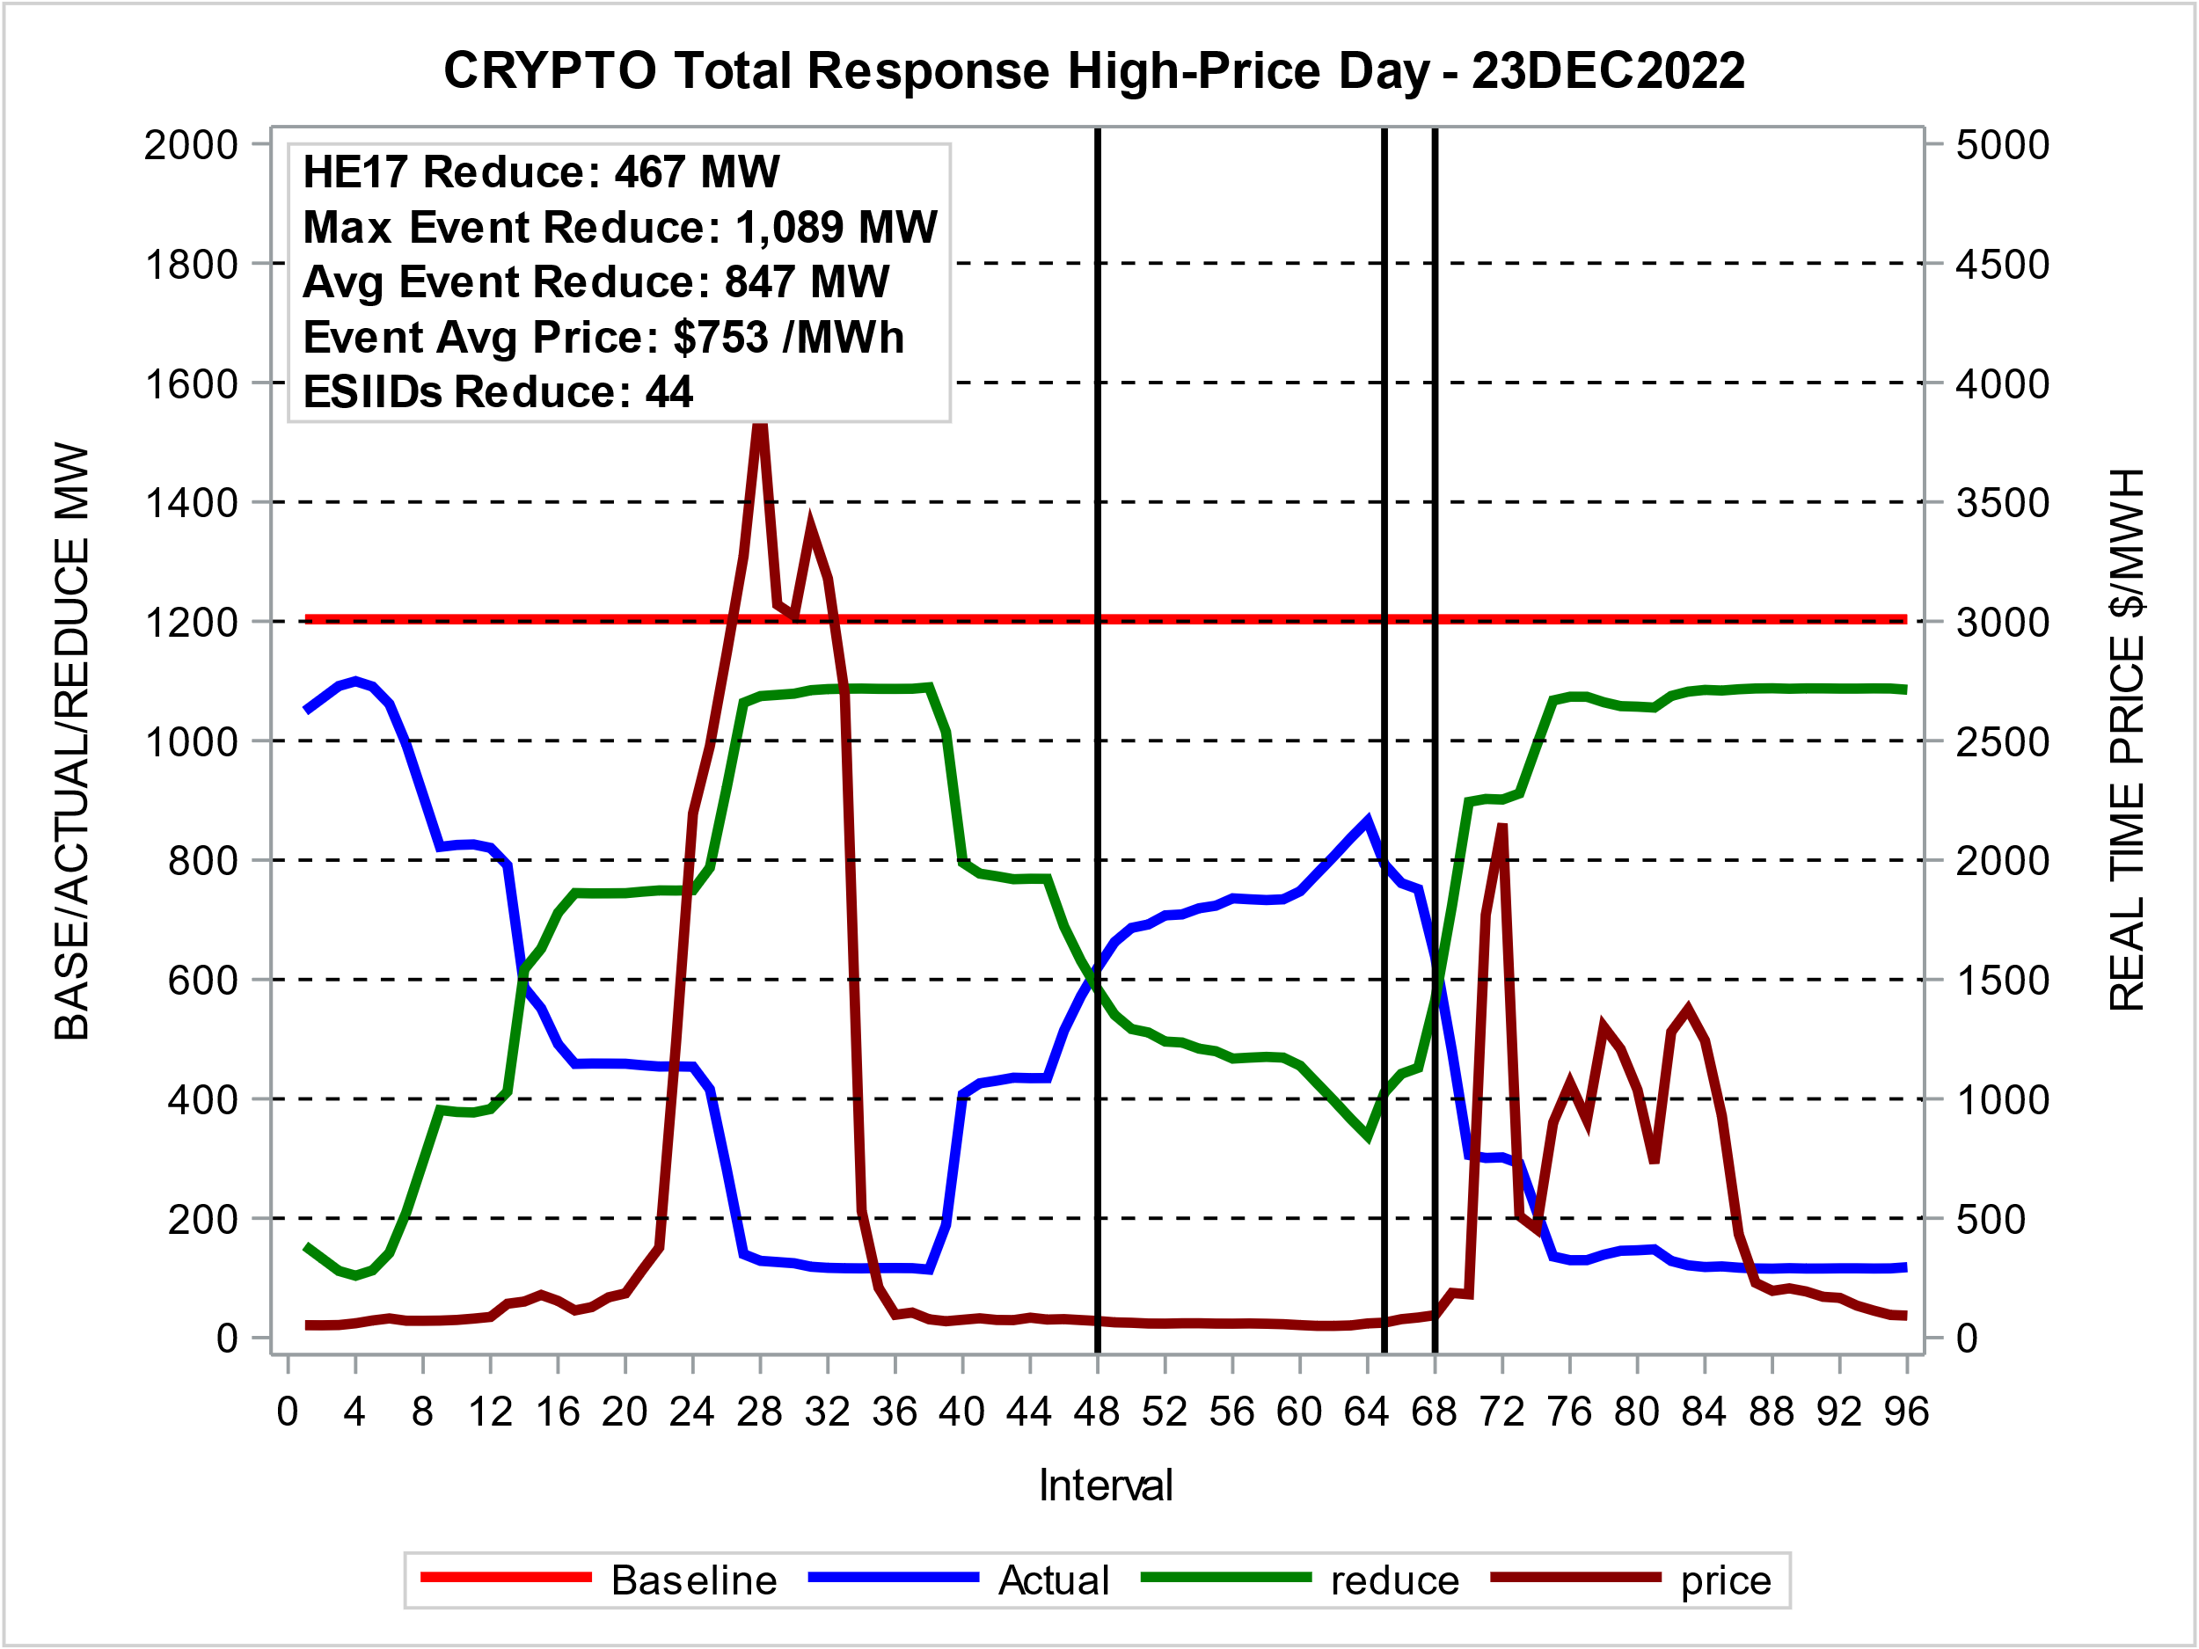
Winter Strom Elliott Response

Slide 9
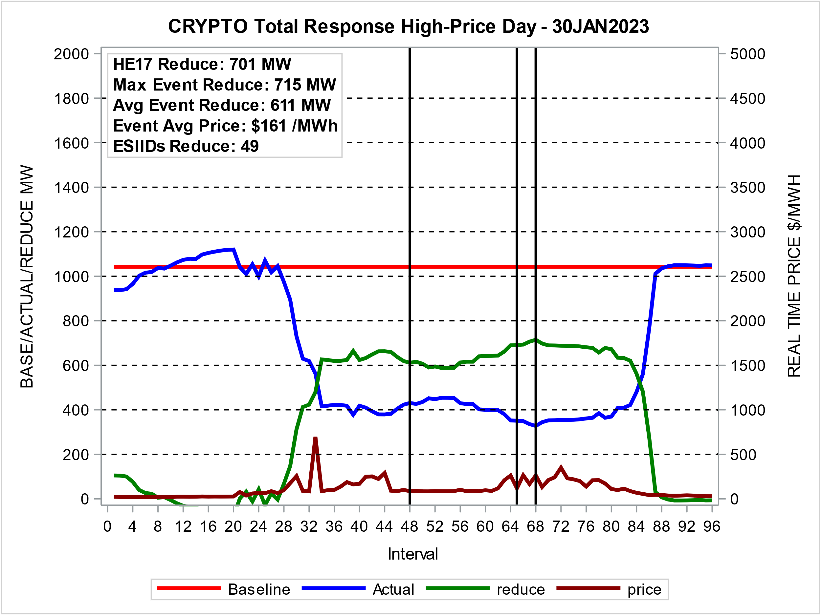
Highest Response Day – 2023

Slide 10
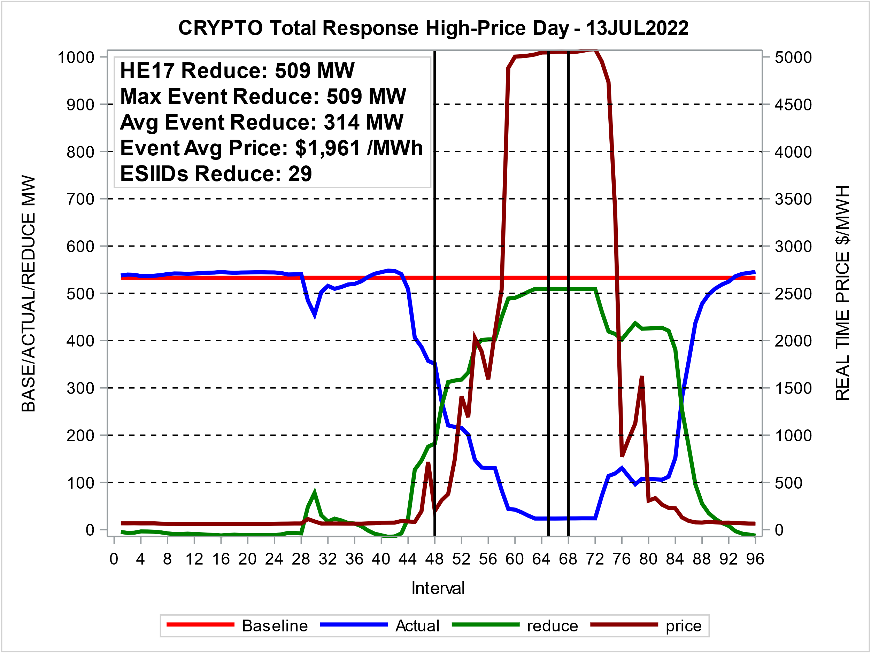
Response on Highest Price Day – 2022
Near-CP Day

Slide 11
Crypto-mining Daily Max Load Reduction
Responding ESIIDs - 2021 - 2023
Days with High Prices in all zones, and Response >= 100 MW

Slide 12
Crypto-mining Reduction Percent vs RT Price
Responding ESIIDs - 2021 - 2023
Days with High Prices in all zones, and Response >= 100 MW

Slide 13
Questions?
ON
OFF
craish@ercot.com 512/248-3876

