Slide 1
DWG Report to ROS
Javier Martinez – DWG Chair
May 4, 2023

Slide 2
DWG Update
DWG WebEx meeting held on 4/19/2023
DWG Post Flat Start Activities
  Final submission date for UVLS, UFLS, Contingencies, and dynamic load models was on April 26, 2023.
  Stability book should be posted in April 2023.
Update on ALDR Survey
  DWG and ERCOT had discussion on possibly discontinuing the use of the motor load data provided in the ALDR.
  DWG tabled discussion, pending additional comments from the group and plan to come to a consensus on this issue in the next DWG meeting.

Slide 3
NOGRR 247 (proposed UFLS Modification)
ERCOT discussed the proposed changes to the UFLS program.
DWG had concerns about the implementation timeline and cost associated with updating and reprogramming relays.
DWG consensus was in support of NOGRR247, but need the implementation period to be extended.

Slide 4
Update DWG Procedure Manual for approval PGRR102
PGGR102 was approved on March, 2023 by PUCT.
As a results, DWG is requesting ROS approval on language added to DWG Procedure Manual in order to align with PGGR102.
  Revisions involve TSAT being included to the model quality analysis.

Slide 5
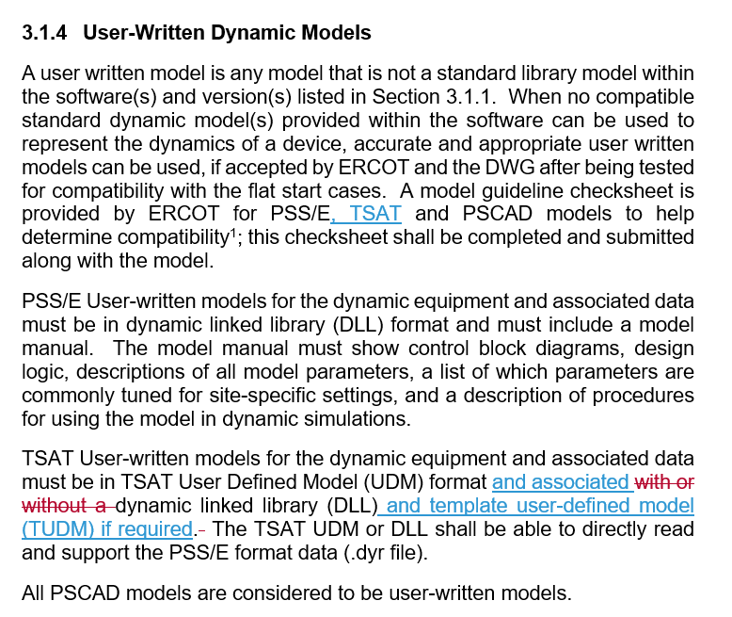
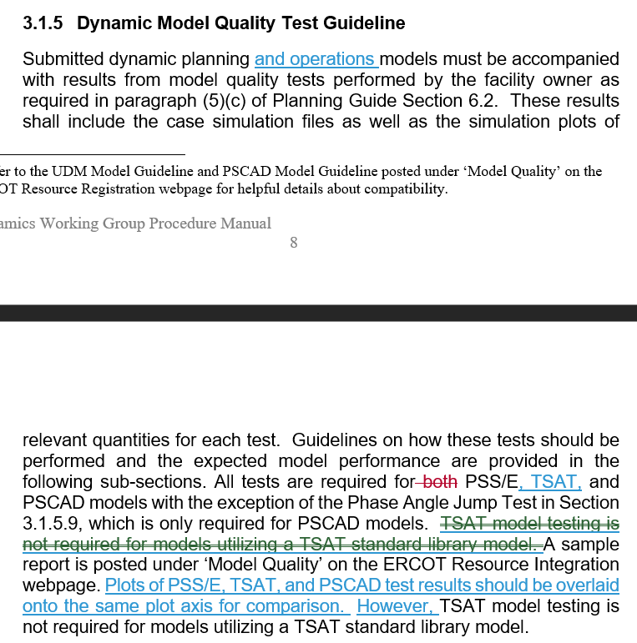
Update DWG Procedure Manual for approval PGRR102

Slide 6
Draft PGRR- Review Process for IBR Modification
At the February DWG meeting, ERCOT presented two concepts to DWG with the aim of improving review process of changes to settings or equipment associated with Inverter-Based Resources.
Based on the DWG inputs, ERCOT shared with DWG a draft potential PGRR for one of the two concepts for feedback in March.
At the April DWG meeting, ERCOT went through the draft PGRR. DWG had various concerns and provided feedback about the timeline to complete the dynamic study, the dynamic study would not be a limited study, and discussed if there should be an intermediate process to determine if MQT is acceptable.
ERCOT will work on a revision and provide a revised draft PGRR to DWG via email to obtain any additional major comments.

