Slide 1
Unregistered Distributed Generation Report:
2022 Annual Report
2023 Q1 Update
Dan Mantena
Resource Adequacy
5/3/2023

Slide 2
2022 Annual Unregistered Distributed Generation Report
Totals may not match the sum of their columns/rows due to rounding
Notes:
Competitive and NOIE breakdown:
Competitive: 1,122 MW
NOIE: 871 MW

Slide 3
Annual Unregistered DG Growth Comparison
Competitive TDSP data: Same as 2022 Q4 quarterly report
NOIE data: All NOIEs required to report all capacity in annual report
Notes:
Competitive and NOIE breakdown:
Competitive: 1,123 MW
NOIE: 871 MW

Slide 4
2023 Q1 Unregistered Distributed Generation Report
Totals may not match the sum of their columns/rows due to rounding
Notes:
Competitive and NOIE breakdown:
Competitive: 1,224 MW
NOIE: 941 MW
For the quarterly report, NOIE capacity below 50 kW only includes information from NOIEs that have more than two MW of aggregate capacity from those sites.

Slide 5
2022 Q4 → 2023 Q1 Change
Totals may not match the sum of their columns/rows due to rounding

Slide 6
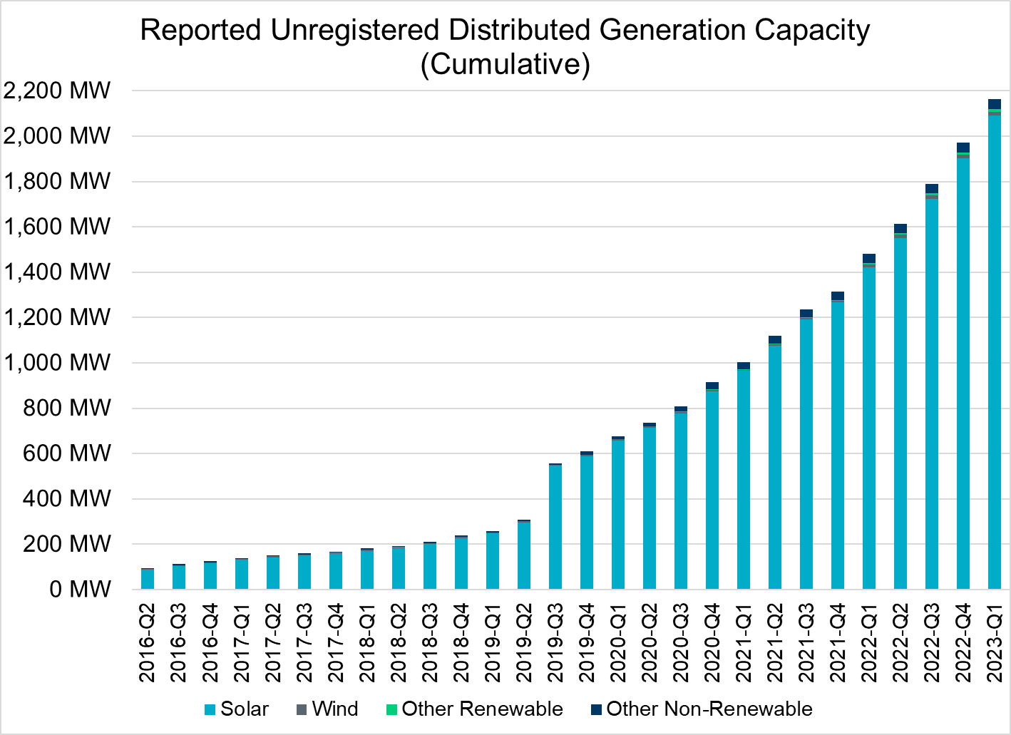
Unregistered DG Growth: 2016-Q2* to 2023-Q1
Large increase due to reporting requirement change**
* 2016-Q2 was the first report published after implementation of report changes per NPRR794/COPMGR044
** 2019-Q3 was the first report published after implementation of report changes per NPRR891

