Slide 1
Resource Integration Topics
Jay Teixeira
ERCOT
Resource Integration Working Group
April 26, 2023

Slide 2
Quarterly Stability Assessment (QSA)
Planning Guide 5.9
Next Deadline for QSA
If a GINR is not included in QSA, its Initial Synchronization date will be automatically delayed to the next quarter
All-Inclusive Generation Resource Initial Synchronization Date | Last Day for an IE to meet prerequisites as listed in paragraph (4) below | Completion of Quarterly Stability Assessment
Upcoming January, February, March | Prior August 1 | End of October
Upcoming April, May, June | Prior November 1 | End of January
Upcoming July, August, September | Prior February 1 | End of April
Upcoming October, November, December | Prior May 1 | End of July

Slide 3
Quarterly Stability Assessment (QSA)
Planning Guide 5.9, Quarterly Stability Assessment
Issue’s seen in previous QSA’s
  10 day comment period for FIS
    Needs to be complete before QSA deadline
    TSPs need to plan for it
  Dynamic/PSCAD Model Review
    Dependent on FIS Stability study
    Need to meet PG 6.9 15 to 30 days prior to QSA deadline
PSSE Model Quality Test Required
PSCAD Model Quality Test and Unit Model Validation required
TSAT Model Required – If PSSE model is UDM, then TSAT model should be UDM and should include MQT

Slide 4
RIOO-IS Updated 12/9/2022
The new release allows entry of resource data into RIOO database rather than use of RARF
The existing RARF forms that were in RIOO-IS were supposed to be migrated to the new database
Migration effort is delayed and completion date unknown
IE/RE may will have to re-enter data into RIOO-IS or wait for Migration effort if in FIS or Planning stage. Those with an PLD in 2023 may continue to use RARF forms.
PLD dates beyond 2023 (even those that slip) will have to re-enter data into RIOO-IS
Screenshot document created to help with RIOO-IS

Slide 5
RIOO-IS Issues
Node creation and use
Date Relationships and how to change them
Changing Contacts
RARF Attestation
Attachments for embedded documents
Modifying the Project Details to make corrections that cannot be made in RIOO
TSPs not Creating RIOO Accounts Correctly
TSPs still requiring use of RARF forms from RE’s

Slide 6
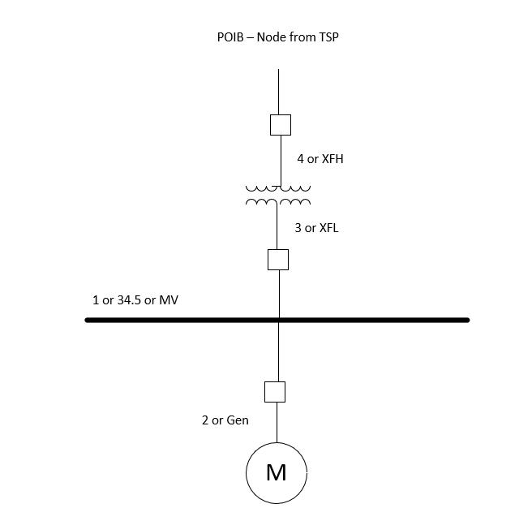
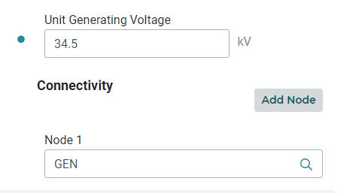
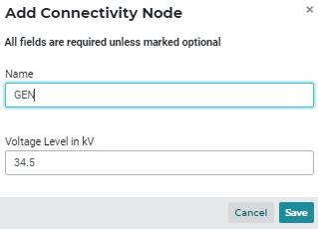
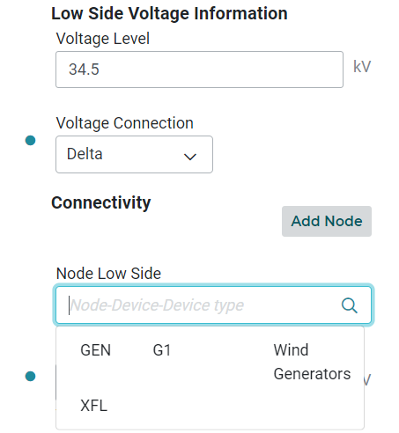
Node creation and use
Must be entered
To create Node
Must be entered
To create Node
Click to create
node
Nodes
Created at
34.5 kV

Slide 7
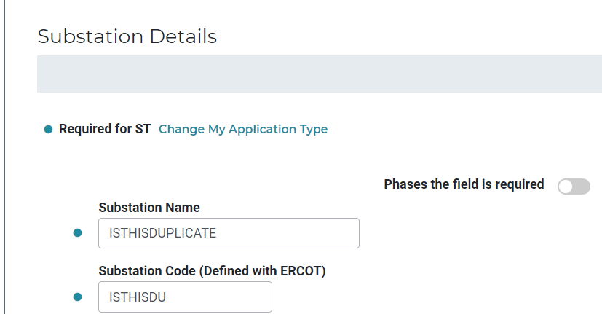
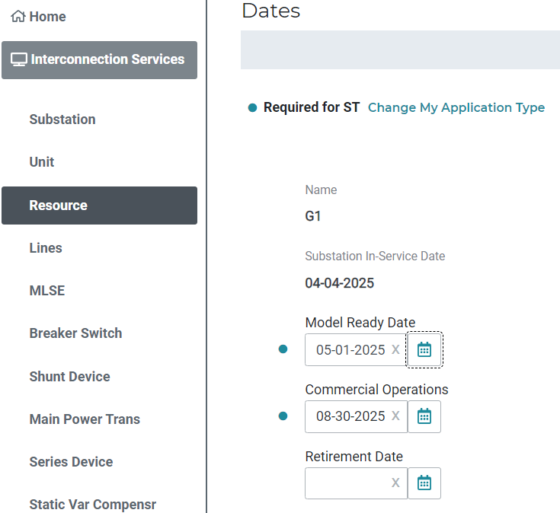
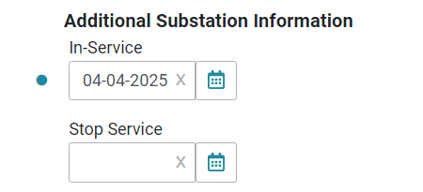
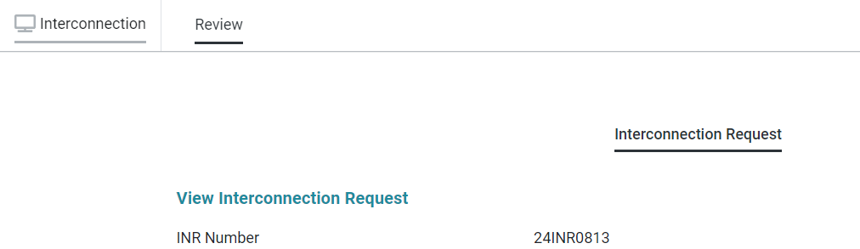
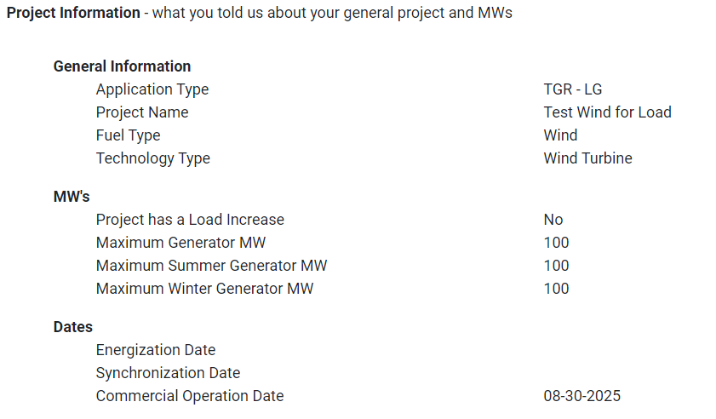
Date Relationships and how to change them
Change on Substation Details
Use Basic Project Information
Add a Change Request
To Change
Notes:
24INR0813 on ITEST

Slide 8
Changing Contacts
RE Contact Scheme
Primary Contact
Full Name: I Me Mine
Company: ERCOT RE LLC (RE)
An.emailaddress@att.net
DUNS: 012345673000
P: 5125551234
Ext:
To Change from RE Contact Scheme to IE Contact Scheme
IE Contact Scheme
Primary Contact
Full Name: For You Blue
An.emailaddress@att.net
P: 5125551234
Ext:
Backup Contact
Full Name: I Me Mine
An.emailaddress@att.net
P: 512-5551234
Ext:

Slide 9
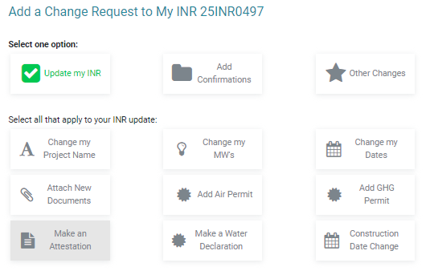
RARF Attestation
Most entities could not click “Make an Attestation” button
Cause undetermined at the time
Should be fixed
ERCOT instructed entities to complete Planning Guide Section 8, Attachment A: Declaration of Resource Data Accuracy and attach to RIOO as type “Other”

Slide 10
Attachments for embedded documents
Renewable Form Tab Name | Files to be include from that tab | Proposed RIOO Attachment Type
Collector System - RENEWABLE | Collection System One Line Diagram – Collector Workbook, One-Line | CollectorSystem
 | Collection System Detailed Model – RAW, SEQ | CollectorSystemModel
Dynamic Data | PSSE Model and MQT VSAT Model and MQT | PSSE MMQT,VSAT MMQT
PSCAD Model | PSCAD Model and MQT | PSCAD MMQT
Inverter Efficiency Curve | Inverter Efficiency Curve | Inverter Curve
Transmission Form Tab Name | Files to be include from that tab | RIOO Attachment Type
One Line | PDF or CAD One Line Diagram | One-Line (existing type)
Transformer Test Data | Transformer Test Data | Test Data
Attach these documents using Basic CR with type “Other” until attachment types are available

Slide 11
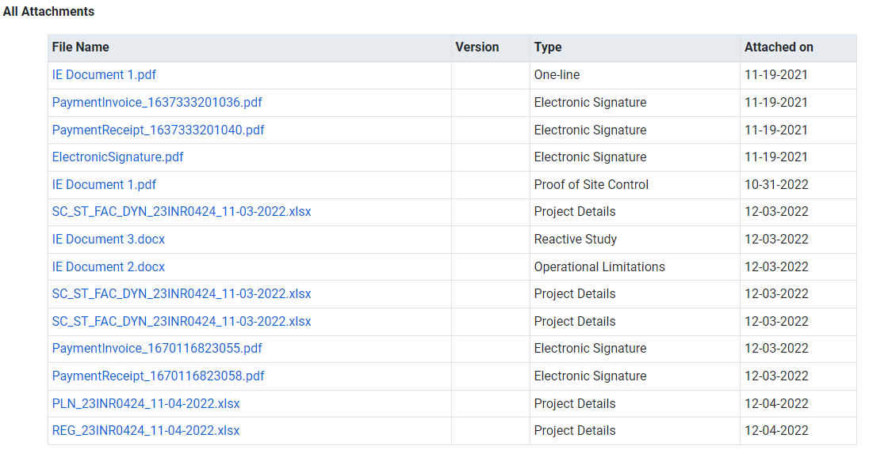
Modifying the Project Details to make corrections that cannot be made in RIOO

Slide 12
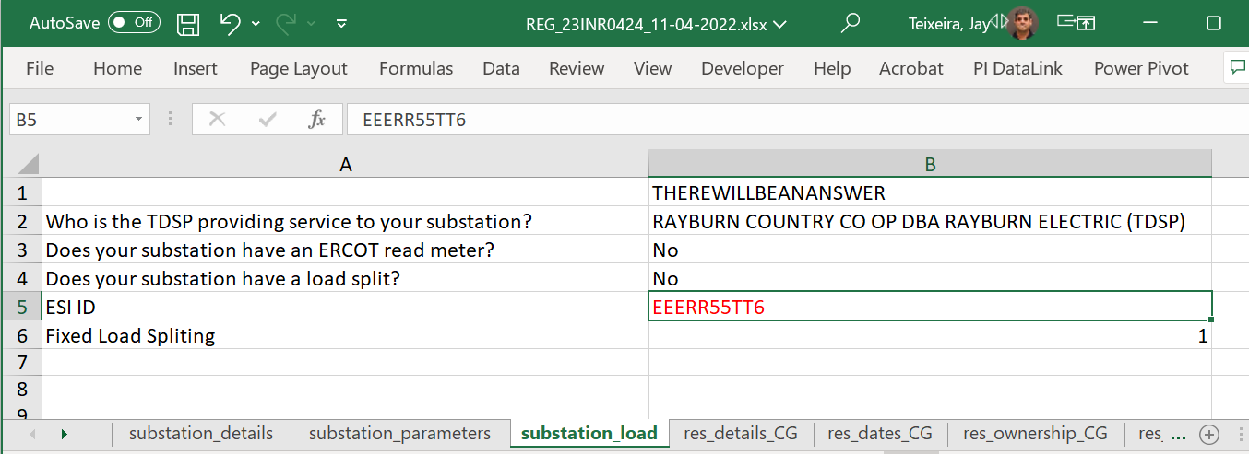
Modifying the Project Details to make corrections that cannot be made in RIOO
Take latest Project Details file, which is an excel spreadsheet and modify the data that cannot be modified in RIOO. Find the tab and modify the data. Re-attach to RIOO as file “Other” and put “_modified” at the end of the filename. “REG_23INR0424_11-04-2022_modified.xlsx”

Slide 13
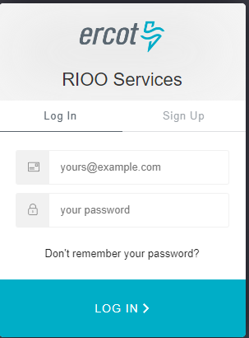
TSPs not Creating RIOO Accounts Correctly
Use this document
  https://www.ercot.com/files/docs/2022/01/14/TSP-Sign-Up-for-RIOO-Services.pdf.
Too many TSP employees create IE account because they didn’t use the above document
Takes several days for ERCOT to fix this issue in the database and in auth0
TSP’s and RE’s – never click this tab!
TSP’s and RE’s – start here after USA adds role

Slide 14
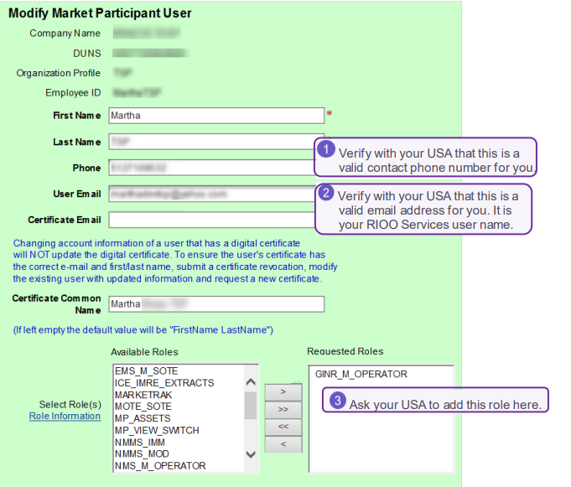
TSPs not Creating RIOO Accounts Correctly
TSP’s – GINR_M_OPERATOR only
RE’s – RIOORS_M_OPERATOR only
Do not do anything until you receive an email from ERCOT. This may take 20 minutes after the role is added.
Then click the verify email link in the email.
This gives you the RIOO Services log in page. Do not enter an email address or any other username. Click the “Don’t remember your password” link.
The next screen enter your email and another email will be sent to you. Click the “Change my Password” link.
You should get a message that your password has been reset successfully.

Slide 15
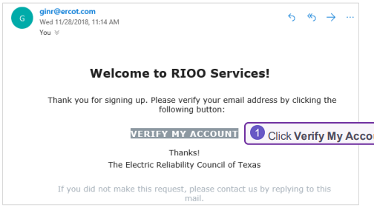
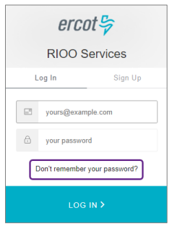
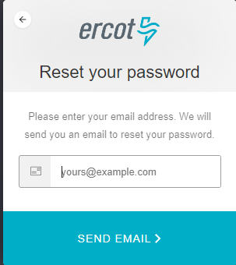
TSPs not Creating RIOO Accounts Correctly
Do not do anything until you receive an email from ERCOT. This may take 20 minutes after the role is added.
Then click the verify email link in the email.
This gives you the RIOO Services log in page. Do not enter an email address or any other username. Click the “Don’t remember your password” link.
The next screen enter your email and another email will be sent to you. Click the “Send Email” link.
You should get a message that your password has been reset successfully.
Click the “Don’t remember your password? link

Slide 16
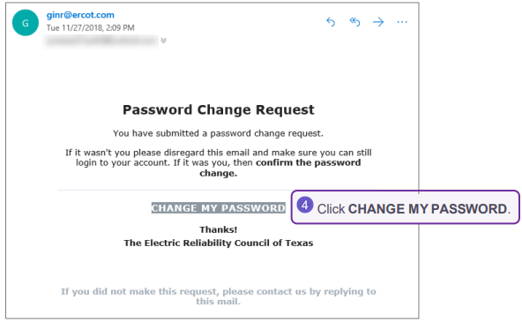
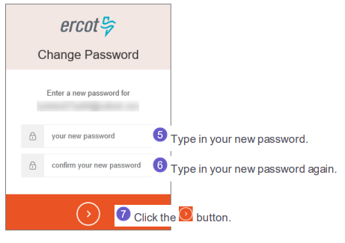
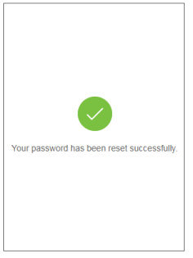

TSPs not Creating RIOO Accounts Correctly
Do not do anything until you receive an email from ERCOT. This may take 20 minutes after the role is added.
Then click the verify email link in the email.
This gives you the RIOO Services log in page. Do not enter an email address or any other username. Click the “Don’t remember your password” link.
The next screen enter your email and another email will be sent to you. Click the “Send Email” link.
If you do not get the “Password Change Request” email, contact your USA to make sure the email address is correct. Click the “Change my Password” link.
Change your password by entering your new password twice and click the button.
You should get a message that your password has been reset successfully.

Slide 17
TSPs still requiring use of RARF forms from RE’s
                Do not do anything until you receive an email from ERCOT. This may take 20 minutes after the role is added.
Why?
Can the RIOO export be used?

Slide 18
Topics from Market Participants
Import template into RIOO-IS for substation data
  Current process is tedious and a template function would significantly improve the application process – import process not part of current plan
Revised export template for substation data – not heard this. Revised how?
  Both TSPs and IEs agree that the current export template format is undesirable and needs to be redone in a manner to make the data easier to read
For “Full RARF”/completed substation data applications for PLD, linking new sites to already modeled sites behind the same POI for substation data and breaker/switch information
  For example, co-located site behind the POI where the solar portion is already in the system but the newer incoming BESS data does not link to the solar mapping info for nodes – This will be fixed in Multi Techtypes and Repower release
Incorporating a proper BESS template with applicable BESS data for RIOO-IS applications
  GEN form still being used which is outdated – This will be fixed in ESR release
  Additional information needs to be requested by TSP
Update on Repower applications in RIOO and transferring data over – req’mts in progress
Update on transferring other non-repower operational projects into the new system – why?
SGIA’s are found on PUC website but not in RIOO

Slide 19
Active RR’s
PGRR103 - Establish Time Limit for Generator Commissioning Following Approval to Synchronize (OWG/PLWG) – To be reviewed by TAC on May 23, 2023.

Slide 20
Other contact information
ResourceIntegrationDepartment@ercot.com is distribution list for Resource Integration department
Mailing List
  RESOURCE_INTEGRATION@LISTS.ERCOT.COM

Slide 21

Questions?
Thank you!

