Slide 1
ERCOT Interconnection Inertia Analysis
04/21/2023
ERCOT Staff

Slide 2
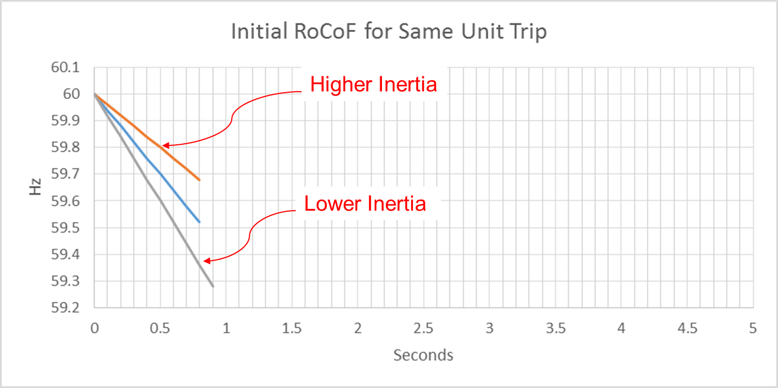
Effect of Synchronous Inertia on System Frequency
With increasing integration of inverter-based generation, there could be periods when total inertia of the system could be low since less synchronous machines will be online.
UFLS trigger
Notes:
UFLS trigger indicates the frequency (59.3 Hz) at which the first stage of involuntary underfrequency load shedding will happen. ERCOT plans and operates the system such that for the simultaneous trip of two largest generating units (2750 MW), UFLS should not be triggered, though it still can happen in some extreme unexpected situations.

Slide 3
Inertia Calculation
In 2013, as instantaneous wind power penetration reached 30%, ERCOT started analyzing impacts of inverter-based generation on system inertia.
In 2015, ERCOT implemented a real-time inertia calculation using inertia parameters of each individual synchronous generator and its status (on/off) telemetry.
$$M_{sys}=\sum_{i∈I}{H_{i}∙{MVA}_{i}}$$
where I is the set of online synchronous generators or condensers,
MVA_{i} is MVA base of on-line synchronous generator or synchronous condenser i, and
H_{i} is inertia constant for on-line generator or synchronous condenser i in a system (in seconds on machine MVA_{i})

Slide 4
Inertia Constants
ERCOT reviews inertia constants in EMS each year following DWG case release
DWG cases were released on 2/28/23
Inertia constant updates will enter model in coming months
$$M_{sys}=\sum_{i∈I}{H_{i}∙{MVA}_{i}}$$
where I is the set of online synchronous generators or condensers,
MVA_{i} is MVA base of on-line synchronous generator or synchronous condenser i, and
H_{i} is inertia constant for on-line generator or synchronous condenser i in a system (in seconds on machine MVA_{i})
Notes:
Since adjustments are yearly, typically do not have as large as an impact as 2021 update (first annual update)

Slide 5
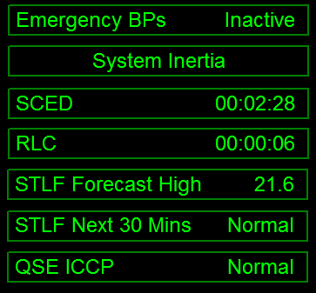
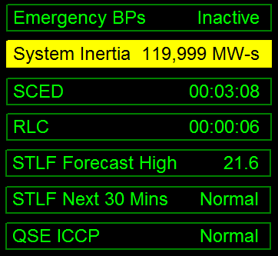
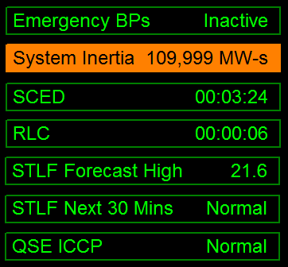
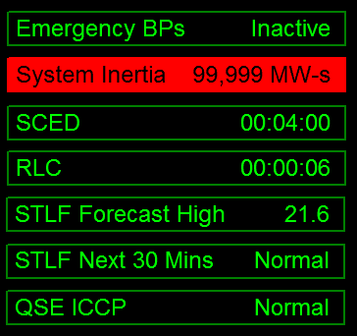
Inertia Monitoring in Real-Time
In 2016, inertia monitoring was implemented in the control room. Visual alarms are raised alarms when inertia gets close to critical levels.
As inertia approaches critical levels, ERCOT System Operators may take actions to bring additional synchronous generation resources with sufficient inertia online.
Current system inertia posted on ERCOT.com https://www.ercot.com/content/cdr/html/real_time_system_conditions.html

Slide 6
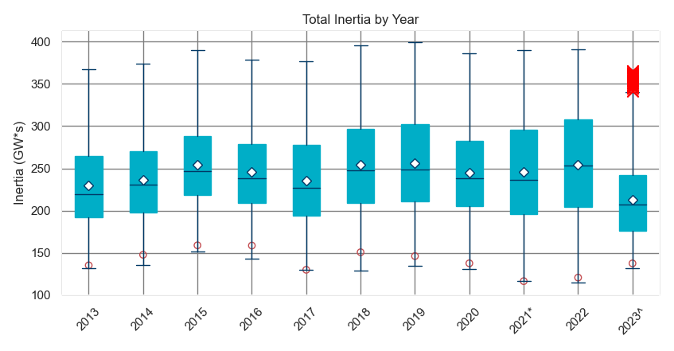
ERCOT Inertia 2013-2023^
Date and Time | 2013 3/10 3:00 AM | 2014 3/30 3:00 AM | 2015 11/25 2:00 AM | 2016 4/10 2:00 AM | 2017 10/27 4:00 AM | 2018 11/03 3:30 AM | 2019 3/27 1:00 AM | 2020 05/01 2:00 AM | 2021* 03/22 1:00 AM | 2022 03/21 2:00 AM | 2023^ 03/16 4:00 AM
Min synch. Inertia (GW*s) | 132 | 135 | 152 | 143 | 130 | 128.8 | 134.5 | 131.1 | 116.6* | 115.0 | 131.6
System load at minimum synch. Inertia (MW) | 24,726 | 24,540 | 27,190 | 27,831 | 28,425 | 28,397 | 29,883 | 30,679 | 31,767 | 33,784 | 37,098
Non-synch. Gen. in % of System Load | 31 | 34 | 42 | 47 | 54 | 53 | 50 | 57 | 66 | 65 | 65
* Measured at 109.6 GW*s, re-calculated using corrected inertia constants
^ data through 4/1/2023
Notes:
For each box, the central dark blue line is the median, the edges of the box are the 25th and 75th percentiles, the whiskers correspond to +/- 2.7 sigma (i.e., represent 99.3% coverage, assuming the data are normally distributed. The corresponding lowest inertia in each year is given in the table.
The circle on each boxplot is showing inertia at the highest IRR penetration in that year.
ERCOT tripled installed wind capacity between 2013 and 2020, adding nearly 20 GW of wind generation (including all synchronized projects)
An equal amount of coal capacity has about 55 GW*s of inertia contribution.
Have observed lower minimum inertia in recent years;
Counterintuitively, the inertia trend is not declining as installed IBR capacity increases, as was anticipated, due to other factors, such as load growth, gas prices, wind curtailments etc.

Slide 7
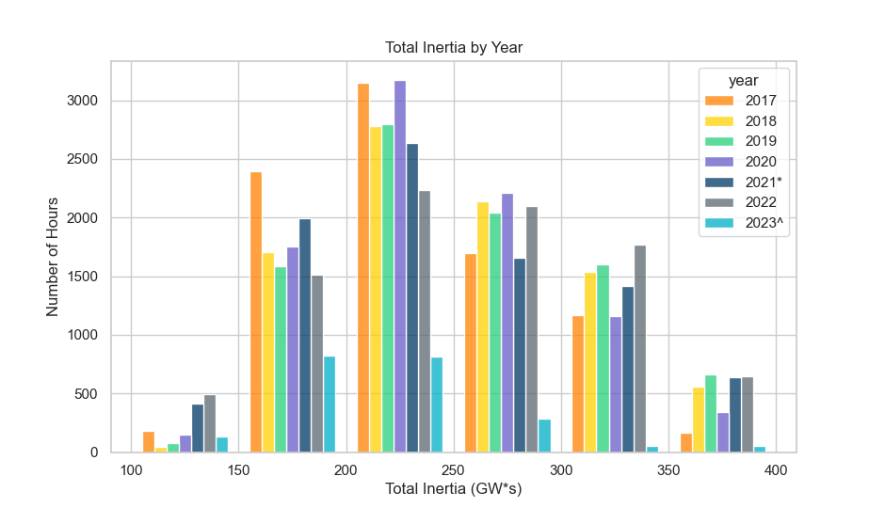
ERCOT Inertia 2017-2023^

Slide 8
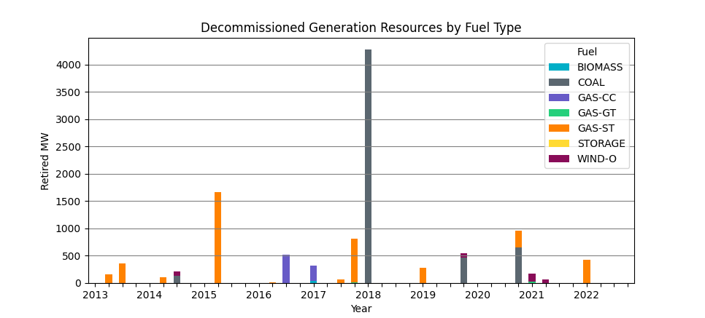
Generation Retirement
Total Generation Capacity Retired Since 2013
Biomass | Coal | Gas-CC | Gas-GT | Gas-ST | Storage | Wind
45 | 5,531 | 804 | 35 | 4,166.5 | 2 | 316.55
420 MW of GAS-ST retired in 2022

Slide 9
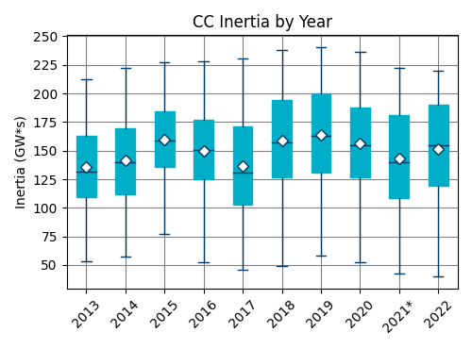
Coal and Combined Cycle Inertia Trends
Combined Cycle Plant has about 1.5x higher inertia than a Coal Plant with the same MVA rating
Notes:
Coal outlier occurred on 3/9/22 when Total Inertia close to 200 GW*s, CC Inertia >> 100 GW*s

Slide 10
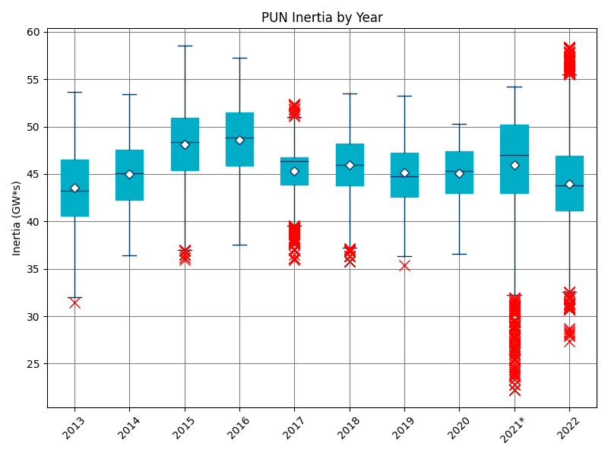
PUN Inertia
Notes:
PUN generators may be online at all times regardless of electricity market conditions.
Even when PUNs are not exporting power, they are contributing to system inertia, because they are synchronized to the ERCOT grid.

Slide 11
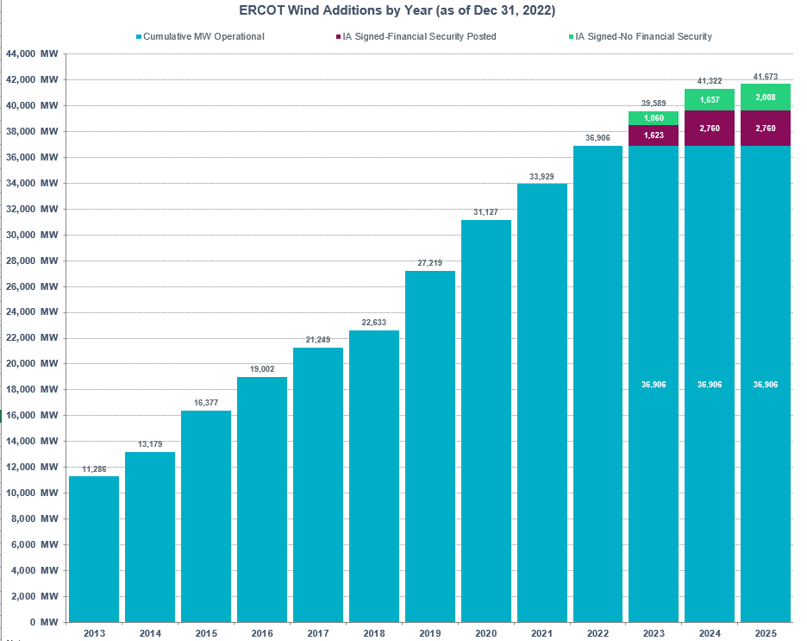
Wind Generation Capacity
+2,977 MW
+2,802 MW
+3,908 MW
+4,587 MW
+1,384 MW
+2,247 MW
+2,625 MW
+3,198 MW
+1,893 MW

Slide 12
Wind Generation by Year

Slide 13
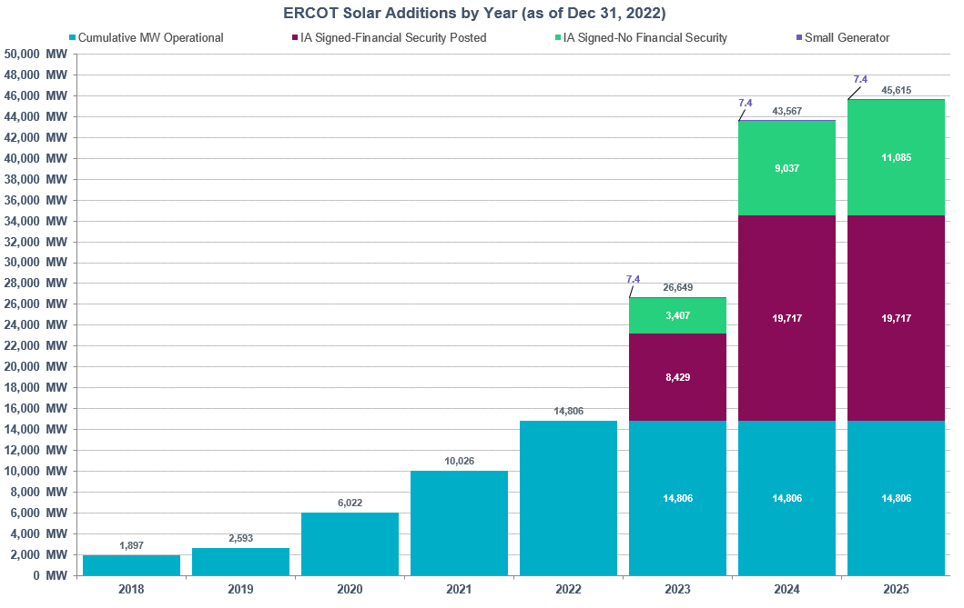
Solar Generation Capacity
+4,780 MW
+4,003 MW
+3,429 MW
+696 MW

Slide 14
Solar Generation by Year
Notes:
Daytime hours (generation > 5MW)

Slide 15
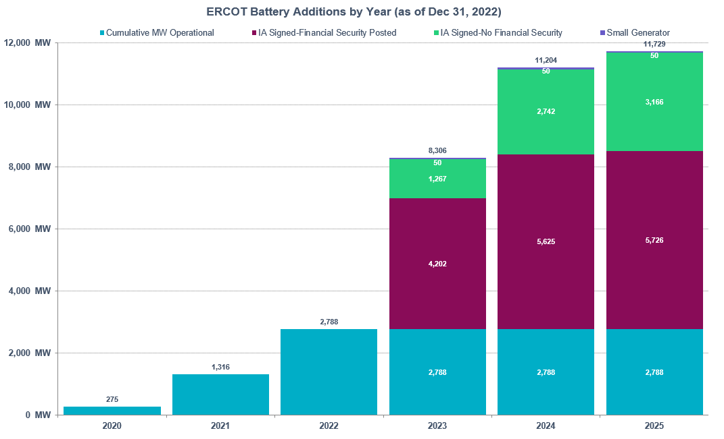
Energy Storage Resource (ESR) Capacity
+1,472 MW
+1,041 MW

Slide 16
ESR Generation by Hour

Slide 17
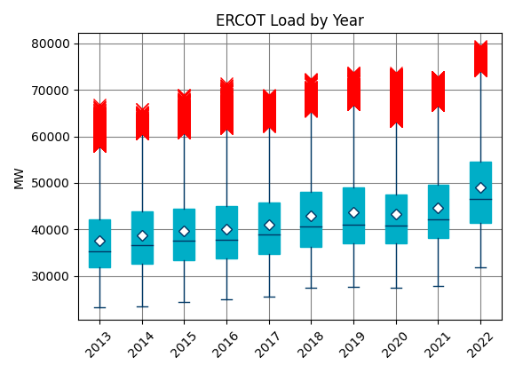
Total Load by Year

Slide 18
Net Load by Year
Net Load = Load – Wind Generation – Solar Generation

Slide 19
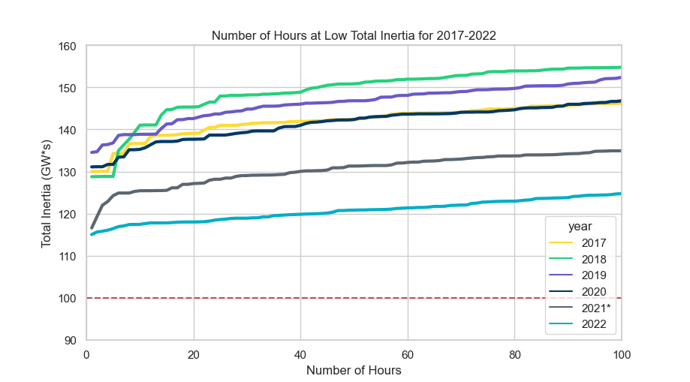
Lowest 100 Inertia Hours 2017-2022
 | 2017 | 2018 | 2019 | 2020 | 2021* | 2022
Lowest Inertia Hour (GW*s) | 130 | 129 | 135 | 131 | 117 | 115
100th Lowest Inertia Hour (GW*s) | 146 | 155 | 152 | 147 | 135 | 125

Slide 20
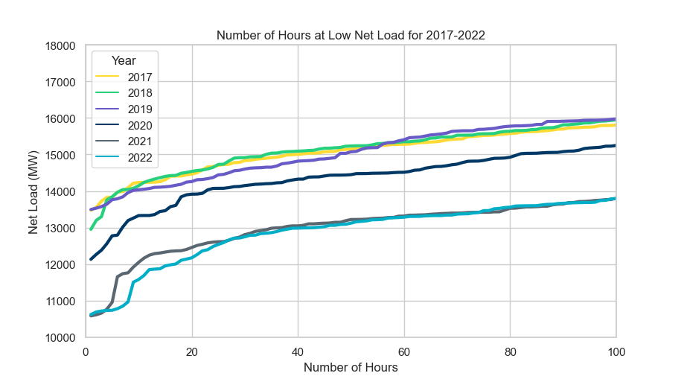
Low Net Load Hours 2017-2022

Slide 21
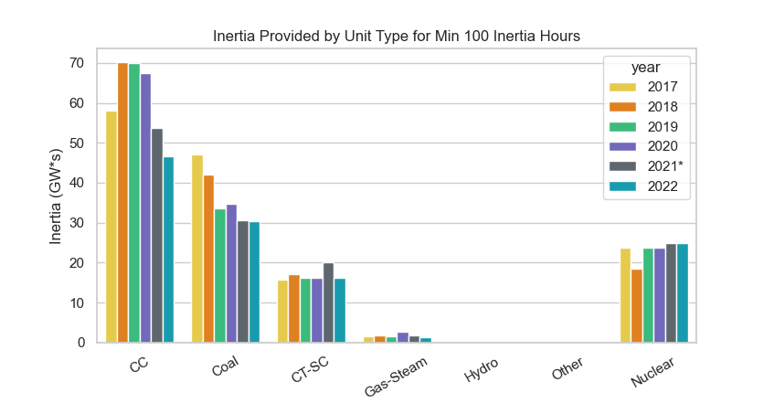
Median Inertia by Source During Lowest 100 Total Inertia Hours

Slide 22
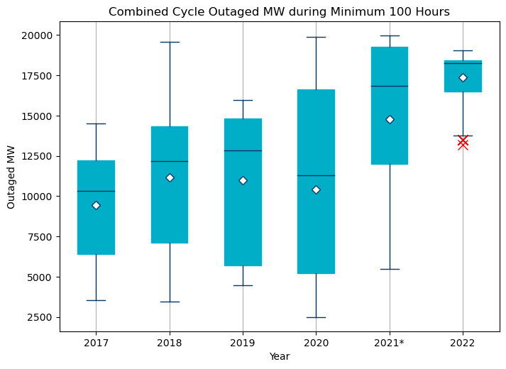
Combined Cycle Outages during Low Inertia Hours

Slide 23
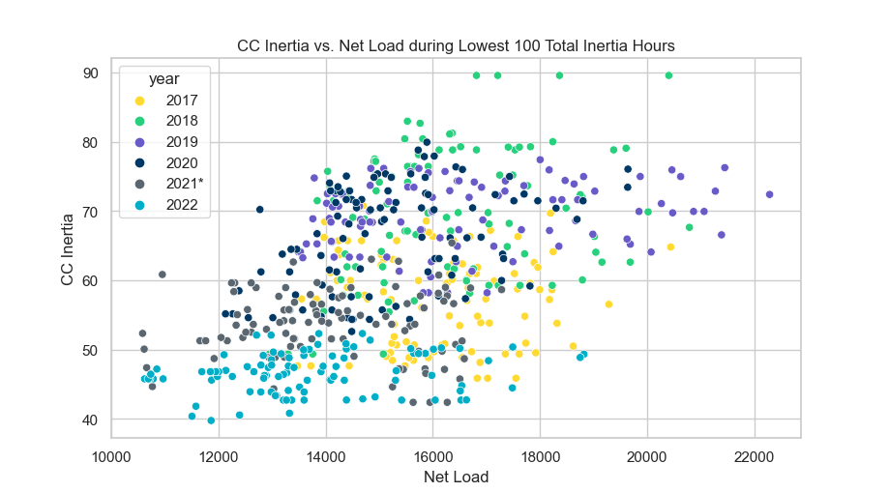
CC Inertia vs. Net Load
Less conventional generation is dispatched during low net load hours
More low net load hours (below 14 GW) in 2022 and 2021 than in past years
CC inertia is low in 2022’s lowest total inertia hours regardless of net load
Notes:
r^2 = 0.249
r^2 = 0.813 (all hours)

Slide 24
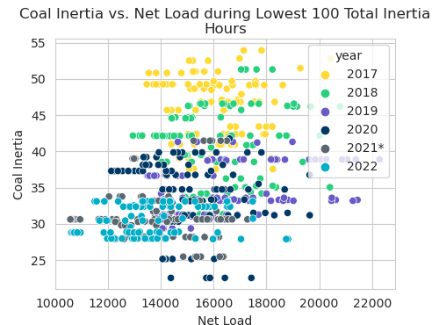
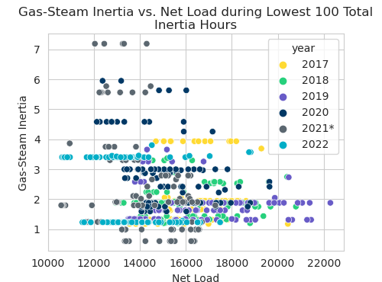
Coal & Gas-Steam vs. Net Load
Very small correlation between coal inertia and net load; gas-steam inertia and net load
Less synchronous generation to be dispatched at low net load
CC inertia appears to be affected most by lower net load
Notes:
r^2 (coal) = 0.039
r^2 (coal) = 0.221 (all hours)
r^2 (GS) = 0.048
r^2 (GS) = 0. (all hours)

Slide 25
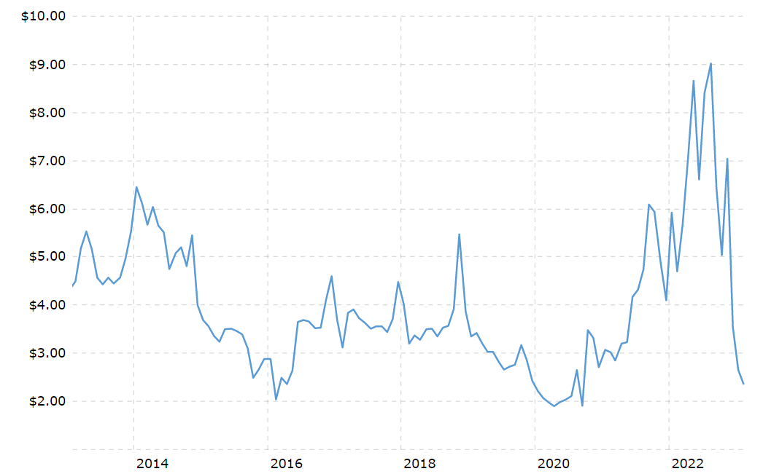
Natural Gas Prices
https://www.macrotrends.net/2478/natural-gas-prices-historical-chart
Notes:
About 50% of ERCOT’s generation fleet is natural gas based
Fluctuations in natural gas prices affect generating unit commitment patterns and, thus, system inertia
More combined cycle units are committed during periods with low gas prices (higher inertia than coal)
More Coal units are committed in periods with high gas prices (lower inertia than combined cycle)

Slide 26
Summary
Lowest system inertia in 2022 was 115 GW*s
2022 experienced more hours below 150 GW*s than in previous years; more hours above 300 GW*s
As in 2021, lower contribution from combined cycle units was correlated with the lowest system-wide inertia hours
CC capacity has not decreased over last 5 years
A combination of increased outages, higher natural gas prices, and lower net load led to different dispatch of CC units during lowest inertia hours
Higher ERCOT load offset the increase in IRR generation
Lowest net load hours in 2022 were similar to lowest net load hours in 2021

Slide 27
Thank you! Questions?

Slide 28
Appendix

Slide 29
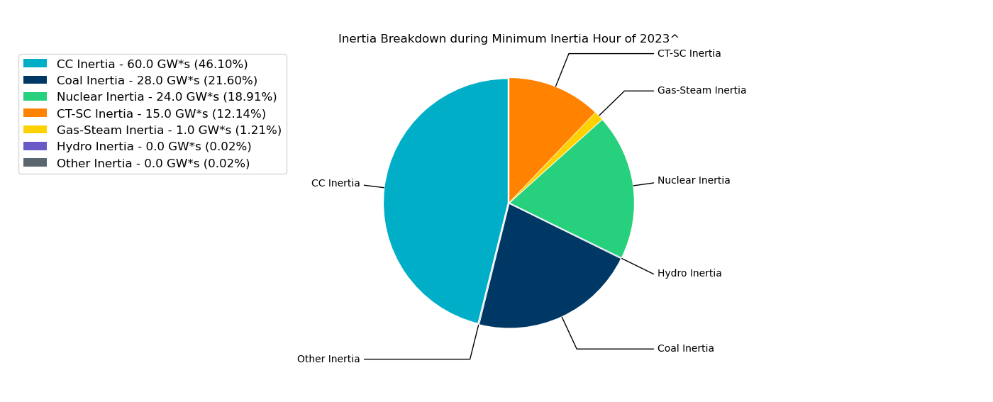
Inertia by Unit Type during Minimum Inertia Hour 2023^

Slide 30
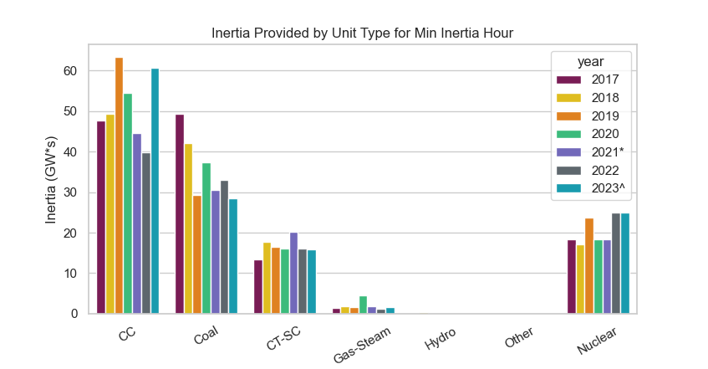
Inertia by Unit Type during Minimum Inertia Hour
Date and Time | 2017 10/27 4:00 AM | 2018 11/03 3:30 AM | 2019 3/27 1:00 AM | 2020 05/01 2:00 AM | 2021 03/22 1:00 AM | 2022 03/21 2:00 AM
Min synch. Inertia (GW*s) | 130 | 128.8 | 134.5 | 131.1 | 116.6* | 115.0

Slide 31
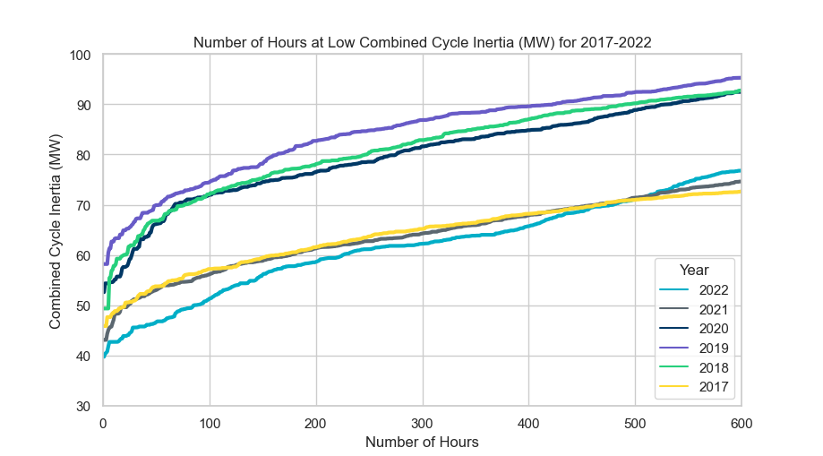
Low Combined Cycle Inertia Hours
Notes:
** function of net load?
Trim to 500

Slide 32
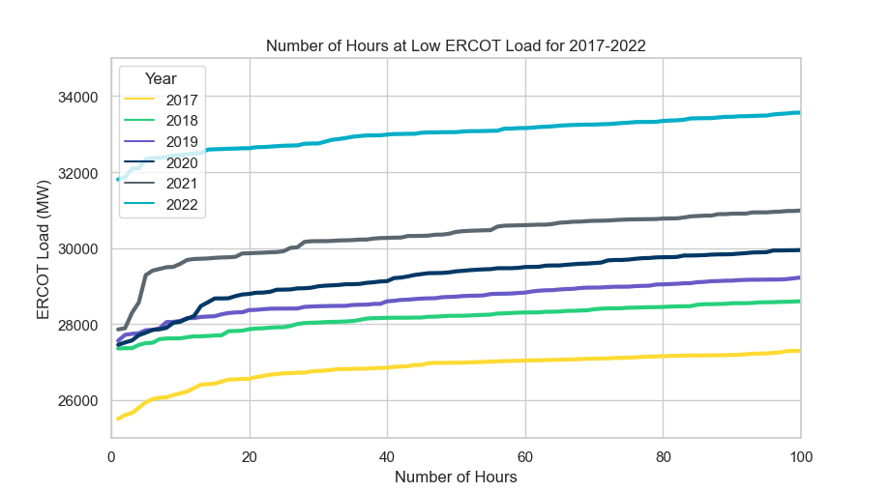
Low Load Hours 2017-2022
Notes:
** talk to Chris C about potential drivers for load

Slide 33
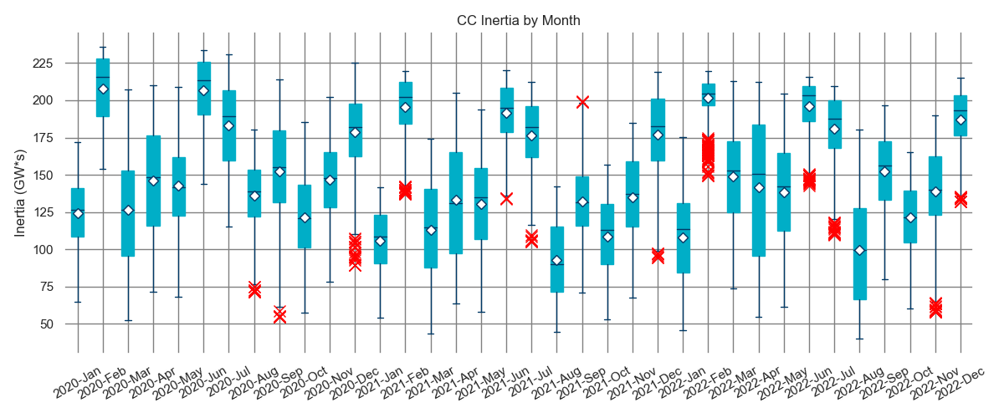
Combined Cycle by Month 2020-2022

Slide 34
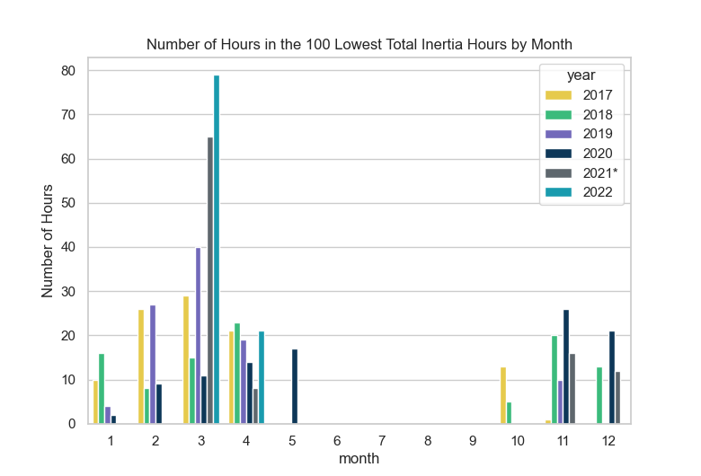
Low Inertia Hours by Month

Slide 35
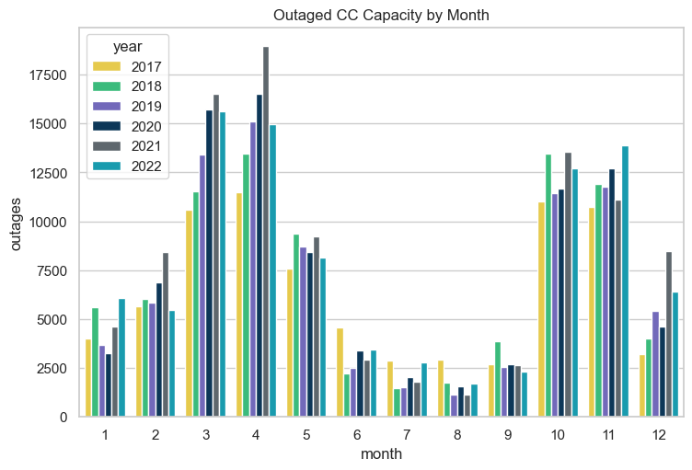
Average Combined Cycle Outages by Month

Slide 36
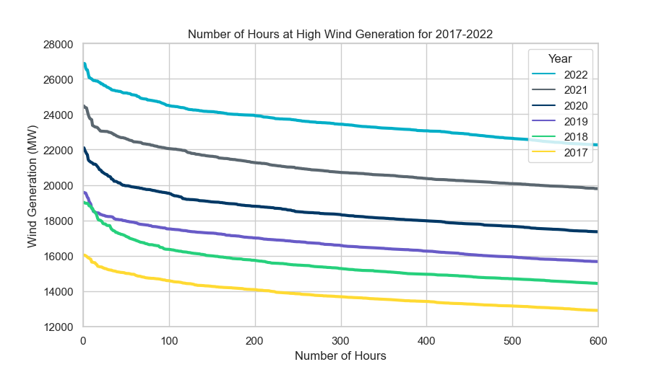
High Wind Generation Hours 2017-2022

Slide 37
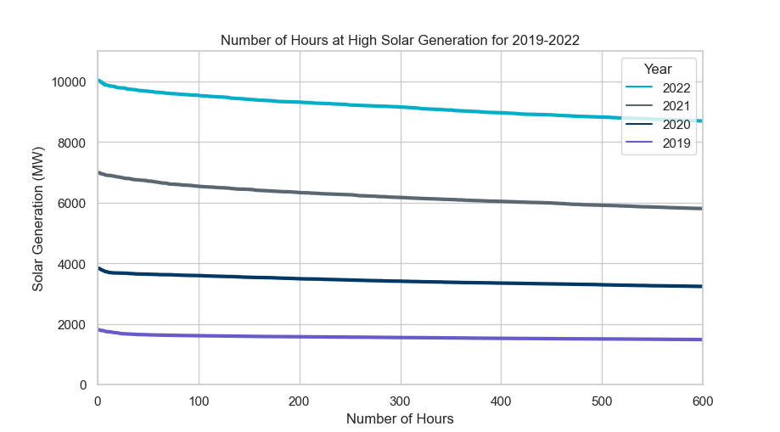
High Solar Generation Hours 2017-2022

