Slide 1
ERCOT Frequency Events
March 2023
ERCOT
Operations Planning
PDCWG |Apr 21st, 2023

Slide 2
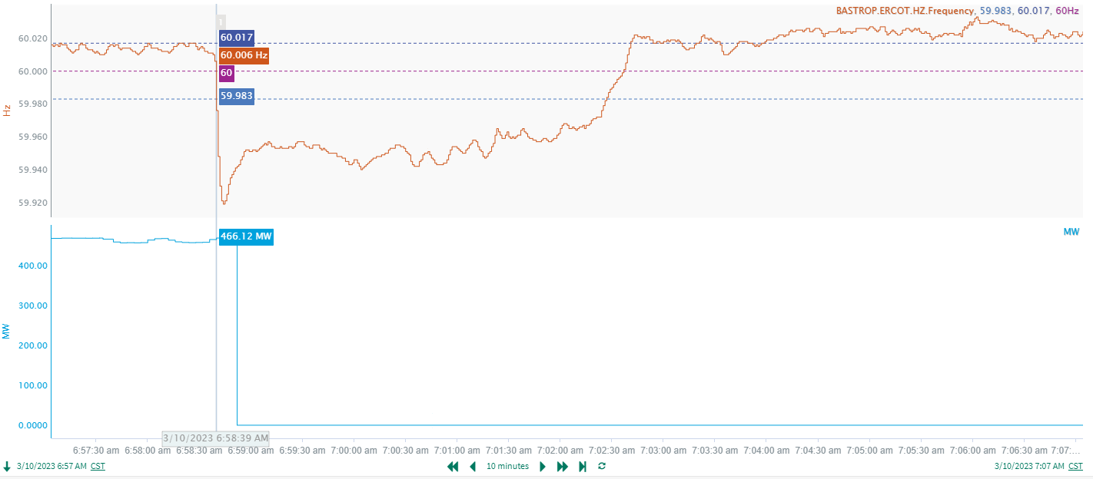
3/10/2023 06:58:39 (Non-FME)
Notes:
A unit tripped offline while carrying approximately 466 MW gen
Starting Frequency: 60.006 Hz
Maximum Frequency: 59.919 Hz
A-C Time : 5 seconds
Recovery Time(back to deadband): 3 minutes 48 seconds
RRS Released: 0 MW
Trip Reason: Unknown at this time
Contextual Information: A total of 278 MW of regulation Up was deployed during the event

Slide 3
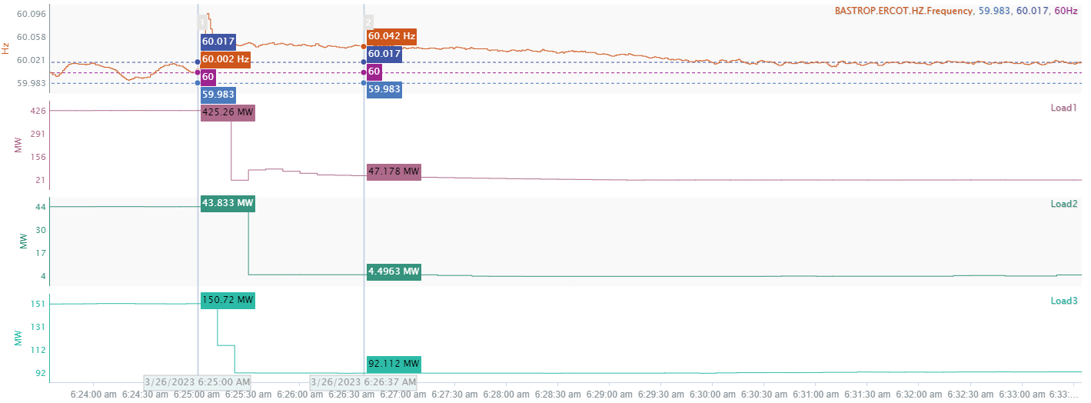
3/26/2023 06:25:00(FME)
Notes:
Three loads tripped offline with a combined loss of 501MW
Starting Frequency: 60.002 Hz
Maximum Frequency: 60.096 Hz
A-C Time : 6 seconds
Recovery Time(back to deadband): 4 minutes 29 seconds
Trip Reason: Unknown at this time
Contextual Information: A total of 228 MW of regulation down was deployed during this time

Slide 4
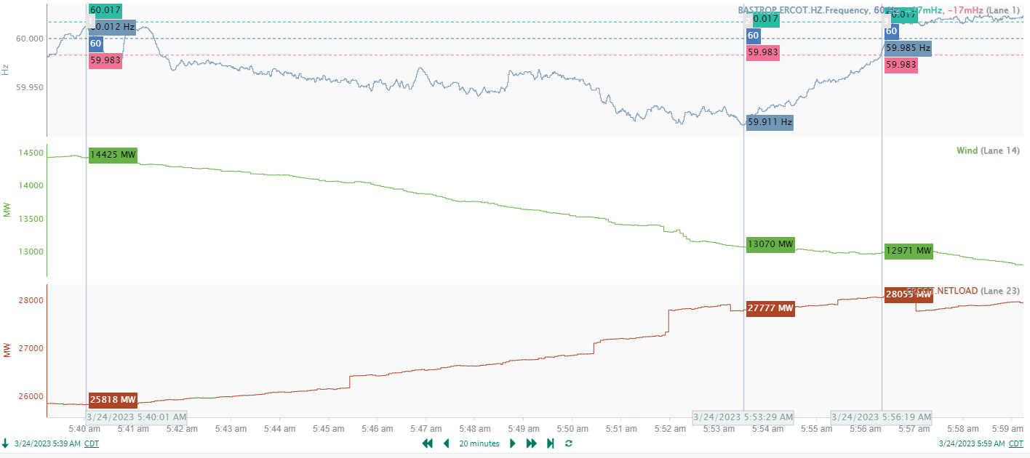
3/24/2023 05:40:00(Non-FME)
Notes:
Frequency started to decline @ 5:40 and dropped to 59.911Hz @ 5:53. @5:56, frequency recovered back to the lower deadband.
Wind ramped down by approximately 1425 MW from 5:40 to 5:56 in a rate of 89MW/min while PWRR was capped at 30MW/min in SCED.
Non-conforming load ramped up by approximately 250 MW between 5:50 to 5:55.
Expected Generation Deviation remained negative during this period with significant contribution from wind generation and several Thermal Generators were slow to follow the basepoints.
Contextual Information: A total of 429MW of regulation up was deployed and exhausted during this event. A 400 MW SCED offset was applied.

Slide 5
Questions?
Thank you!

