Slide 1
ERCOT Updates
NDSWG March 2023
Joel Koepke
3/21/2023

Slide 2
Topics
Updates:
  Contingency Review
    Annual double-circuit review: In Progress
    Manual contingency review: Starting Soon
  NMMS “Tech Health” Project
  Ongoing SSWG Node/Breaker Data Maintenance
  DGR conversions to “new style”
New:
  Review of NPRR1164 – Black Start and Isochronous Control Capable Identification
  Telemetry: Uninitialized and location of line kV (voice over)
  Summer weather preparedness declarations (voice over)
  Resource Definition Framework/Matrix

Slide 3
NMMS Tech Health Project – Deployments (Update)
Initial deployment was in early December
  Performance issues experienced
  Defects identified
Upcoming deployments (schedule subject to change)
  January deployment to fix critical defects
    Completed
  February deployment
    Completed
  March deployment to improve stability
    Completed
  April deployment to improve stability
    Complete (4/12)
  May deployment to improve stability (TBD)

Slide 4
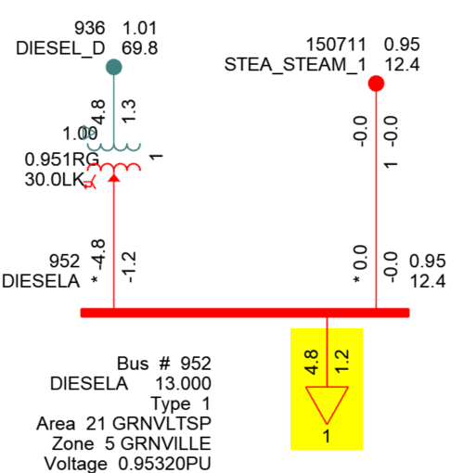
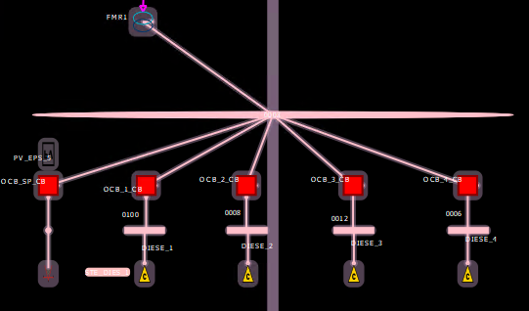
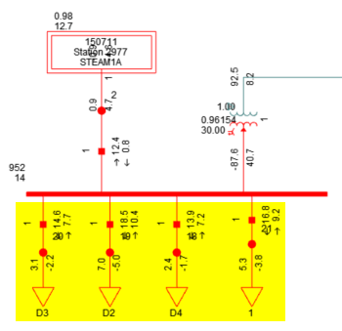
SSWG NOMCR Example: Deconsolidating Shunt Devices
Bus-Branch
The PSSE ID of many shunt devices must be updated to avoid consolidation during topology processing
Topology Processing
Loads are consolidated if their PSSE IDs are the same
Node-Breaker
Example: The operations model has 4 loads connected to the same Connectivity Node Group
Loads remain unaggregated if their PSSE IDs are different

Slide 5
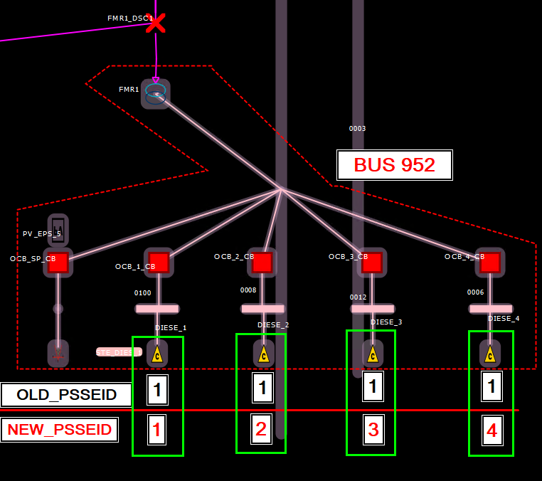
SSWG NOMCR Example: Deconsolidating Shunt Devices
Ongoing submissions must consider collisions with pre-existing PSSE IDs at the same ConnectivityNodeGroup

Slide 6
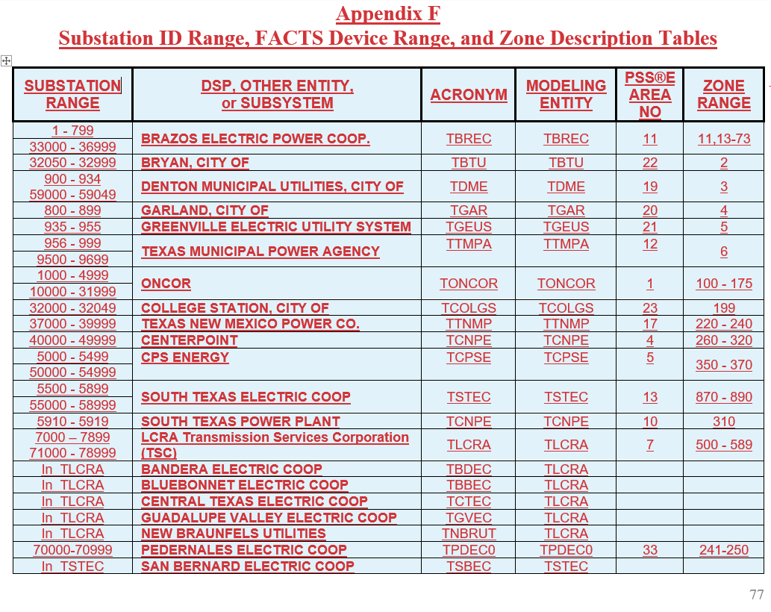
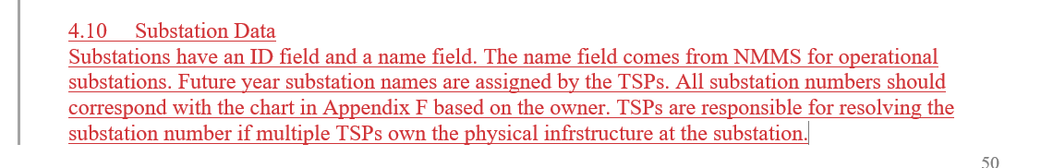
SSWG NOMCR Example: Substation Numbering
The Topology Processor will use the PSSE ID of Substation instances when creating node/breaker Planning models.

Slide 7
Recap - Transitioning to Simplified Modeling of DGR and DESRs
TSP Station
Old-Style
Transmission Network
New-Style
Transmission Network
DGR Station
TSP Station
Single substation with load and generator modeled at transmission voltages
CIM Load
CIM Load
Line
Multiple substations with load and generator modeled at distribution voltages

Slide 8
DGR Conversion Update
ERCOT’s goal is to convert all “old-style” (pre-moratorium) DGRs to the new style of modeling by the end of 2023
New-Style
DGR metrics as of 4/13/23:
45 DGR/DESRs:
  27 are modeled in the “new way”
    13 have been converted
    14 are new Resources
  18 still remain modeled in the “old way”
    10 are in the process of being converted
    8 have not been scheduled
Transmission Network
TSP Station
Single substation with load and generator modeled at transmission voltages

Slide 9
NPRR1164 – Black Start and Isochronous Control Capable Identification
Summary:
  Creates definitions for:
    Black Start Capable Resource
    Isochronous Control Capable Resource
    Synchronism Check Relay
    Synchroscope
  Requires REs to identify Resources that are:
    Black Start Capable, and
    Isochronous Control Capable
  Requires REs and TSPs to identify breakers and switches which have:
    Synchroscope, and
    Synchronism Check Relays

Slide 10
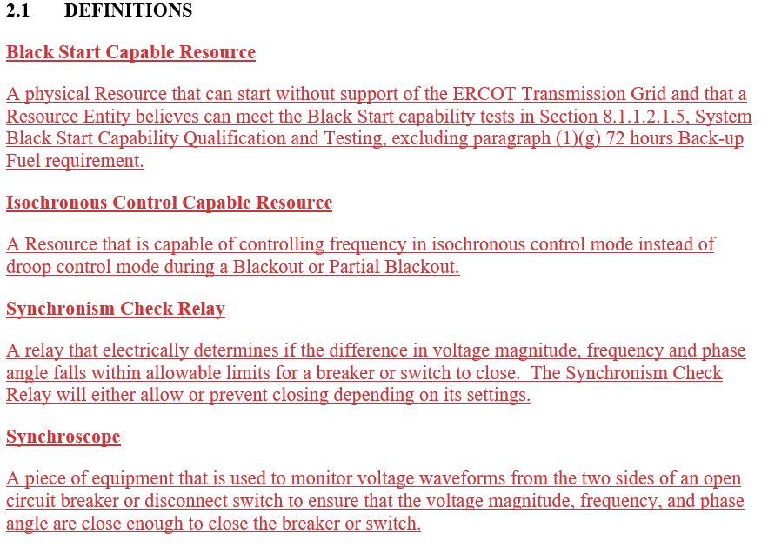
NPRR1164 – New Definitions
NPRR1164 creates 4 new definitions in section 2.1

Slide 11
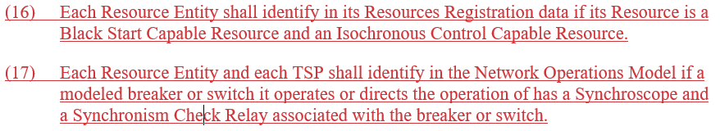
NPRR1164 – 3.14.2 Updates

Slide 12
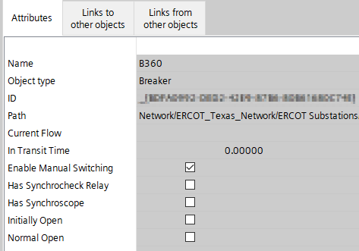
NPRR1164 – Updating in NMMS
Metrics from Network Operations Model:
  Circuit Breakers (18,670)
    Synchronism Check Relay: 286
    Synchroscope: 1,341
    Both: 158
  Disconnectors (45,850)
    Synchronism Check Relay: 0
    Synchroscope: 0
    Both: 0
Breaker and Disconnector instances already have attributes to hold this information

Slide 13
Weatherization Attestations – Appendix A
Substations are associated to TSPs based on the ownership and operatorship of equipment within the station.
A substation will be associated if any equipment (a Transmission Facility) is owned or operated by the TSP
Transmission Facility = transmission voltage element inside the fence owned or operated by the TSP
A substation may require a response from multiple TSPs
Example: A response for substation ABC will be required by Company A, Company B, Company C, and Company D

Slide 14

Company, Operatorship, and Ownership Instances
Substations were added to Appendix A based on the Company instance.
Company
Operatorship
Ownership
Ownership
Ownership and Operatorship instances must be under the company which submits the model changes and is contained within the Digital Certificate

Slide 15
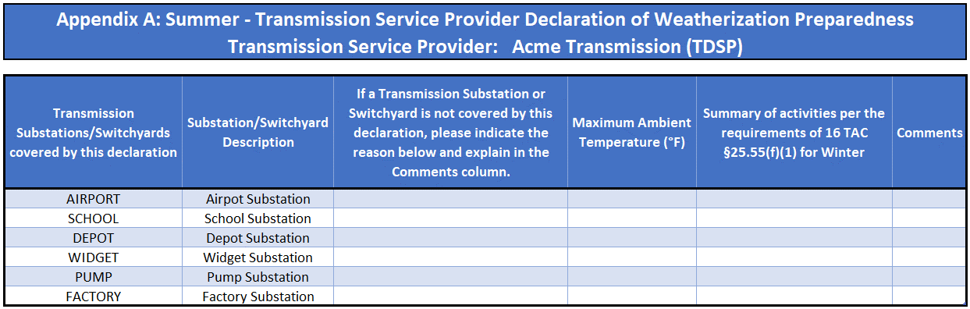
TSP Appendix A – Which Substations Require a Response?
Every substation in Appendix A requires a response; rows cannot be deleted.
Brief summary of activities or references to supplemental files
Reason substation is not covered by the declaration
Maximum experienced temperature value

Slide 16
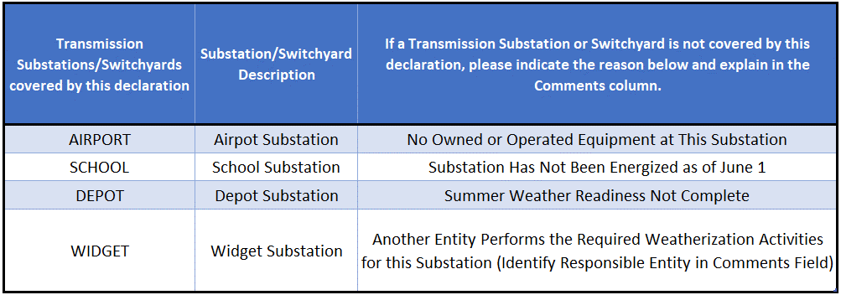
Appendix A – Excluding Substations from the Declaration
To exclude a substation from the Declaration, a reason from a pre-defined list must be selected.
New
Reasons for excluding the substation can be selected via a drop down in Excel

Slide 17
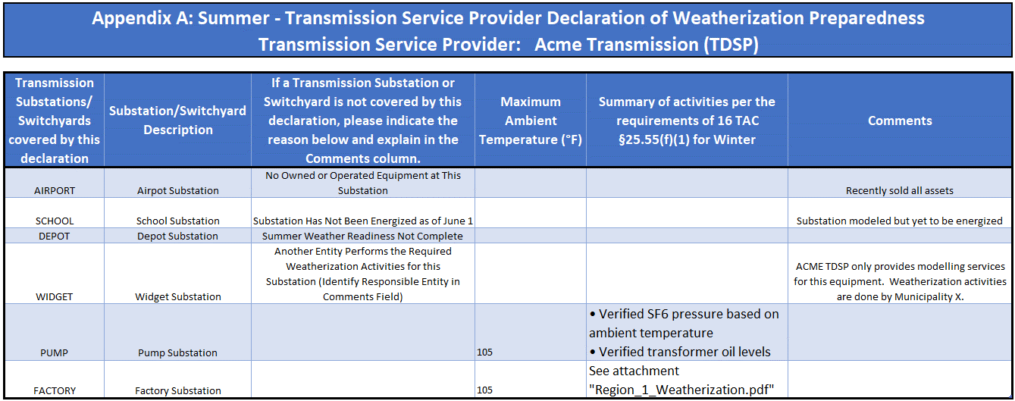
TSP Appendix A – Summary of Activities
A summary of weatherization activities must be provided within the Excel file.
Activities can be listed within the cell…
…or supplemental attachments can be referenced

Slide 18
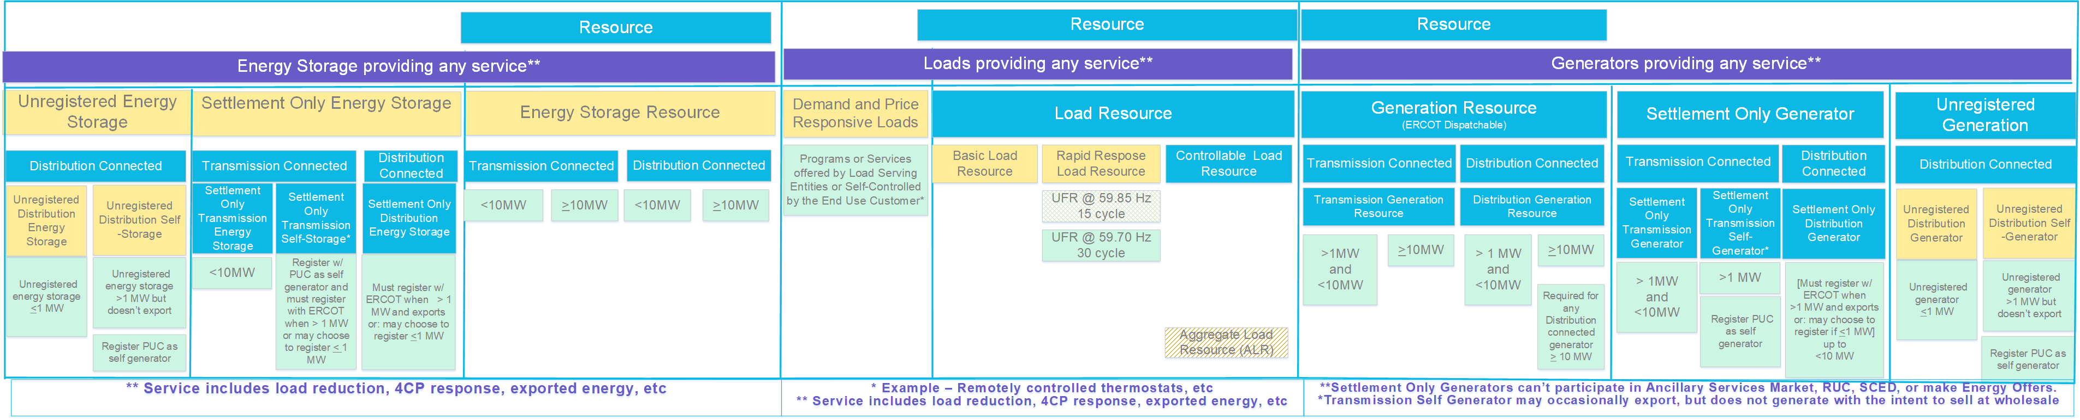
Resource Definition Framework/Matrix
Energy Storage
Loads
Generation

Slide 19
Resource Definition Framework/Matrix - Loads

Slide 20
Resource Definition Framework/Matrix - Generation

Slide 21
Resource Definition Framework/Matrix - Storage

Slide 22
Resource Definition Framework/Matrix - Generation

Slide 23
Resource Definition Framework/Matrix - Generation
GR
TGR → GR
DGR

Slide 24
Resource Definition Framework/Matrix - Generation
SOG
SOTG → SOG
SODG
SOTSG
* SOTSG may occasionally export, but does not generate with the intent to sell at wholesale

Slide 25
Resource Definition Framework/Matrix - Storage
ESR
TESR → ESR
DESR

Slide 26
Resource Definition Framework/Matrix - Storage
SOESS?
(not used)
SOTESS
SODESS
SOESSSS!?!
(not used, yet)
* Self storage may occasionally export, but does not generate with the intent to sell at wholesale

Slide 27
Summary
ERCOT models all generation and storage
Generation or storage within the distribution system will require additional ERCOT, TDSP, and RE coordination:
  DGRs
  DESRs
  SODGs
  SODSGs
  SODESSs
  SODESSSSs?!?!

