Slide 1
The IEEE 2800 Conformity Assessment Paradigm
An update on IEEE P2800.2
Presented to ERCOT Inverter-based Resource Performance Task Force
April 14, 2023
Andy Hoke, IEEE P2800.2 WG Chair
Manish Patel, Secretary
Jens Boemer, Bob Cummings, Divya Kurthakoti,
Julia Matevosyan, Mahesh Morjaria, Steve Wurmlinger, Vice Chairs

Slide 2
Disclaimers
The views presented in this presentation are the personal views of the individuals presenting it and shall not be considered the official position of the IEEE Standards Association or any of its committees and shall not be considered to be, nor be relied upon as, a formal position of IEEE, in accordance with IEEE Standards Association Standards Board Bylaws 5.2.1.6.
Use of an IEEE standard is wholly voluntary
This work was supported in part by the National Renewable Energy Laboratory, operated by Alliance for Sustainable Energy, LLC, for the U.S. Department of Energy (DOE) under Contract No. DE-AC36-08GO28308. Funding provided by U.S. Department of Energy Office of Energy Efficiency and Renewable Energy Solar Energy Technologies Office and Wind Energy Technologies Office. The views expressed in the article do not necessarily represent the views of the DOE or the U.S. Government.

Slide 3
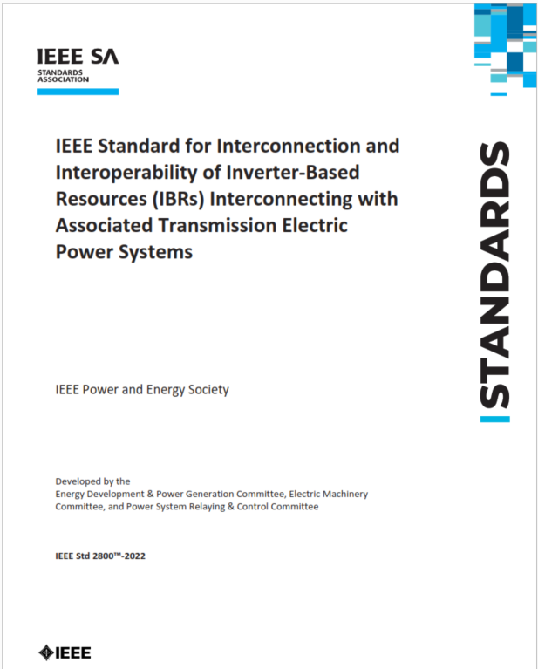
Summary of IEEE Std 2800
The standard harmonizes Interconnection Requirements for Large Solar, Wind and Storage Plants
It is a consensus-based standard developed by over ~175 Working Group participants from utilities, system operators, transmission planners, & OEMs over 2 years
It has successfully passed the IEEE SA ballot among 466 SA balloters (>94% approval, >90% response rate)
Published on April 22, 2022 (Earth Day)

Slide 4
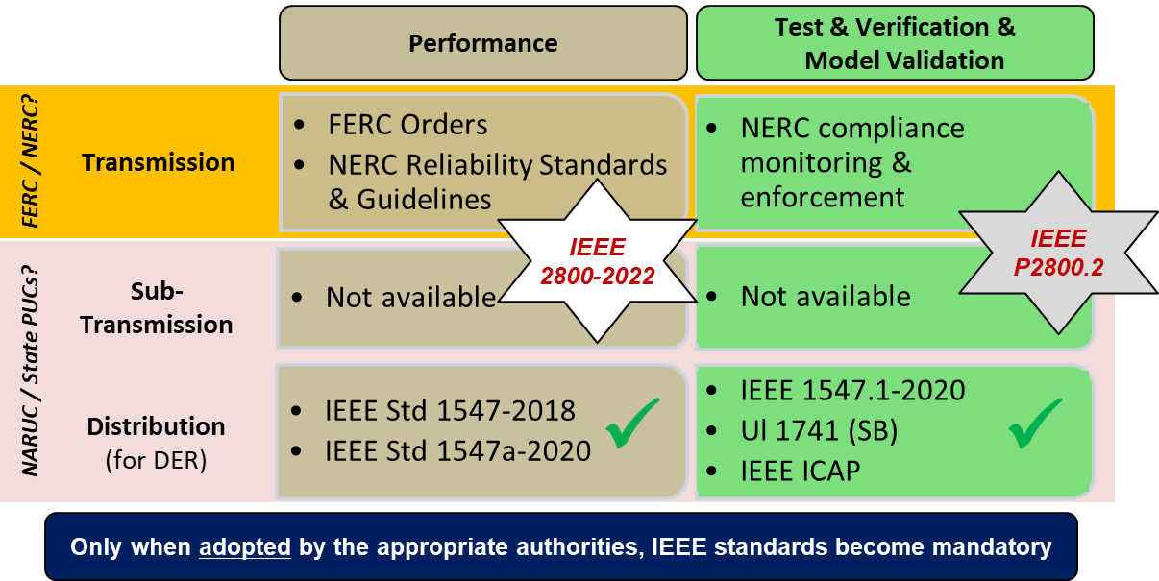
Completing North American Reliability Standards
Source: EPRI, 2021

Slide 5
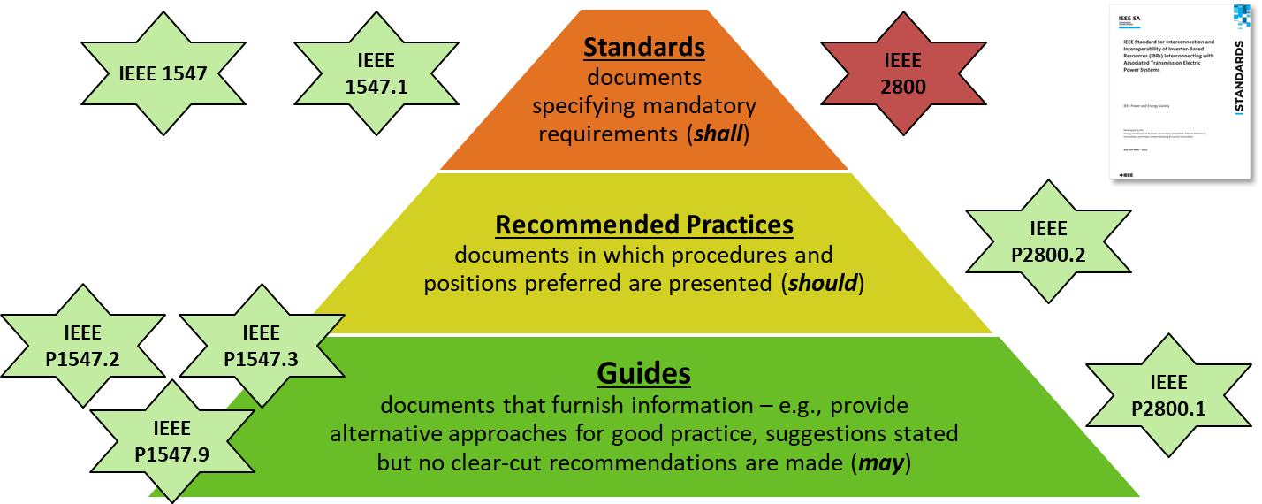
IEEE Standards Classification

Slide 6
P2800.2 Summary
Title: Recommended Practice for Test and Verification Procedures for Inverter-Based Resources Interconnecting with Bulk Power Systems
Scope:
Defines recommended practices for test and verification procedures that should be used to confirm plant-level conformance of IBRs interconnecting with bulk power systems in compliance with IEEE Std 2800.
Applies to IBRs interconnected to transmission and sub-transmission systems
May also apply to isolated IBRs that are interconnected to an alternating current (AC) transmission system via dedicated voltage source converter high-voltage direct current (VSC-HVDC) transmission facilities, e.g., offshore wind farms
Includes specifications for the equipment, conditions, tests, modeling methods, and other verification procedures that should be used to demonstrate conformance with IEEE 2800

Slide 7
P2800.2 Summary
Includes:
Type tests
Unit level, not full compliance with 2800
Test results are used to validate unit level model
Design evaluation using verified plant model
Includes procedures to validate unit level model
As-built evaluation and commissioning tests
Post-commissioning model validation, monitoring, periodic tests & verifications
Recommended Practice: uses “should” language, not “shall” language
In recognition that prescribing uniform procedures across all IBR types and interconnecting locations would be very challenging.

Slide 8
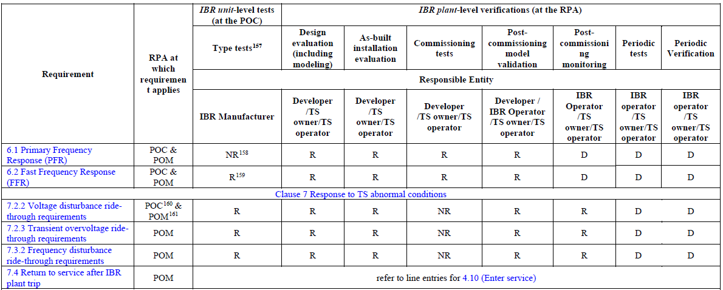
Motivation for IEEE P2800.2
IEEE 2800 contains capability & performance requirements for IBRs, and a table of methods to verify each requirement
Details of verification methods not included
P2800.2 is defining recommended practices for test and verification procedures for IBRs
IEEE-2800-2022 - Adapted and reprinted with permission from IEEE. Copyright IEEE 2022. All rights reserved

Slide 9
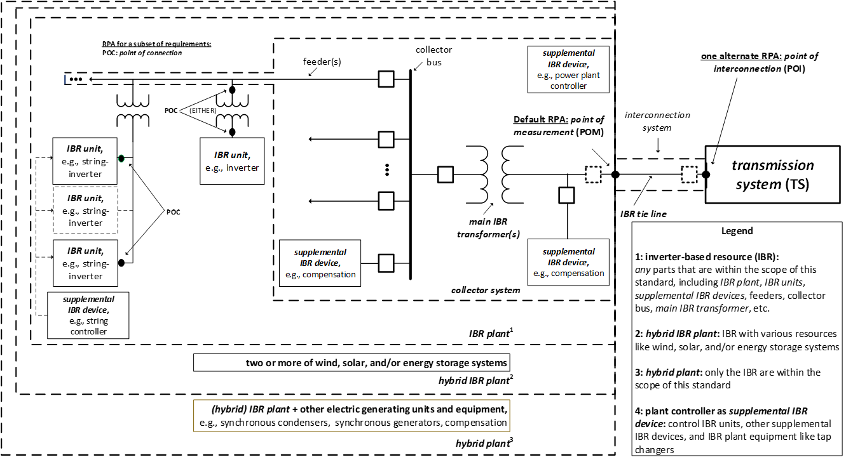
Reference Point of Applicability
Almost all requirements of IEEE 2800 apply at Point of Measurement (POM) by default
POM
(default RPA)
POI
POC

Slide 10
Overview of conformity assessment steps in IEEE P2800.2
Type Tests
Lab or field tests of individual IBR unit for model verification
IBR Unit Model Validation
Based on type test data
IBR Plant Model Development
Based on validated IBR unit model(s) and balance of plant
IBR Plant Design Evaluation
Simulations to assess plant conformity to IEEE 2800
As-built Installation Evaluation
Verification of installed plant
Commissioning Tests
Partial field assessment of plant performance
Post-commissioning Monitoring
Monitoring of plant performance during grid events
Post-Commissioning Model Validation
Based on commissioning test data
Periodic Tests and Verifications
Design Evaluation
Plant construction complete
This is a general diagram of the process.
Details are under development in IEEE P2800.2.
Some variations permitted.

Slide 11
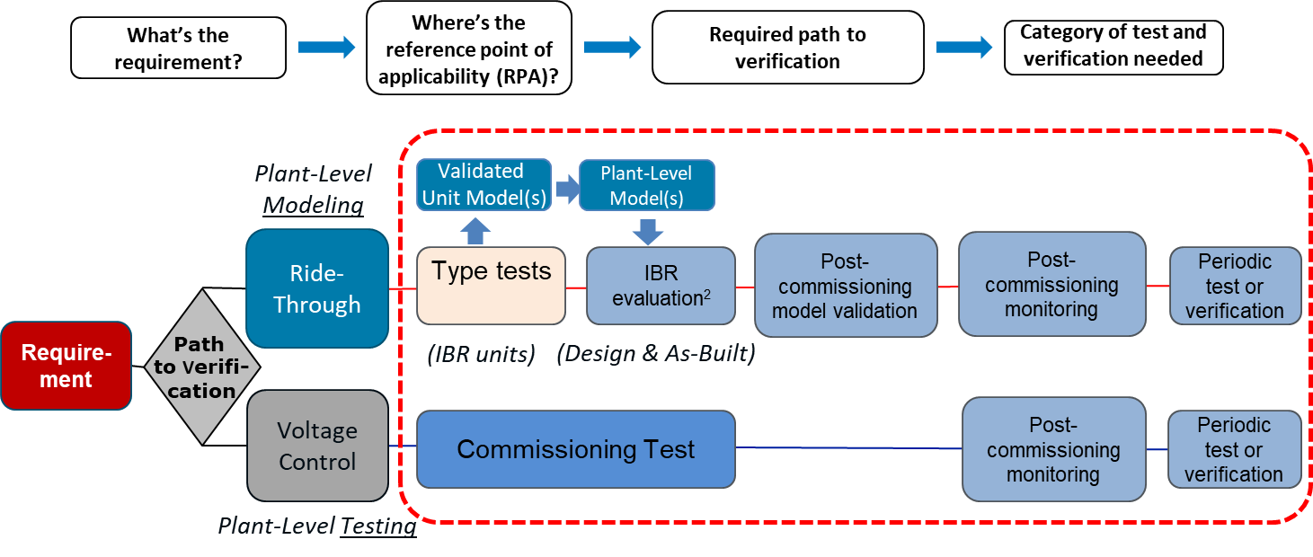
Test & Verification Framework

Slide 12
Equipment certification?
Almost all requirements in IEEE 2800 apply to the IBR plant (not the inverter/WTG)
The type tests in IEEE P2800.2 do not generally have pass/fail criteria.
Instead, they generate data (e.g. test waveforms) to validate the unit-level model.
Certification of inverters/WTGs by a Nationally Recognized Test Laboratory (NRTL, e.g. UL) is unlikely
Even “self-certification” of inverters/WTGs is not really possible because compliance is at the plant level
Therefore an “IEEE 2800 certified inverter/WTG” probably will not exist
Instead, inverters/WTGs could perhaps be considered “2800 compatible” if 2800 requirements have been taken into consideration so that they can be used to build a 2800-compliant plant.
This is different from the IEEE 1547/1547.1/UL 1741 paradigm on the distribution system, where pass/fail type tests and NRTL certification play a large role in conformity assessment

Slide 13
What is the required inverter/WTG capability for 2800 compliance?
There are many ways to comply
For example, an inverter could have limited reactive power capability, but still comply with 2800 if the plant designer includes appropriate supplement equipment
Even with ride through capability, the required inverter-level capability is not defined by 2800 because the voltage that each inverter sees is not the same as the voltage the plant sees (and the 2800 requirement is at the plant level)
Therefore an OEM and plant designer will need to work together to decide how to achieve plant-level compliance
This flexibility is intentional. 2800 does not want to tell anyone how to design a plant. It just specifies minimum performance capabilities for the plant. It is up to the plant designer to decide how to achieve them.

Slide 14
What can I do to prepare for 2800?
OEM
Review 2800 requirements. Does product need to be updated to be used in a 2800-compliant plant? May need to work with plant designer(s) to decide.
Develop, test, and clearly describe product capabilities that a plant designer can use to build a 2800-compliant plant.
Provide unit-level (EMT) model and type test data to verify model
Plant developer/EPC/consultant/owner
Review 2800 requirements. Collaborate with OEMs to identify product capabilities and balance-of-plant needed for plant-level compliance with 2800
Develop plant models that can be used to demonstrate conformance with 2800. Models should be based on OEM’s validated unit-level model.
Transmission utility/ISO
Work towards adoption of IEEE 2800. Determine specific requirements within range offered by 2800.
Determine compliance timeline
Keep in mind compliance is at plant level
All: Join IEEE P2800.2 working group. Help make sure verification procedures work for you.

Slide 15
Adoption of IEEE 2800:
Adoption of IEEE 2800 is not contingent upon publication/adoption of IEEE P2800.2
In absence of IEEE P2800.2, IBR owners, TS owners/operators, OEMs, etc. could develop their own test and verification procedures or use existing procedures
For systems experiencing IBR ride-through events/problems, some requirements may be higher priority than others (ride through of low voltage, TOV, ROCOF, phase jump)
Needs consideration of enforcement date, grandfathering etc.
Possible adoption methods:
Full adoption by simple reference
Full or partial adoption, clause-by-clause reference, additional requirements
Many utilities/ISOs are already moving towards adoption

Slide 16
IEEE 2800—ERCOT Adoption and Alternatives
ERCOT is adopting IEEE 2800-2022 using the “full specification” approach
Adoption of specific requirements from 2800-2022 using own language, for selected requirements
This could risk losing the stakeholder consensus reached on the precise language specified in IEEE 2800-2022
Transparency rules for ERCOT protocols would require the standard to be publicly available at no cost
However,… IEEE makes selected standards publicly available:
If FERC ruled in RM22-12 or RM22-14 with a reference to IEEE 2800-2022, the standard would be made public at no cost.
Note: The Electric Power Research Institute (EPRI) has gone on public record with this information in RM22-12 (link).
“Standards are available in recognition of their incorporation by reference in the U.S. Code of Federal Regulations (CFR)”
Standards in the Reading Room are available in "view only" format to anyone who registers with a free-of-charge IEEE account.
https://ieeexplore.ieee.org/browse/standards/reading-room/page

Slide 17
General Info on IEEE P2800.2
Target Dates:
WG approved draft by Q1 2024
IEEE SA Ballot: Q2, 2024 – Q1, 2025
Publication: Q1-Q2, 2025
Next WG Meeting:
Virtual meeting scheduled for April 25-27, 2023
Call for Participation:
Please consider joining the WG and SGs of your interest to help develop P2800.2

Slide 18
IEEE P2800.2 WG Structure/Leaders
Group | Vice Chair | Subgroup Chair(s)
Subgroup 2 – Type Tests | Steve Wurmlinger (Stephen.Wurmlinger@sma-america.com) | Pramod Ghimire Michael Ropp
Subgroup 3 – Design Evaluation | Jens Boemer (j.c.boemer@ieee.org) | Andrew Isaacs Alex Shattuck
Subgroup 4 – As-built Evaluation & Comm. Tests | Divya Kurthakoti (dkuch@orsted.com) | Chris Milan Dave Narang
SG 5 – Post-Comm Model Validation, Monitoring, Periodic Verification & Tests | Julia Matevosyan (Julia@esig.energy) | Jason McDowell Brad Marszalkowski
Power Quality Task Force |  | Eugen Starschich David Mueller
Chair | Andy Hoke (Andy.Hoke@nrel.gov)
Secretary | Manish Patel (mpatel@southernco.com)
Vice Chair | Bob Cummings
Vice Chair | Mahesh Morjaria
Lead SG1
and WG
Outreach
Activities
Most of the detailed work occurs in SGs and TF
Instructions to join mailing lists are on later slide
Contact SG leads after joining a SG listserv of interest
Lead SG & Coordinate
with other SGs
Facilitate SG calls

Slide 19
IEEE P2800.2 Subgroup Scopes
SG2
SG3
SG4
SG5
SG1 – Overall document and general requirements
Excerpt of 2800 Table 20: Verification Methods Matrix
PQ Task Force

Slide 20
Signup Instructions
Listservs:
Subgroup 1 (overall document): STDS-P2800-2-SG1
Subgroup 2 (type tests): STDS-P2800-2-SG2
Subgroup 3 (design evaluation): STDS-P2800-2-SG3
Subgroup 4 (commissioning and as-built): STDS-P2800-2-SG4
Subgroup 5 (post-commissioning): STDS-P2800-2-SG5
Power quality task force: STDS-P2800-2-PQTF
Overall P2800.1 listserv: P2800-2 (used to communicate meeting dates, agendas, etc.)
To Join a Listserv:
Send an email message to listserv@listserv.ieee.org
In first line of the email body, write: SUBSCRIBE <list name> <Your Name>
For example, “SUBSCRIBE STDS-P2800-2-SG1 Andy Hoke”

Slide 21
Contacts
P2800.2 WG
Andy Hoke, Andy.Hoke@nrel.gov
Manish Patel, mpatel@southernco.com
https://sagroups.ieee.org/2800-2/
https://standards.ieee.org/ieee/2800.2/10616/
IEEE 2800-2022 is available at:
https://standards.ieee.org/project/2800.html
https://ieeexplore.ieee.org/document/9762253/

