Slide 1
South Wind Event: March 10th, 2023
IBRTF Meeting
April 14th, 2023

Slide 2
South Wind Event Summary
On March 10, 2023, at 4:48 AM CDT, the high-side of a thermal Generator’s Main Power Transformer (MPT) in the West Valley area experienced a Phase-C to ground fault
One minute later, the high-side of another MPT at the same site experienced a Phase-C to ground fault
The event resulted in a loss of approximately 271 MW of IRR generation
All lost IRR generation was from Wind Generation Resources
The thermal site where the fault occurred was not generating at the time
System frequency dropped to 59.957 Hz and returned to 60 Hz within 37 seconds
Categorized as NERC Cat 1 event (unexpected outage, contrary to design, of three or more BES Facilities caused by a common disturbance)

Slide 3
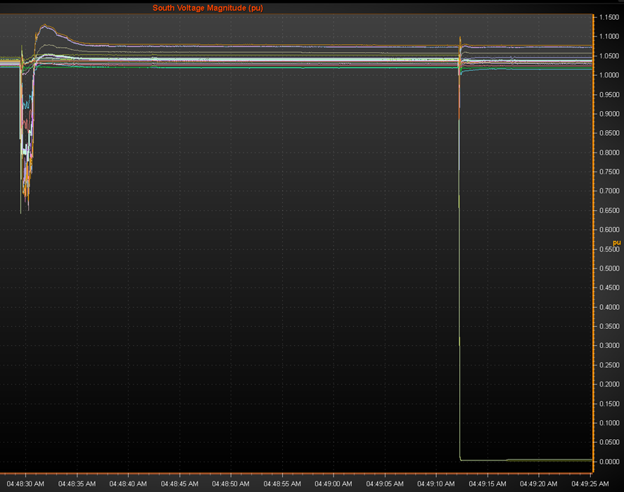
Real Time PMU Voltage
South Texas PMU recorded the lowest voltage of 0.64pu on a 345 kV line
Sub-synchronous oscillations observed in the Laredo area (due to the first fault isolating the circuit where the oscillations originated)
Contamination at the station was the cause of each fault
Both faults were cleared within approximately 3.5 cycles

Slide 4
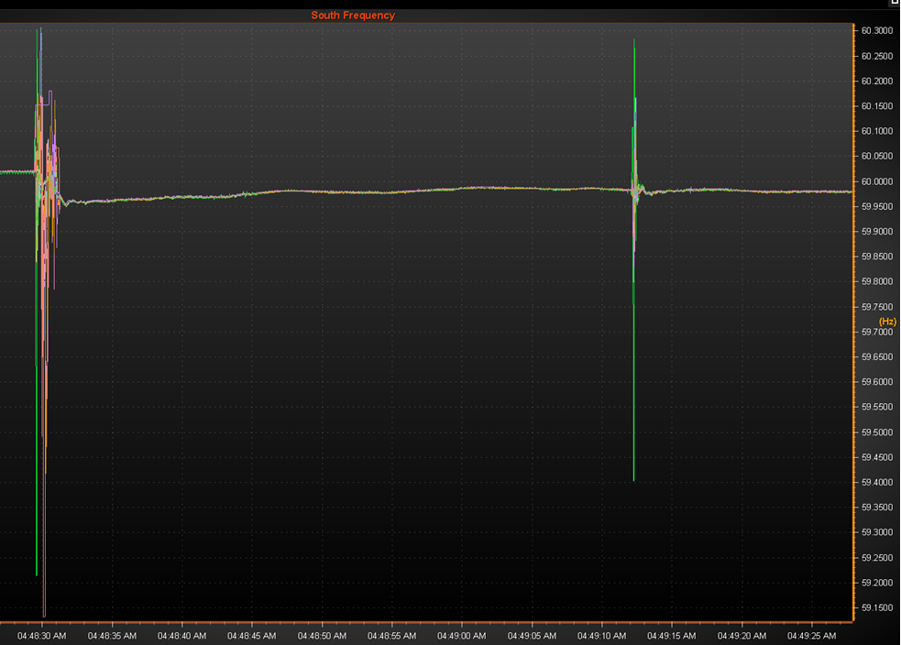
Real Time PMU Frequency
Single PMU near Laredo had lowest freq. of 59.13 Hz during fault/oscillation period
Oscillation occurred for approximately 1 second immediately following the fault clearing
System frequency never fell below 59.957 Hz

Slide 5
Event Progress
RFIs were sent out to 1 TDSP and the REs of 8 facilities (consisting of 12 units lost)
Does not include generation that came back within 2 sec of fault clearing
Responses have been received from 3 of the 8 facilities so far
Inconclusive information from RFI responses received thus far
Fault codes were included in RFI but also inconclusive
ERCOT will be following up with REs involved in event

Slide 6
Next Steps
Evaluation of RFI responses
Reasons for turbine trips/MW reduction
SSO protection and/or mitigation plans?
Evaluation of received PMU/DFR data
Possible follow-up calls with impacted Generators
NERC Brief Report
Due date is 4/28

Slide 7
Questions?

