Slide 1
ERCOT IBRTF: NERC and Other Industry Updates
Julia Matevosyan
Chief Engineer
ESIG
04/13/2023

Slide 2
Agenda
EPRI, Verifying Performance of Bulk Power System-Connected Solar, Wind, and Storage Plants
Proposed draft NYSRC’s PRR 151, wholesale adoption of IEEE2800-2022 (with exceptions)
NERC EMT Guideline and Task Force, Update
ESIG Spring Technical Workshop, Summary of Reliability Sessions
National Grid ESO Grid Forming Best Practice Guide

Slide 3
Verifying Performance of Bulk Power System-Connected Solar, Wind, and Storage Plants
Selected slides for Julia Matevosyan for presentation to ERCOT IBRTF on 4/14, 2023
Bulk System Integration of Renewables and Distributed Energy Resources & Transmission Planning
Jens Boemer, Aidan Tuohy, Anish Gaikwad, Jose Cordova
DER Integration
Aminul Huque, Tom Key
April 13, 2023 Classification: Public

Slide 4
Disclaimer and Copyright
These slides are provided by courtesy of Electric Power Research Institute (EPRI).
EPRI does not guarantee for the accuracy of the information provided and declines any liability associated with the use of the information.
The material provided is EPRI copyrighted. Any use of these slides should adequately attribute EPRI: © EPRI 2023
Please submit any comments or questions to Jens Boemer, jboemer@epri.com.
Thank you for collaborating with us!

Slide 5
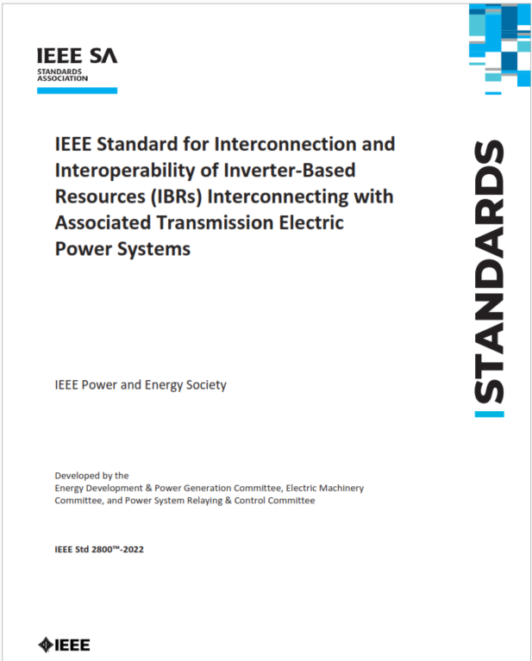
Verifying Performance of Bulk Power System-Connected Solar, Wind, and Storage Plants
40/173
16/3
MOD
Motivation
SPN #3002025832; ~18 months in 2023-2024
COORDIN.
174
Leading IEEE standards like 2800 and 1547 now firmly establish capability and performance requirements for large inverter-based resources (IBRs). But the testing and verification for the plant-level conformity remains a challenge.
Measurements
Simulations
Unit Lab Testing
Validated Models
Plant
Commissioning
Field Evaluations
Requirement |  | Conformity
Voltage Ride-Through (VRT) |  | Pass
Restore Output After Voltage Ride-Through |  | Pass
Dynamic Voltage Support / Current Injection during VRT | Balanced | Pass
 | Unbalanced | Fail
Plant Operations
As-built &
As-Configured
Deliverables & Contact
Training and review of leading IEEE interconnection standards like IEEE 2800-2022 and international practices for conformity assessment
Assess and determine improvements of participants’ technical interconnection requirements, processes, and impact study approaches
Recommend pre-commissioning conformity procedures like inverter type tests and plant-level design evaluation, with:
  IBR unit capabilities checklist for the shorter-term adoption of IEEE 2800
  Application of IBR unit and IBR plant models for the longer-term adoption per 2800.2
Recommend post-commissioning conformity procedures like plant as-built installation and settings evaluation, commissioning tests, performance monitoring, and model validation
Close coordination with the IEEE P2800.2 Working Group and associated Subgroups
Deliverables (* access immediately after execution of agreement)
[Webcasts] Training recordings and slide decks*
[Virtual Meetings] Monthly collaboration meetings*
[Decision Tools] (i) IEEE 2800 adoption user responsibilities and decisions spreadsheet*; (ii) mapping recent NERC and FERC guidance to IEEE 2800 (iii) generic technical interconnection requirements template; (iv) IEEE 2800/1547 applicability decision matrix
[Technical Update] Plant performance verification procedures report with (i) interim and (ii) recommended approach for IEEE P2800.2, including Responsibility Assignment (RACI) matrix
Contact
Jens C. Boemer, (206) 471-1180 | jboemer@epri.com
Aminul Huque, (865) 218-8051 | mhuque@epri.com
Balancing Interconnection Process Efficiency and Reliability
Notes:
5

Slide 6
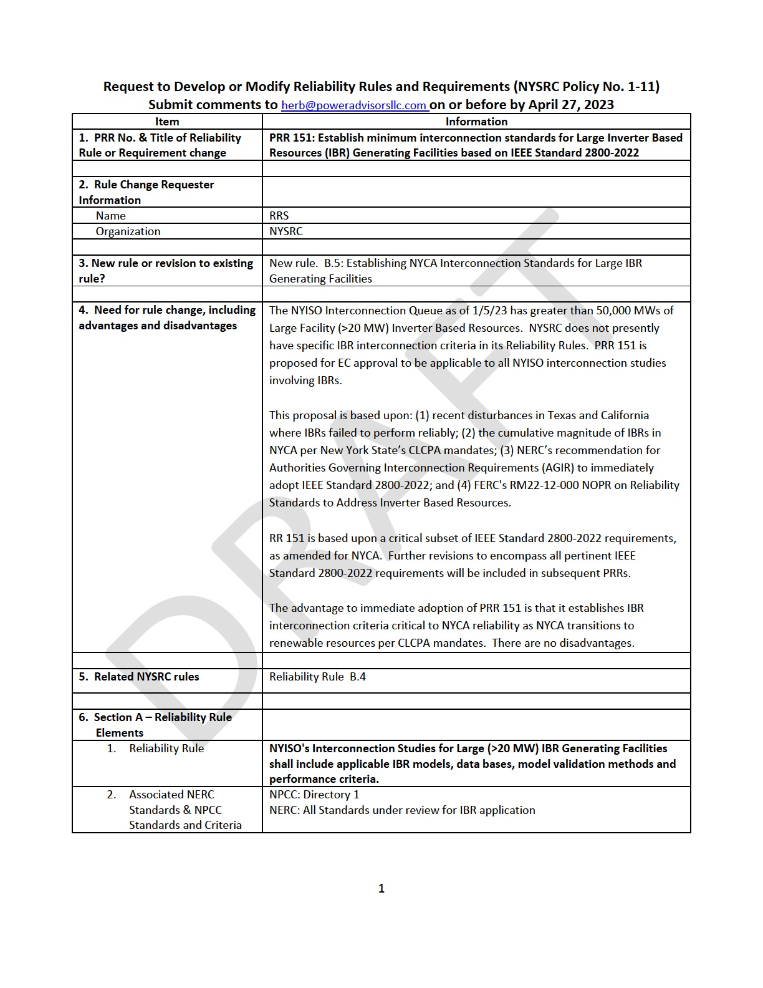
Review of NYSRC’s PRR 151 – AGIR-Driven Adoption
Draft rule posted for comment on March 13, 2023
New York State Reliability Council (NYSRC)’s mission is to promote and preserve the reliability of electric service on the New York State Power System
NYSRC develops, maintains, and, from time-to-time, updates the Reliability Rules which shall be complied with by the New York Independent System Operator (NYISO)
In the IEEE 2800 taxonomy, the NYSRC is equivalent to the Authority Governing Interconnection Requirements (AGIR)
Sept 2022
March 13, 2023
April 27, 2023
Implement within 6mo of approval?
Posting of draft rule for comment
NYSRC IEEE 2800-2022 Workshop
July 2022
Inverter Based Resource White Paper
April 2022
Publication of IEEE 2800-2022
Stakeholder and public comments due date
Latest after Class Year 2023 is completed
https://www.nysrc.org/PDF/Revisions/PRR%20151%203-12-2023.pdf

Slide 7
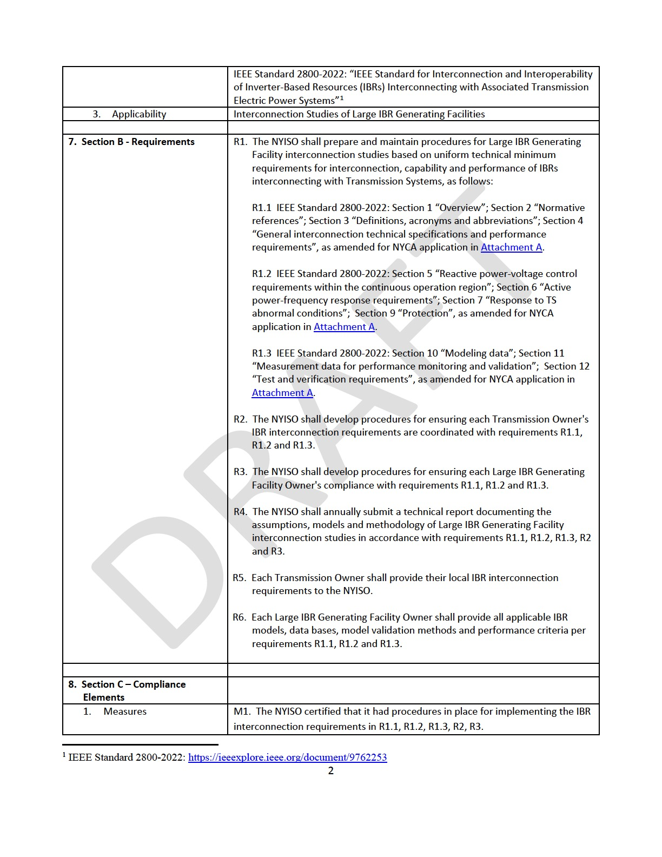
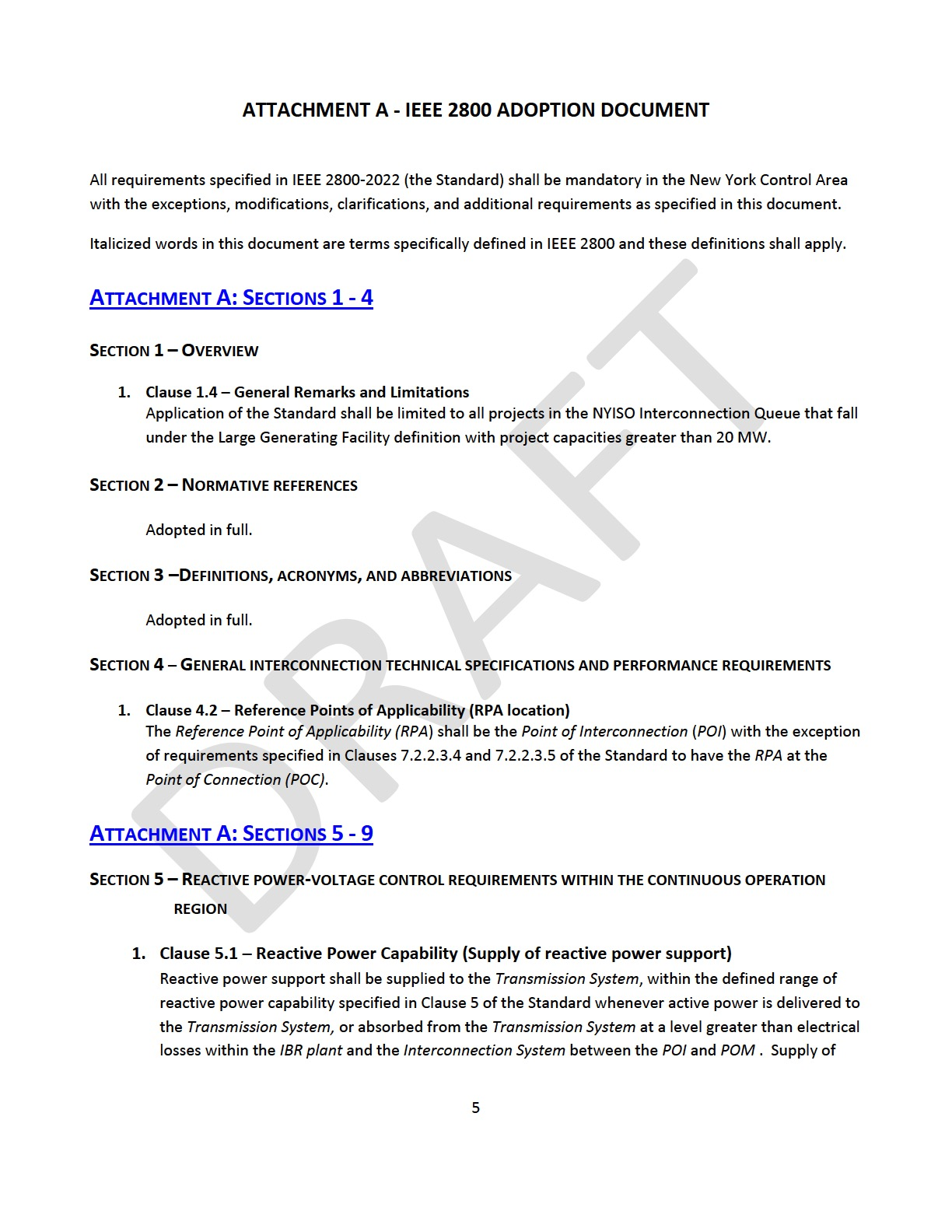
High-Level Review of NYSRC’s PRR 151
Succinct document of 10 pages
  4 pages (procedural) front matter
  6 pages (technical) appendix
Directive towards the NYISO, each Transmission Owner,
and each Large IBR Generating Facility Owner
  Streamline NYISO’s Interconnection Studies of Large IBR Generating Facilities greater than 20 MW (includes offshore wind!) based on uniform technical minimum requirements.
  Align Transmission Owners’ Interconnection Requirements (mostly) with IEEE 2800-2022.
  Verify Facility Owner’s Conformity with Requirements for interconnection, capability and performance of IBRs
  Specifies four Measures of Compliances and four Levels of Non-Compliance, considering compliance of each Responsible Party
Detailed Reference approach
  (Almost) full adoption of IEEE 2800-2022
  Excludes Clause 8 (Power Quality)
  Clause-by-clause references
  Some additional requirements/language ➔ Interc. Studies
https://www.nysrc.org/PDF/Revisions/PRR%20151%203-12-2023.pdf

Slide 8
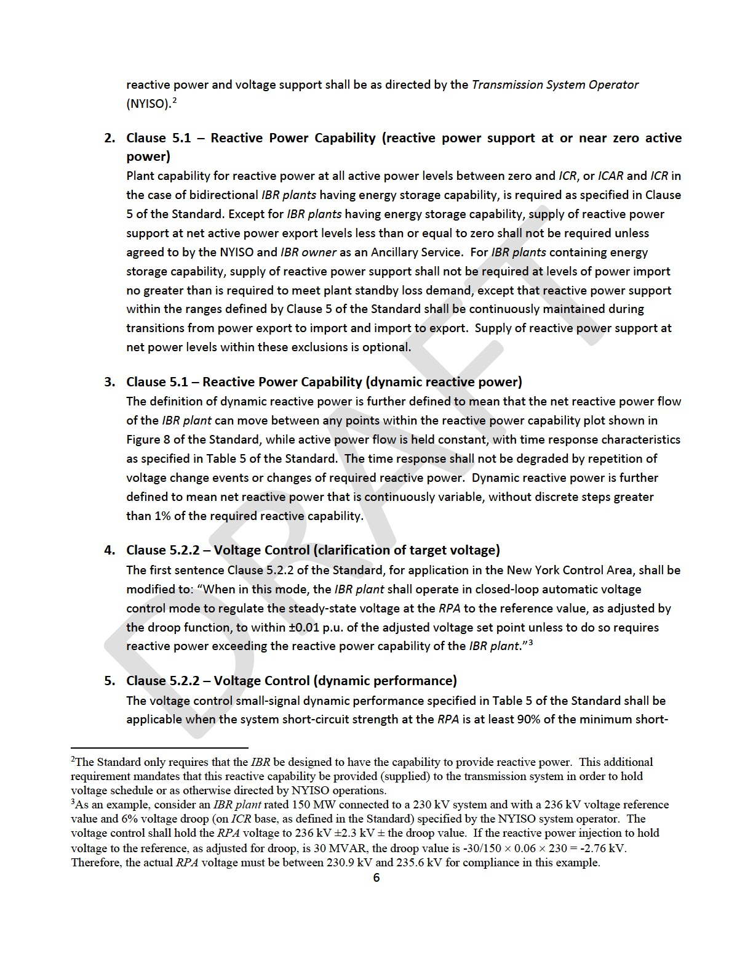
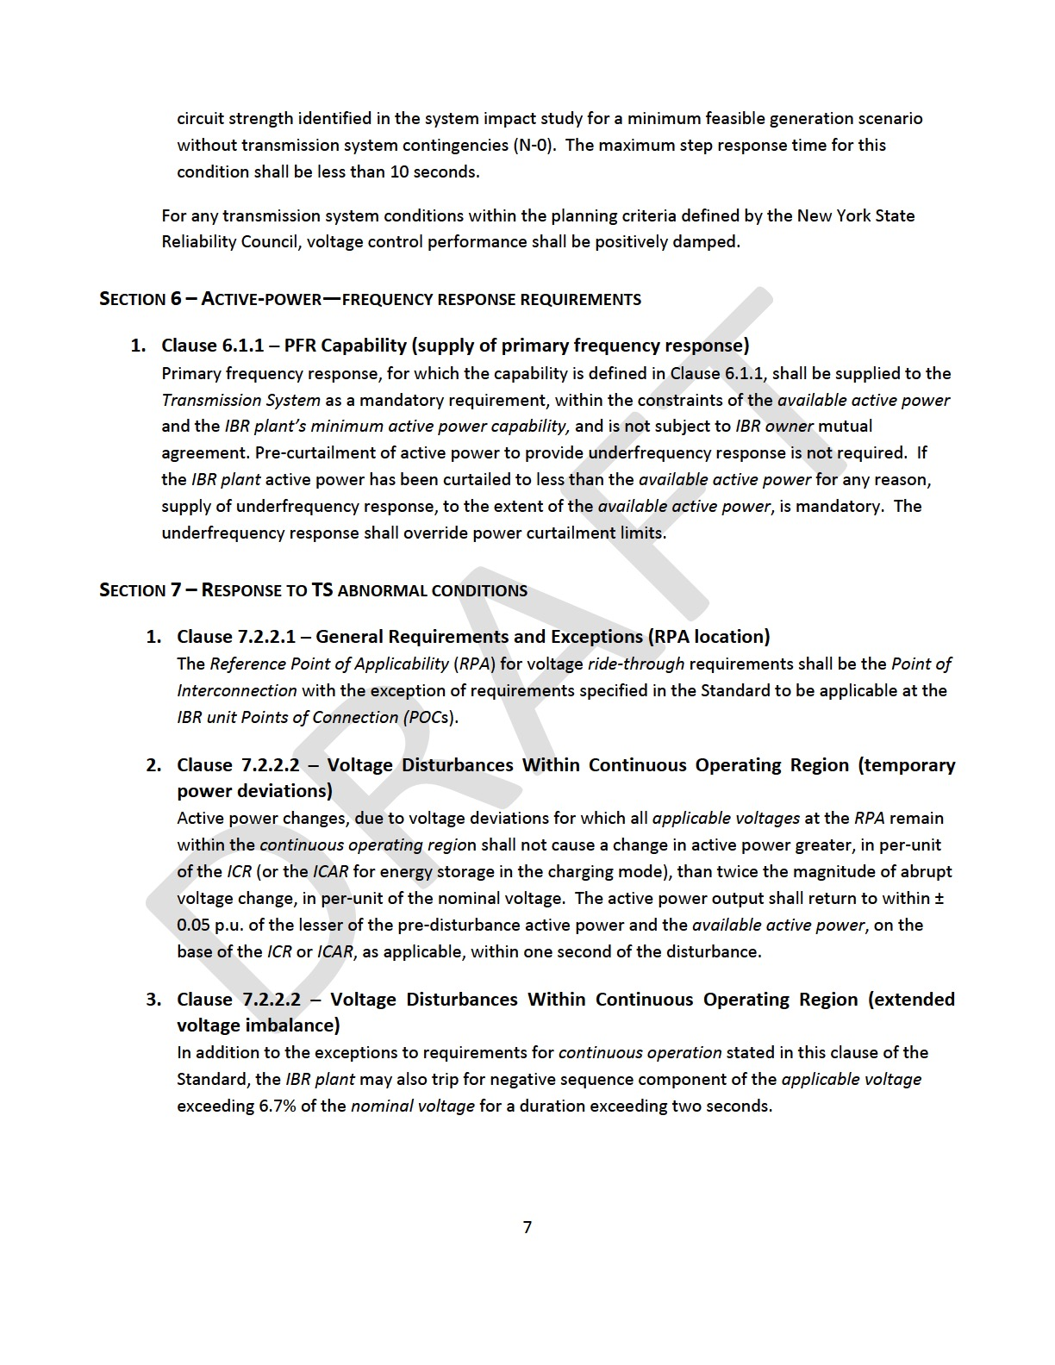
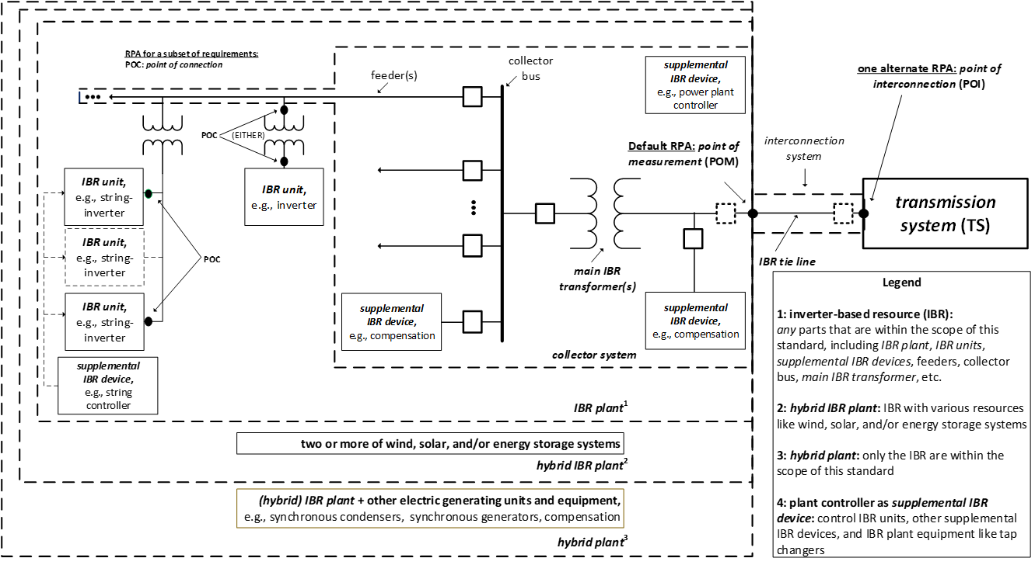
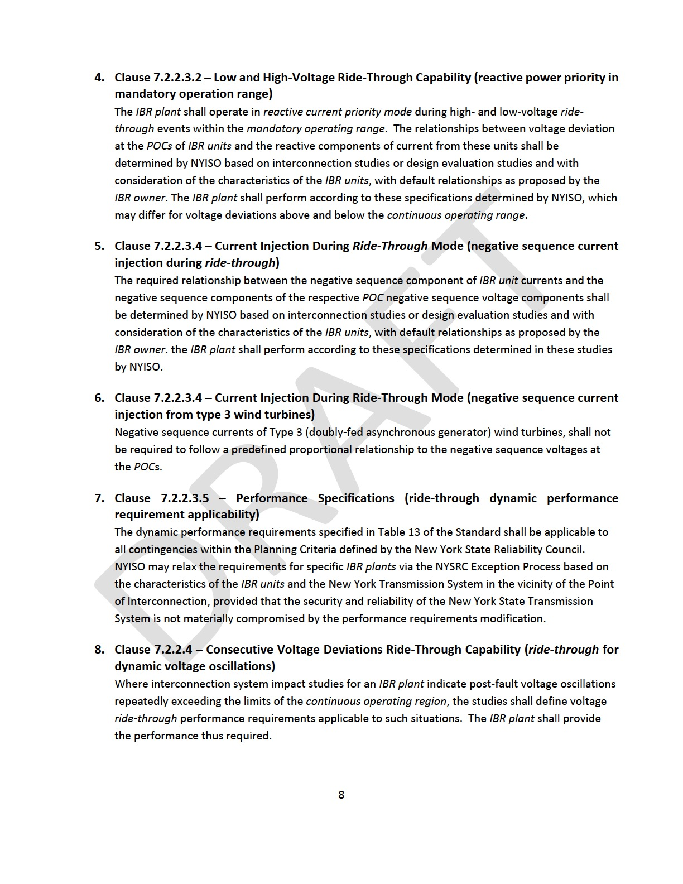
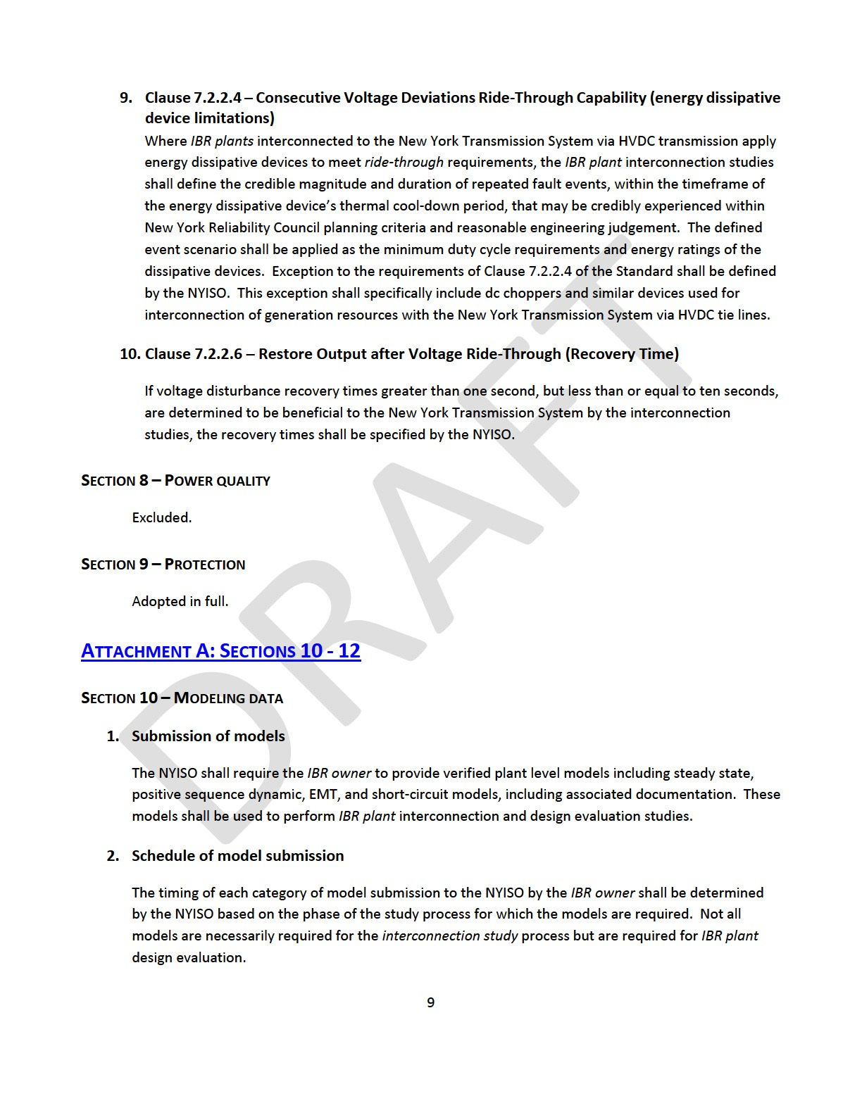
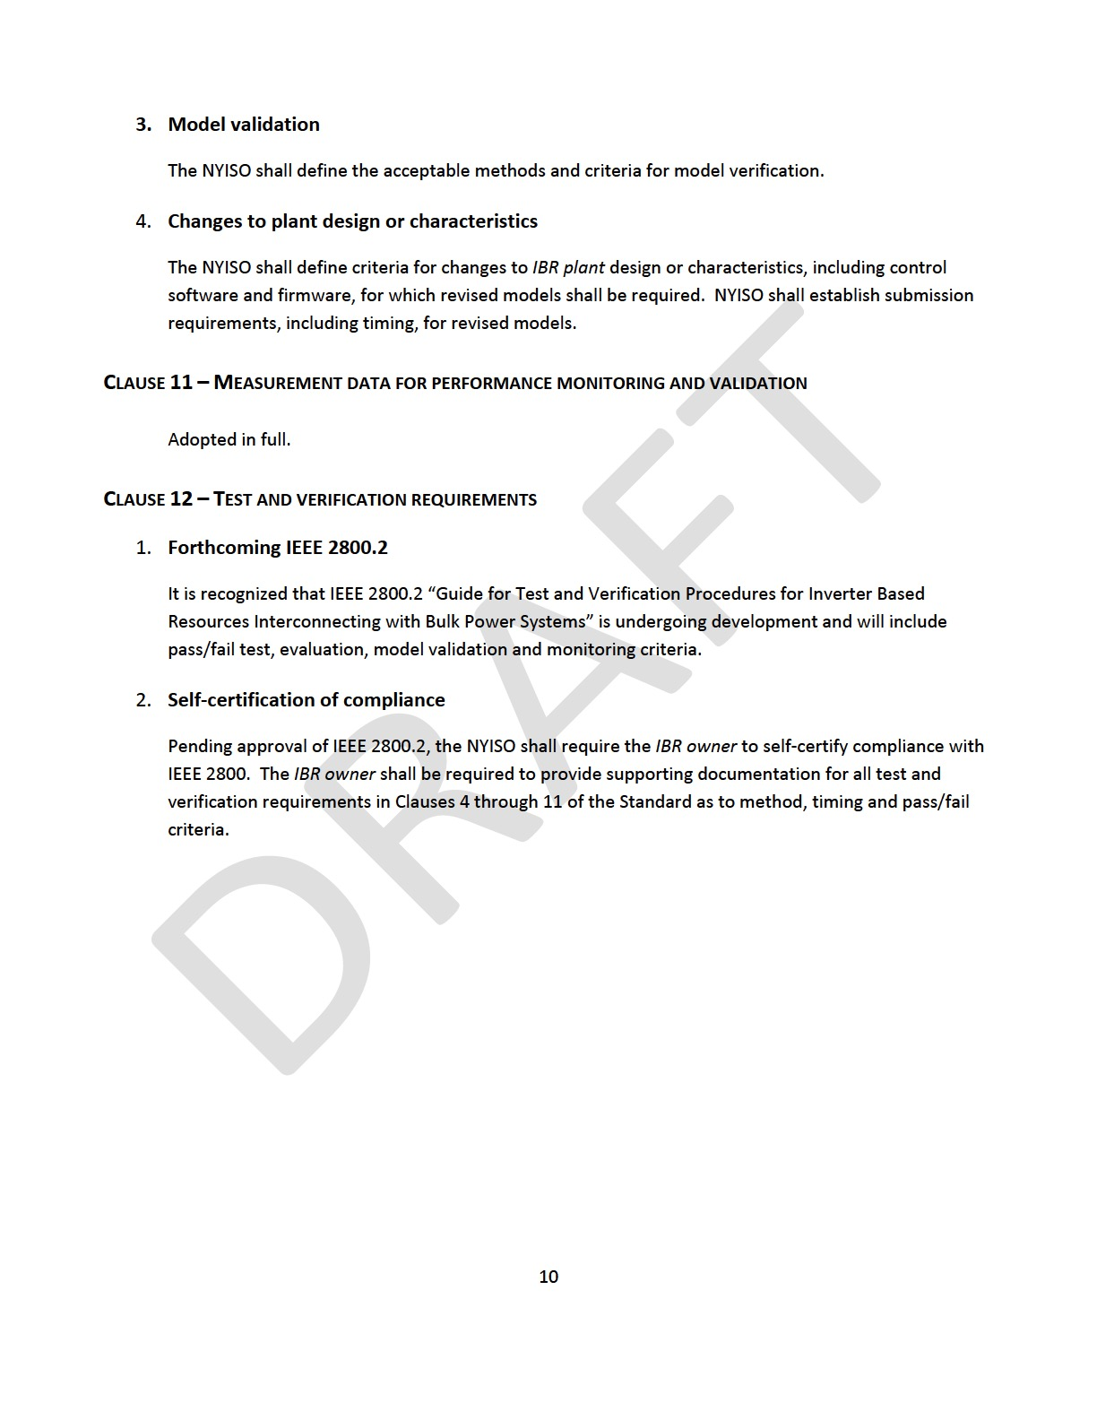
Noteworthy Observations on NYSRC’s PRR 151
(Technical) Appendix of NYSRC’s PRR 151
Reference Point of Applicability shall be the Point of Interconnection (POI) – except for Clauses 7.2.2.3.4 and 7.2.2.3.5
Additional Specs for
  Clause 5 (Reactive Power-Voltage Control)
  Clause 6 (Active Power-Frequency Response)
  Clause 7 (Response to TS Abnormal Conditions)
Modeling Data
  Directive to NYISO regarding submission of models, related schedule, model validation, and changes to plant design
Test and Verification Requirements
  Recognizes IEEE P2800.2 efforts and forthcoming IEEE document
  IBR owner to self-certify compliance with IEEE 2800
POM
POI
(NYSRC RPA)
POC
https://www.nysrc.org/PDF/Revisions/PRR%20151%203-12-2023.pdf

Slide 9
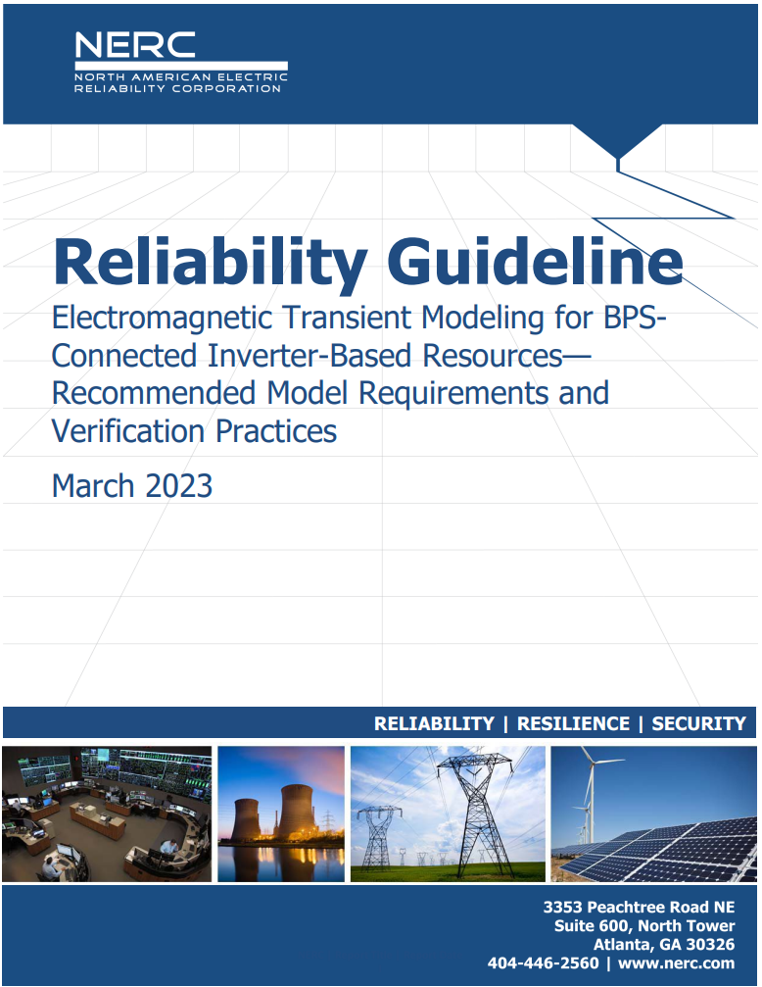
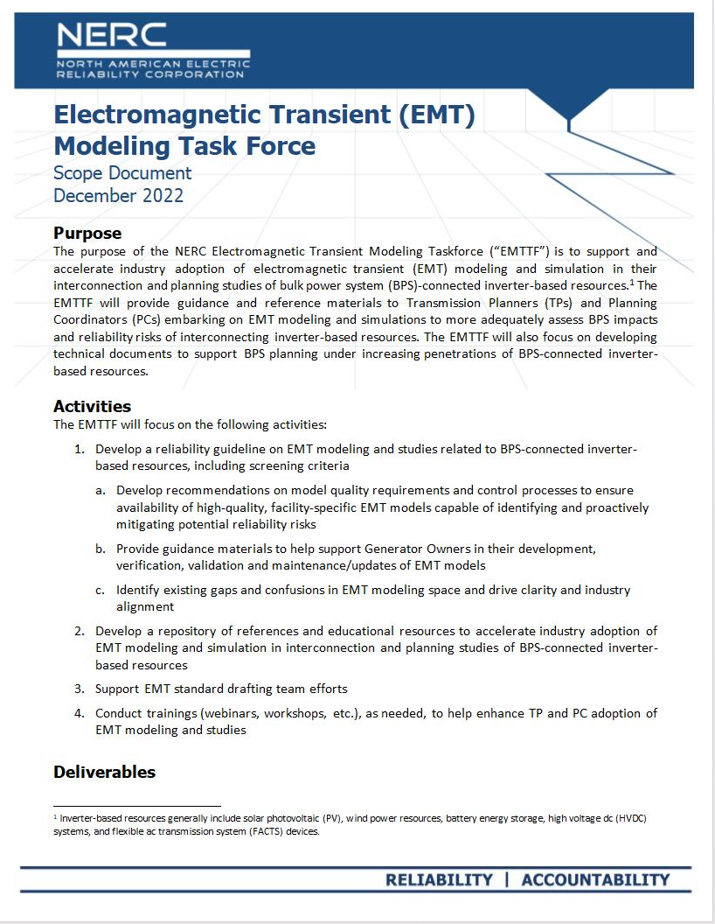
EMT Modeling Guideline, Vol.1 Approved by RSTC
Next Step: Vol. 2,EMT Studies
Scoping detailed EMT studies
Building EMT study models
Interconnection studies
Transmission planning studies
Material modification and model updates during interconnection study process and post COD
Modeling requirements
Model quality assessment
Screening for EMT study need
Assess VRT capability and performance
Resourcing for EMT studies
Different flavors of EMT models
Contact: Aung Thant Aung.Thant@nerc.net
https://www.nerc.com/comm/RSTC_Reliability_Guidelines/Reliability_Guideline-EMT_Modeling_and_Simulations.pdf

Slide 10

ESIG Spring Technical Workshop, March 27-30
Sessions of interest to ERCOT IBRTF:
GFM Requirements and Specifications
  ENTSO-E Requirements for Generators 2.0 Including GFM Specifications, Mario Ndreko, TenneT (Germany)
  GFM Batteries: A Unique Window of Opportunity, Julia Matevosyan, ESIG
  UNIFI GFM Performance Requirements Deepak Ramasubramanian, EPRI
  NG ESO GFM Specification Best Practice Application Guide, Nick Harvey, National Grid ESO (United Kingdom)
  AEMO Draft Grid Forming Specifications Nilesh Modi, Specialist, AEMO (Australia)
IBR Studies and Tools
  Dynamic Stability Screening Approaches for High IBR Systems, Matt Richwine, Telos Energy
  Analysis of 19.5 Hz Oscillation on Kaua’I Island System Jin Tan, NREL
  Dynamic Performance Optimization for 100% Inverter-based Power Systems: Experiences from Hawai’i Island, Ulrich Münz, Siemens
  New System Strength Metrics, Tim Green, Imperial College London (UK)
  NERC EMT Modeling Guide, Alex Shattuck, NERC
Presentations slides are here: https://www.esig.energy/event/2023-spring-technical-workshop/

Slide 11
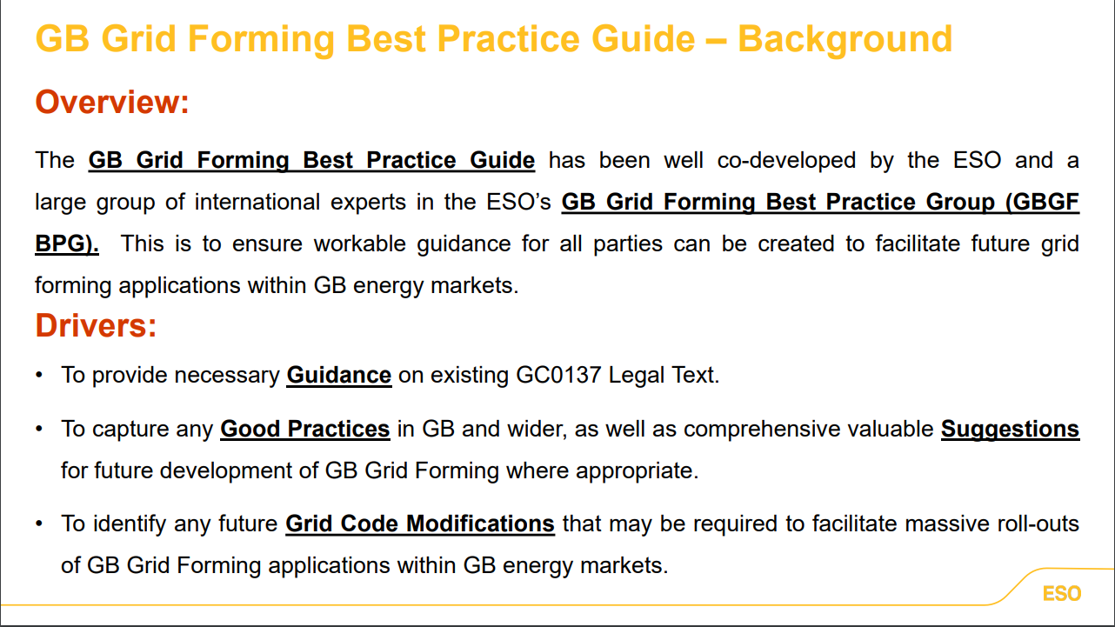
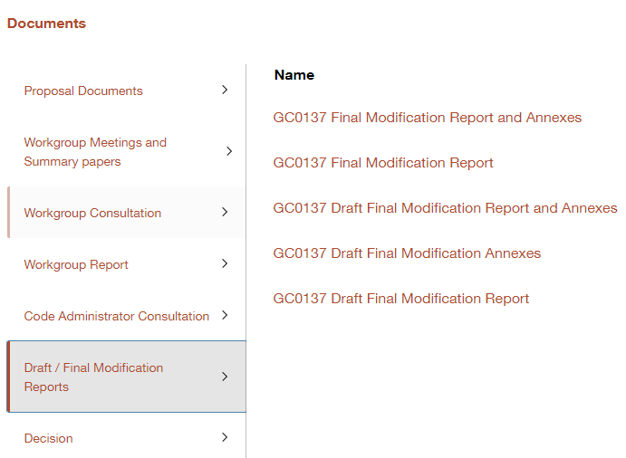
National Grid ESO, Grid Forming Best Practice Guide, Background
GC0137: Minimum Specification Required for Provision of GB Grid Forming (GBGF) Capability
(Go To the Documents and Final Modification Reports for final Legal Text)
Source: Nick Harvey, NGESO, ESIG Spring Technical Workshop 2023

Slide 12
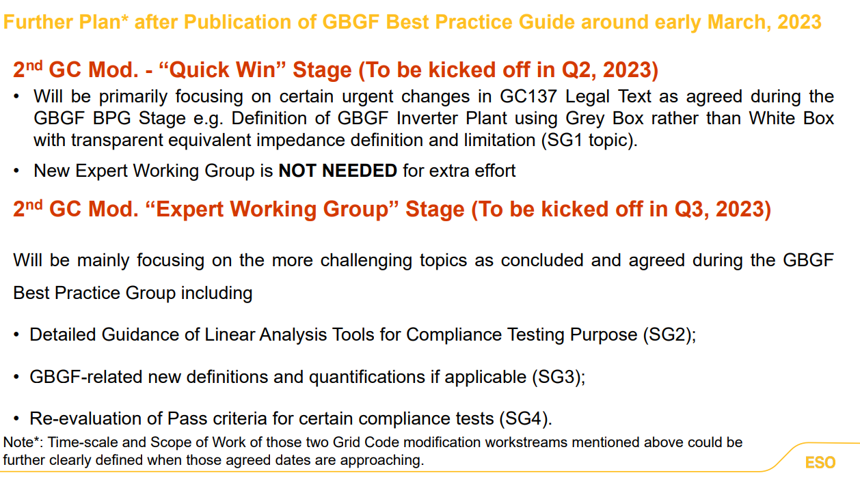

National Grid ESO, Grid Forming Best Practice Guide, Next Steps
https://www.nationalgrideso.com/document/278491/download
Source: Nick Harvey, NGESO, ESIG Spring Technical Workshop 2023

Slide 13
Julia Matevosyan
julia@esig.energy

