Slide 1
Monthly Review of Reliability Unit Commitment Market Impacts – March 2023
Wholesale Market Working Group
ERCOT Staff

Slide 2
RUC Resource-Hours
March 2023 | Total | Opt-Out | Non-Opt-Out
Instructed Resource-Hours
Total Count | 203.8 | 38.0 | 165.8
Effective Resource-Hours*
Total Count | 185.3 | 37.9 | 147.4
Average LSL | 80.3 | 94.6 | 76.6
Average LDL | 98.8 | 180.8 | 77.5
Average BP | 103.1 | 197.8 | 78.5
Average HSL | 296.2 | 304.1 | 294.2
* The difference between “Instructed” and “Effective” values is a result of Resources starting up, shutting down, receiving partial hour instructions, or otherwise not being dispatchable by SCED.

Slide 3
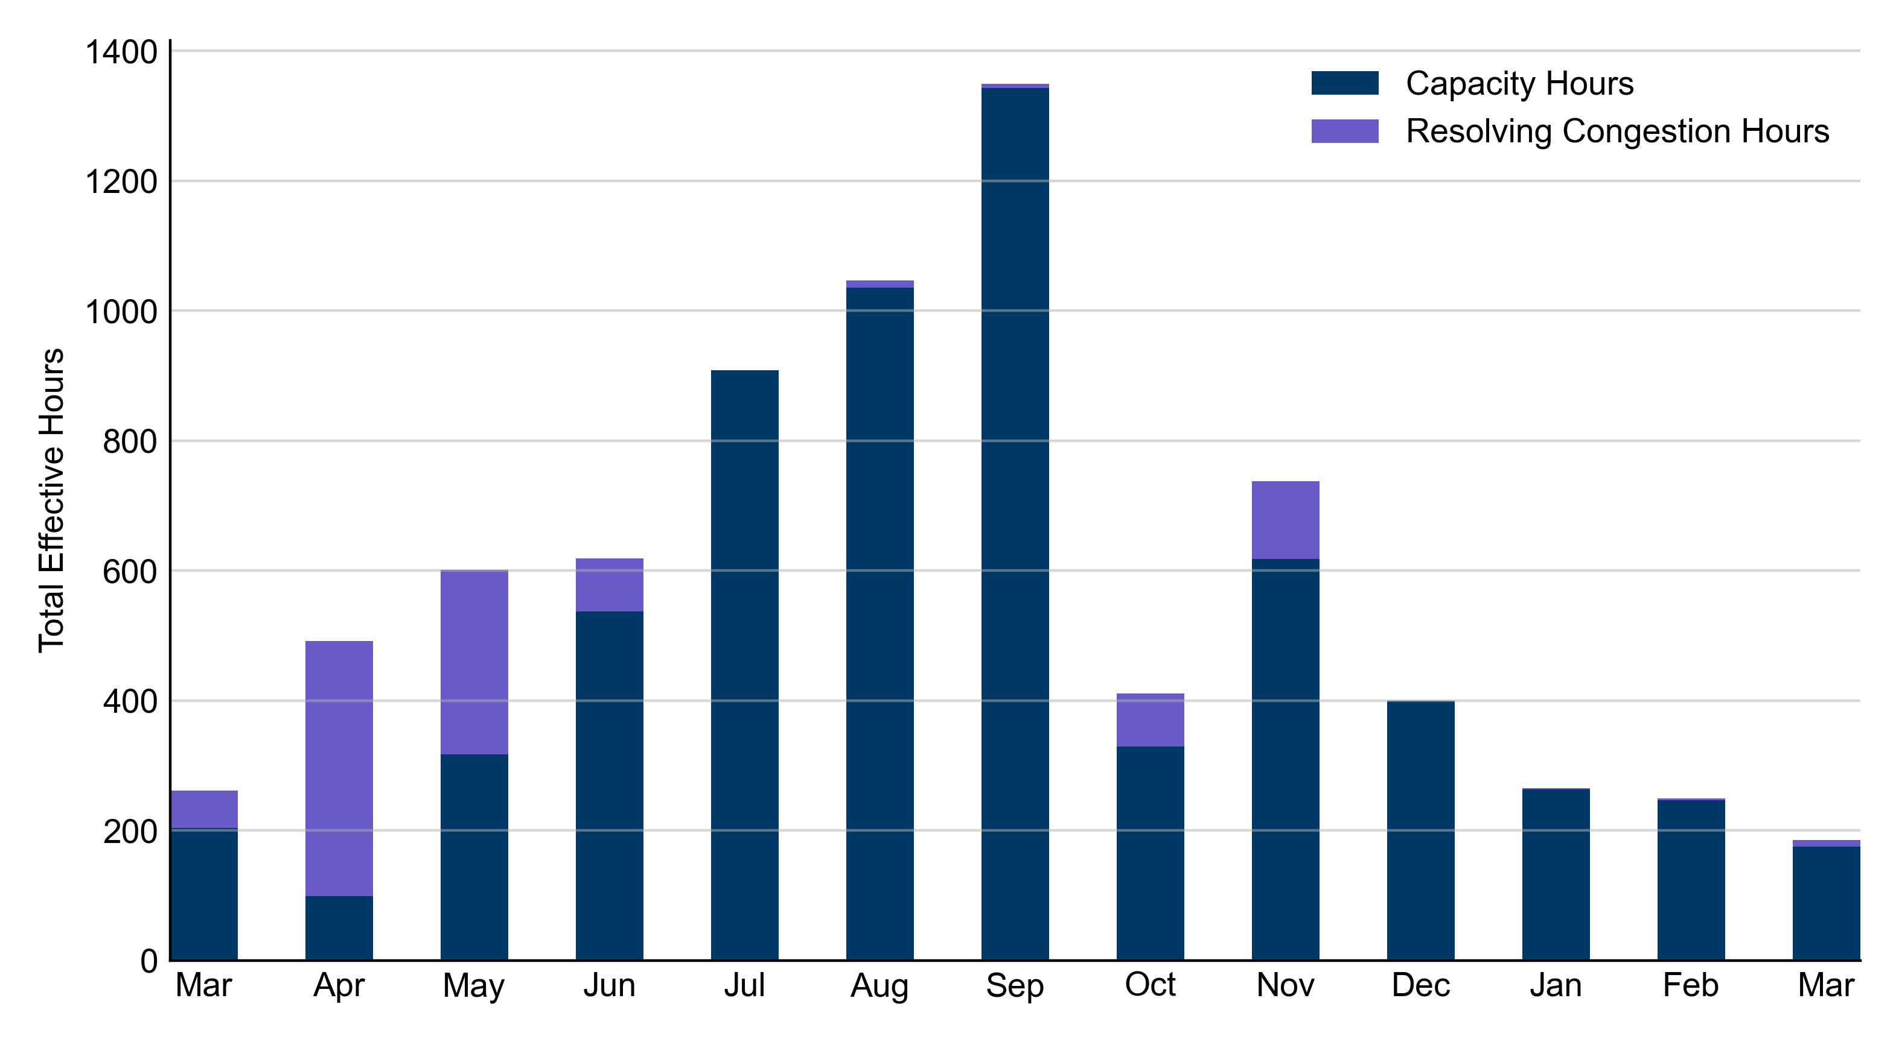
RUC Instruction Reasons: Last 13 Months RUCs in March 2023 were primarily driven by system-wide capacity concerns.

Slide 4
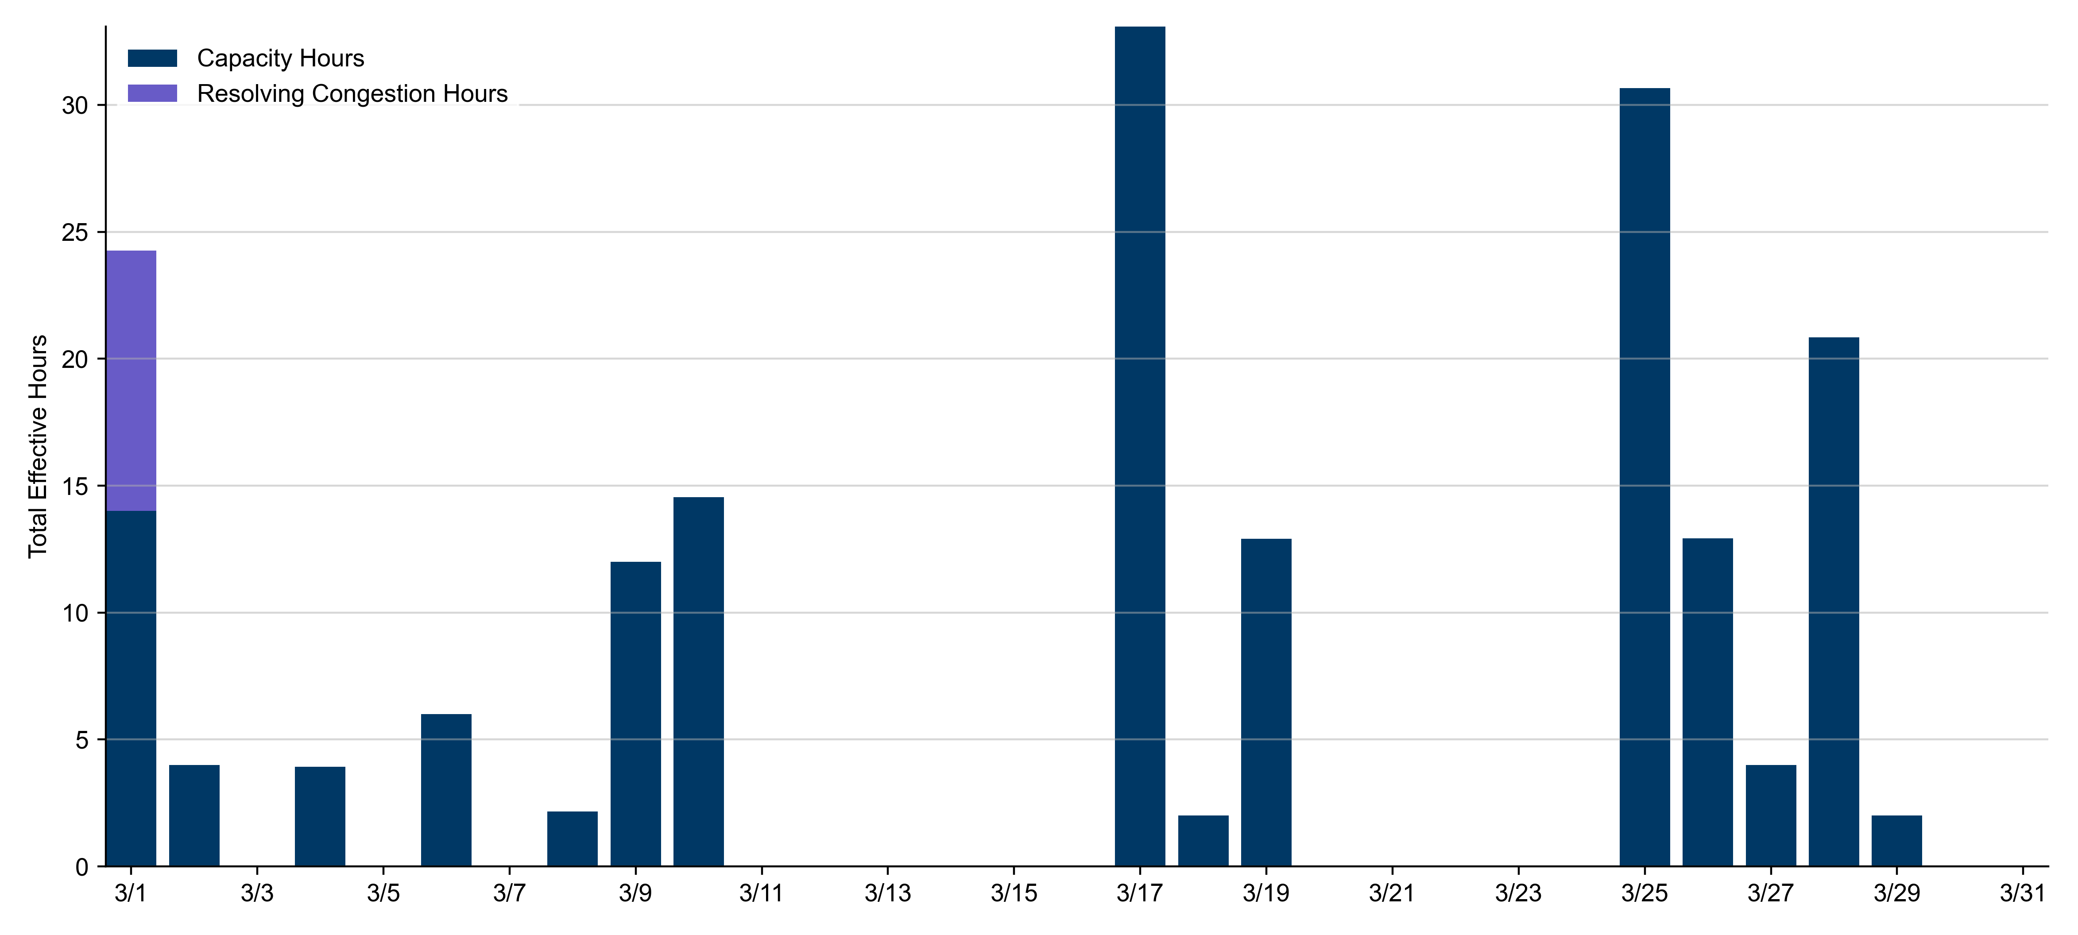
RUC Instruction Reasons
March 2023
185.3 effective RUC Resource-hours.
175.1 hours (94.47%) for capacity concerns.
10.2 hours (5.53%) for congestion concerns.

Slide 5
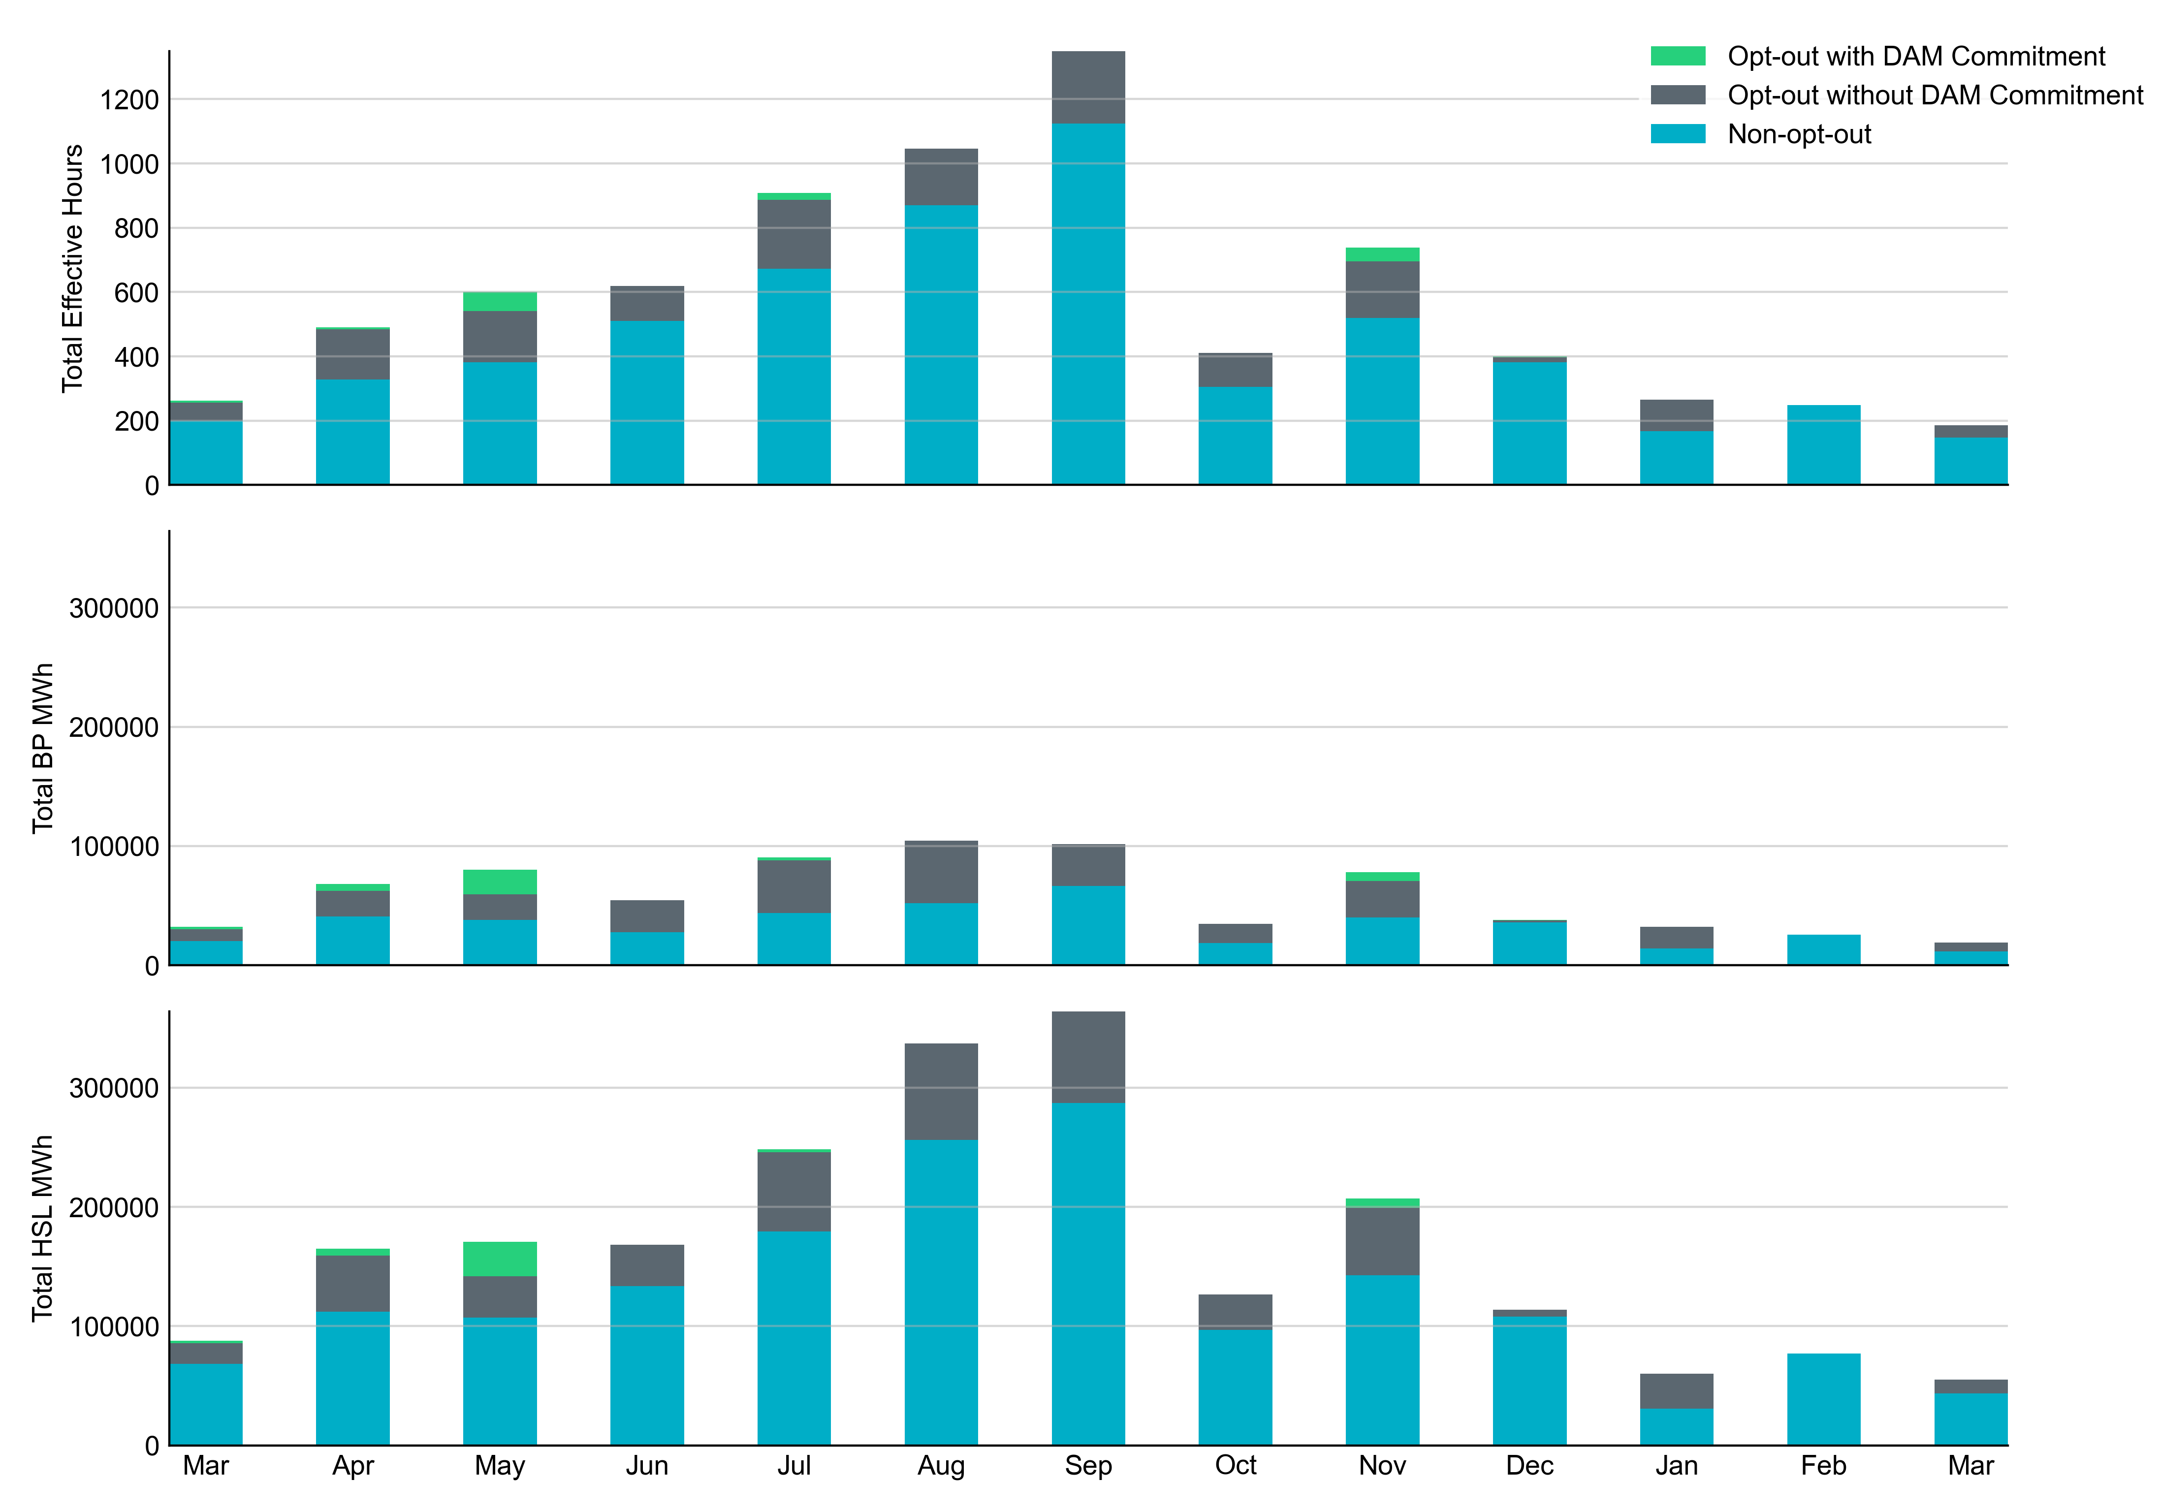
Non-opt-out and Opt-out Totals: Last 13 Months March 2023 had a total of 147.4 non-opt-out effective Resource-hours (79.53%) and 37.9 opt-out effective Resource-hours (20.47%).

Slide 6
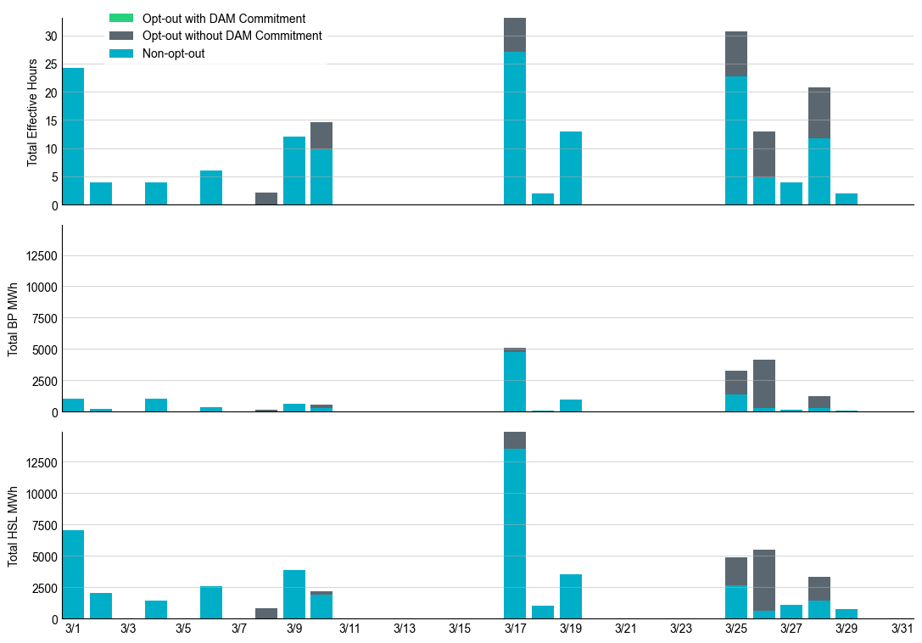
Non-opt-out and Opt-out Totals: March 2023

Slide 7
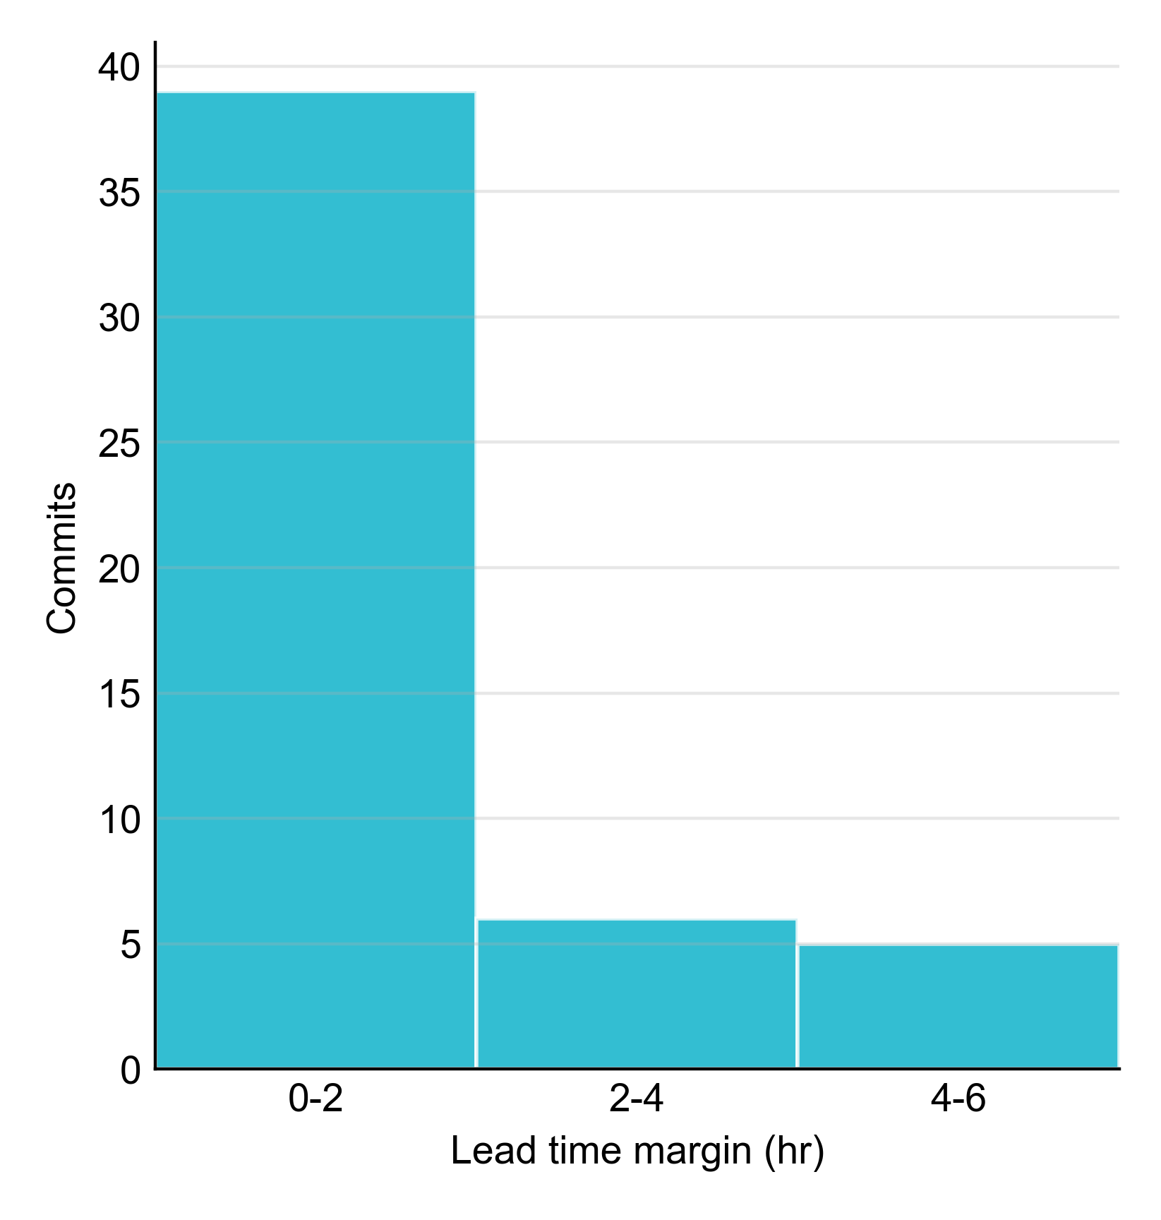
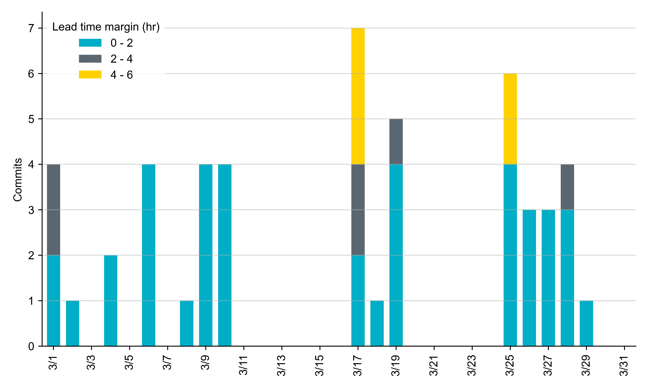
RUC Lead Time Margin: March 2023
Most RUC commit windows had lead time margin at or below 4 hours.
Lead time refers to the length of time between a RUC instruction and the start of the commitment window.
Lead time margin is the difference between lead time and the Resource’s startup time.
In cases where a Resource is committed for multiple back-to-back time blocks, lead time margin is calculated from the first instruction.
Notes:
The first bin is both-inclusive (i.e. [0, 2] ), while subsequent bins are left-inclusive (i.e. [2, 3), [3, 4), etc.).

Slide 8
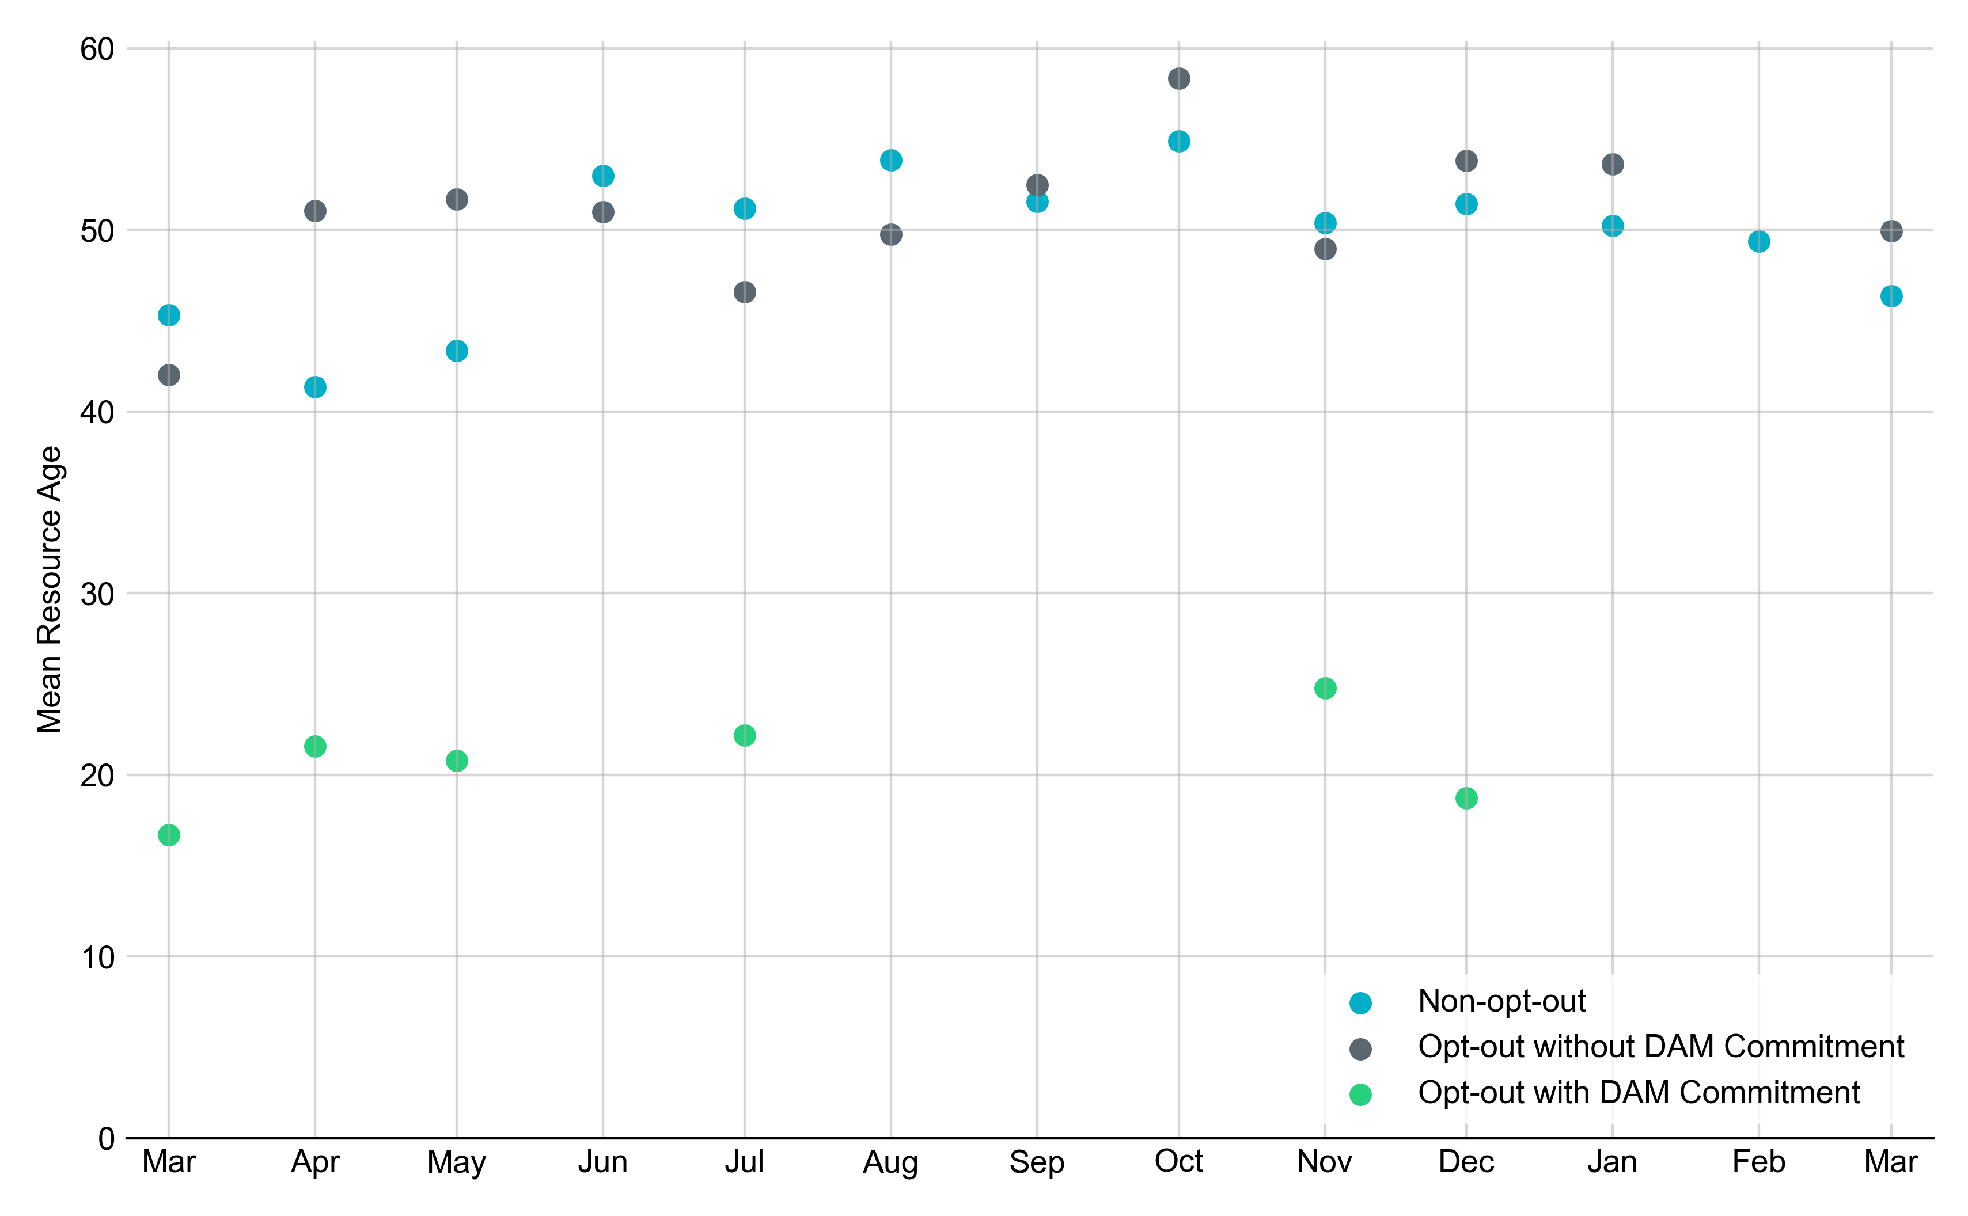
Average Resource Age In March 2023, the mean age of RUC-committed Resources was 46.4 years for Non-Opt-Out Resource-hours and 49.9 years for Opt-Out Resource-hours.
Note: For Resource configurations with multiple physical generators, the age of the oldest generator is used.

Slide 9
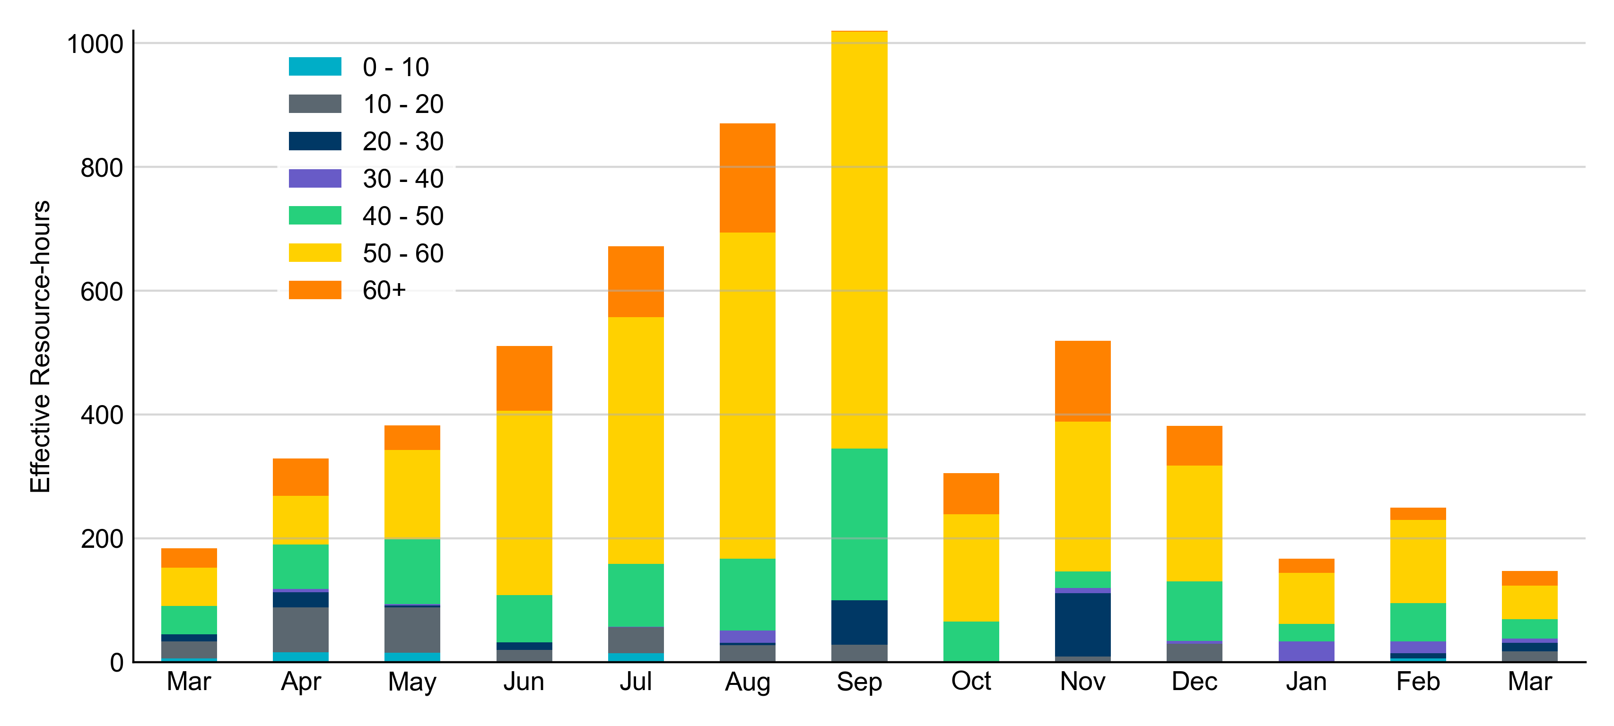
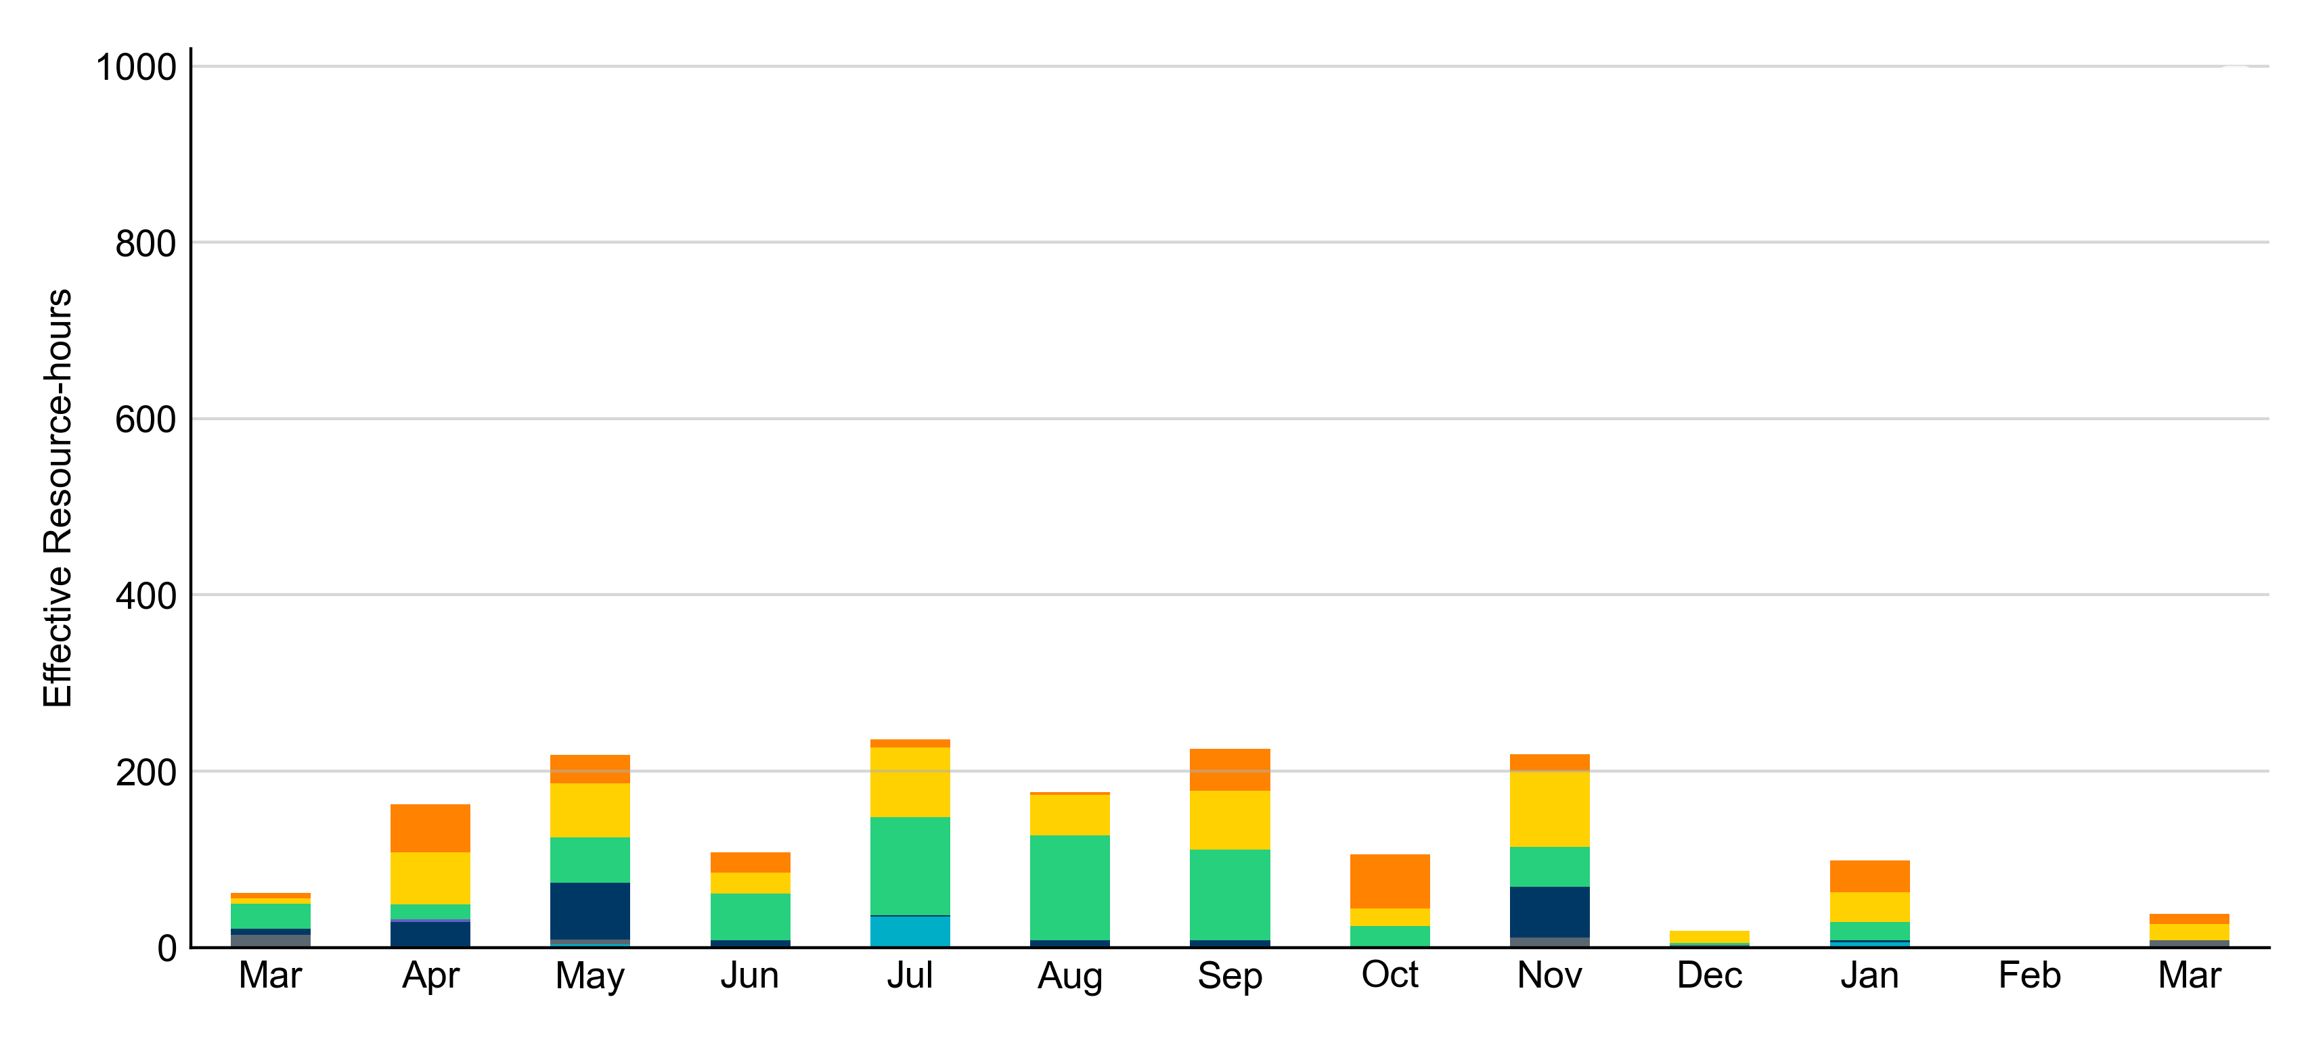
Age Category Most RUC-Committed Resources in March 2023 were older than 40 years.
Non-opt-out
Opt-out

Slide 10
RUC-Instructed Resource Dispatch above LDL
March 2023
When Resources did not successfully opt out, there were 8.8 effective Resource-hours for which the Resource was dispatched above its LDL.
For 4.0 of these Resource-hours, the LMP for the RUC-instructed Resource was above the RUC offer floor.
For 4.8 of these Resource-hours, the LMP for the RUC-instructed Resource was below the RUC offer floor.
For all these Resource-hours, the RUC-instructed Resource was mitigated.
There were no Exceptional Fuel Cost submissions for any RUC-Committed Resources in March 2023.

Slide 11
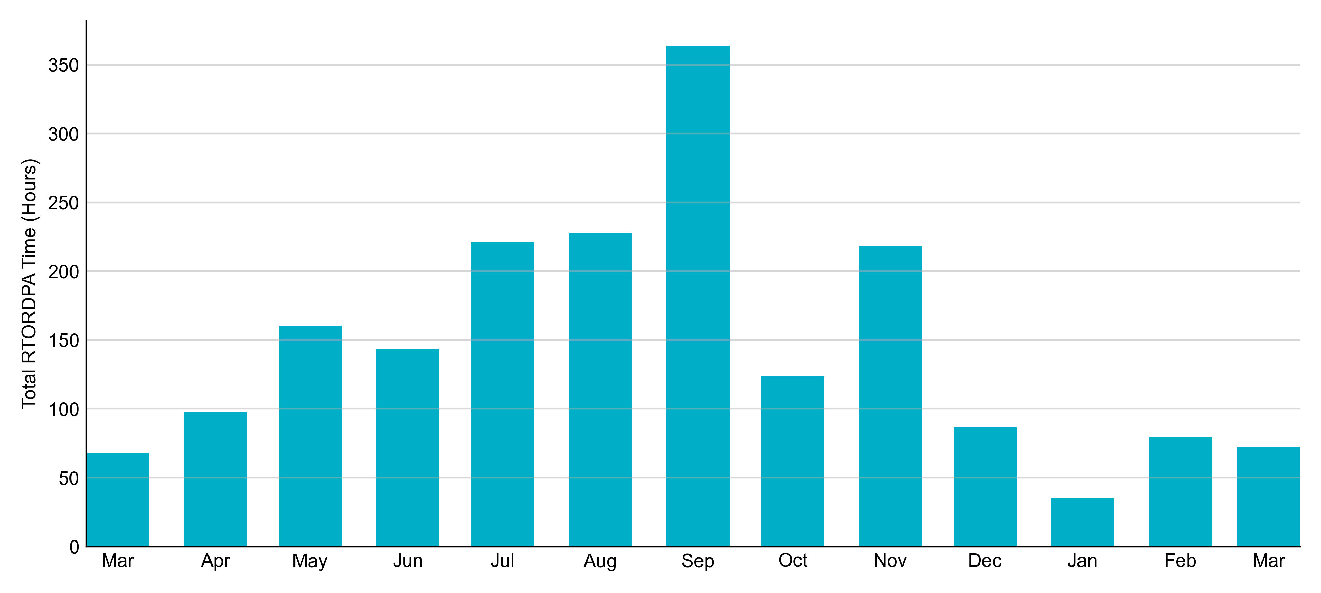
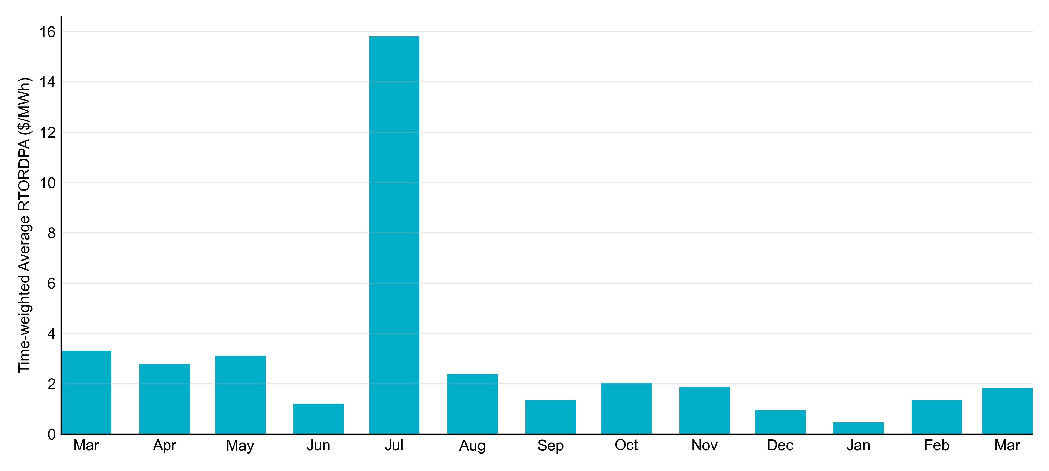
Reliability Deployment Price Adder: Last 13 Months March 2023 had a total of 72.15 RTORDPA hours with an average value of $1.84/MWh.

Slide 12
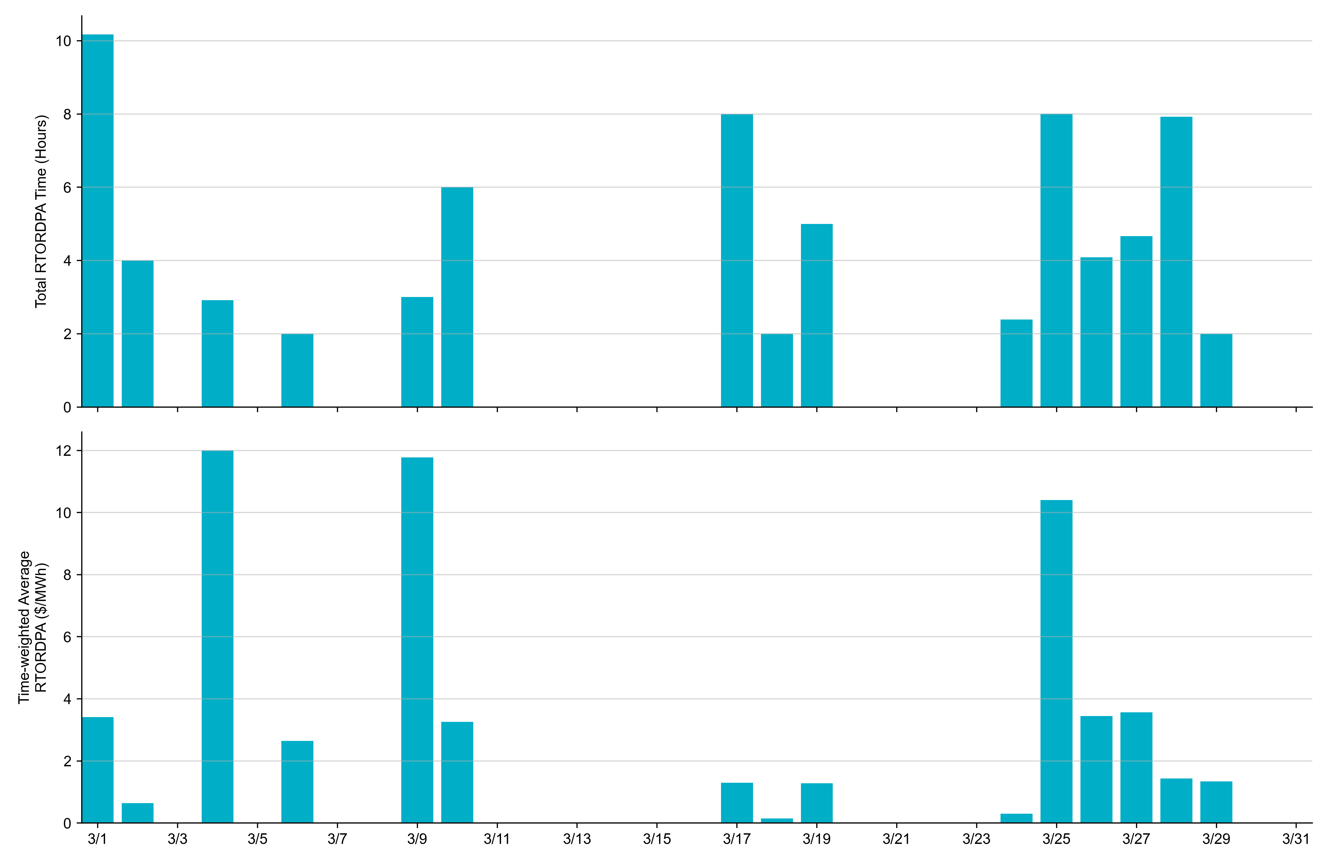
Reliability Deployment Price Adder: March 2023 OD 3/4 had the highest daily time-weighted average RTORDPA: $12.00/MWh.

Slide 13
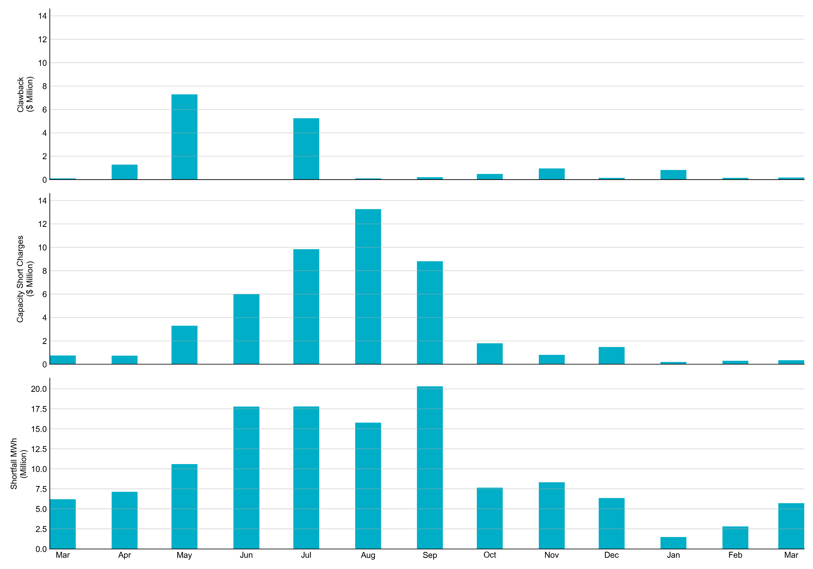
RUC Clawback, Capacity Short Charges, and Shortfall For March 2023, the total Clawback charge was $0.2M. The total Make-Whole payment was $0.3M, which was almost entirely covered through capacity-short charges.
In March 2023, $0.343M in Make-Whole was paid out. There was a total amount of $0.14 uplifted to load this month due to rounding.
Data as of April 7th, 2023

Slide 14
RUC Make-Whole by Settlement Type
Month | Initial Settlement ($) | Final Settlement Change ($) | True-up Settlement Change ($) | Net as of March 7, 2023 ($)
Mar '22 | -636,118 | 0 | -113,323 | -749,442
Apr '22 | -742,010 | 0 | 0 | -742,010
May '22 | -1,366,293 | 658 | -1,936,192 | -3,301,827
Jun '22 | -1,474,085 | 0 | -4,540,116 | -6,014,201
Jul '22 | -1,282,874 | 0 | -8,558,242 | -9,841,116
Aug '22 | -3,464,254 | 0 | -9,809,538 | -13,273,792
Sep '22 | -4,666,217 | 0 | -4,139,983 | -8,806,200
Oct '22 | -851,291 | -37,747 | - | -8,89,038
Nov '22 | -809,352 | 0 | - | -8,09,352
Dec '22 | -1,479,207 | 0 | - | -1,479,207
Jan '23 | -141,639 | -59,381 | - | -201,020
Feb ‘23 | -295,131 | - | - | -295,131
Mar ‘23 | -343,491 | - | - | -343,491
Negative dollars represent a payment from ERCOT to a market participant
“-” indicates settlement has yet to be completed.

Slide 15
RUC Clawback by Settlement Type
Month | Initial Settlement ($) | Final Settlement Change ($) | True-up Settlement Change ($) | Net as of March 7, 2023 ($)
Mar '22 | 244,125 | 0 | -142,617 | 101,508
Apr '22 | 1,284,735 | 0 | 0 | 1,284,735
May '22 | 8,167,123 | 19,018 | -892,817 | 7,293,324
Jun '22 | 12,379 | 0 | 0 | 12,379
Jul '22 | 6,500,951 | 0 | -1,255,520 | 5,245,432
Aug '22 | 985,985 | 0 | -876,395 | 109,590
Sep '22 | 364,507 | 0 | -156,692 | 207,814
Oct '22 | 544,601 | -16,449 | - | 528,152
Nov '22 | 951,568 | 0 | - | 951,568
Dec '22 | 148,277 | 0 | - | 148,277
Jan '23 | 835,738 | -6,526 | - | 829,212
Feb ‘23 | 158,319 | - | - | 158,319
Mar ‘23 | 179,783 | - | - | 179,783
Negative dollars represent a payment from ERCOT to a market participant
“-” indicates settlement has yet to be completed.

