Slide 1
Discussion on Enhancement of the Operating Reserve Demand Curve (ORDC): TAC-Requested ORDC Analysis
David Maggio
Sr. Director, Market Design & Analytics
Special Technical Advisory Committee (TAC) Meeting
April 10, 2023
ERCOT Public

Slide 2
Recap
Following the March 31, 2023, special TAC meeting, TAC requested additional back-cast analysis on potential modifications to ORDC that would yield similar annual revenues (~$500M) to ERCOT’s recommended bridging option* for 2022, specifically:
Retaining the proposed $10/MWh Real-Time On-Line Reserve Price Adder (RTORPA) floor with On-Line ORDC reserves (RTOLCAP) at or below 7,000 MW and deriving an additional RTORPA floor to apply when RTOLCAP is at or below 4,000 MW that generates a similar additional revenue outcome (~$500M for 2022).
Removing all proposed floors and instead determining a level of Value-of-Lost-Load (VOLL) decoupled from the System-Wide Offer Cap (SWCAP) that yields a similar additional revenue outcome (~$500M for 2022).
The following slides highlight these selected options as well as additional analysis that was requested.
*Multi-step RTORPA floor: 6500MW @ $20/MWh & 7000MW @ $10MWh

Slide 3
Cases Considered
ERCOT-preferred ORDC enhancement
Step 1: $20/MWh RTORPA at 6.5 GW RTOLCAP and below.
Step 2: $10/MWh at 7 GW RTOLCAP and below.
TAC Option 1
Step 1: Derived floor at 4 GW RTOLCAP.
Step 1 floor determined by targeting incremental revenue of ~ $500M for 2022 back-cast.
Step 2: $10/MWh at 7 GW RTOLCAP.
TAC Option 2
Raise VOLL until additional revenue due to the RTORPA adjustment reaches ~$500M for 2022 back-cast.

Slide 4
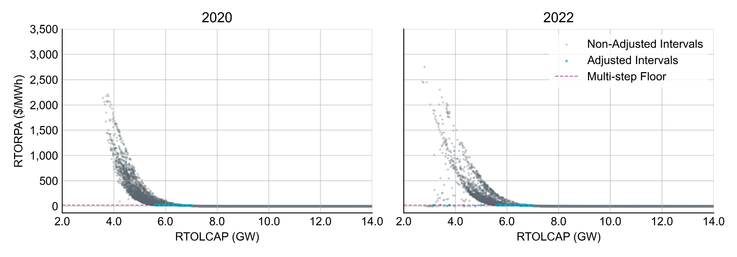
ERCOT-Preferred Option Analysis
Adjusted Interval Summary | Step 1: $20/MWh floor at 6.5 GW |  | Step 2: $10/MWh floor at 7 GW |  | Combined
Year | 2020 | 2022 | 2020 | 2022 | 2020 | 2022
Count | 5,381 | 4,398 | 4,241 | 4,048 | 9,622 | 8,446
Avg. RTORPA increase ($/MWh) | 13.71 | 14.45 | 9.37 | 9.43 | 11.80 | 12.04
Total energy dispatched (GWh) | 21.1 | 19.2 | 16.6 | 17.5 | 37.7 | 36.7
Energy rev. increase ($M) | 287.6 | 274.4 | 154.9 | 163.8 | 442.4 | 438.2
Headroom rev. increase ($M) | 37.1 | 31.8 | 21.9 | 21.0 | 59.0 | 52.8
Total rev. increase ($M) | 324.7 | 306.2 | 176.7 | 184.8 | 501.4 | 491.0

Slide 5
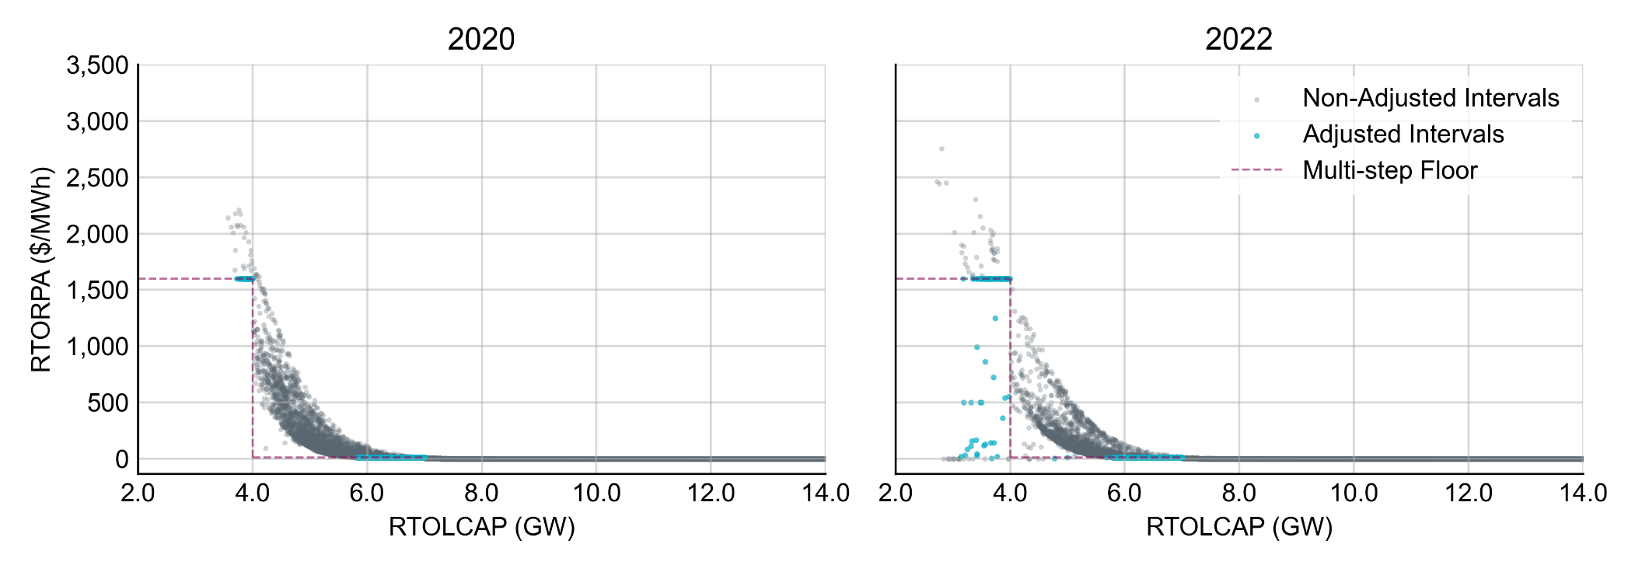
TAC Option 1 Analysis: Multi-step floor with Step 1 at 4 GW
Adjusted Interval Summary | Step 1: $1,550/MWh floor at 4 GW |  | Step 2: $10/MWh floor at 7 GW |  | Combined
Year | 2020 | 2022 | 2020 | 2022 | 2020 | 2022
Count | 37 | 91 | 8,373 | 7,648 | 8,410 | 7,739
Avg. RTORPA increase ($/MWh) | 355.69 | 414.5 | 7.78 | 8.01 | 9.31 | 12.79
Total energy dispatched (GWh) | 0.2 | 0.5 | 32.7 | 33.0 | 32.9 | 33.5
Energy rev. increase ($M) | 55.1 | 192.1 | 253.2 | 262.5 | 308.3 | 454.5
Headroom rev. increase ($M) | 4.2 | 11.7 | 34.8 | 32.7 | 39.0 | 44.4
Total rev. increase ($M) | 59.3 | 203.8 | 288.0 | 295.2 | 347.3 | 499.0

Slide 6
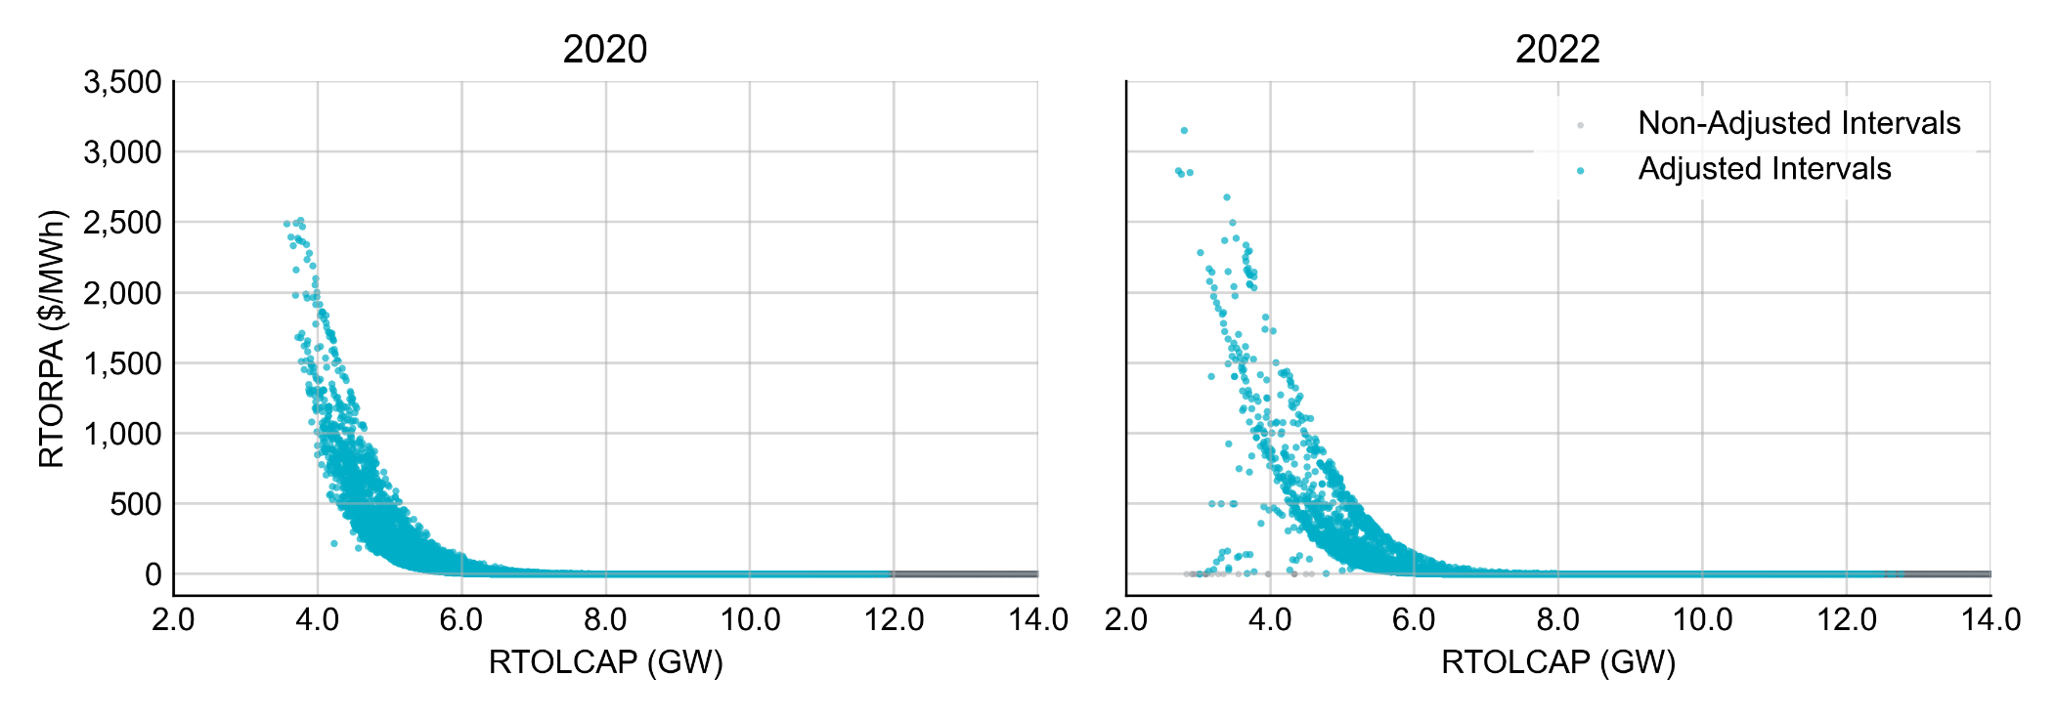
TAC Option 2 Analysis: VOLL Adjustment to $5,670/MWh
Adjusted Interval Summary
Year | 2020 | 2022
Count | 51,730 | 53,593
Avg. RTORPA increase ($/MWh) | 2.43 | 1.62
Total energy dispatched (GWh) | 195.8 | 225.3
Energy rev. increase ($M) | 577.6 | 451.8
Online headroom rev. increase ($M) | 47.3 | 31.1
Offline headroom rev. increase ($M) | 25.5 | 31.1
Total rev. increase ($M) | 650.4 | 500.4

Slide 7
Average Fuel Mix by Resource Type for Studied Years and During Intervals with Adjusted RTORPAs
Proxy for distribution of additional revenue due to RTORPA adjustments.
This approach is a better approximation for the ERCOT-preferred option given the consistency in adjusted RTORPA values.
Energy % by Fuel Type | All intervals |  | Preferred Option Adjusted Intervals |  | TAC Option 1 Adjusted Intervals |  | TAC Option 2 Adjusted Intervals
Resource Type | 2020 | 2022 | 2020 | 2022 | 2020 | 2022 | 2020 | 2022
Natural Gas | 45.85 | 42.64 | 54.61 | 53.28 | 54.40 | 53.02 | 50.25 | 48.18
Coal and Lignite | 17.98 | 16.77 | 20.86 | 17.90 | 20.88 | 17.95 | 19.95 | 17.40
Nuclear | 11.06 | 9.76 | 9.71 | 8.97 | 9.74 | 9.02 | 10.20 | 9.29
Energy Storage | 0.01 | 0.12 | 0.02 | 0.20 | 0.02 | 0.19 | 0.01 | 0.14
Hydro | 0.15 | 0.07 | 0.20 | 0.07 | 0.20 | 0.07 | 0.19 | 0.07
Wind | 22.73 | 25.02 | 11.59 | 13.67 | 11.79 | 13.83 | 16.60 | 19.09
Solar | 2.20 | 5.52 | 2.98 | 5.80 | 2.95 | 5.81 | 2.79 | 5.72
Other | 0.01 | 0.10 | 0.02 | 0.11 | 0.02 | 0.11 | 0.01 | 0.10

Slide 8
Average Fuel Mix by Resource Age for Studied Years and During Intervals with Adjusted RTORPAs
Proxy for distribution of additional revenue due to RTORPA adjustments.
This approach is a better approximation for the ERCOT-preferred option given the consistency in adjusted RTORPA values.
Energy % by Age Category | All intervals |  | Preferred Option Adjusted Intervals |  | TAC Option 1 Adjusted Intervals |  | TAC Option 2 Adjusted Intervals
Age (Years) | 2020 | 2022 | 2020 | 2022 | 2020 | 2022 | 2020 | 2022
0 – 10 | 30.24 | 33.28 | 24.87 | 27.10 | 24.95 | 27.17 | 27.32 | 29.89
10 – 20 | 37.24 | 23.09 | 38.57 | 22.88 | 38.58 | 22.90 | 37.81 | 23.17
20 – 30 | 11.16 | 21.12 | 11.35 | 24.35 | 11.35 | 24.29 | 11.22 | 22.95
30 – 40 | 11.75 | 11.37 | 11.60 | 11.12 | 11.64 | 11.16 | 11.72 | 11.22
40 – 50 | 8.77 | 8.92 | 12.08 | 10.88 | 12 | 10.85 | 10.73 | 9.87
50 – 60 | 0.63 | 1.94 | 1.17 | 3.22 | 1.13 | 3.17 | 0.89 | 2.53
60+ | 0.22 | 0.28 | 0.37 | 0.46 | 0.36 | 0.45 | 0.31 | 0.37

Slide 9
Approximation of Additional Revenues by Resource Type and Age for the ERCOT-Preferred Option
Additional Revenue ($M) | Study Year
Resource Type | 2020 | 2022
Natural Gas | 273.8 | 261.6
Coal and Lignite | 104.6 | 87.9
Nuclear | 48.7 | 44.0
Energy Storage | 0.1 | 1.0
Hydro | 1.0 | 0.3
Wind | 58.1 | 67.1
Solar | 14.9 | 28.5
Other | 0.1 | 0.5
Additional Revenue ($M) | Study Year
Age (Years) | 2020 | 2022
0 – 10 | 124.7 | 133.1
10 – 20 | 193.4 | 112.3
20 – 30 | 56.9 | 119.6
30 – 40 | 58.2 | 54.6
40 – 50 | 60.6 | 53.4
50 – 60 | 5.9 | 15.8
60+ | 1.9 | 2.3

Slide 10
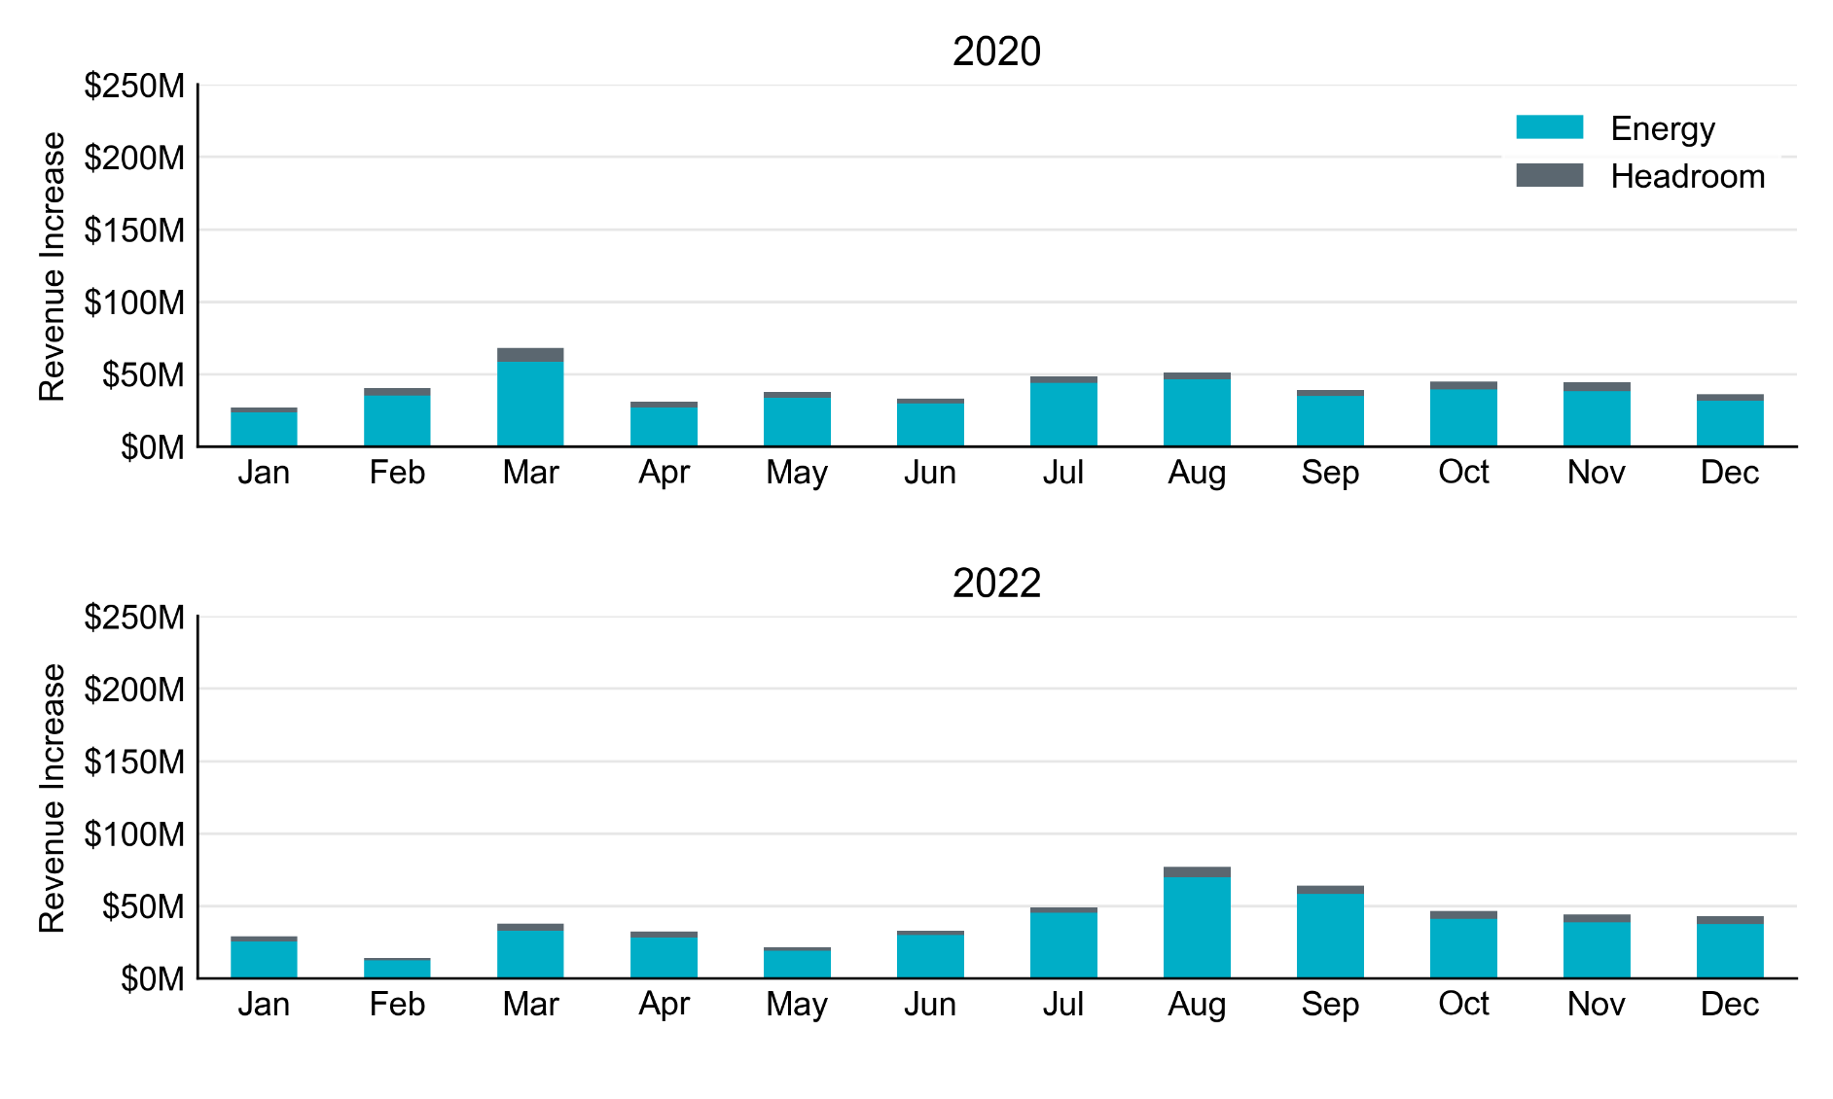
ERCOT-Preferred Option Incremental Revenue Breakdown by Month

Slide 11
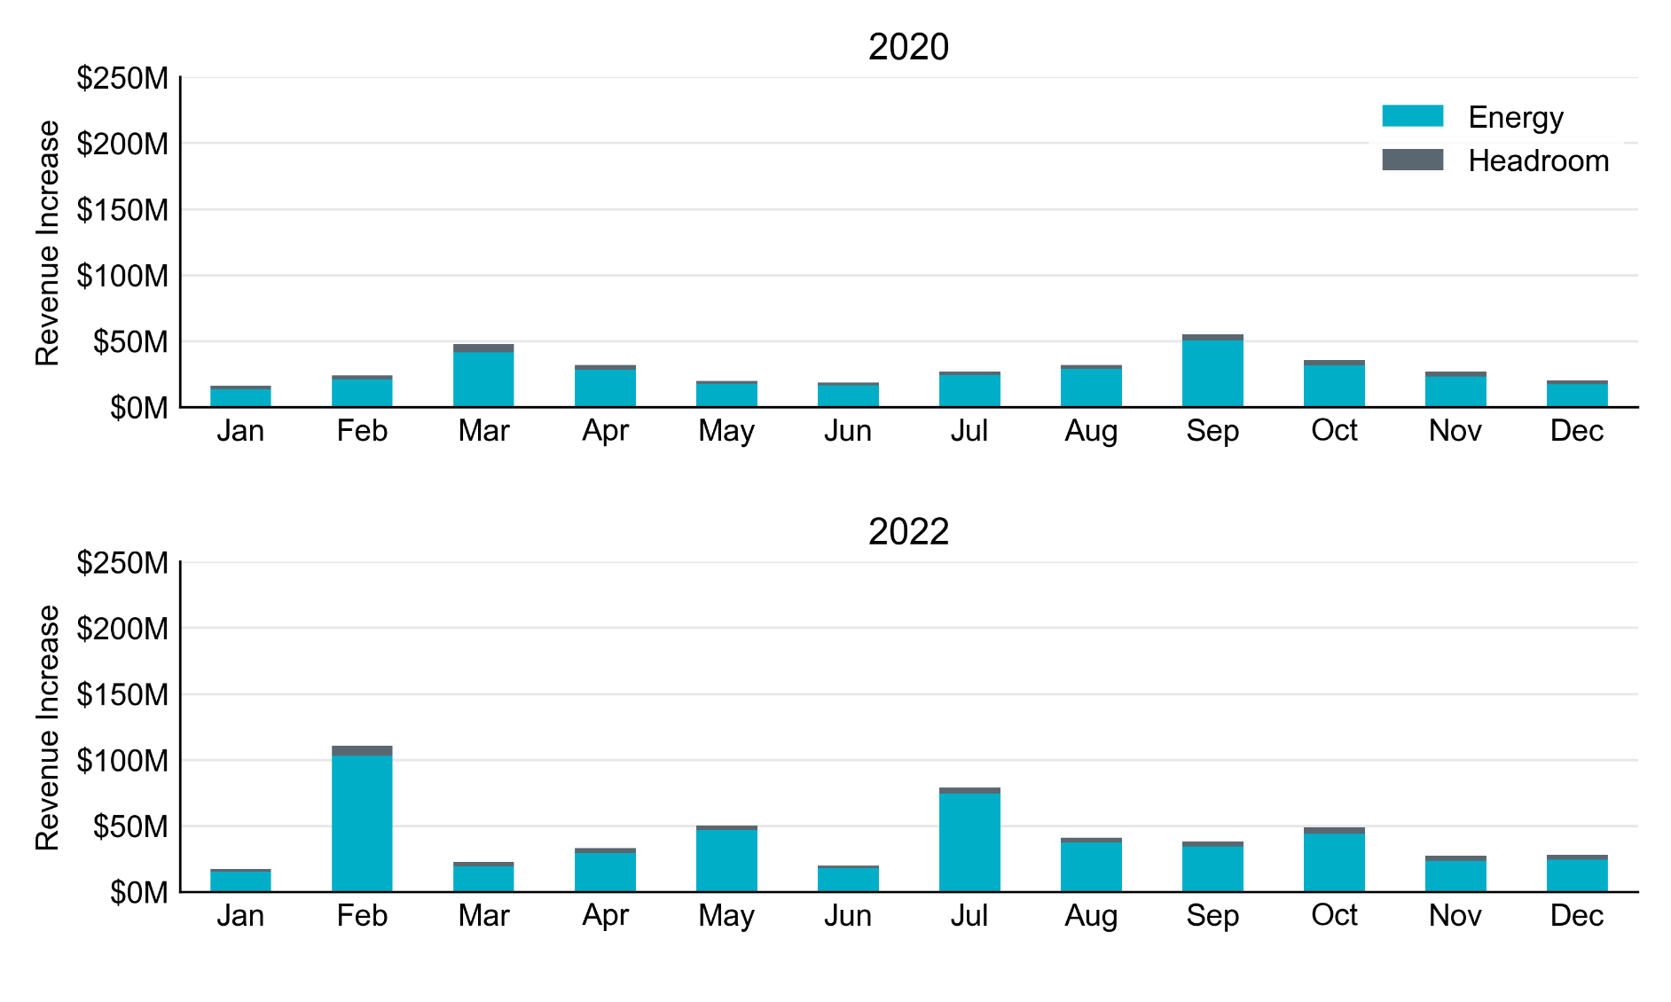
TAC Option 1 Incremental Revenue Breakdown by Month

Slide 12
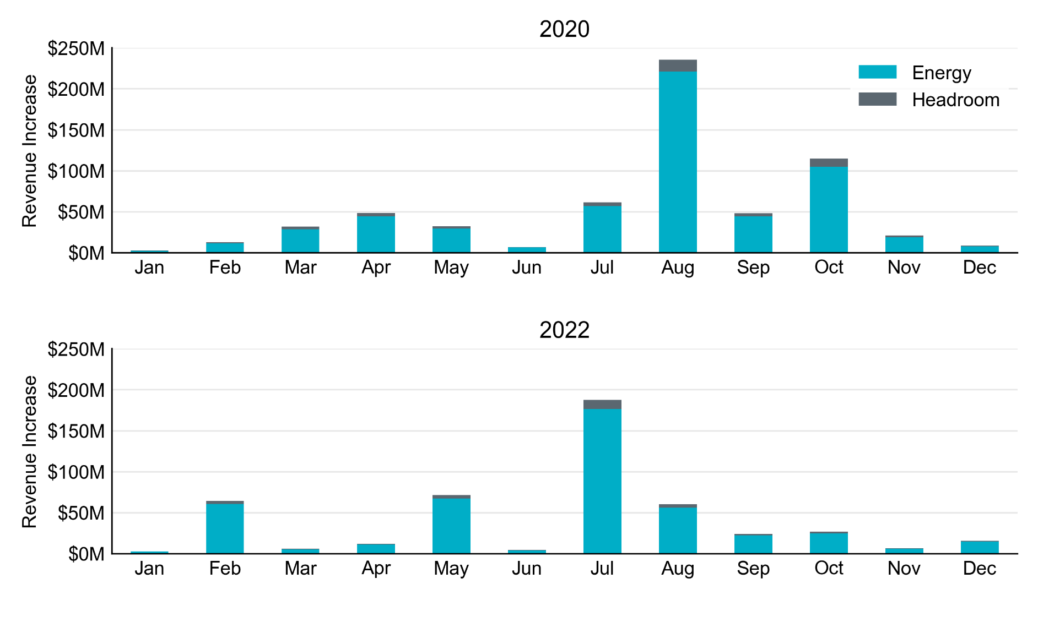
TAC Option 2 Incremental Revenue Breakdown by Month

Slide 13
ERCOT- Preferred Option Benefits
Multi-step RTORPA floor: 6,500MW @ $20/MWh & 7,000MW @ $10MWh
Aligns with PCM: The back-cast analysis for 2020 and 2022 indicates that by applying these floors the total revenue increase would be in the $500M range. While we recognize the analysis does not account for behavioral changes, this level of increase aligns with the additional average revenue PCM would provide (as calculated by E3).
Targeted to the right resources at the right time: The back-cast analysis for 2022 confirms that when applying these floors the increase in revenue would be largely directed to dispatchable resources. In the preferred scenario, 80% of the revenue increase would be directed to dispatchable resources. The floor prices also have impact when ERCOT is seeing the greatest need for increased generator commitment.
Helps address RUC: Applying a floor that initially kicks in within the 6,500-7,000MW range provides a self-commitment incentive better aligned with conservative operations. Adding multiple steps to the floor incorporates feedback provided by market participants, provides for tiering in the strength of the self-commitment signal, and provides some mitigation of risk for generators that self-commit.

