Slide 1
System Protection Working Group
(SPWG)
Update to ROS
April 6, 2023
Chair: jon snellgrove, P.E.
vice Chair: Andrew mattei, P.E.

Slide 2
SPWG Meeting Overview
1st SPWG Meeting of 2023 was held on March 1st, 2023
Topics Discussed:
  Texas RE 2022 Q4 Misoperation Data (included)
  MIDAS Data Reporting Instructions (DRI)
  ERCOT Case Build Updates
  NERC SPCWG Activities
    PRC-019-2 – still working of Compliance Implementation Guidance (CIG)
    PRC-023 SAR – final draft passed
    PRC-002 SARs – made it through initial pass, but some details are not covered yet
  PRC-002 Project 2021-04b – next meeting on April 5th
  NOGRR247 Changes to UFLS Stages and Load Relief Amounts

Slide 3
Protection System Misoperations
2022 Q4

Slide 4
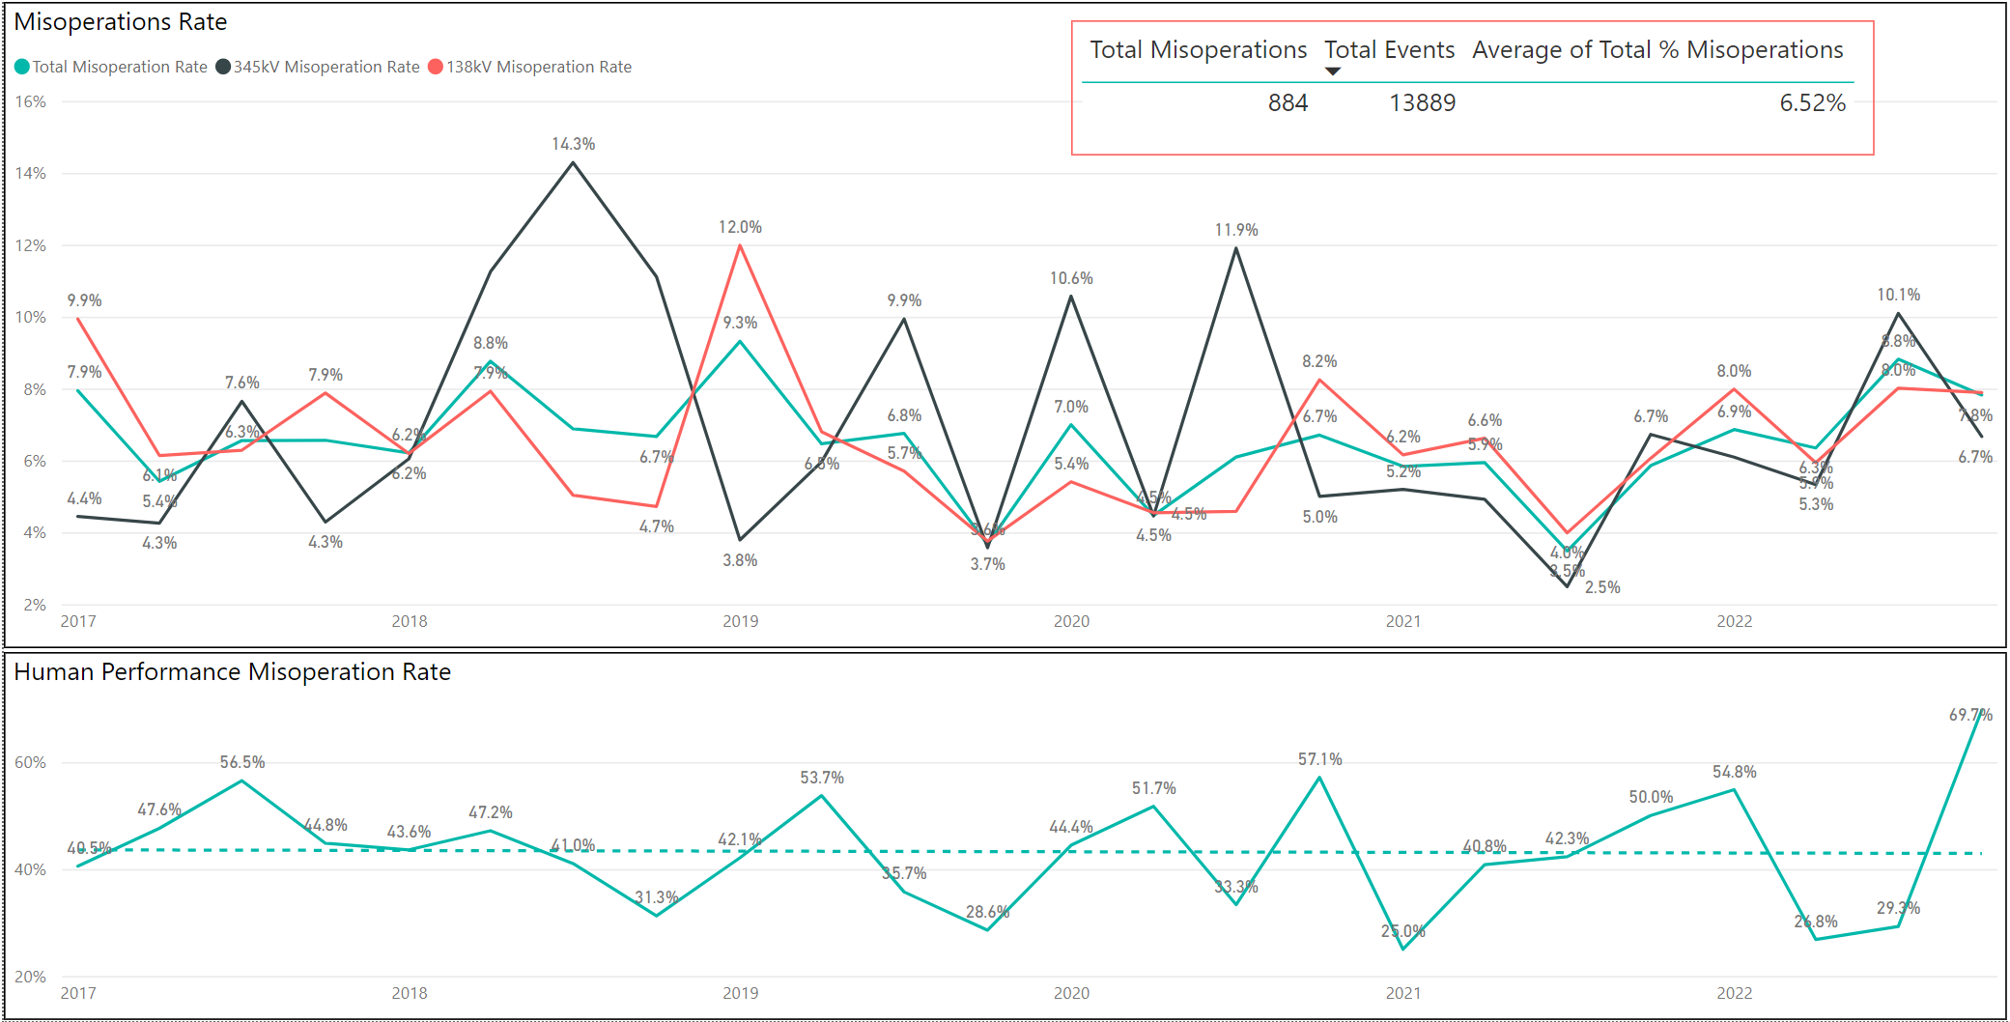
Protection System Misoperations: 2017-2022 Q4
2022 Q4 Misoperation rate was 7.8%

Slide 5
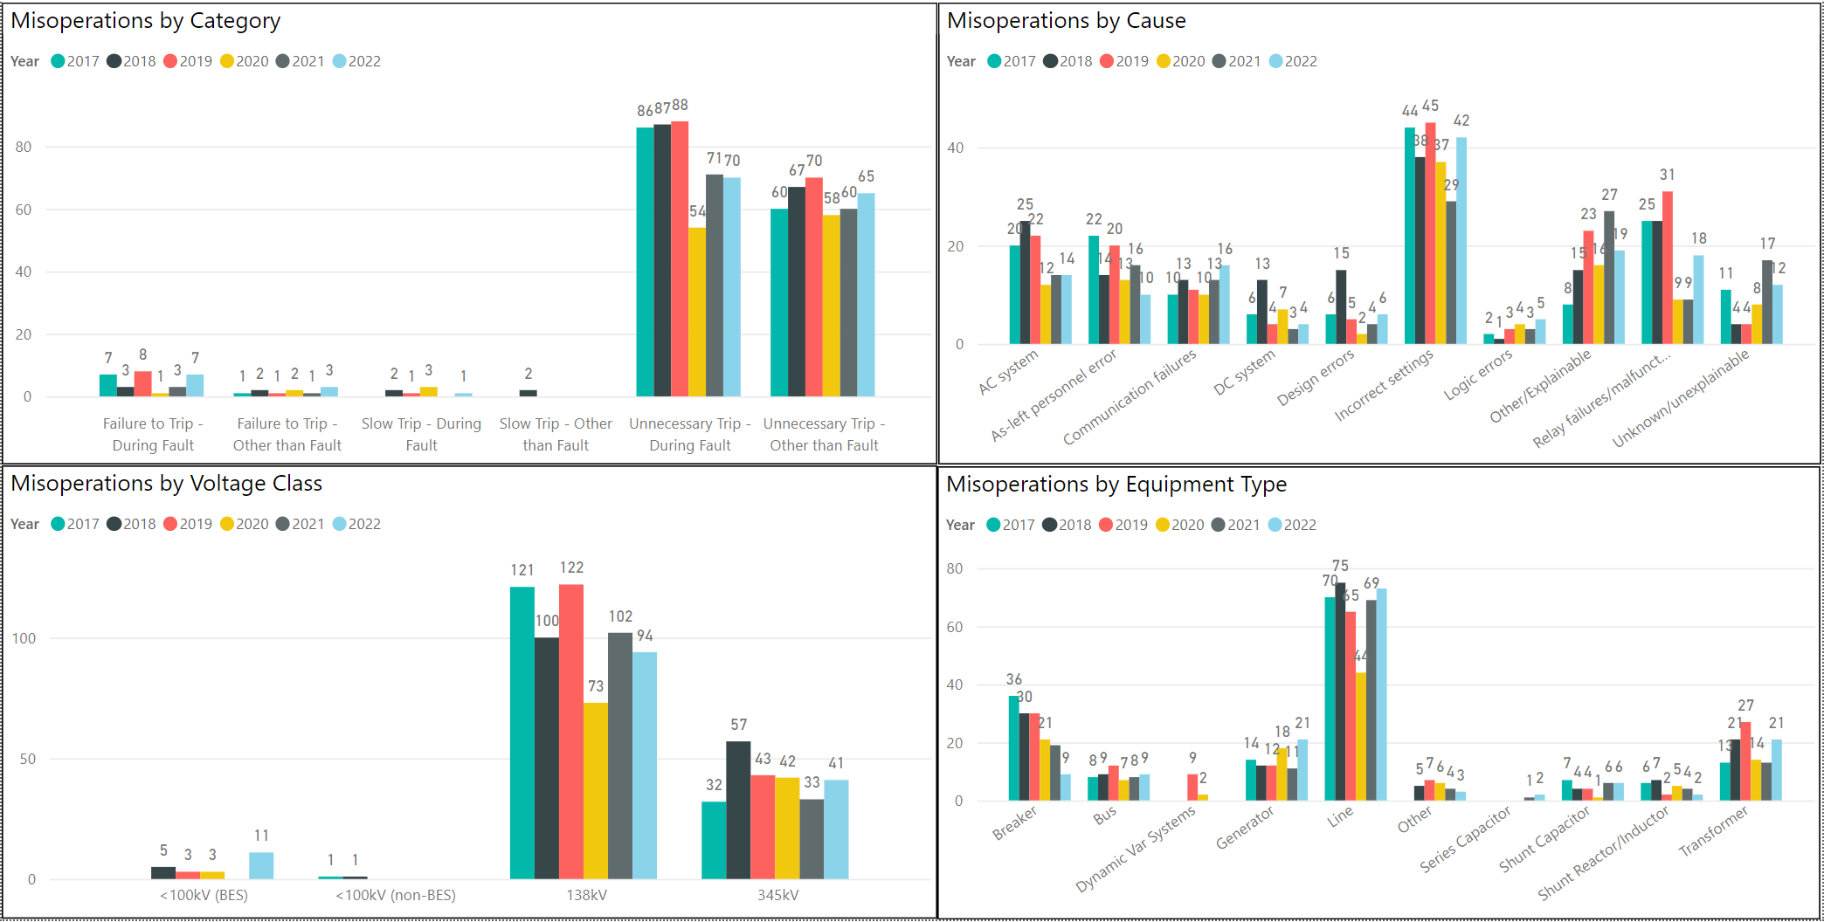
Protection System Misoperations: 2017-2022 Q4

Slide 6
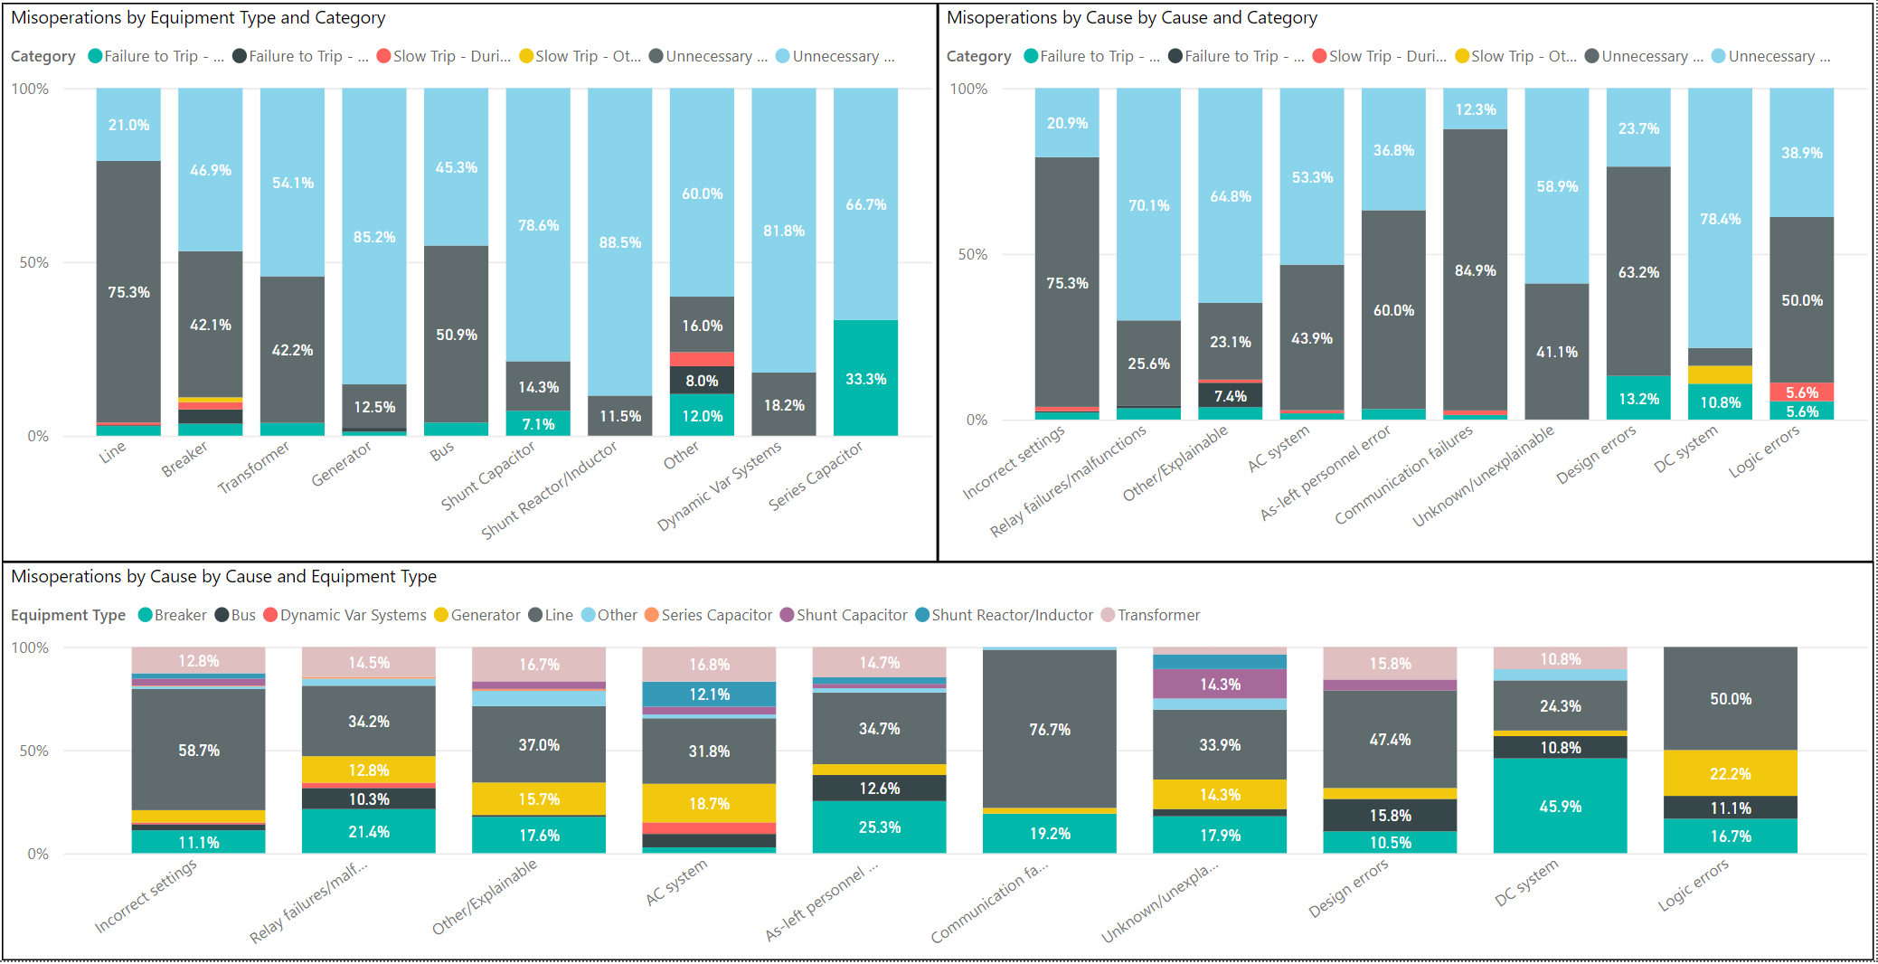
Protection System Misoperations: 2017-2022 Q4

Slide 7
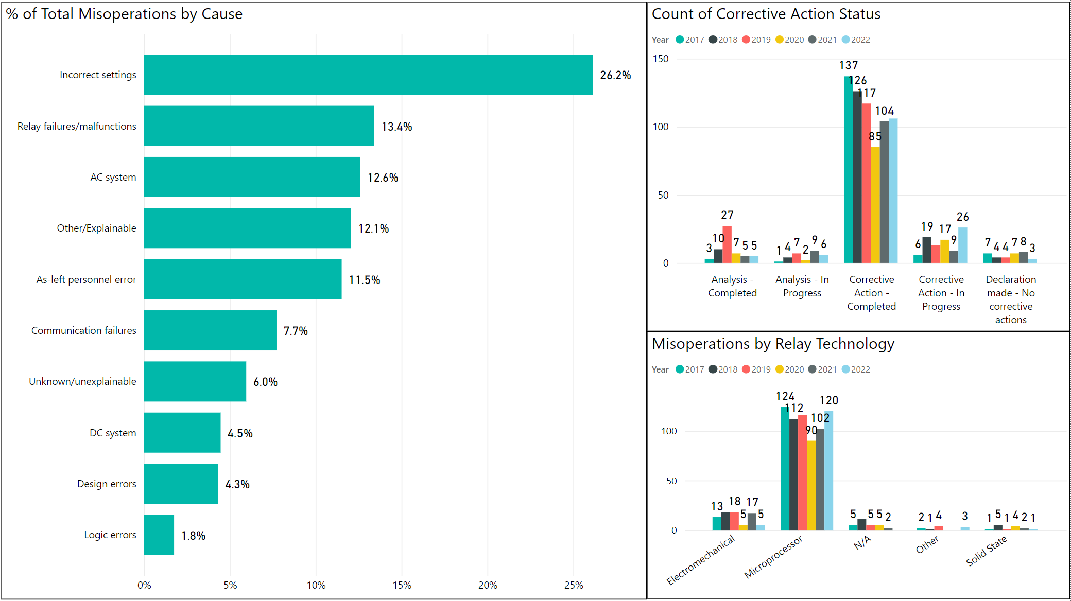
Protection System Misoperations: 2017-2022 Q4

Slide 8
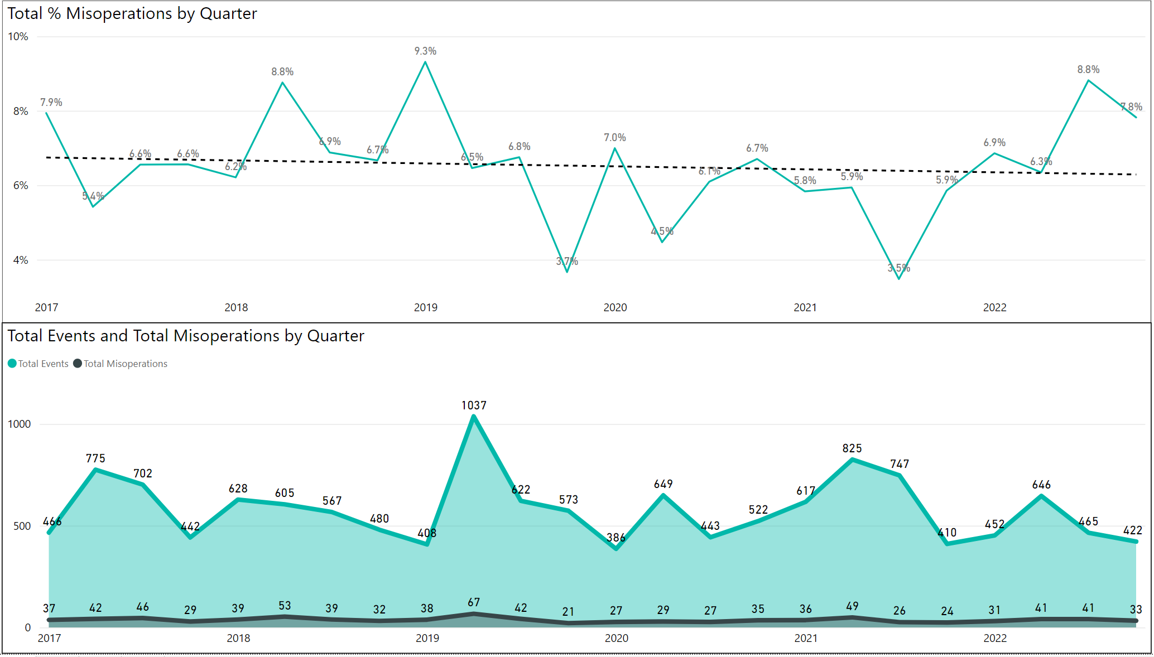
Protection System Misoperations: 2017-2022 Q4

Slide 9
Protection System Misoperations – 2022 Q4
 |  | Q4 | 2022 YTD
# of Misoperations | Total | 33 | 146
 | 345 kV | 9 | 41
 | 138 kV | 22 | 94
 | < 100 kV | 2 | 11
By Category | Failure to Trip | 1 | 10
 | Slow Trip | 0 | 1
 | Unnecessary Trip during Fault | 20 | 70
 | Unnecessary Trip – Non Fault | 12 | 65
 | RAS | 0 | 0
By Relay System Type | Electromechanical | 2 | 5
 | Solid State | 1 | 1
 | Microprocessor | 24 | 120
 | Other/ N/A | 6 | 20
By Equipment Protected | Line | 13 | 73
 | Transformer | 3 | 21
 | Generator | 9 | 21
 | Shunt/Series Capacitor | 4 | 8
 | Shunt/Series Reactor | 0 | 2
 | Dynamic VAR system | 0 | 0
 | Bus | 1 | 9
 | Breaker | 3 | 9
 | Other | 0 | 3

Slide 10
Human Performance - 2022 Q4
Summary of Human Performance Issues noted for 2022 Q4:
Generator tripped when syncing to the grid. PTs were wired C-B-A instead of A-B-C
138kV line tripped for a remote fault due to carrier control switch in the Test position
138kV line tripped for a remote fault due to incorrect settings on an overreaching ground element
138kV line tripped for a remote fault due to multiple grounds in the CT secondary circuit
Generator tripped with normal load due to an instantaneous overcurrent element that was inadvertently enable
Failure to Trip/Slow Trip Misoperations in 2022 Q4:
138kV breaker failed to trip due to a failure of one of it’s auxiliary contacts assemblies. The relaying schemes used breaker auxiliary contacts to supervise tripping. The failure of the contacts to correctly indicate that the breaker was open, when it was actually closed, prevented tripping of the breaker and required remote clearing of the fault.

Slide 11
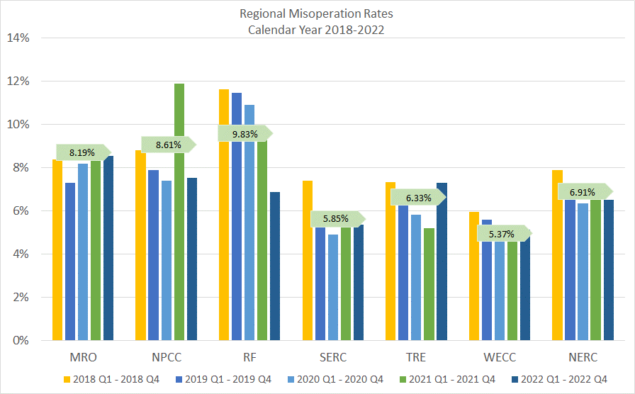
Regional Misoperation Rates: 2018 - 2022

Slide 12
End of SPWG Presentation
Next Meeting Scheduled for July 19-20, 2023
Next ERCOT ROS Update will be Provided on August 3rd, 2023
Thank You
Any Questions?

Slide 13
Definitions
Protection System –
  Protective relays which respond to electrical quantities,
  Communications systems necessary for correct operation of protective functions
  Voltage and current sensing devices providing inputs to protective relays,
  Station dc supply associated with protective functions (including station batteries, battery chargers, and non-battery-based dc supply), and
  Control circuitry associated with protective functions through the trip coil(s) of the circuit breakers or other interrupting devices

Slide 14
Definitions
Composite Protection System - The total complement of Protection System(s) that function collectively to protect an Element. Backup protection provided by a different Element’s Protection System(s) is excluded.
Misoperation – The failure a Composite Protection System to operate as intended for protection purposes. Any of the following is a Misoperation:
  Failure to Trip – During Fault – A failure of a Composite Protection system to operate for a Fault condition for which it is designed.
  Failure to Trip – Other than Fault - A failure of a Composite Protection system to operate for a non-Fault condition for which it is designed, such as a power swing, undervoltage, overexcitation, or loss of excitation.

Slide 15
Definitions
Misoperation – The failure a Composite Protection System to operate as intended for protection purposes. Any of the following is a Misoperation:
  Slow Trip – During Fault – A Composite Protection system that is slower than required for a Fault condition if the duration of its operating time resulted in the operation of at least one other Element’s Composite Protection System.
  Slow Trip – Other than Fault - A Composite Protection system that is slower than required for a non-Fault condition, such as a power swing, undervoltage, overexcitation, or loss of excitation, if the duration of its operating time resulted in the operation of at least one other Element’s Composite Protection System.

Slide 16
Definitions
Misoperation – The failure a Composite Protection System to operate as intended for protection purposes. Any of the following is a Misoperation:
  Unnecessary Trip – During Fault – An unnecessary Composite Protection system operation for a Fault condition on another Element.
  Unnecessary Trip – Other than Fault - An unnecessary Composite Protection system operation for a non-Fault condition. A Composite Protection System operation that is caused by personnel during on-site maintenance, testing, inspection, construction, or commissioning activities is not a Misoperation.

