Slide 1
Market Readiness and Qualification Workshop for ERCOT Contingency Reserve Service (ECRS)
ERCOT staff
April 3, 2023
(point of contact mmereness@ercot.com)

Slide 2
Agenda
Introduction (Matt Mereness)
High level explanation of ECRS (Nitika Mago)
How QSEs will submit ECRS into ERCOT systems (Nathan Smith)
How and when ECRS will be deployed (Nitika Mago)
Telemetry points (Nitika Mago and Kevin McGarrahan)
Reporting changes (Jamie Lavas)
Qualification (Abhi Masanna Gari and Steve Krein)
Required testing and scorecard (Matt Mereness)
Next steps (Matt Mereness)

Slide 3
1. Market Readiness Progression for ECRS Matt Mereness
ECRS Interface changes reviewed at Sept 29, 2022 TWG meeting
February-March 2023
Regular TAC and TWG updates for awareness of implementation
Progression to ECRS go-live:
Monday April 3, 2023:
Market Readiness and Qualification Workshop (Monday April 3, 2023, 2-4pm)
Market Notice was sent on 3/14/2023
Friday April 14, 2023:
Initial Deadline for QSE Declaration of Resources to participate in ECRS April 14
Thursday, April 20, 2023
ECRS in MOTE 4/20/2023
TBD
Begin Weekly Market Readiness WebEx meetings (tbd)
Scorecards for QSE testing and qualification progress (tbd)
June 6-8, 2023 Go-Live (first ECRS OD planned for June 10, 2023)

Slide 4
1. Market Readiness for ECRS
Key References:
ECRS Interface changes: https://www.ercot.com/calendar/09292022-TWG-Meeting-by-Webex
ECRS Operations and Business explanation
April 3, 2023 Workshop will be latest revisions- link to this meeting
Sample XML Questions
XML Sample ECRS Deployment
03/29/2023 09.03.09 AM QTEST CM-ASM-NOTF AS_TYPE: ECRS, RES_NAME: LD_TEST, DEPLOY_MW: 5.0, BEGIN_TIME: 2023-03-29 09:03:09, END_TIME: 2023-03-29 10:00:00, DURATION: 56.85 mins, ID: 365;
XML Sample ECRS DAM Award (to be provided in next 2 weeks)
Qualification principles being discussed to enable a robust ECRS fleet “qualified and ready” for ECRS participation on first OpDay.
April 3 workshop will review details of Qualification expectations and timeline
ERCOT will request QSE declaration of Resources that plan to qualify for ECRS (by April 14, 2023).
Qualification approach from ERCOT may include:
Leveraging existing qualification into provisional qualification for transitional purposes.
Considering open-loop telemetry tests to qualify a Resource.
Considering if sample of Resources successfully qualify, allow provisional qualification for remainder of fleet with similar capabilities or other AS qualification.

Slide 5
2. High level explanation of ECRS Nitika Mago
ECRS is a service that is provided using capacity that can be sustained at a specified level for two consecutive hours.
ECRS may be provided by
unloaded, On-Line Generation Resource capacity;
Quick Start Generation Resources (QSGRs);
Load Resources that may or may not be controlled by high-set, underfrequency relays;
Controllable Load Resources; and
Generation Resources operating in synchronous condenser fast-response mode as defined in the Operating Guides.
ECRS may be deployed to
restore frequency within 10 minutes of a significant frequency deviation to recover deployed Regulation Service,
to compensate for intra-hour net load forecast uncertainty and variability on days in which large amounts of online thermal ramping capability is not available, or
when there is a limited amount of capacity available for Security-Constrained Economic Dispatch (SCED).

Slide 6
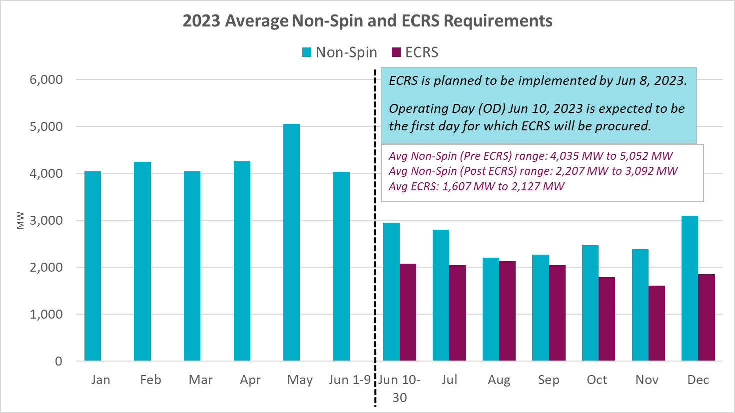
2. 2023 ECRS Quantities
The 2023 Ancillary Service Methodology contains the methodology that will be used to compute ECRS requirements in 2023.
Note that upon implementation of ECRS, the methodology used to compute Non-Spinning Reserve Service (Non-Spin) quantities will change to use 6 hours ahead average Net Load forecast error.
Hourly average ECRS quantity between Jun 10 and Dec 31, 2023 is expected to be ~1,931 MW.
Pursuant to Nodal Protocol 3.16 (8), up to 50% of total hourly ECRS may come from Load Resources excluding Controllable Load Resources that may or may not be on high-set underfrequency relays providing ECRS.

Slide 7
3. How QSEs will submit ECRS into ERCOT Nathan Smith
New Ancillary Service ECRS will impact the following submissions systems:
AS Offers
Current Operating Plan
AS Self-Arrangement
AS Trades

Slide 8
3. COP Submission Changes
COP AS Resource Responsibility will have a new column for ECRS MW.
Resource must be qualified for ECRS if responsibility submitted is greater than 0 MW.
Submitted COP ECRS responsibility must not be greater than the Resource’s ECRS qualification MW.
For OFFQS (Offline Quick Start) resources providing NSPIN and/or ECRS, the total responsibility of NSPIN + ECRS should be less than the resource HSL.
A Load Resource that is not a Controllable Load Resource shall not have NSPIN and ECRS responsibility for the same hour. It can have ECRS and RRSUF responsibility for the same hour.

Slide 9
3. Self-Arranged Submission Changes
Self-Arranged submissions for ECRS are split into two subtypes based on the type of resource expected to provide:
ECRSS – ECRS that is SCED dispatchable provided by:
Generation Resources
Quick Starts Generation Resources (QSGRs)
Controllable Load Resources
Generation Resources operating in Synchronous Condenser mode
ECRSM – manually dispatched ECRS provided by:
Load Resources that may or may not be controlled by high-set under frequency relays.
ECRSM self-arranged can not exceed 50% of the QSE’s ECRS Obligation.
Negative ECRSM self-arranged will not be allowed.
ECRSS + ECRSM self-arranged shall not exceed QSE’s ECRS obligation by 100 MW.
Note: AS Obligation for ECRS will continue be reported as “ECRS” obligation, not by these subtypes.

Slide 10
3. AS Offer Changes
For Online Reserves (ONRES), a new price will be added for online ECRS. The prices available for ONRES AS offer quantities will be as follows:
REGUP
RRSPF
RRSFF
RRSUF
ONNS
ECRS
For Offline Reserves (previously used just for Offline Non-Spin), a new price will be added for offline ECRS. The prices available for Offline Reserves AS offer quantities will be as follows:
OFFNS
OFFEC
The Market Submissions Validation Rules Document has been updated and posted to the ECRS Workshop Calendar Event.

Slide 11
3. AS Qualifications
Resources that are looking to submit an ECRS AS Offer into DAM/SASM will require the following qualifications:
Online ECRSS AS Offer
Resource must be ECRSS qualified
QSE must be ECRS qualified
If Resource is CLR, resource must be SCED qualified
Online ECRSM AS Offer
Resource must be ECRSM qualified
QSE must be ECRS qualified
If NCLR without under-frequency relay enabled, must also have BLR qualification
OFFQS ECRS AS Offer
Resource must be ECRS qualified
Resource must be QSGR qualified
QSE must be ECRS qualified
Note: For ESRs, both Gen and CLR need individual qualifications.

Slide 12
3. ECRS by Resource Type
Resource type to AS type/subtype breakdown:
Note: Resources can only be awarded either Online Reserves or Offline Reserves, not both.
*BLR – Basic Load Resource - NCLR without an under-frequency relay or disabled under-frequency relay. Must have BLR qualification
Resource Type | Online Reserves |  | Offline Reserves
 | ECRSS | ECRSM | OFFQS(ECRSS)
ESR - CLR | Y | N | N
ESR - GR | Y | N | N
Non-ESR Gen | Y | N | Y (QSGR)
Non-ESR CLR | Y | N | N
NCLR | N | Y | N
BLR* | N | Y | N

Slide 13
3. ECRS Specific Limits
DAM and SASM ECRS awards will be limited by the resource’s ECRS qualification MW.
ECRSS awards (both Online and Offline ECRSS) will be limited to 10 * Maximum Emergency Ramp Rate of the resource.
ECRSM total AS Awards and Self-Arranged must contribute no more than 50% of the AS plan for ECRS.
ECRSM + RRSUFR awards will be less than or equal to UFR qualified MW.
Generation Resources operating in synchronous condenser mode – RRSPF and ECRSS awards total will be less than or equal to the ONSC qualified MW.

Slide 14
3. AS Awards Changes
DAM and SASM ECRS awards will be reported as:
ECRSS
ECRSM
OFFEC.
ECRS will have a single MCPC “ECRS”.

Slide 15
3. AS Trades
ECRS AS Trade types will be ECRSS and ECRSM.
The table below shows the ECRS trades that are allowed for each new type of original responsibility:
An AS Trade for ECRSM cannot cover an ECRSS responsibility.
 | Allowable ECRS Ancillary Service Trades
Original Responsibility | SCED-dispatchable ECRSS | Manually dispatched ECRSM
SCED-dispatchable ECRSS | Yes | No
Manually dispatched ECRSM | Yes | Yes

Slide 16
4. How and when ECRS will be deployed Abhi Masanna Gari ECRS Providers/Resource Status
The resources that are qualified to provide ECRS are expected to
use following Resource Statuses (RST)
ECRS Provider | Resource Status to be used
Online Generation Resources | All Online Generation Resource Statuses except NA, ONTEST, ONRR, SHUT DOWN and START UP
Quick Start Generation Resources | OFFQS
Load Resource that is not a Controllable Load Resource | ONECL
Controllable Load Resources | ONCLR and ONRGL
Generation Resources operating in Synchronous condenser fast-response mode | ONECRS
ONECRS Resource Status cannot be used to carry ONRR-RRS
ONECL Resource Status can be used to carry both ECRS and RRS-UFR

Slide 17
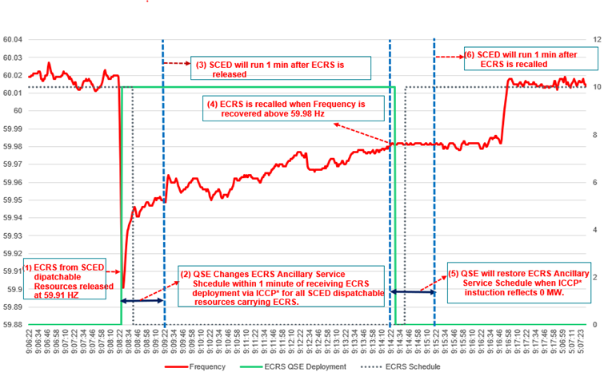
4. ECRS Deployment/Recall from – SCED Dispatchable Generation Resources (including QSGR’s) and Controllable Load Resources
ERCOT will deploy the ECRS from SCED dispatchable resources automatically when frequency drops below 59.91 Hz and may manually deploy to respond to large net load ramps OR when additional capacity is needed.
When deployed, the QSE will be sent an ECRS Deployment Instruction with requested MW’s via ICCP*.
Upon receiving an ECRS Deployment Instruction, the QSE shall adjust the ECRS Ancillary Service Schedule* for resources that have non-zero ECRS Ancillary Service Responsibility*(<= 10*EURR).
ECRS from SCED dispatchable Resources will be recalled when frequency has been recovered above 59.98 Hz
When recalled, the ICCP Deployment Instruction will reflect zero MW and the QSE can restore ECRS Ancillary Service Schedule.
Online Quick Start Generation Resources may follow the process outlined in Nodal Protocol Section 3.8.3.1, Quick Start Generation Resource Decommitment Decision Process to take the Resource Off-Line.
* Refer the ERCOT’s ICCP handbook* for details on these tags.

Slide 18
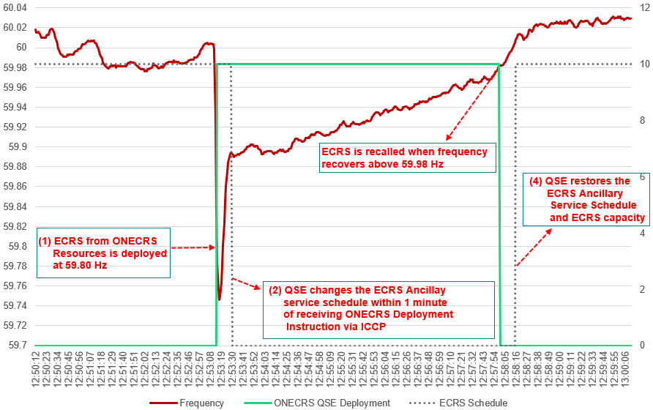
4. ECRS Deployment & Recall Steps – Generation Resources operating in Synchronous Condenser mode (RST = ONECRS)
Automatic Deployment/Recall
Manual Deployment/Recall
ECRS from ONECRS Resources is automatically deployed when frequency drops below 59.80 Hz.
The initiation setting of the automatic under-frequency relay shall not be lower than 59.80 Hz, upon getting triggered, full response must be provided within 20 seconds.
ERCOT will follow-up with a separate QSE level ICCP* Deployment Instruction equal to the total ECRS Ancillary Service Responsibility* of resources telemetering ONECRS Resource Status
Upon receiving an ECRS Deployment Instruction, the QSE shall adjust ECRS Ancillary Service Schedule* to zero for the resources within 1 minute.
Once operating under normal conditions and system frequency is stable above 59.98 Hz, ERCOT will reset the ONECRS ICCP Deployment signal to reflect zero MW deployment. The QSE can restore ONECRS capability and stop generating MW from ONECRS Resources.
ECRS from ONECRS Resources is manually deployed (A) to meet NERC standards and other performance criteria as defined in the Nodal Protocol Section 6.5.7.6.2.4( 2) OR (B) during scarcity conditions following declaration of EEA level 1 per Nodal Protocol Section 6.5.9.4.2 (1).
The QSE will be sent a manual Deployment Instruction via ICCP* to deploy all available ECRS capacity from the Resources that are telemetering non zero ECRS Ancillary Service Responsibility*
Upon receiving ECRS Deployment Instruction, the QSE shall adjust the ECRS Ancillary Service Schedule* to zero within 1 minute and deploy all available ECRS capacity within 10 minutes.
Following recovery from the event, once operating under normal conditions and system frequency is stable above 59.98 Hz, ERCOT will reset the ONECRS Deployment Instruction to reflect zero MW deployment. QSE’s can restore ONECRS capability and stop generating MW from ONECRS Resources.
* Refer the ERCOT’s ICCP handbook* for details on these tags.

Slide 19
4. ECRS Deployment & Recall Steps – Non-Controllable Load Resources (RST=ONECL)
Non-Controllable Load Resources that are providing ECRS and/or RRS-UFR will be separated into five deployment groups as defined in Nodal Protocols Section 6.5.9.4.2 EEA levels paragraph (2)
The QSE will be sent a Resource-specific Dispatch Instruction via ERCOT A/S Manager (XML Instruction) for the ECRS Deployment, indicating a time and date stamp, QSE, Dispatch Asset code and Deployed MW. ERCOT may deploy the NCLR’s in groups with deployment order from 0 to 4 or as an entire block.
Upon receiving the Deployment Instruction, the QSE shall adjust the ECRS Ancillary Schedule telemetry* to zero within one minute for all the Load Resources telemetering non zero Ancillary Service Responsibility*.
The Load Resource must operate at ERCOT instructed level within 10 minutes and at a minimum, be capable of remaining deployed until recalled.
Following recovery from the event, once operating under normal conditions with system frequency stable above 59.98 Hz, ERCOT will recall the ECRS deployment for NCLR’s. NCLR’s will be recalled from 5 to 1 if deployed in groups.
Upon Recall, the QSE shall ensure that the Load energy and ECRS capacity from NCLR’s is restored within 3 hours, If the QSE cannot restore within 3 hours, the ECRS obligation must be replaced by the QSE from other ECRS qualified Resources capable of providing ECRS.
The QSE shall ensure that the ECRS Ancillary Schedule telemetry continuously and accurately represents the amount of load energy that has been restored and is available for subsequent deployment.
Group | Carrying ECRS without relay or relay unarmed | Carrying RRSUFR | Carrying ECRS with relay Armed
0 | Yes | No | No
1a | Yes | No | Yes
1b | Yes | Yes | Yes
1c | Yes | Yes | Yes
2,3,4 | No | Yes | Yes
* Refer the ERCOT’s ICCP handbook* for details on these tags.

Slide 20
5. Summary of Telemetry Changes- Nitika Mago
ERCOT’s ICCP handbook* has been updated to include the various telemetry changes that are being put in place to support implementation of ECRS.
Follow normal processes for requesting new ICCP Service Request.
Additional support from ercoticcpsupport@ercot.com
The following new Resource Status’ will be available for use after the implementation of the ECRS project
ONECRS | Code = 022 | For Generation Resource operating in synchronous condenser mode providing ECRS
ONHOLD | Code = 023 | For Generation Resource per guidance included in NPRR1085
ONECL | Code = 264 | For Load Resources that are not Controllable Load Resources that provide ECRS
The following are the new telemetry that will be used for deployment of ECRS
ECRS | QSE Level ECRS deployment/requested MW for SCED dispatchable Resources
ONEC | QSE Level ECRS deployment/requested MW for Generation Resource operating in synchronous condenser mode
ECRS | ECRS Ancillary Service Resource Responsibility available for Generation Resource, Energy Storage Resource, Controllable Load Resource and Non-Controllable Load Resource
ECSC | ECRS Ancillary Service Resource Schedule available for Generation Resource, Energy Storage Resource (ESR), Controllable Load Resource and Non-Controllable Load Resource
The following are additional new telemetry that will be available for Market Participant consumption
MMEC | Non-Controllable Load Resource (NCLR) level status to provide follow up flag to affirm that NCLR has been deployed for ECRS. Note that ECRS deployments are sent via XML instruction. This flag is solely for information purpose. Available to QSEs only
ECRG, ECCG | Generation Resource ECRS Responsibility and Capacity (ECRS on ESR-Gen will be included in this)
ECRQ, ECCQ | Quick Start Generation Resource ECRS Responsibility and Capacity
ECRC, ECCC | Controllable Load Resource ECRS Responsibility and Capacity
ECRN, ECCN | Non-Controllable Load Resource ECRS Responsibility and Capacity
ECRS | ECRS deployed from Generation and Load Resources

Slide 21
6. CDR Report Impact Summary – ECRS Jamie Lavas
Report | Change Summary
NP4-179-CD Total Ancillary Service Offers | Report: Add ECRS subtype columns 'ECRSSD', 'ECRSMD’. XSD: Addition of element names for new ECRS columns 'ECRSSD', 'ECRSMD’.
NP4-19-CD Aggregated Ancillary Service Offer Curve | Report: Update AS Type filter to include ECRS subtype values ECRSS, ECRSM, OFFEC. No new columns XSD: Addition of enumeration values 'ECRSS', 'ECRSM', 'OFFEC'
NP6-323-CD Real-Time ORDC and Reliability Deployment Price Adders and Reserves by SCED Interval | Report: Add new ECRS Real-Time ORDC and Reliability Deployment Price Adder columns XSD: Addition of element name for new ECRS column 'RTNCLRECRS'
NP6-325-CD RTD Indicative ORDC and Reliability Deployment Price Adders and Reserves | Report: Add new ECRS RTD Indicative ORDC and Reliability Deployment Price Adder columns. Additional column updates for missed impact with NPRR1093 XSD: Addition of element name for new ECRS column 'RTNCLRECRS'. Addition of 'RTDNCLR', Removal of 'RTDLRRRS'
NP8-142-CD Resource AS Supply Insufficiency at 1430 | Report: Add new column 'ECRSSupplyInsufficiency' XSD: Addition of element name for new ECRS column 'ECRSSupplyInsifficiency'

Slide 22
6. CDR Report Impact Summary - ECRS
Report | Change Summary
NP6-552-CD Group Assignments for Load Resources Providing RRS & ECRS | Report Link Name Change Filename Change Structural changes to column 'GroupNo’ from Number to String format type. XSD: Format change for element name = 'GroupNo' to xs:string
NP8-143-CD QSE Ancillary Services Capacity Monitor | Report: Column additions - 12 new columns ECRS_RESP_GN ECRS_RESP_QS ECRS_RESP_CL ECRS_RESP_NCL ECRS_CAPACITY_GN ECRS_CAPACITY_QS ECRS_CAPACITY_CL ECRS_CAPACITY_NCL ECRSDT ECRS_SUM_RES_RESP ECRS_QSE_RESPONSIBILITY ECRS_RESPONSIBILITY_MET XSD: 12 Element additions for new ECRS columns

Slide 23
6. Public Dashboard Impact Summary - ECRS
Report | Change Summary
DAM Clearing Prices for Capacity Display | Dashboard: New 'ECRS' column added to existing AS Types
System Ancillary Services Capacity Monitor (ASCAPMON) Display | Dashboard: Section Additions -2 new ECRS sections ERCOT Contingency Reserve Capacity (MW) --Generation Resources --Load Resources excluding Controllable Load Resources --Controllable Load Resources --Quick Start Generation Resources --Deployed Generation Resources and Load Resources ERCOT Contingency Reserve Responsibility (MW) --Generation Resources --Load Resources excluding Controllable Load Resources --Controllable Load Resources --Quick Start Generation Resources

Slide 24
6. Report Impact Summary - ECRS
Report | File(s) within zip | Change Summary
NP4-181-ER Historical DAM Clearing Prices for Capacity |  | Report: Add new column 'ECRS'
NP3-108 Monthly ERCOT Demand Response from Load Resources |  | Report: Addition of new AS Type ECRS. Removal of ESR registered CLR resources
NP8-117-ER ECRS Performance Report for Generators and CLRs |  | New ECRS Report Similar to existing Responsive Reserve Performance Report for Generators and CLRs | NP8-541-ER | Report ID 11027
NP8-545-ER Monthly Deployment Performance Report for Resource Specific Non-CLRs Providing RRS and ECRS |  | New ECRS Report
NP8-544-ER Monthly Deployment Performance QSE Summary Report for Non-CLRs Providing RRS and ECRS |  | New ECRS Report
NP1-302-EX AS Obligation and Responsibility |  | Report: Add two new columns, 'ECRS Responsibility' and 'ECRS Obligation' for new ECRS AS Type
NP3-911-EX 2-Day Ancillary Services Disclosure | NP3-959-EX 2D Aggregate AS Offers NP3-961-EX 2D Cleared DAM AS NP3-960-EX 2D Self-Arranged AS | NP3-959-EX: Add two new csv output files for ECRSS and ECRSM NP3-961-EX: Add two new csv output files for ECRSS and ECRSM NP3-960-EX: Add two new csv output files for ECRSS and ECRSM
NP3-915-EX 3-Day Highest Price AS Offer Selected |  | Report: Update AS Type filter to include ECRS (taking max value of new subtypes ECRSS, ECRSM, OFFEC) for the clearing price
NP3-987-EC 7 Day Event Trigger Posting | NP3-989-ER 7-Day Event Trigger Posting When MCPC Exceeds 50xFIP | Report: Add new columns Add 5 new columns PRICE1_ECRS to PRICE5_ECRS Add 5 new columns PRICE1_OFFEC to PRICE5_OFFEC

Slide 25
6. Report Impact Summary - ECRS
Report | File(s) within zip | Change Summary
NP3-990-EX 60-Day SASM | SASM Generation Resource AS Offers SASM Load Resource AS Offers SASM Generation Resource AS Offer Awards SASM Load Resource AS Offer Awards | Report: Gen Resource AS Offers – Add 10 new columns Add 5 new columns PRICE1_ECRS to PRICE5_ECRS Add 5 new columns PRICE1_OFFEC to PRICE5_OFFEC Report: Load Resource AS Offers -add 5 new columns PRICE1_ECRS to PRICE5_ECRS Report: Gen Resource AS Offer Awards – add 3 new columns 'ECRSS Awarded', 'OFFEC Awarded' and 'ECRS MCPC' Report: Load Resource AS Offer Awards – add 2 new columns 'ECRSM Awarded' and 'ECRS MCPC'
NP3-966-ER 60-Day DAM Disclosure Reports | NP3-975-EX 60D DAM Generation Resource Data NP3-976-EX 60D Generation Resource AS Offers in DAM NP3-978-EX 60D Load Resource AS Offers in DAM NP3-974-EX 60D QSE Specific Self-Arranged AS in DAM NP3-977-EX 60 Day Load Resource Data in DAM | NP3-975-EX: Add 2 new columns 'ECRSSD Awarded' and 'ECRS MCPC' NP3-976-EX: Add 10 new columns Add 5 new columns PRICE1_ECRS to PRICE5_ECRS Add 5 new columns PRICE1_OFFEC to PRICE5_OFFEC NP3-978-EX: Add 5 new columns PRICE1_ECRS to PRICE5_ECRS NP3-974-EX: Add 2 new columns 'Total Self-Arranged AS ECRSSD' quantities 'Total Self-Arranged AS ECRSMD' quantities NP3-977-EX: Add 3 new columns 'ECRSSD Awarded'. 'ECRSMD Awarded' and 'ECRS MCPC'
NP3-965-ER 60D SCED Disclosure Report | NP3-967-EX QSE self arranged AS NP3-968-EX Generation Resource Data NP3-969-EX Load Resource Data | NP3-968-EX: Add new output column ‘Ancillary Service ECRS’ NP3-969-EX: Add new output column ‘AS Responsibility for ECRS’ NP3-967-EX: Add 2 new ECRS subtype columns: 'ECRSS' and 'ECRSM'
NP3-991-EX 60-Day COP All Updates |  | Report: Add 1 new 'ECRS' AS Type column
NP1-301-EX 60-Day COP Adjustment Period Snapshot |  | Report: Add 1 new 'ECRS' AS Type column

Slide 26
6. Supplemental Posting Information
CDR Draft ECRS XSD is available on the Services/Market Data Transparency/XSD page of ERCOT.com
Current Day Reports XSD 2023 R3 ECRS DRAFT
Draft Disclosure Report Column Definitions Guide will be posted to Services/Market Data Transparency/User Guide page of ERCOT.com by end of week
Please note that there are NO structural changes to any of the shadow settlement extracts therefore no DDL, XSD updates will be made and no mock reports will be made available for this reporting suite. All new ECRS data will flow through into existing extract tables and columns.

Slide 27
7. Qualification- Matt
At TAC ERCOT Shared:
April 3 workshop will review details of Qualification expectations and timeline
ERCOT will request QSE declaration of Resources that plan to qualify for ECRS (by April 14, 2023).
Qualification approach from ERCOT may include:
Leveraging existing qualification into provisional qualification for transitional purposes.
Considering open-loop telemetry tests to qualify a Resource.
Considering if sample of Resources successfully qualify, allow provisional qualification for remainder of fleet with similar capabilities or other AS qualification.
Abhi- Describe qualification path for Gen, ESR, QS
Steve- Describe qualification path for CLR/NCLR

Slide 28
7. ECRS Provisional Qualification- Abhi
ERCOT will accept request to qualify the QSE(s) and the Resource(s) seeking to provide ECRS prior to the ECRS project go-live. The QSE/Resource that receive qualification through this process will be able to offer, get awarded and carry ECRS in Real Time upon implementation
If a Resource is granted provisional qualification, then pursuant ERCOT Nodal Protocol Section 8.1.1.1 (3) the qualification will end 90 days after ECRS project go-live .
If provisional qualification is granted, before the end of provisional period, the QSE is to provide ERCOT the Operating Day(s) in which the Resource had ECRS responsibility assigned and deployed during the first 60 days of the provisional period so that ERCOT may analyze the performance and grant Full qualification status.
If after 60 days, the Resource has not been assigned ECRS responsibility or it can’t be analyzed by ERCOT for performance, the QSE must schedule an Ancillary Service Qualification test with ERCOT
Provisional qualification may be revoked by ERCOT at any time for any non-compliance.

Slide 29
7. Provisional Qualification Criteria for Generation Resources seeking ECRS qualification (including, QSGR’s, Sync Cond & ESR’s)
QSE shall submit ECRS provisional qualification declaration form to ERCOT with list of resources seeking provisional ECRS qualification.
ERCOT will select a sample set of Resources from the QSE’s submittal to conduct a coordinated ECRS telemetry test. This test will verify the QSE’s ability to receive the ECRS deployment signal from ERCOT and update the tested Resource’s ECRS Ancillary Service Schedule within 15 seconds.
Resources from Sub-QSE(s), that use same GMS dispatching systems and controls as that of parent QSE, may be grouped with the Resources from parent QSE for requesting ECRS qualification.
Upon successful completion of the test, ERCOT will grant provisional qualification for all the Resources listed in the declaration form.
As a part of this process ERCOT will establish the maximum MWs each Resource that is granted ECRS qualification will be able to provide. This limit will be established using the capacity, the Resource can ramp to or interrupt in 10-minutes, demonstrated maximum 2-hour sustained capability (where applicable).

Slide 30
7. NCLR Qualification- Steve Krein
RE/QSE can request provisional qualification to be effective on Go-Live date based on current AS qualifications for RRS
‘Requested Qualification MW’ value for NCLR’s need to be less than the historical maximum Load Resource Net Power Consumption value over the previous 12 months. That value will be a limit on offers for ECRS until there is historical data to support an increase.
Plan to test each QSE and at least one NCLR to make sure NCLR and QSE EMS respond correctly – to be done over 4 week period of time (after go-live)
If initial testing and regular dispatch performance is satisfactory, remaining resources will be changed to show as fully qualified
QSEs and NCLRs will be evaluated on a monthly basis going forward and qualifications can be revoked based on poor market or deployment performance
Post Go-Live the new AS Qualification Procedure will have a new section for ECRS similar to RRS and there will be a new Provisional AS Qualification for similar to the ones for Non-Spin and RRS

Slide 31
7. CLR Qualification
RE/QSE can request provisional qualification to be effective on Go-Live date based on current AS qualifications for RRS
‘Requested Qualification MW’ value for CLR’s need to be less than the historical maximum Load Resource Net Power Consumption value over the previous 12 months. That value will be a limit on offers for ECRS until there is historical data to support an increase.
Plan to test each QSE and at least one CLR to make sure CLR and QSE EMS respond correctly – this test will be a telemetry test to verify Schedule changes when deployed and may be done over a 4 week period of time (after go-live)
If initial testing and regular dispatch performance is satisfactory remaining resources will be change to show as fully qualified
QSEs and CLRs will be evaluated on a monthly basis going forward and qualifications can be revoked based on poor market or deployment performance

Slide 32
8. Required Testing and Scorecard- Matt
In order to ensure successful cutover, testing of QSEs will scored and communicated on a weekly basis leading up to go-live.
Any QSE that meets the following criteria will be part of an external scorecard to TAC for MOTE testing:
QSEs with historical AS Offers will submit at least one AS Offer into MOTE
QSE with historical AS Self-Arrangements will submit one AS Self-Arrangement including ECRS into MOTE
QSEs that submit COP for Resource will submit at least one COP into MOTE
If QSE/subQSE share system, one transaction satisfies reqt for all QSE/subQSEs
Tracked in QSE worksheet by name
QSEs seeking ECRS Qualification:
ECRS Resources that requested qualification will be internally tracked by ERCOT by type through process (varies by technology- ICCP, qual testing, etc)
Submit AS Offer with ECRS into MOTE for at least one Resource
Submit COP with ECRS into MOTE for at least one Resource
External Scorecard will track the aggregate status of ECRS qualification and MW qualified until maximum of AS Plan for ECRS is met.
Detailed Market Notice in next 2 weeks

Slide 33
9. Next Steps- Matt
DRAFT

Slide 34
9. Next Steps- Matt
Next 3 weeks:
Later today- ERCOT Market Notice requesting QSE Qualification intent
April 14, 2023- QSE response deadline to request qualification testing in order to complete for June go-live
Note that ICCP requests take 3 weeks to model so request as soon as possible
April 14, 2023 (or earlier) Market Notice of Scorecard details & MOTE connection
April 20, 2023 MOTE open for QSE testing
Weekly WebEx meetings to begin the week of April 24. 2023
Weekly discussion of Ops and Technical issues, scorecards, cutover plan, etc
Go-Live system implementation 6/8/2023 with first OpDay 6/10/2023
Contact
Matt Mereness (matt.mereness@ercot.com)

Slide 35
APPENDIX

Slide 36
ECRS deployment based on Frequency deviation
Following large unit trips or other large frequency deviation, ECRS-Gen will be deployed to replenish the deployed RRS or Regulation Up (Reg-Up). Specifically, EMS’s LFC will,
Release all or partial capacity of ECRS-Gen to respond to a frequency deviation when the power requirement to restore frequency to normal exceeds available Reg-Up.
Recall the deployed ECRS-Gen when the frequency is restored above 59.98 Hz
Frequency Deviation × Frequency Bias
ECRS
Requested MW Deployment

Slide 37
ECRS deployment based on Net Load ramps
ECRS may also be deployed to respond to a large, sustained, rapidly increasing net-load up ramp event.
Scenario 2
Scenario 1
OFFLINE
Non-Spin
10 minutes
30 minutes
The following two triggers to decide when ECRS-gen deployment may be needed
Trigger 1 : (PRC – 3200 MW) – (projected 10min Net Load ramp) + Remaining QSGR capacity < 300 MW
Designed to trigger ECRS deployment before Non-Spin (@PRC = 3200 MW).
ECRS may be deployed either when PRC is low, or when the projected 10min Net Load ramp may cause PRC to drop below 3,200 MW
Remaining QSGR capacity helps account for the capacity that is not frequency responsive and is able to respond within 10min (i.e., QSGRs in OFFQS not carrying A/S plus QSGRs in OFF).
Trigger 2: (10min ramp capacity) – (projected 10min Net Load ramp) < 0 MW
ECRS may be deployed when there is lack of 10min ramping capacity.

Slide 38
ECRS Qualification Test Expectations upon implementation
All SCED Dispatchable Resources (Including QSGR’s and Excluding NCLR’s):
Any QSE providing ECRS shall provide communications equipment to receive ERCOT telemetered control deployments for ECRS. ERCOT will conduct a coordinated telemetry test to demonstrate that the QSE can respond to ECRS deployment instruction by updating the ECRS Ancillary Service Schedule telemetry for the qualifying resource
ERCOT testing coordinator will contact QSE during testing window to setup initial telemetry and discuss the following expectations before beginning test.
QSE sets RST to ONTEST (8)
QSE sets ECRS Responsibility to qualification amount (must be less than or equal to 10 * Emergency Ramp Rate)
QSE sets ECRS Schedule (ECSC) to qualification amount (must be less than or equal to 10* Emergency Ramp Rate)
Discuss test guidelines and expectations
ERCOT will send ECRS deployment signal to QSE
Resource starts the test
ECSC must change to reflect deployment within 15 seconds

Slide 39
ECRS Qualification Test Expectations upon implementation
Additional Qualification Requirements for QSGR’s:
Generation Resources desiring qualification to provide ECRS when Off-Line must meet the QSGR qualification criteria outlined under section 8.1.1.2, General Capacity Testing Requirements. ERCOT shall measure the test Resource’s response as described under Section 8.1.1.2, General Capacity
For purposes of qualifying Quick Start Generation Resources (QSGRs), ERCOT shall issue a unit specific VDI for the MW amount that the QSE is requesting to qualify its QSGR to provide. The QSE shall telemeter an ONTEST Resource Status. The QSGR will only be qualified to provide an amount not to exceed the observed output at the end of a ten-minute test period.
Additional Qualification Requirements for ESR’s:
The QSE shall provide ERCOT, the start and end time stamps for when the ESR-GR provided a sustained output to deliver the SoC required to meet the ECRS qualification amount.
ERCOT may use the existing hourly capability or Non-Spin capability test results on record to establish the preliminary ECRS qualified MW’s.

Slide 40
ECRS Qualification Test Expectations upon implementation
Additional Qualification Requirements for Generation Resources Operating in synchronous condenser fast response mode:
ERCOT shall use the proven 20s response capability from the most recent Seasonal capability submitted in the NDCRC application pursuant to Nodal Protocol Section 8.1.1.2 (6) General Capacity Testing Requirements.
Qualification Requirements for NCLR’s:
For Load Resources, excluding Controllable Load Resources, desiring qualification to provide ECRS, ERCOT shall deploy ECRS, indicating the MW amount. ERCOT shall measure the test Resource’s response as described under Section 8.1.1.4.4.
For QSEs with Load Resources, excluding Controllable Load Resources, ten minutes following deployment instruction the sum of the QSE’s Load Resource response shall not be less than 95% of the requested MW deployment, nor more than 150% of the lesser of the following:
(i) The QSE’s awards for ECRS from non-Controllable Load Resources; or
(ii) The requested MW deployment.
The QSE’s portfolio shall maintain this response until recalled.

