Slide 1
Lubbock Retail Integration Task Force – LRITF April 4th, 2023
Chris Rowley Michael Winegeart Sheri Wiegand

Slide 2
LRITF Meetings 3/7/23 3/24/23
The Task Force continued to discuss four major implementation items that must be resolved prior to LP&L entering competition:
Pro-Forma Retail Access Tariff – Project# 54212 was approved on consent at the 3/23 PUC Open Meeting. Effective date of the Access Agreement is 4/13-4/14.
CSA & Mass Transition Transaction Workflows –NPRR1159 and RMGRR171 have been approved by PUCT.
Customer Data Issue / Customer Choice Billing – HB2664/HB2663 have been read by Committee, waiting to go to Floor; SB1171/SB1170 are still in Committee.
FERC Approval – required to transition remaining load from SPS to ERCOT; expected FERC response by 4/23 despite intervention by other parties; LP&L construction progressing with completion by April/May timeframe.
Major Implementation Items

Slide 3
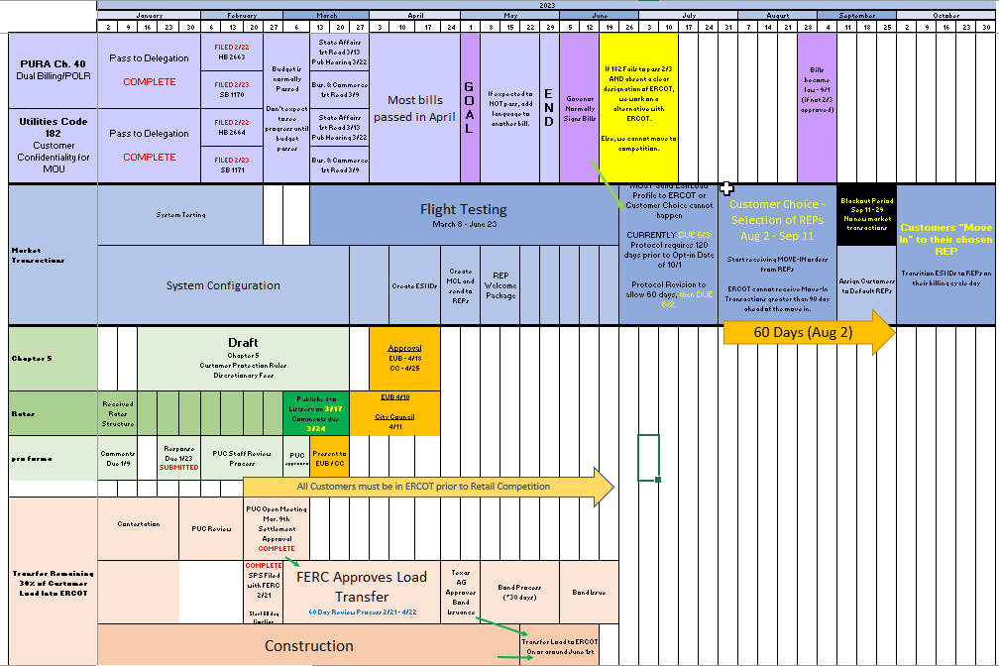
TRANSITION TO COMPETITION TIMELINE v20230320

Slide 4
ACTION | UPDATE
Customer Enrollment Process | Access Agreement (complete) → MCL/ESI list (early May) → REP Welcome Packet (early May) → Customer Choice (Aug 2 – Sep 11) → Blackout Period → MVIs transition to ERCOT → Business as Usual
Default/POLR REP | DREP/VREP: NRG, TXUE, Octopus; POLR: NRG
Dual Billing, if applicable | Once legislation is passed, Lubbock will choose for all billing to move to REP under consolidated billing
Registration of D2D agents | Continued discussion of current peddler’s license requirements; seeking clarity on applicability and exception process
Customer Protection Rules | Goal is to begin discussion at 4/4 task force meeting with presentation to City Council 4/11
Power to Choose | PUCT Staff to “tee up” PTC readiness for Lubbock zip codes and REP offers
Customer Forums/ Town Halls | Meet and greet for REPs and Energy Assistance Agencies scheduled for 4/18, 8:30 to 10:30 AM
Flight Testing | Total of 96 DUNS registered; 2 connectivity tests complete; BANK TESTING: awaiting banking information authorization form; Lubbock EDI contact information: Jamie Wood (806) 438-0729 marketops@mylubbock.us
Summary of Updates
2/7/23
2/28/23
Action items will continue to be updated at LRITF meetings

Slide 5
ACTION | UPDATE
RMG/Protocol Revisions | ERCOT targeting RMG Sections 7 & 8 for inclusion of Lubbock information and including customer choice billing comments submitted earlier
LSE files | LSE files will only be sent to ERCOT upon transition until ~Q2 2024 when SMT version is updated; REPs to use AMS Supplemental Extract for interval data access
Stacking Logic | Lubbock finalizing development – suggested separate meeting to review stacking logic and customer communications for all participating REPs
Historical Usage/ LOA | LOA form presented for use pre-transition; Lubbock to consider modifications to existing RMG template post transition: samples of interval and non-interval data formats requested
Critical Care Forms | Forms to be submitted to marketops@mylubbock.us
Summary of Updates
2/7/23
2/28/23 - continued
Action items will continue to be updated at LRITF meetings

Slide 6
Proposed rates/ structure summary
Lubbock proposed rates:
Rate Classifications: residential, secondary < 10 kW, Secondary > 10 kW, primary, transmission, lighting, residential with DG, secondary < 10 kW with DG
Cost recovery components: delivery service charge, transition charge, and DG monthly charge
SAC04 codes: Delivery Charge – DIS001, Transition Charge – MSC029, Monthly DG Charge - TBD
Transition Charge: debt service for stranded costs over 20 years; same for all rate classes
Street Lighting rates: only street lighting rates, no security lighting will be offered
Rate Revisions: expected annual cadence to align with fiscal year in October
Rates will be presented to City Council 3/28 & 4/11

Slide 7
Proposed Discretionary service Charges
Rates will be presented to City Council 3/28 & 4/11
Discretionary Service Charges reflect many existing fees at LP&L and will continue to refine as AMS savings are realized. The above fees do not differentiate by meter type.

Slide 8
Completed Action Items Q&A
TDSP Activities
Q: Will the meter read and holiday calendars be posted on LP&L’s website by October 31st each year? A: YES, schedules will be posted on LP&L website and 2023 schedules will be posted on LRITF main page. Meter Cycle # is listed as “Bill Cycle”; ALOP stands for ‘always open’ and is indicative of an internal LP&L process Q: What is LP&L’s temp to perm process for new installations? Will new ESIs be created or will a ‘swingover’ process occur? A: The existing temporary meter will not require re-configuration and a new ESI will be created for the permanent service. Q: Will REPs be provided a different phone number for agents to contact LP&L regarding underground line locating, tampering hotlines, etc? A: No, REPs should contact the REP hotline phone number Q: Will a fax number for LP&L be available? A: No Q: What are the number of AMS opt-out customers within the fully deployed AMS Lubbock territory? A: 32 opt out customers

Slide 9
Completed Action Items Q&A
TDSP Activities - continued
Q: Will service orders be accepted through LP&L’s Contact Center for those REPS not utilizing 650 transactions? A: Yes, service orders such as meter tests will be accepted through the Contact Center. Meter re-reads are discouraged since AMS meters are in place. Meter tests will be accepted. Q: Will AMSM meters have color coded meter tags representing a specific status of the service? If so , what do the various colors represent? A: For AMSM meters requiring a field visit: Red = DNPd Yellow = MVO Blue = Energized All AMSR meters will not have a designated meter tag. Q: Will LP&L service guard lights? A: No, LP&L plans to either sell or remove all existing guard light services by market open and will not offer guard light services. Q: Will LP&L maintain its existing URL and website? Will any subsites be updated/revised such as outage mapping? A: LP&L will maintain current website URLs including outage mapping information.

Slide 10
Completed Action Items Q&A
Customer Education & ERCOT Market Requirements
Q: Will payment history information be available for LP&L customers? A: LP&L customers may self-serve using their current customer portal to print a payment history form. Q: When will flight testing occur for LP&L and REPs planning to operate in LP&L’s territory? A: A special flight test has been approved for REPs to test with LP&L. TX SET is planning a ‘round-robin’ approach for full testing selecting 5 different use cases and 5 REPs to test. All REPs participating in round robin have been notified.

Slide 11
Activities timeline Posted to LRITF meeting page
A big thank you to Melenda w/ Oncor for developing timeline!

Slide 12
TIMELINE of Actions
Pro Forma Tariff
Access Agreement
POLR Process
Safety Net Process
Q4 2022
ERCOT Activities: SAC04s, Load Profiles
TSDP Activities: Critical Care, DLFs, Solar/DG, Switch Hold Files, BUSIDDRQ, Call Center, OGFLT, Weather Moratoriums, Proration
LP&L Rates
Customer Enrollment Process – Detailed Timeline
PUCT Complaint Process / Application of PUCT Rules
Transaction Timelines / TXSET Timelines
CSA Process
Q1 2023
Q2 2023
ESI IDs in TDSP Extract
RMG Chapter 8 Revisions
Historical Usage Requests
TDSP AMS Data Practices
Mass Customer Lists
Power to Choose website
Customer Forums/Town Halls
Flight Testing / Bank Testing
Q3 2023
CBCI files
Default REP Selection Process
DNP Blackout Period
Market Operations Group Established
Tampering Information Process
Smart Meter Texas
Q4 2023
GO LIVE – Transition to Competition

Slide 13
Lritf meeting Held after RMS @ 1:30 PM April 4th, 2023
AGENDA:
FERC timeline impacts
Chapter 5 – Customer Protection Rules
Rate Structure/Proposed Rates
LP&L legislation impacts
Flight Testing Status
Historical Usage LOA
Peddler’s License
EFLs
Tampering Documentation
Critical Care Applications
“TDU” or “MOU” FERC timeline impacts
867 and 810 Formats / Examples
Mass Customer List
Distribution Loss Factors (DLFs)
Activities Timeline
Open Discussion

