Slide 1
Proposed Market Design Bridging Option Discussion
ERCOT Staff
Special Technical Advisory Committee (TAC)
March 31, 2023
ERCOT Public

Slide 2
Purpose of the Analysis
“…the Commission directs ERCOT to evaluate bridging options to retain existing assets and build new dispatchable generation until the PCM can be fully implemented” (Memorandum attached to Order, Project 53298 (January 19, 2023)
Also, interest expressed at the February 2023 Reliability and Markets Committee in mechanisms that could help reduce the frequency of RUC for system capacity
Operating Reserve Demand Curve (ORDC) changes are one option being considered as a bridging option
This analysis targets potential ORDC increases in operating reserve ranges that are above emergency levels, while avoiding ORDC increases at times of substantial operating reserve surpluses, with the objectives of enhancing price signals that would have positive effects on:
  Retaining existing assets
  Adding new dispatchable generation
  Reducing the frequency of Reliability Unit Commitment (RUC) for system capacity
Additionally, these ORDC bridging options would:
  Have minimal system changes and be quickly implementable (i.e. 8 to 12 months)
  Fit within the existing market framework, from day-ahead through Settlement, including credit
  Continue to be hedgable by market participants through energy positions

Slide 3
Analysis Summary
Market wide energy revenue was calculated considering:
  (GTBD * SCED duration) * (System Lambda + RTORPA + RTORDPA)
Market wide headroom revenue was calculated considering:
  (RTOLCAP * SCED duration) * (RTORPA + RTORDPA)
Changes in revenue were then calculated by flooring RTORPA at varying prices (5,10,15,20,25) when RTOLCAP fell below certain thresholds (6500,7000,7500)
Additionally, we explored adding multi-step floors within the same range of operating reserves
We executed this analysis for 2020 and 2022. The idea here was to compare a year with mild pricing to a year with higher pricing.
For 2020 baseline, we considered 2022 ORDC parameters for pricing (VOLL = 5000, X = 3000, 2022 seasonal mu & sigma).
2020 Load Weighted Energy Price | 2022 Load Weighted Energy Price
$25.73/MWh | $74.93/MWh

Slide 4
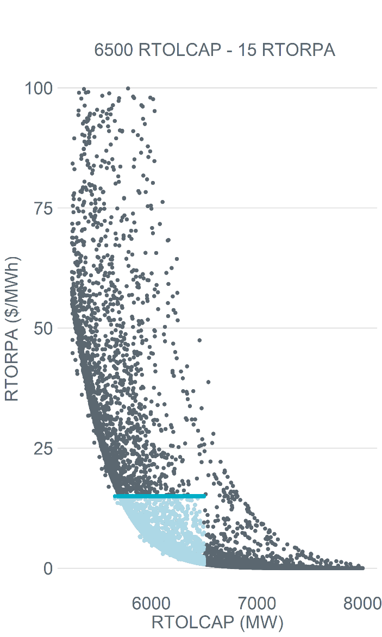
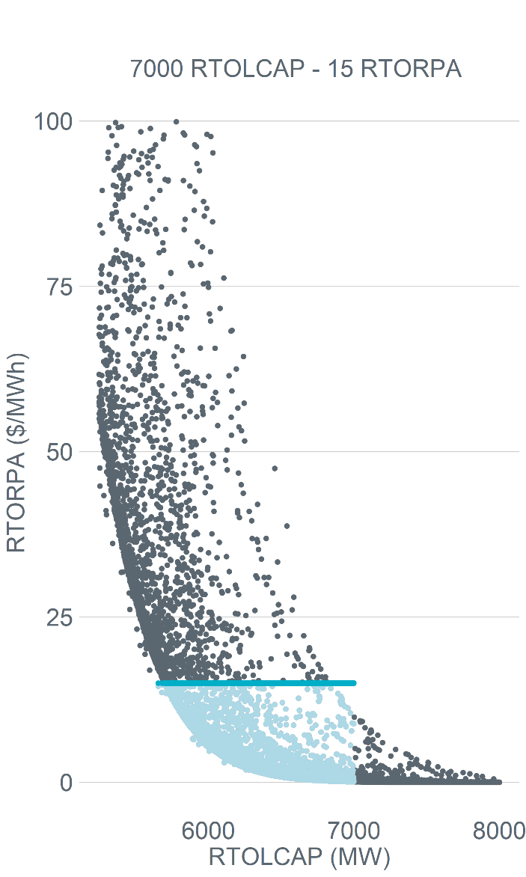
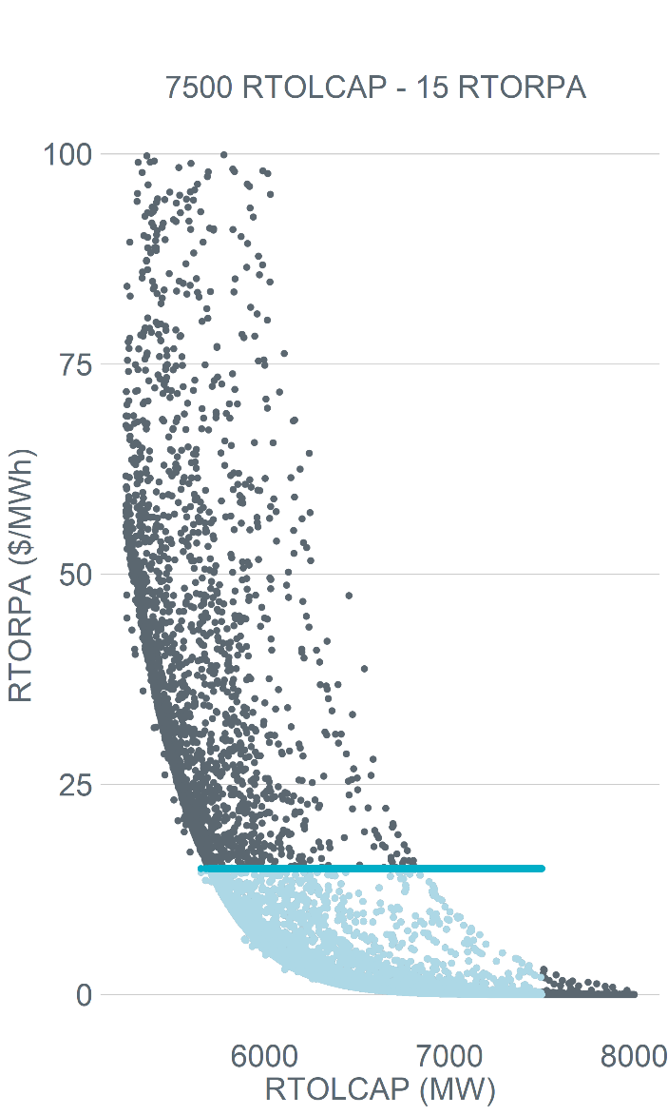
Single floor on the ORDC in practice (2020)

Slide 5
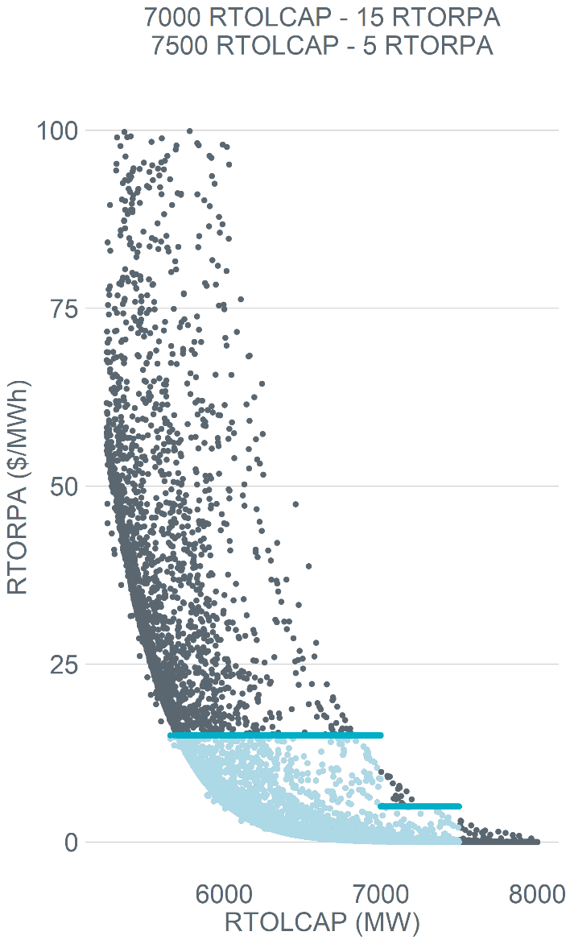
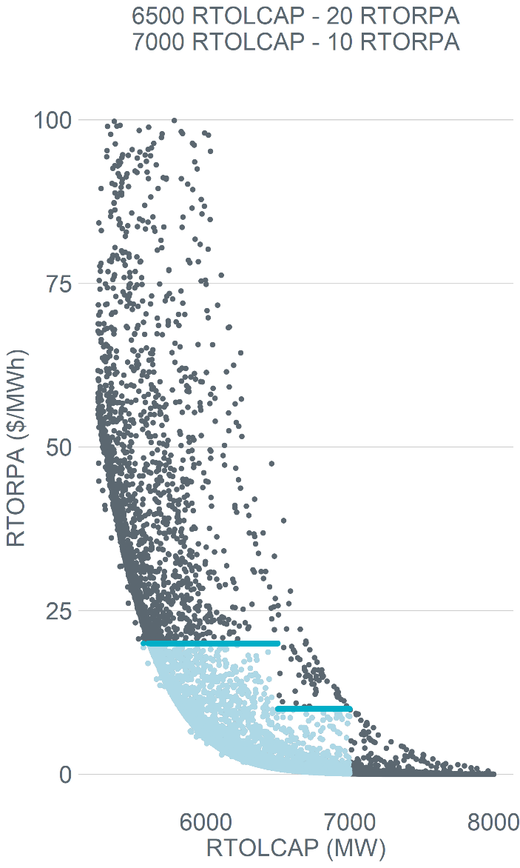

Multi-step floor on the ORDC in practice (2020)

Slide 6
Revenue Summary 2020
2020 - baseline energy revenue = $12.6B , baseline headroom revenue = $.3B
Floor Level (Online Reserve_Price) | Energy Revenue Increase ($M) | Headroom Revenue Increase ($M) | Total Revenue Increase ($M)
6500_15 | 186.0 | 24.2 | 210.2
6500_20 | 286.3 | 37.0 | 323.3
6500_25 | 395.7 | 50.7 | 446.4
6500_20, 7000_10 | 440.2 | 58.7 | 498.9*
6500_20, 7000_10, 7500_5 | 524.1 | 71.5 | 595.6
7000_15 | 422.9 | 57.6 | 480.5
7000_20 | 607 | 82.1 | 689.1
7000_25 | 800.6 | 107.6 | 908.2
7000_15, 7500_5 | 506.7 | 70.5 | 577.2
* 9% of 2020 intervals adjusted.
Preferred solution. See slide 9.

Slide 7
Revenue Summary 2022
2022 - baseline energy revenue = $32.1B , baseline headroom revenue = $.3B
Floor Level (Online Reserve_Price) | Energy Revenue Increase ($M) | Headroom Revenue Increase ($M) | Total Revenue Increase ($M)
6500_15 | 182.1 | 21.3 | 203.4
6500_20 | 274.3 | 31.8 | 306.1
6500_25 | 373.1 | 42.9 | 416.0
6500_20, 7000_10 | 438.0 | 52.8 | 490.8*
6500_20, 7000_10, 7500_5 | 533.7 | 65.9 | 599.6
7000_15 | 433.6 | 53.5 | 487.1
7000_20 | 613.9 | 75.1 | 689.0
7000_25 | 800.9 | 97.4 | 898.3
7000_15, 7500_5 | 529.3 | 66.6 | 595.9
* 7.9% of 2022 intervals adjusted.
Preferred solution. See slide 9.

Slide 8
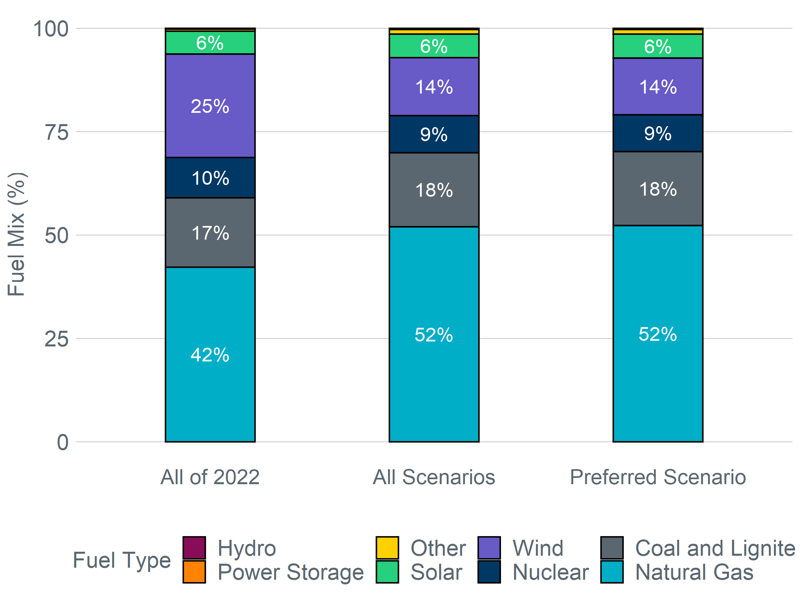
2022 Fuel mix average comparison
44% lower than annual average
24% higher than annual average

Slide 9
Preferred Solution
Multi-step floor - 6500MW @ $20/MWh & 7000MW @ $10MWh
Aligns with PCM: The back-cast analysis for 2020 and 2022 indicates that by applying these floors the total revenue increase would be in the $500M range. While we recognize the analysis does not account for behavioral changes, this level of increase aligns with the additional average revenue PCM would provide (as calculated by E3).
Targeted to the right resources at the right time: The back-cast analysis for 2022 confirms that when applying these floors the increase in revenue would be largely directed to dispatchable resources. In the preferred scenario 80% of the revenue increase would be directed to dispatchable resources. The floor prices are also having impact when ERCOT is seeing the greatest need for increased generator commitment.
Helps address RUC: Applying a floor that kicks in initially in the 6500-7000MW range provides a self-commitment incentive better aligned with conservative operations. Adding multiple steps to the floor incorporates feedback provided by market participants, provides for tiering in the strength of the self-commitment signal, and provides some mitigation of risk for generators that self-commit.

