Slide 1
Supply Analysis Working Group Update April 2023 Update to WMS
April 5, 2023
Kevin Hanson (National Grid) Chair
Pete Warnken (ERCOT) Co-Vice Chair
Ian Haley (Vistra) Co-Vice Chair

Slide 2
Overview
Annual DG Report Status (Clayton Stice)
Reliability Standard Framework Study (Pete Warnken)
Reserve Margin Study Status (Julie Jin)
Spring SARA Highlights (Pete Warnken)
‘Monthly Assessment of Resource Adequacy’ Planning Update (Pete Warnken / Dan Mantena)
Large Flexible Load Update (Evan Neel)

Slide 3
Annual DG Report Status
No new SODG renewables added in 2022

Slide 4
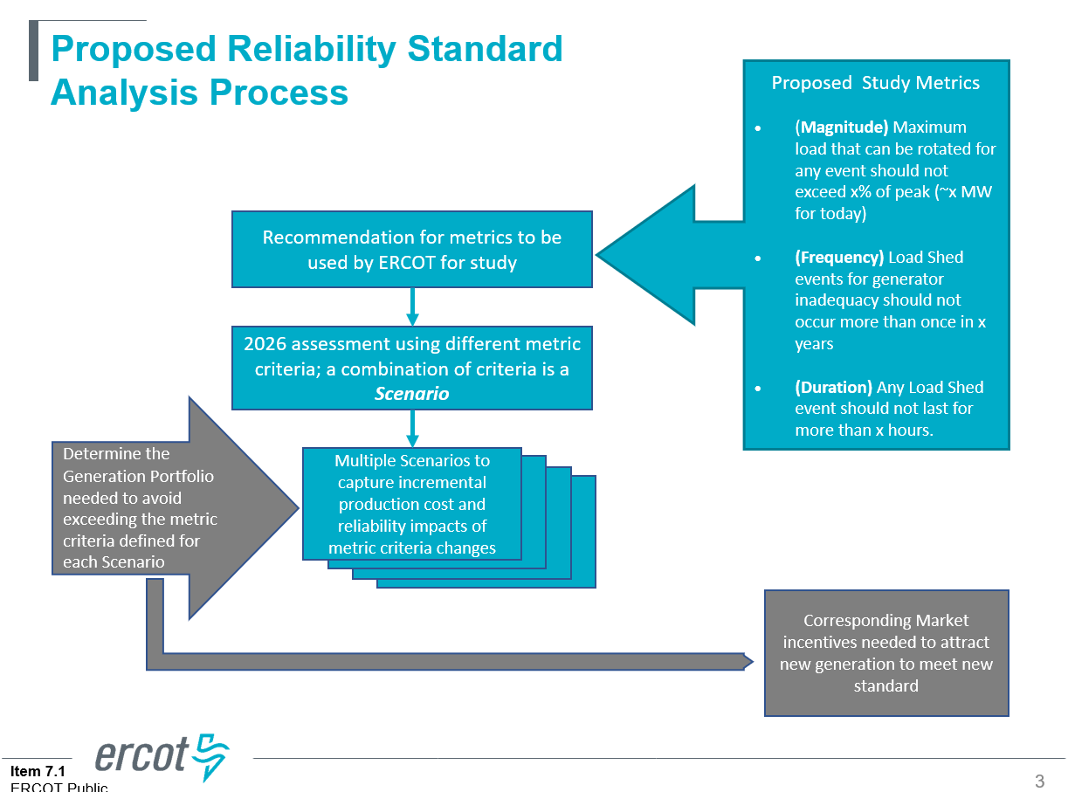
Reliability Standard Framework Study
The study process was discussed at SAWG
Next steps include a new VOLL study
An update on the progress will be made to stakeholder meetings and the Board in April and June 2023

Slide 5
Reserve Margin Study Status
Updating SERVM model inputs to develop base-case: load forecast, generation resources, PUNs and hydro modeling
Collecting and processing generator outage data; some responses to the data request excluded reserve shutdown events, which should be included in NERC Generator Availability Data System (GADS) data submissions
Multiple sensitivities being proposed (shown on next slide)

Slide 6
Reserve Margin Study Status

Slide 7
Spring SARA Highlights
Increased April and May peak load forecasts, 1.5 GW and 5.2 GW, respectively
Increased solar and wind: 4.1 GW and 1.4 GW, respectively
Increased EEA resources available during reserve scarcity conditions: 0.8 GW, mainly from distribution voltage reduction and curtailable Large Flexible Loads (LFLs)
Capacity contribution for battery storage: 0.9 GW
Decreased thermal resource capacity: units on extended outage and summer mothball schedules total 1.2 GW, co-located Large Flexible Loads reduce thermal capacity by 0.6 GW

Slide 8
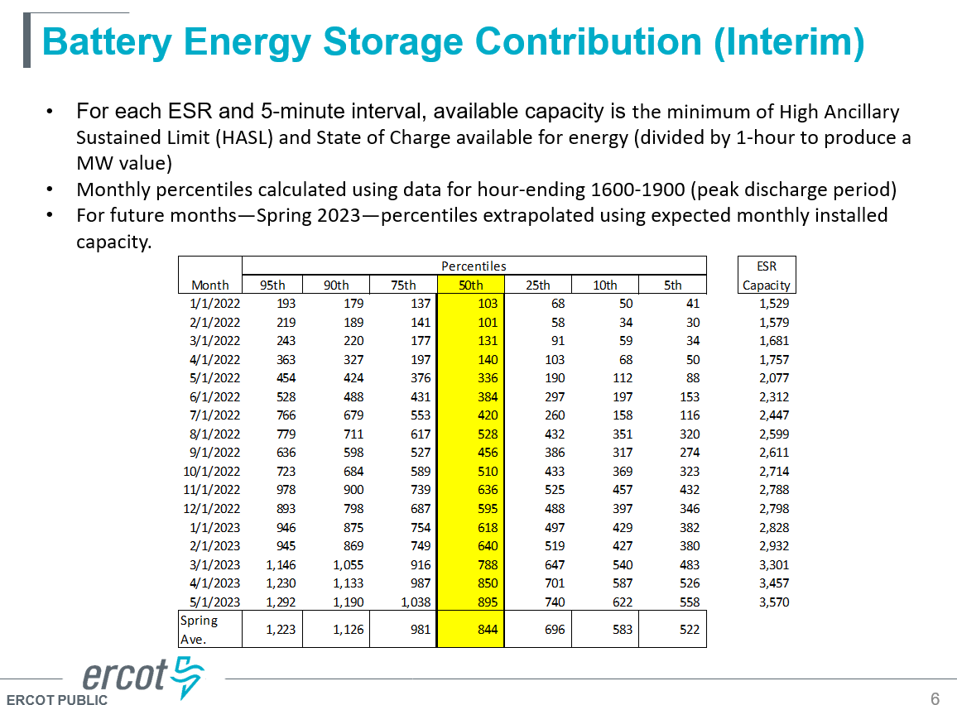
Spring SARA Highlights
Risk Scenarios for March-April and May were presented
Battery Energy Storage Contribution (Interim) was discussed

Slide 9
‘Monthly Assessment of Resource Adequacy’ Planning Update
Posts the reports 2 months prior to the reporting month
Planning to release the first monthly report in September (for the November reporting month)
Planning for an on-line dashboard
ERCOT is looking for feedback on the Monthly Assessment of Resource Adequacy (MARA) update prior to the next meeting

Slide 10
Large Flexible Load Update
LFLs in SAR and CDR
In SARA:
TDSP connected LFLs are currently baked into load forecast.
Co-located LFLs have their own line item and methodology outlined in the report.
In CDR:
TDSP connected LFLs are currently baked into load forecast.
Future TDSP connected LFL projections are 700 MW/year
Co-located LFLs are included in PUN contribution
Currently working on draft NPRR language to separate TDSP connected LFLs into its own line item in CDR. SARA will follow suit.

