Slide 1
Monthly Outlook of Reserve Adequacy (MORA) Report Update
Pete Warnken
Resource Adequacy
March 24, 2023
Notes:
Welcome to

Slide 2
Anticipated Timeline for Releases
Post the reports two months prior to the reporting month, per the schedule at right
Initially planning to release the first monthly report in early September (for the November reporting month)
  Dependency on implementing automated reporting process; risk of delays can be mitigated by rolling out features over several months
Continue to post reports to www.ercot.com
Planning in the works for an accompanying on-line dashboard

Slide 3
Main Report Design Element
Report will be a PDF or PowerPoint file with a link to the dashboard
Highlights page
  Canned section with standard summary statistics
  Ad hoc “Notable Changes” section (e.g., new out-of-service units)
  Chart(s)
Load and resource forecast table
  Columns for expected peak demand hour and net peak demand hour
  Resources listed by technology/fuel type categories
Capacity changes relative to the same month of the prior year
  Waterfall chart and/or table

Slide 4
Load and Resources Table

Slide 5
Load and Resources Table, continued

Slide 6
Load and Resources Table, continued

Slide 7
CAFOR “Under Typical Conditions” Section

Slide 8
Main Report Design Elements – Risk Page
Risk assessment section based on monthly runs of the Reserve Risk Assessment Model
  Show average load and resource capacity by type corresponding to ranges of CAFOR (Capacity Available for Operating Reserves)
  “Extreme Event” scenario based on simulation results
    Provided to NERC for their summer/winter seasonal reliability assessments
  Energy Emergency Alert (EEA) hourly risk profile table similar to what SAWG has seen in past presentations
User-defined scenarios in the dashboard is a possible future enhancement

Slide 9
Risk Assessment Section
CAFOR Risk Profile
CAFOR probabilities are representative of the net peak load hour for the month
Fake Values
Hourly EEA Risk Profile
Hourly EEA probabilities are representative of the peak load day for the month

Slide 10
Risk Assessment Section

Slide 11
Supplementary
Installed capacity additions since the start of the prior month
Actuals vs. forecast
  For example, the report released in February would show a line item comparison of the January forecasts and actuals at the time of the hourly peak and net peak loads
These data displays may be more appropriate for the on-line dashboard

Slide 12
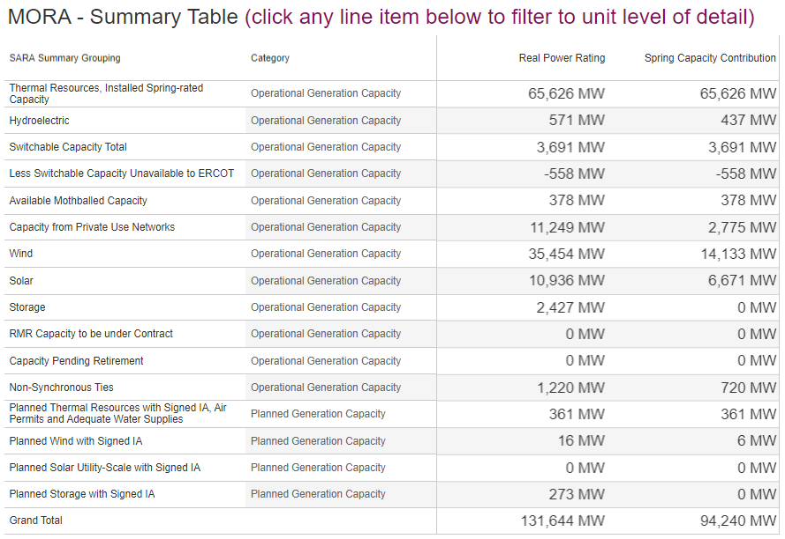
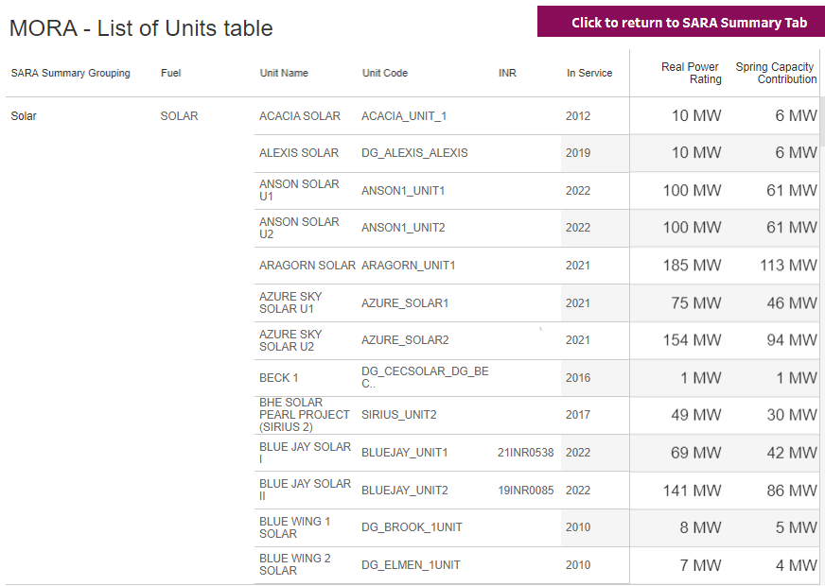
MORA Tableau Dashboard Example - Resources information
Notes:
https://public.tableau.com/app/profile/ercot.resource.adequacy/viz/MORADashboard_DRAFT/MORASummary

