Slide 1
Spring SARA Report Overview
Pete Warnken
Resource Adequacy
March 24, 2023
Notes:
Welcome to

Slide 2
Main Changes Relative to Last Year’s Spring SARA
Increased April and May peak load forecasts, 1.5 GW and 5.2 GW, respectively
Increased solar and wind: 4.1 GW and 1.4 GW, respectively
Increased EEA resources available during reserve scarcity conditions: 0.8 GW, mainly from distribution voltage reduction and curtailable Large Flexible Loads (LFLs)
Capacity contribution for battery storage: 0.9 GW
Decreased thermal resource capacity: units on extended outage and summer mothball schedules total 1.2 GW, co-located Large Flexible Loads reduce thermal capacity by 0.6 GW

Slide 3
Resource Changes Since 2022 Spring SARA

Slide 4
Risk Scenarios: Maintenance Season,
March-April

Slide 5
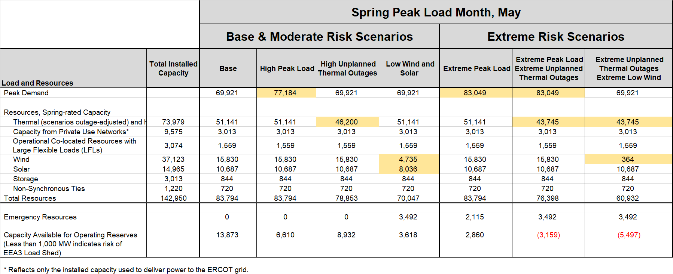
Risk Scenarios: May

Slide 6
Battery Energy Storage Contribution (Interim)
For each ESR and 5-minute interval, available capacity is the minimum of High Ancillary Sustained Limit (HASL) and State of Charge available for energy (divided by 1-hour to produce a MW value)
Monthly percentiles calculated using data for hour-ending 1600-1900 (peak discharge period)
For future months—Spring 2023—percentiles extrapolated using expected monthly installed capacity.

