Slide 1
ERCOT Frequency Events
February 2023
ERCOT
Operations Planning
PDCWG | Mar 22nd, 2023

Slide 2
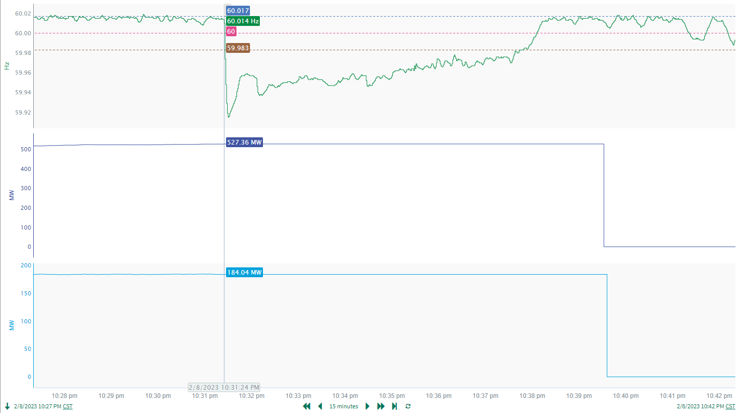
2/8/2023 22:31:24 (FME)
Notes:
Two combine cycle units tripped offline for a combined loss of approximately 711 MW
Starting Frequency: 60.014 Hz
Maximum Frequency: 59.915 Hz
A-C Time : 6 seconds
Recovery Time(back to deadband): 6 minutes 22 seconds
RRS Released: 0 MW
Trip Reason: Unknown at this time
Contextual Information: A total of 195 MW of regulation Up was deployed during the event

Slide 3
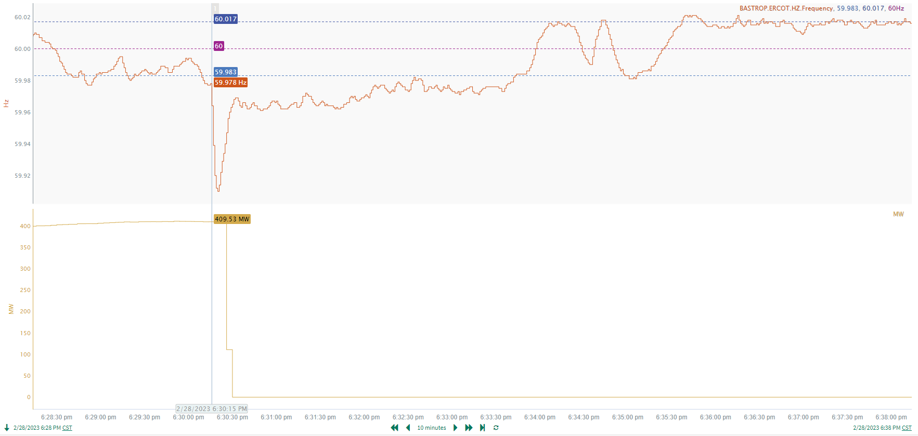
2/28/2023 18:30:15(Non-FME)
Notes:
A unit tripped offline while carrying approximately 410 MW gen
Starting Frequency: 59.978 Hz
Minimum Frequency: 59.91 Hz
A-C Time : 5 seconds
Recovery Time(back to deadband): 3 minutes 28 seconds
RRS Released: 0 MW
Trip Reason: The unit was testing a main steam safety valve and tripped.
Contextual Information: A total of 590 MW of regulation up was deployed during this time
No Selection Reason: Starting frequency below the lower deadband, small event(MW loss = 410 MW)

Slide 4
Questions?
Thank you!

