Slide 1
ERCOT Updates
NDSWG March 2023
Joel Koepke
3/21/2023

Slide 2
Topics
NMMS “Tech Health” Project
Contingency Review
  Annual double-circuit review kickoff
  New manual contingency review
One-Line Modeling Expectations
SSWG Node/Breaker NOMCR Submissions

Slide 3
NMMS Tech Health Project – Deployments (Update)
Initial deployment was in early December
  Performance issues experienced
  Defects identified
Upcoming deployments (schedule subject to change)
  January deployment to fix critical defects
    Completed
  February deployment (2/24)
    Completed
  March deployment (3/27)
    Addresses stability issues along with more than 20 defects
  April deployment
    Issues TBD

Slide 4
Manual Contingency Review
ERCOT will be starting a new process to review manual contingencies
The goal of this review is to determine if the contingencies are still accurate and required
  Many of the contingencies are disabled
The outcome of the review will be a CAMR or ICR similar to the double-circuit contingency review

Slide 5
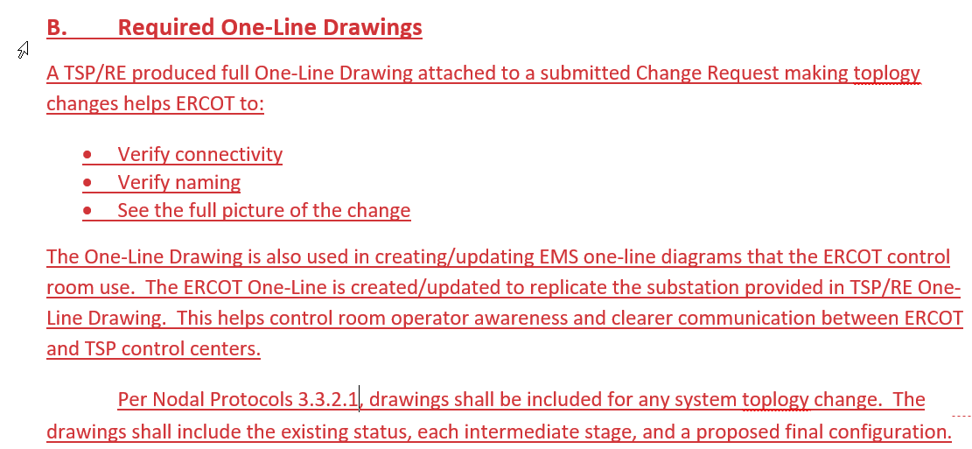
Draft Modeling Expectations Update for One-Line Requirements

Slide 6
Upcoming Model Change Requests for SSWG
SSWG will be starting the process to add node-breaker detail to SSWG cases.
“Bus-Branch” detail of a ring bus for Planning
“Node-Breaker” detail of a ring bus for Operations
SSWG members will be asked to correct and add new information to the model.

Slide 7
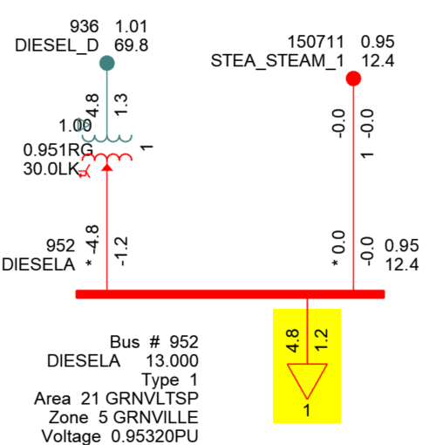
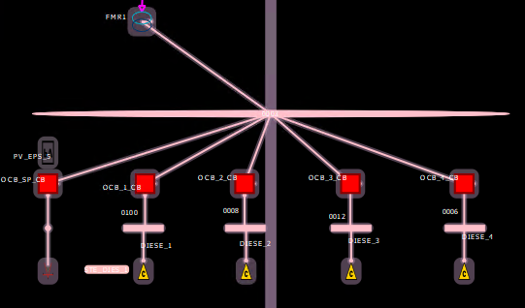
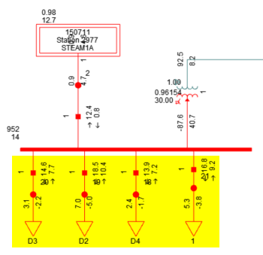
SSWG NOMCR Example: Deconsolidating Shunt Devices
Bus-Branch
The PSSE ID of many shunt devices must be updated to avoid consolidation during topology processing
Topology Processing
Loads are consolidated if their PSSE IDs are the same
Node-Breaker
Example: The operations model has 4 loads connected to the same Connectivity Node Group
Loads remain unaggregated if their PSSE IDs are different

