Slide 1
UFLS Options
Getting Back To Reality
March 20, 2023

Slide 2
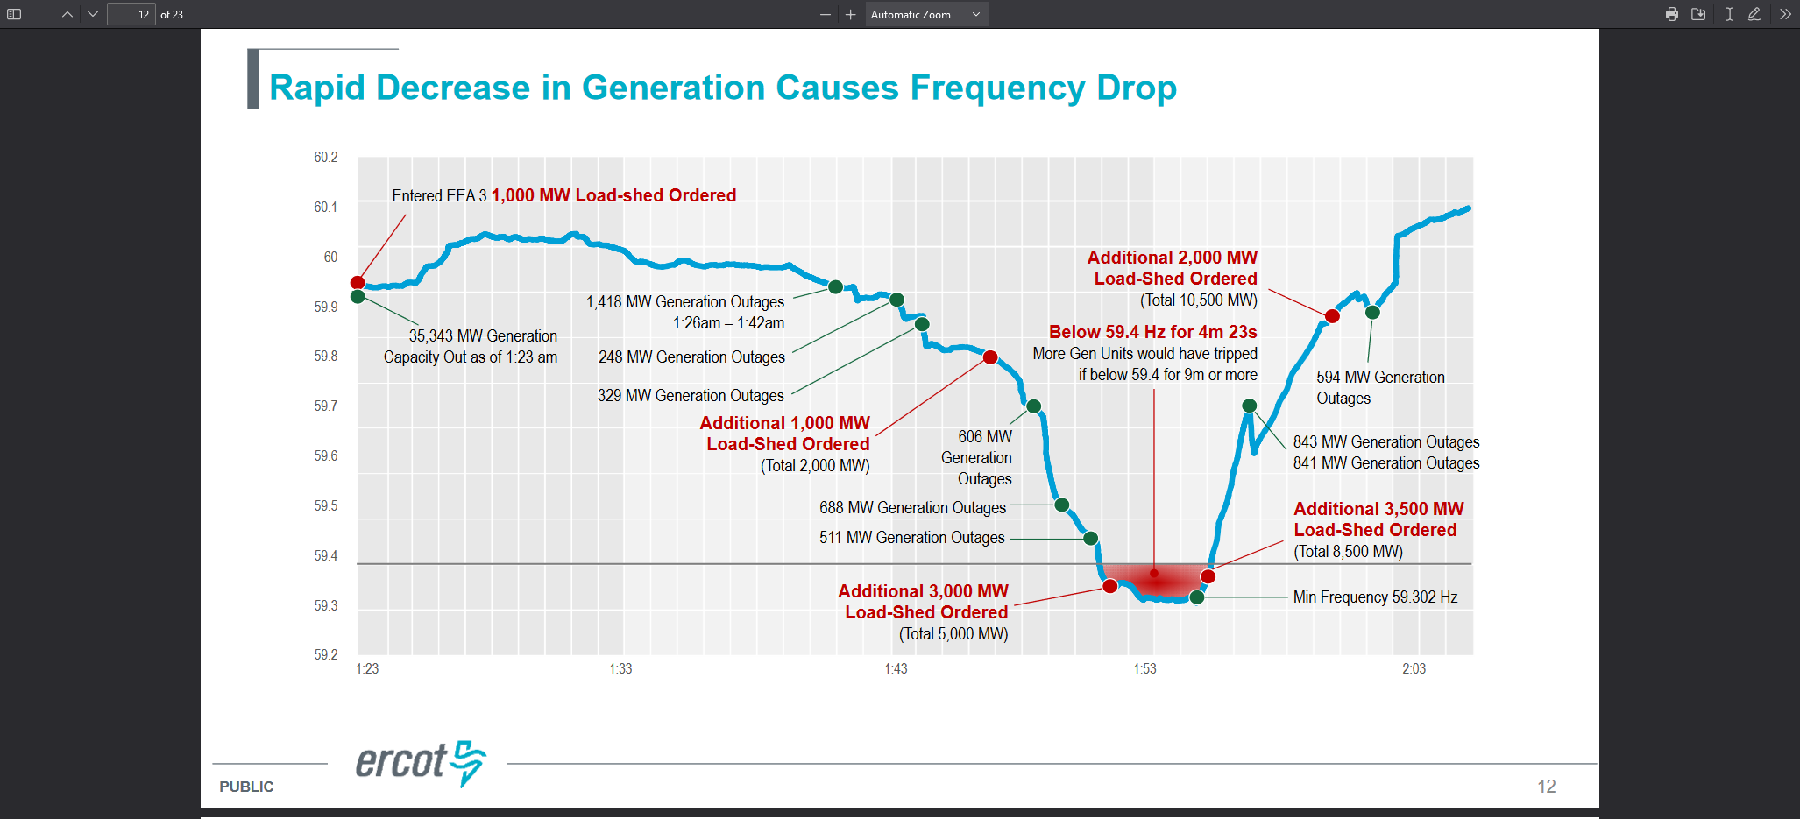
Purpose
Underfrequency Load Shed
  Arrests frequency decay on rapid loss of generation
    May 15, 2003 Turkey Vulture dropping event
  Arrest frequency decay on slow decline in frequency
    Uri!
Must be automated
  May not be time for operator instruction
Must be controlled
  Interruption of too little load could allow further decay
  Interruption of too much load could cause frequency overshoot and instability
Red = BAD

Slide 3

Previous Proposal
The UFLS obligation should belong to the LFL for compliance (i.e., 5-10-10)
  The 5-10-10 is applicable to 25% of site load.
  Design so that the load is not shed at the transmission level breaker or that the load shed is not excessively above each step requirement.
  ERCOT may require P.E. attestation for correct installation of breakers provided to ERCOT and TO.
  LFL UFLS requirement will not be in the denominator for TO load shed obligation.
Above would apply unless the Transmission Operator assumes the UFLS obligation
  Details of responsibility defined in Facilities Extension Agreement (FEA) or Interconnection Agreement (IA)

Slide 4

What is the problem?
Reality of the need
  Proposal only applies to a random subset of loads – Registered LFLs
    If need is real (and it is) the requirement should be for all load
Reality of the Rules
  Texas Administrative Code Title 16, Part 2, Chapter 25, Subchapter I, Division 1 Rule 25.200 (a):
Procedures. The Electric Reliability Council of Texas (ERCOT) shall direct non-discriminatory emergency load shedding and curtailment procedures for responding to emergencies on the transmission system in accordance with ERCOT protocols. (emphasis added)
  I don’t write the rules, I just follow them
Reality of the Load
  Most loads can’t be subdivided into 5/10/10% bitesized chunks
  Bitcoin mines can, but this isn’t just about Bitcoin mines
  Compressor stations, steel mills, electrolyzers…
  Even for loads that can, it’s very expensive
Reality of the Management
  Assuming the loads can subdivide as proposed, there is no need for the QSE to monitor
  TO can perform the same monitoring they are already doing

Slide 5

What can be done?
There is no Silver Bullet
  If it were easy, it would have already been done
Options
  Previous offered by the TSPs (hammering the square peg)
  Previous with TSP monitoring (peg is still square)
  OR!

Slide 6



The Rainbows, Butterflies and Daffodils Proposal (RBD)
For transmission class customers:
  Convert requirement into a fungible product
    MWs of load shed at each frequency tier
    Actuated by UF relay that is remotely armable and monitored
    Product can be set up as annual, quarterly, business hours…
  Loads are allowed to trade their MWs with other loads for coverage
    Can be ran as a centralized ERCOT market or bilateral
    Obligations would be assigned to all loads
    Self provision would obviously be allowed
    Cleared loads would be paid by others with unmet obligations
  Managed at QSE level
    Once obligations are set, QSE would follow compliance criteria
  Considerations
    Additional timeframes are needed to allow broader participation
      However, creates additional burden on monitoring
    Large loads are not as diverse as bulk distribution load
      May need alternate criteria for compliance

Slide 7


