Slide 1
Proposed Adjustments to ORDC
March 15, 2023
Blake Holt

Slide 2
Purpose of the Analysis
“…the Commission directs ERCOT to evaluate bridging options to retain existing assets and build new dispatchable generation until the PCM can be fully implemented” (Memorandum attached to Order, Project 53298 (Jan. 19, 2023)
Also, interest expressed at the Feb. 2023 ERCOT R&M in mechanisms that could help reduce the frequency of RUC for system capacity
ORDC changes are one option being considered as a bridging option
This analysis targets potential ORDC increases in operating reserve ranges that are above emergency levels, while avoiding ORDC increases at times of substantial operating reserve surpluses, with the objectives of enhancing price signals that would have positive effects on:
  Retaining existing assets
  Adding new dispatchable generation
  Reducing the frequency of RUC for system capacity
Additionally, these ORDC bridging options would:
  Have minimal system changes and be quickly implementable (i.e. 8 to 12 months)
  Fit within the existing market framework, from DA through Settlement, including credit
  Continue to be hedgable by market participants through energy positions

Slide 3
Analysis Summary
2022 market wide energy revenue was calculated considering:
  (GTBD * SCED duration) * (System Lambda + RTORPA + RTORDPA)
2022 market wide headroom revenue was calculated considering:
  (RTOLCAP * SCED duration) * (RTORPA + RTORDPA)
2022 baseline energy revenue = $32.08B
2022 baseline headroom revenue = $.3B
Changes in revenue were then calculated by flooring RTORPA at varying prices (5,10,15,20,25) when RTOLCAP fell below certain thresholds (6500,7000,7500)

Slide 4
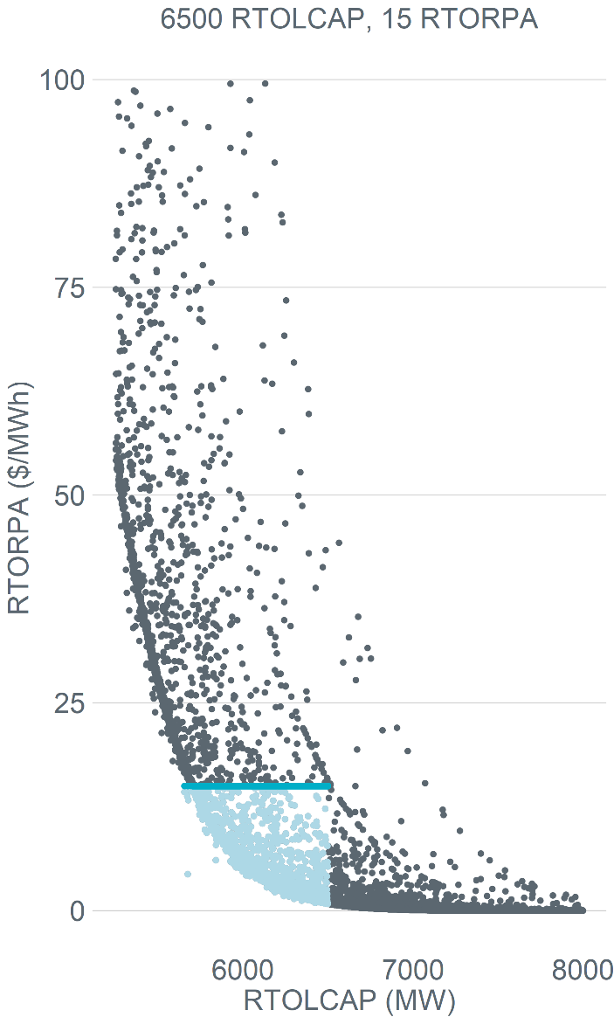
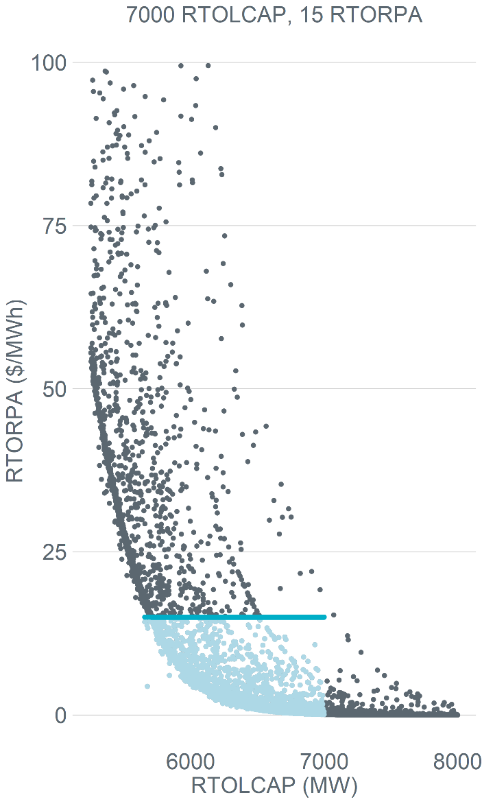
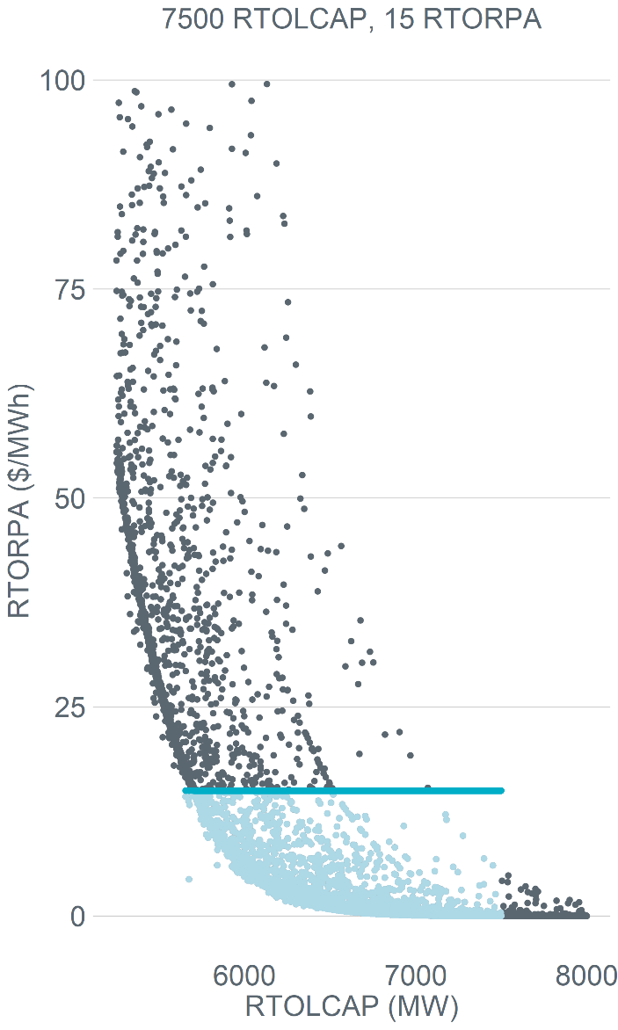
Adjusted price on the ORDC

Slide 5
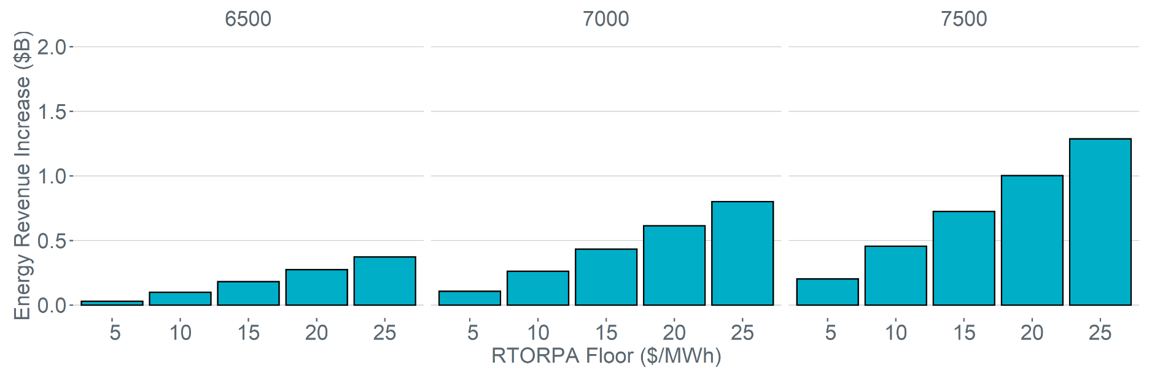
2022 Energy Revenue Increase with RTORPA floor
RTOLCAP Threshold
6,500
Intervals at or above RTOLCAP threshold
99,455
Intervals below RTOLCAP threshold 7,142
RTORPA Floor | Intervals adjusted | RTORPA GTBD weighted average of all intervals ($7.19/MWh) | RTORPA GTBD weighted average where RTOLCAP < threshold ($90.51/MWh)
5 | 2,675 (37%) | 7.26 | 91.41
10 | 3,602 (50%) | 7.42 | 93.47
15 | 4,059 (57%) | 7.63 | 95.98
20 | 4,398 (62%) | 7.84 | 98.75
25 | 4,636 (65%) | 8.08 | 101.73

Slide 6
2022 Energy Revenue Increase with RTORPA floor
RTOLCAP Threshold
7,000
Intervals at or above RTOLCAP threshold
95,375
Intervals below RTOLCAP threshold 11,222
RTORPA Floor | Intervals adjusted | RTORPA GTBD weighted average of all intervals ($7.19/MWh) | RTORPA GTBD weighted average where RTOLCAP < threshold ($59.53/MWh)
5 | 6,657 (59%) | 7.45 | 61.62
10 | 7,650 (68%) | 7.81 | 64.66
15 | 8,125 (72%) | 8.22 | 68.02
20 | 8,468 (75%) | 8.64 | 71.55
25 | 8,708 (78%) | 9.09 | 75.23

Slide 7
2022 Energy Revenue Increase with RTORPA floor
RTOLCAP Threshold
7,500
Intervals at or above RTOLCAP threshold
90,859
Intervals below RTOLCAP threshold 15,738
RTORPA Floor | Intervals adjusted | RTORPA GTBD weighted average of all intervals ($7.19/MWh) | RTORPA GTBD weighted average where RTOLCAP < threshold ($43.19/MWh)
5 | 11,162 (71%) | 7.67 | 46.05
10 | 12,163 (77%) | 8.27 | 49.63
15 | 12,640 (80%) | 8.90 | 53.43
20 | 12,984 (83%) | 9.56 | 57.37
25 | 13,224 (84%) | 10.23 | 61.41

Slide 8
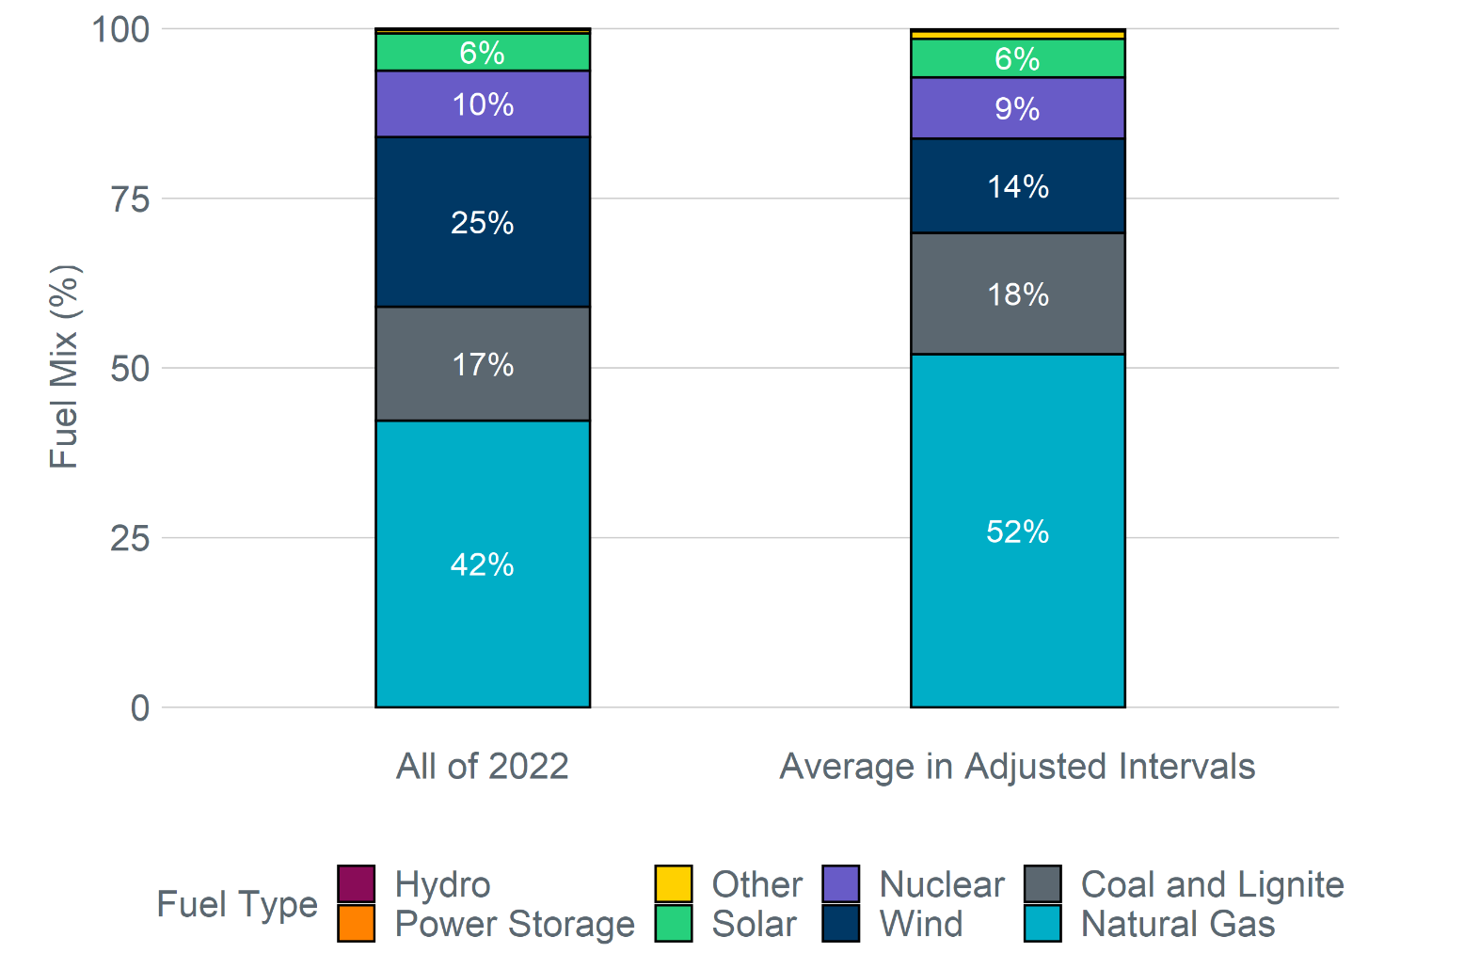
Fuel mix comparison
The fuel mix was relatively constant across all of the adjusted intervals
44% lower than annual average
24% higher than annual average

Slide 9
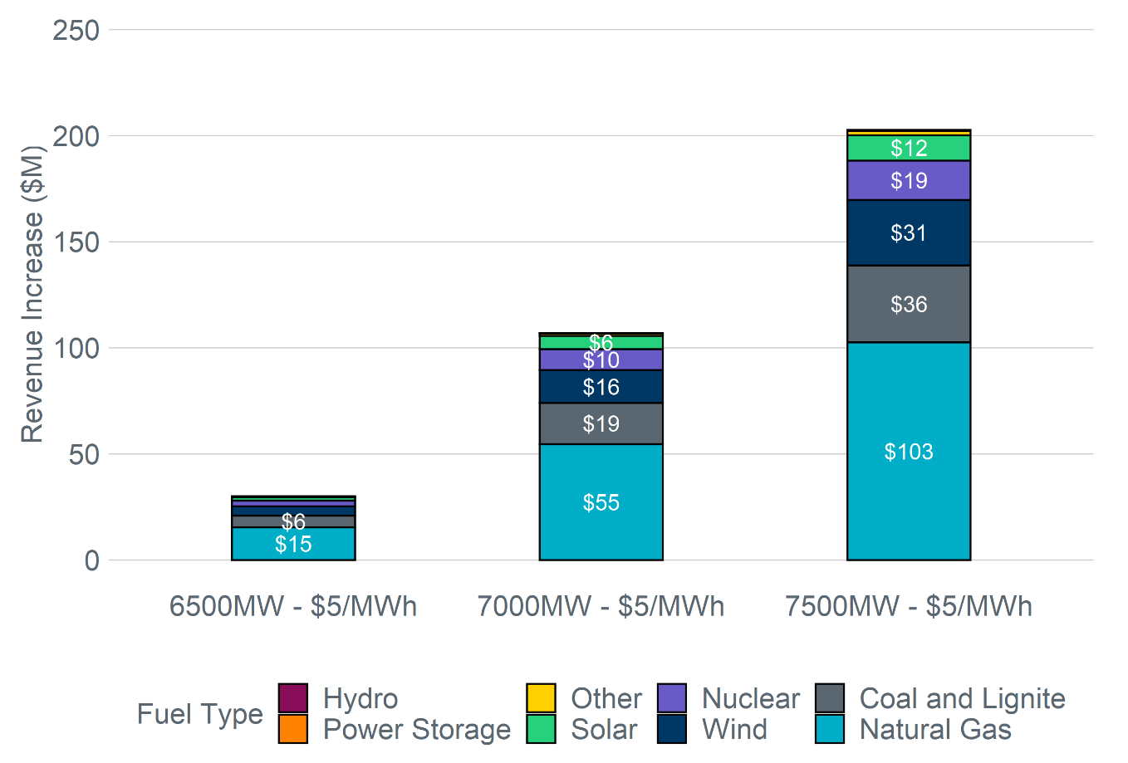
Revenue Increase - $5/MWh floor

Slide 10
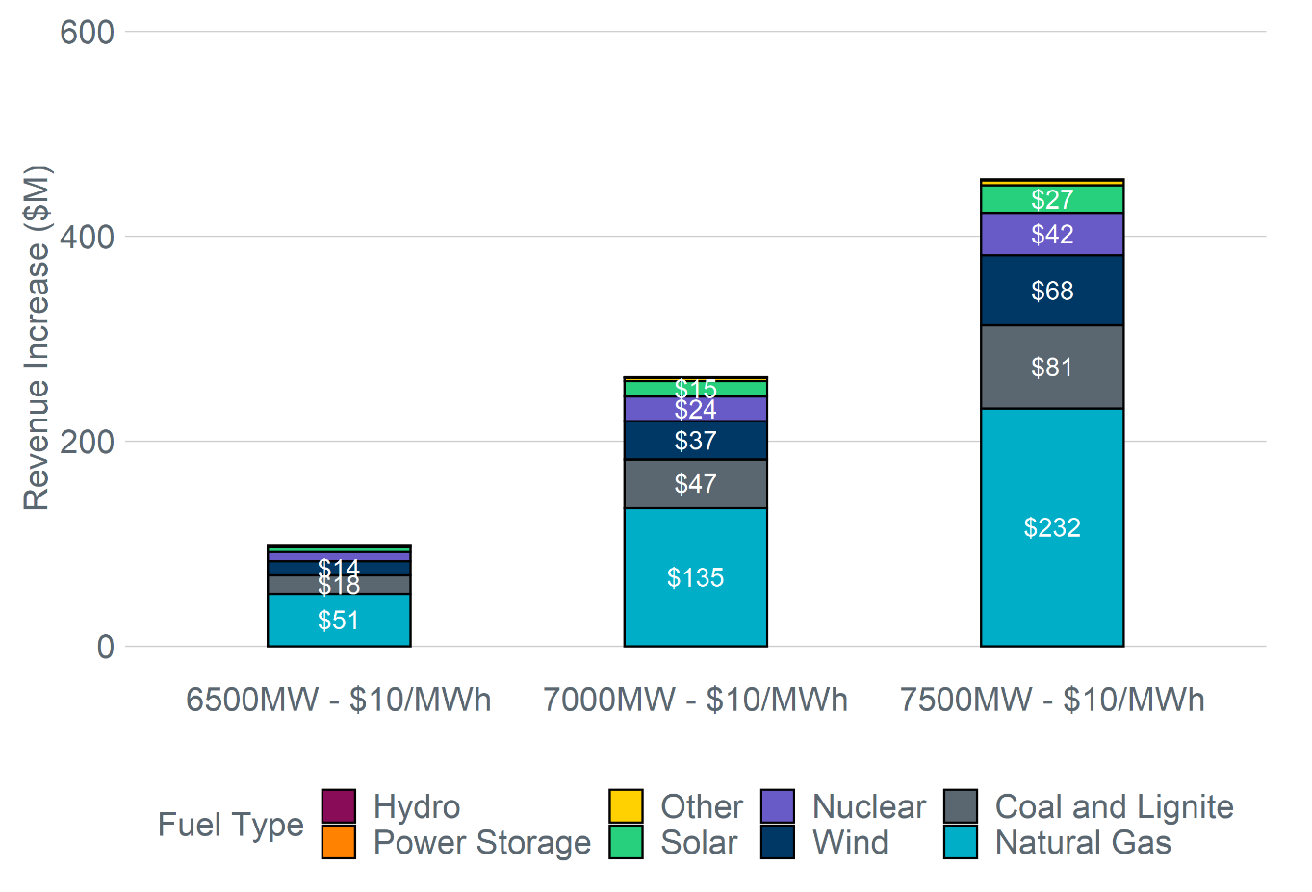
Revenue Increase - $10/MWh floor

Slide 11
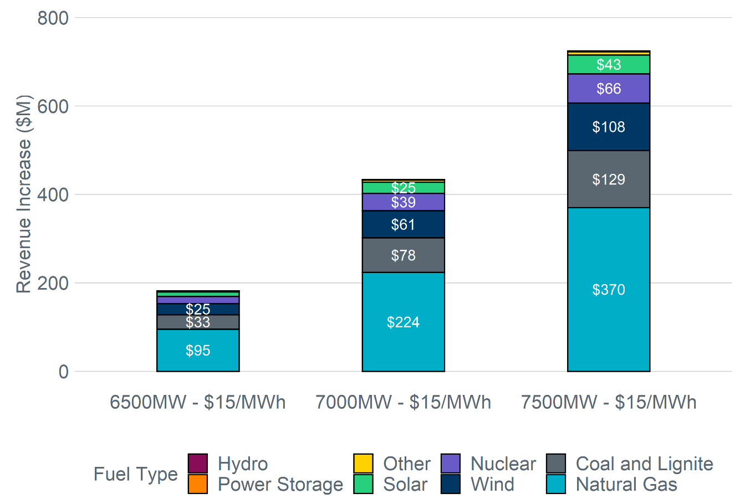
Revenue Increase - $15/MWh floor

Slide 12
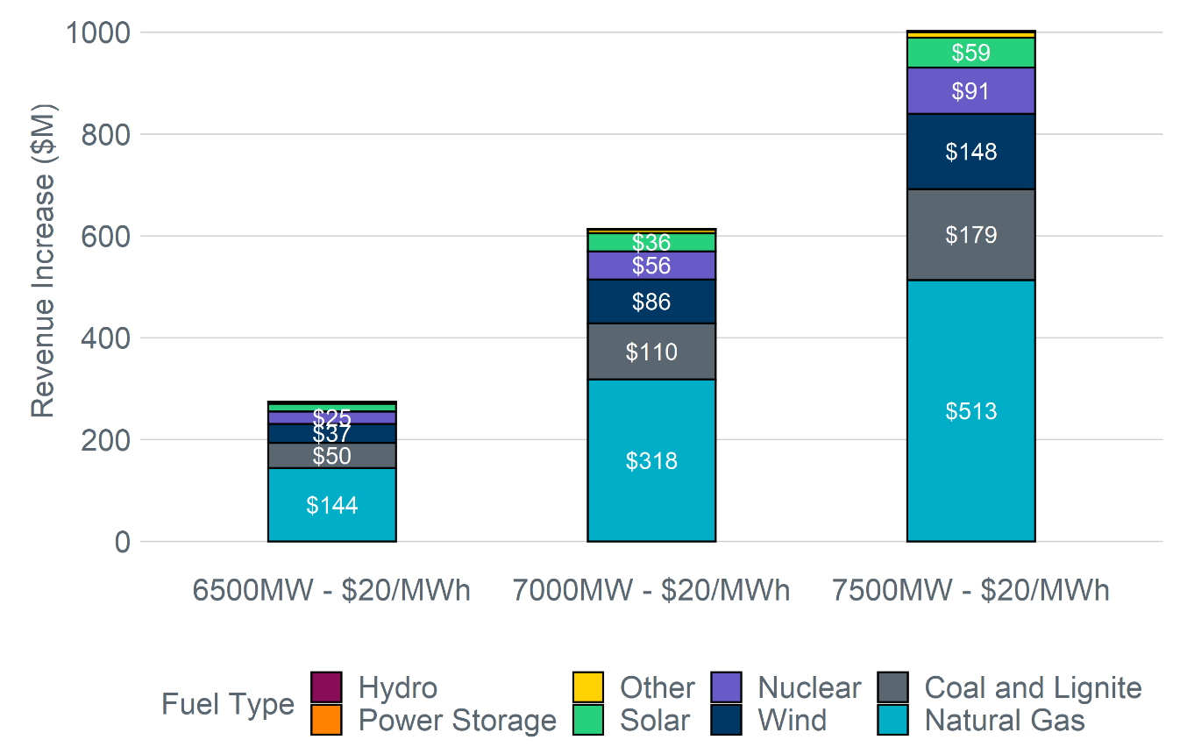
Revenue Increase - $20/MWh floor

Slide 13
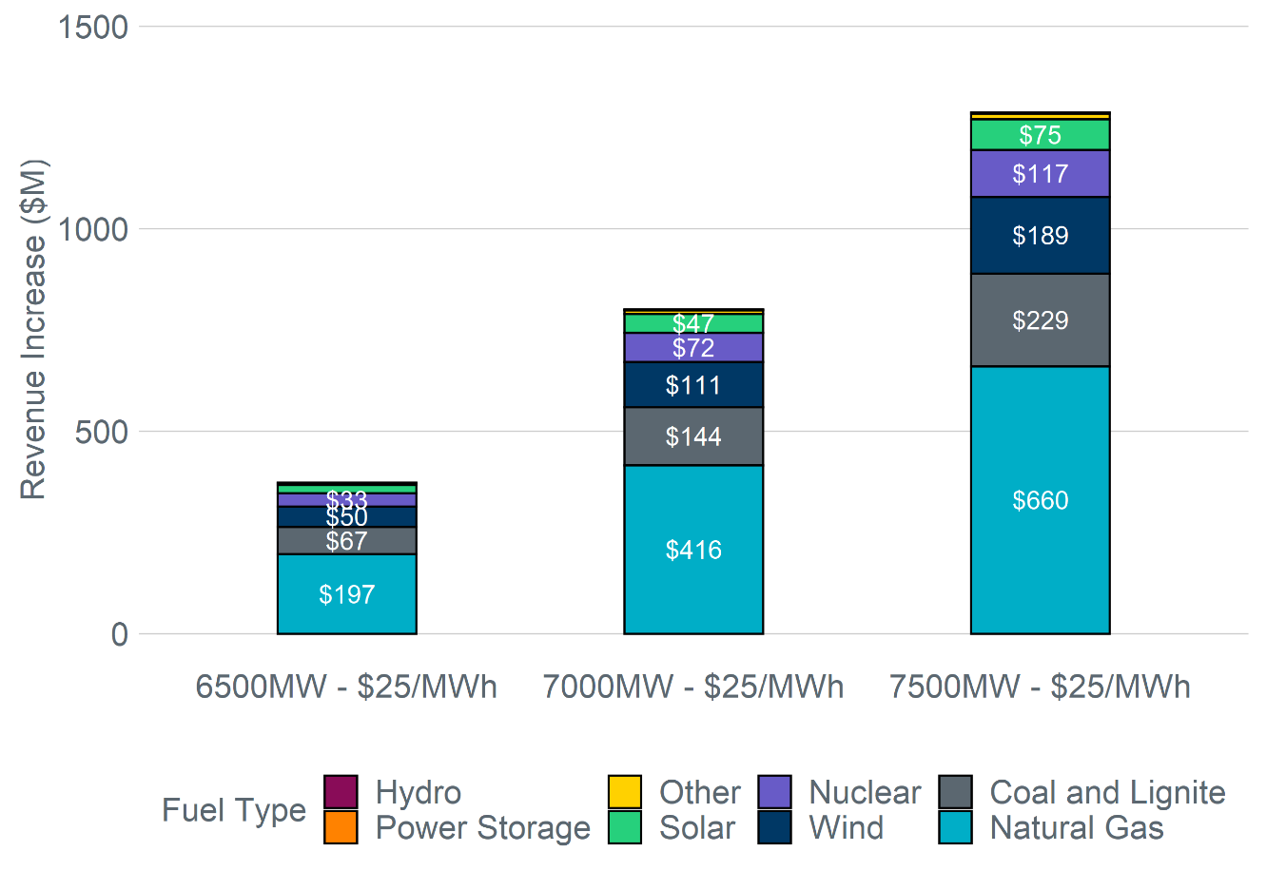
Revenue Increase - $25/MWh floor

Slide 14
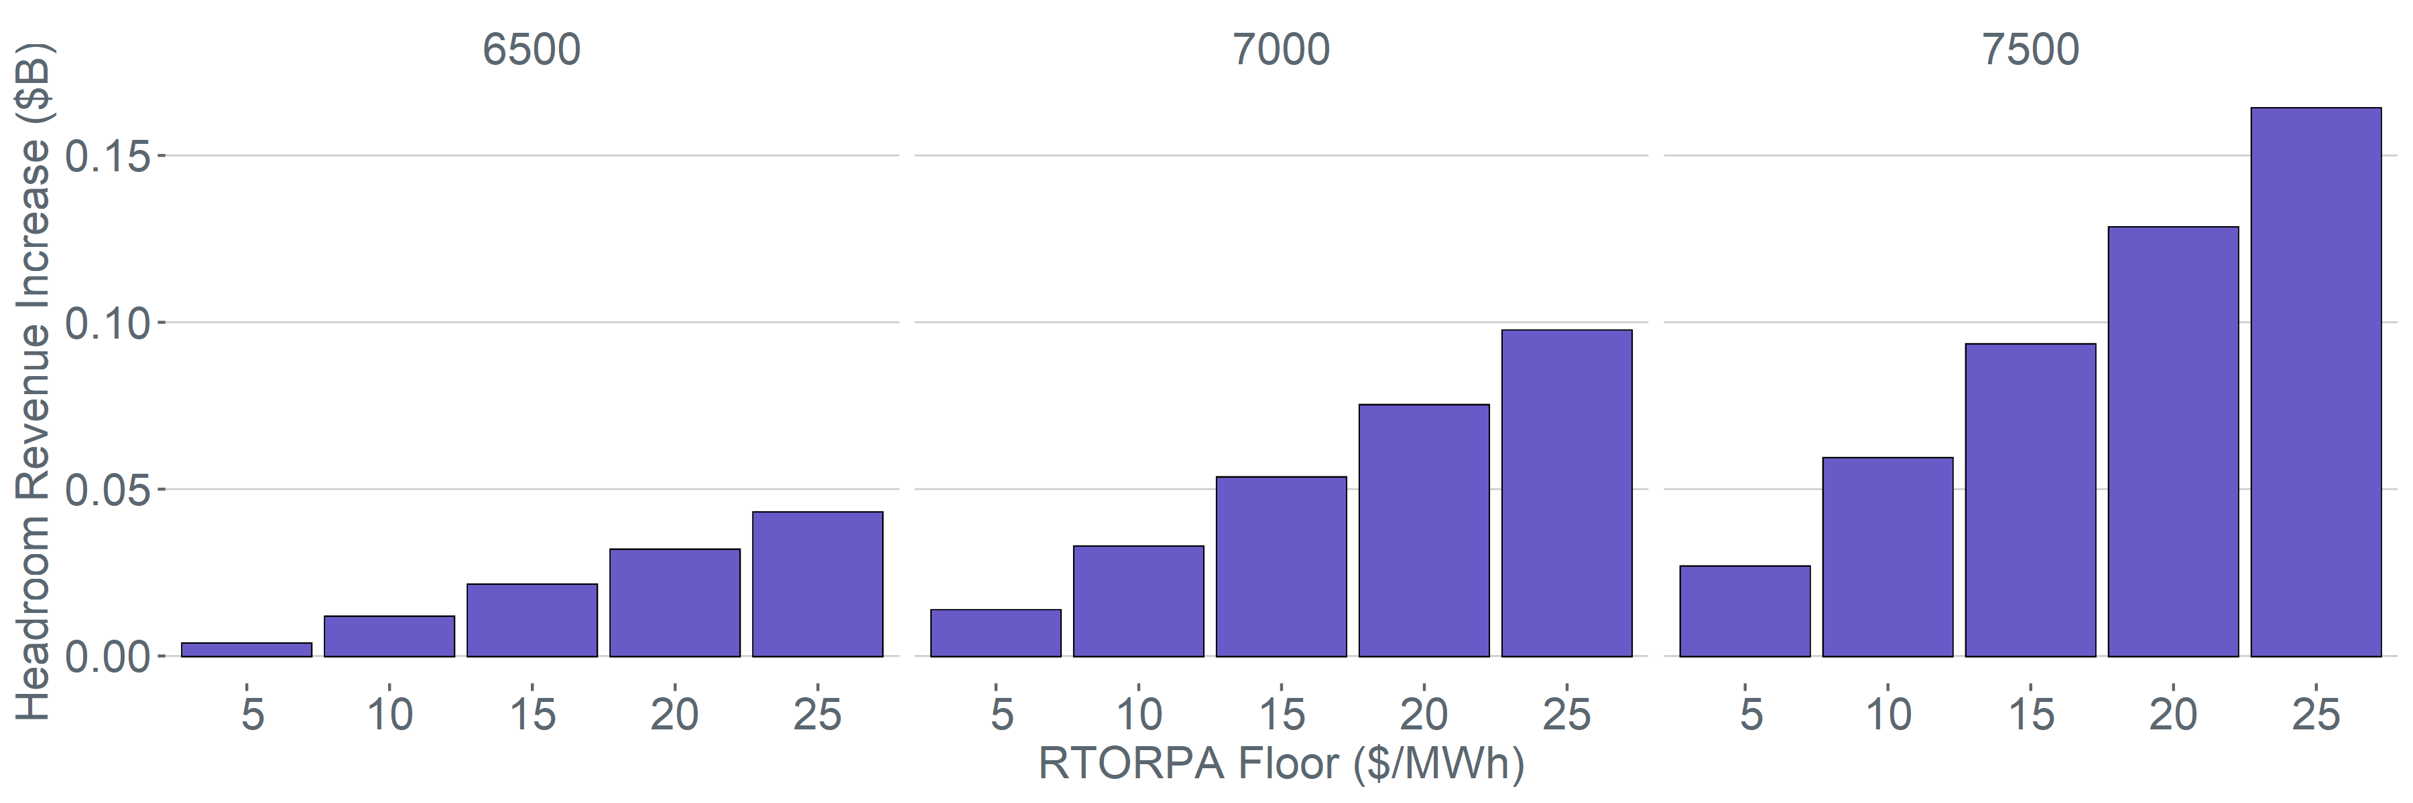
2022 Headroom Revenue Increase with RTORPA floor

