Slide 1
Monthly Review of Reliability Unit Commitment Market Impacts – February 2023
Wholesale Market Working Group
ERCOT Staff
March 17, 2023

Slide 2
RUC Resource-Hours
February 2023 | Total | Opt-Out | Non-Opt-Out
Instructed Resource-Hours
Total Count | 281 | 0 | 281
Effective Resource-Hours*
Total Count | 249.4 | 0 | 249.4
Average LSL | 101 | - | 101
Average LDL | 101.6 | - | 101.6
Average BP | 102 | - | 102
Average HSL | 309.5 | - | 309.5
* The difference between “Instructed” and “Effective” values is a result of Resources starting up, shutting down, receiving partial hour instructions, or otherwise not being dispatchable by SCED.

Slide 3
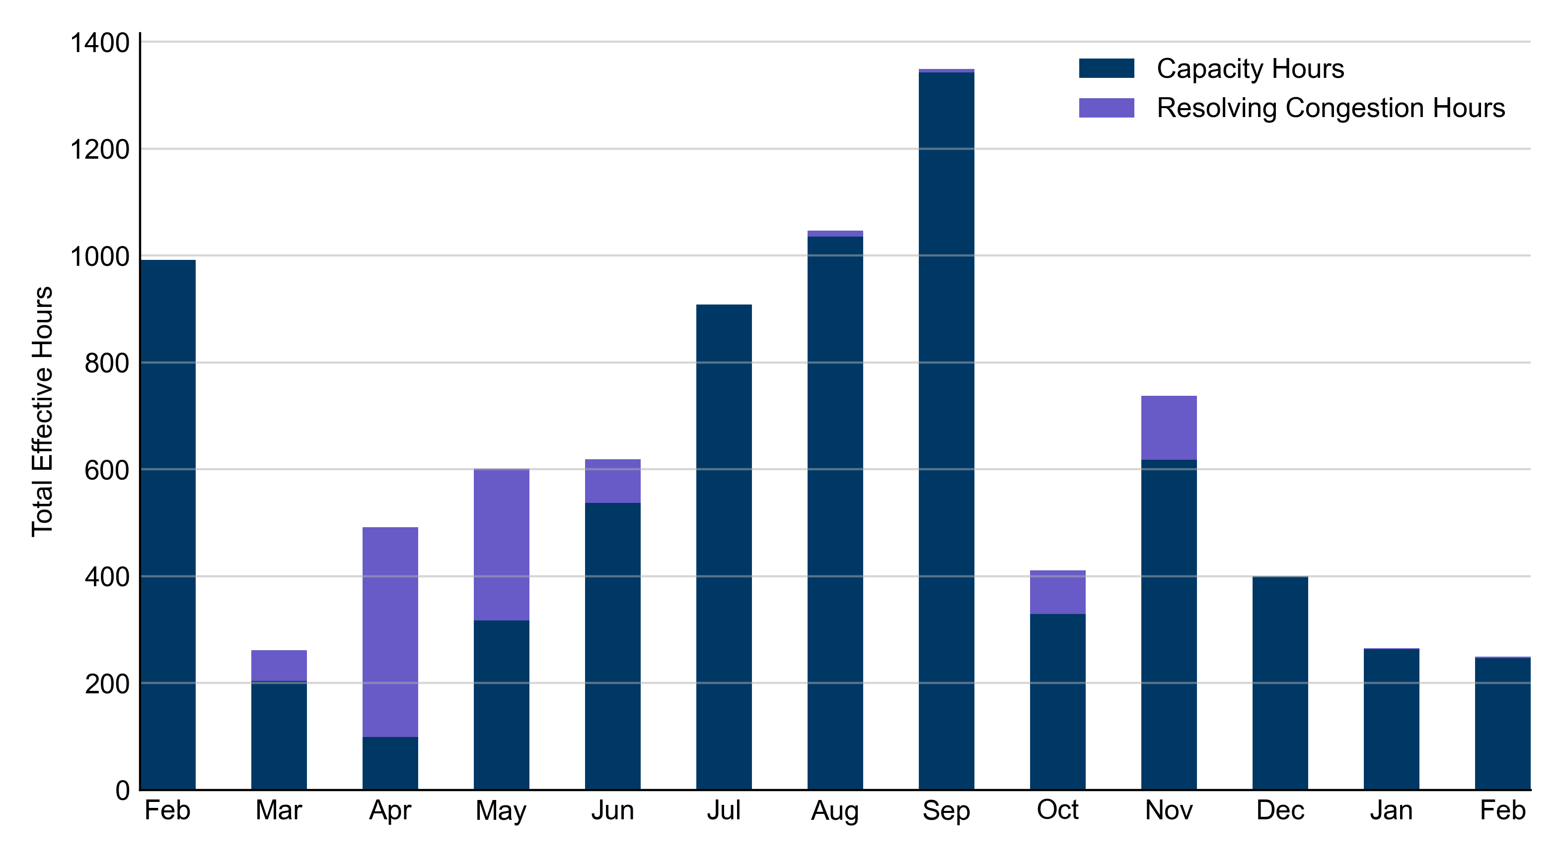
RUC Instruction Reasons: Last 13 Months
RUCs in February 2023 were primarily driven by system-wide capacity concerns.

Slide 4
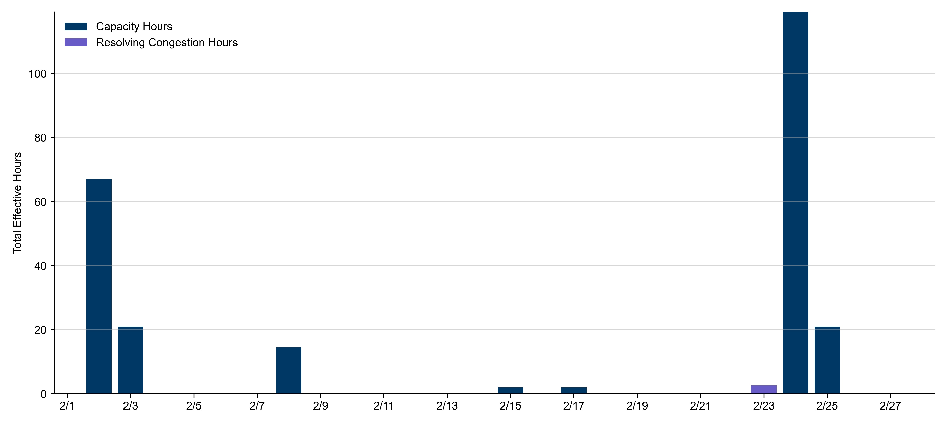
RUC Instruction Reasons
February 2023
249.4 effective RUC Resource-hours.
  246.7 hours (98.93%) for capacity concerns.
  2.7 hours (1.07%) for congestion concerns.

Slide 5
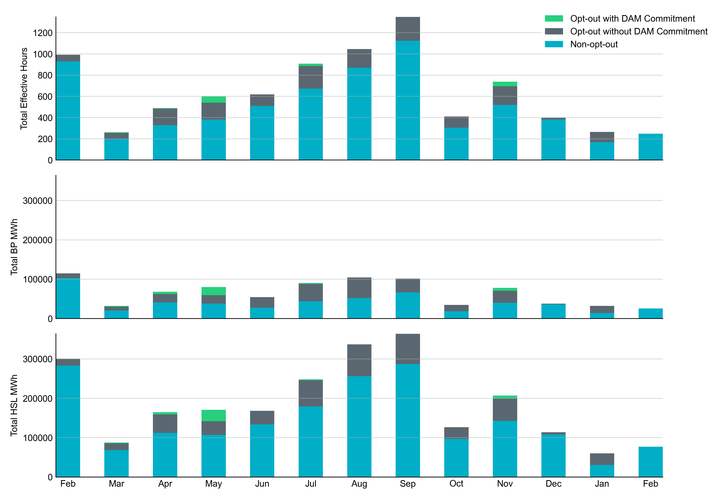
Non-opt-out and Opt-out Totals: Last 13 Months
February 2023 had a total of 249.4 non-opt-out effective Resource-hours (100%).

Slide 6
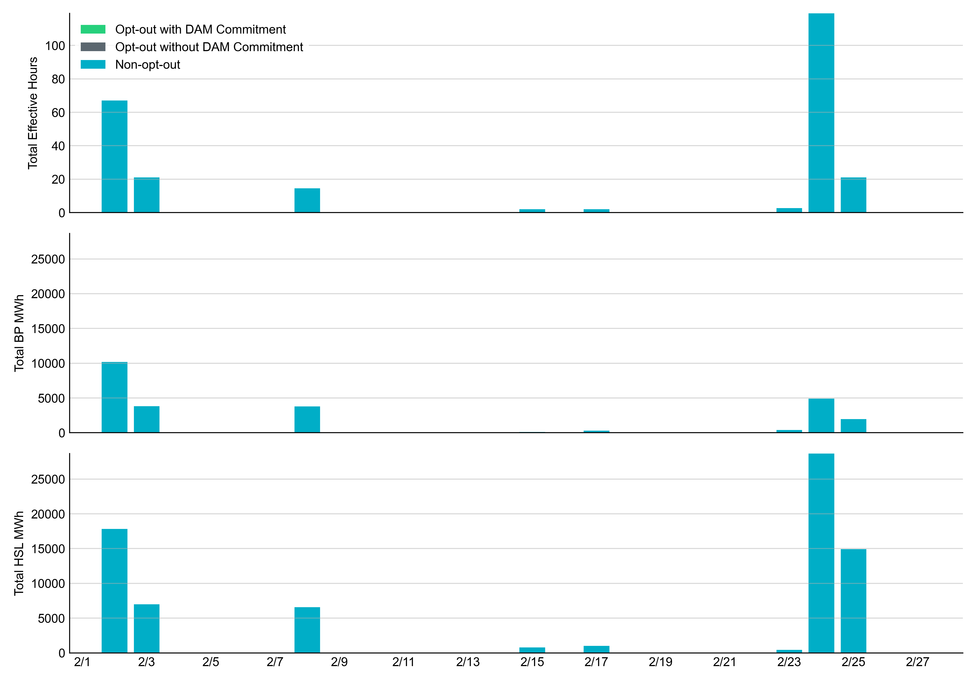
Non-opt-out and Opt-out Totals: February 2023

Slide 7
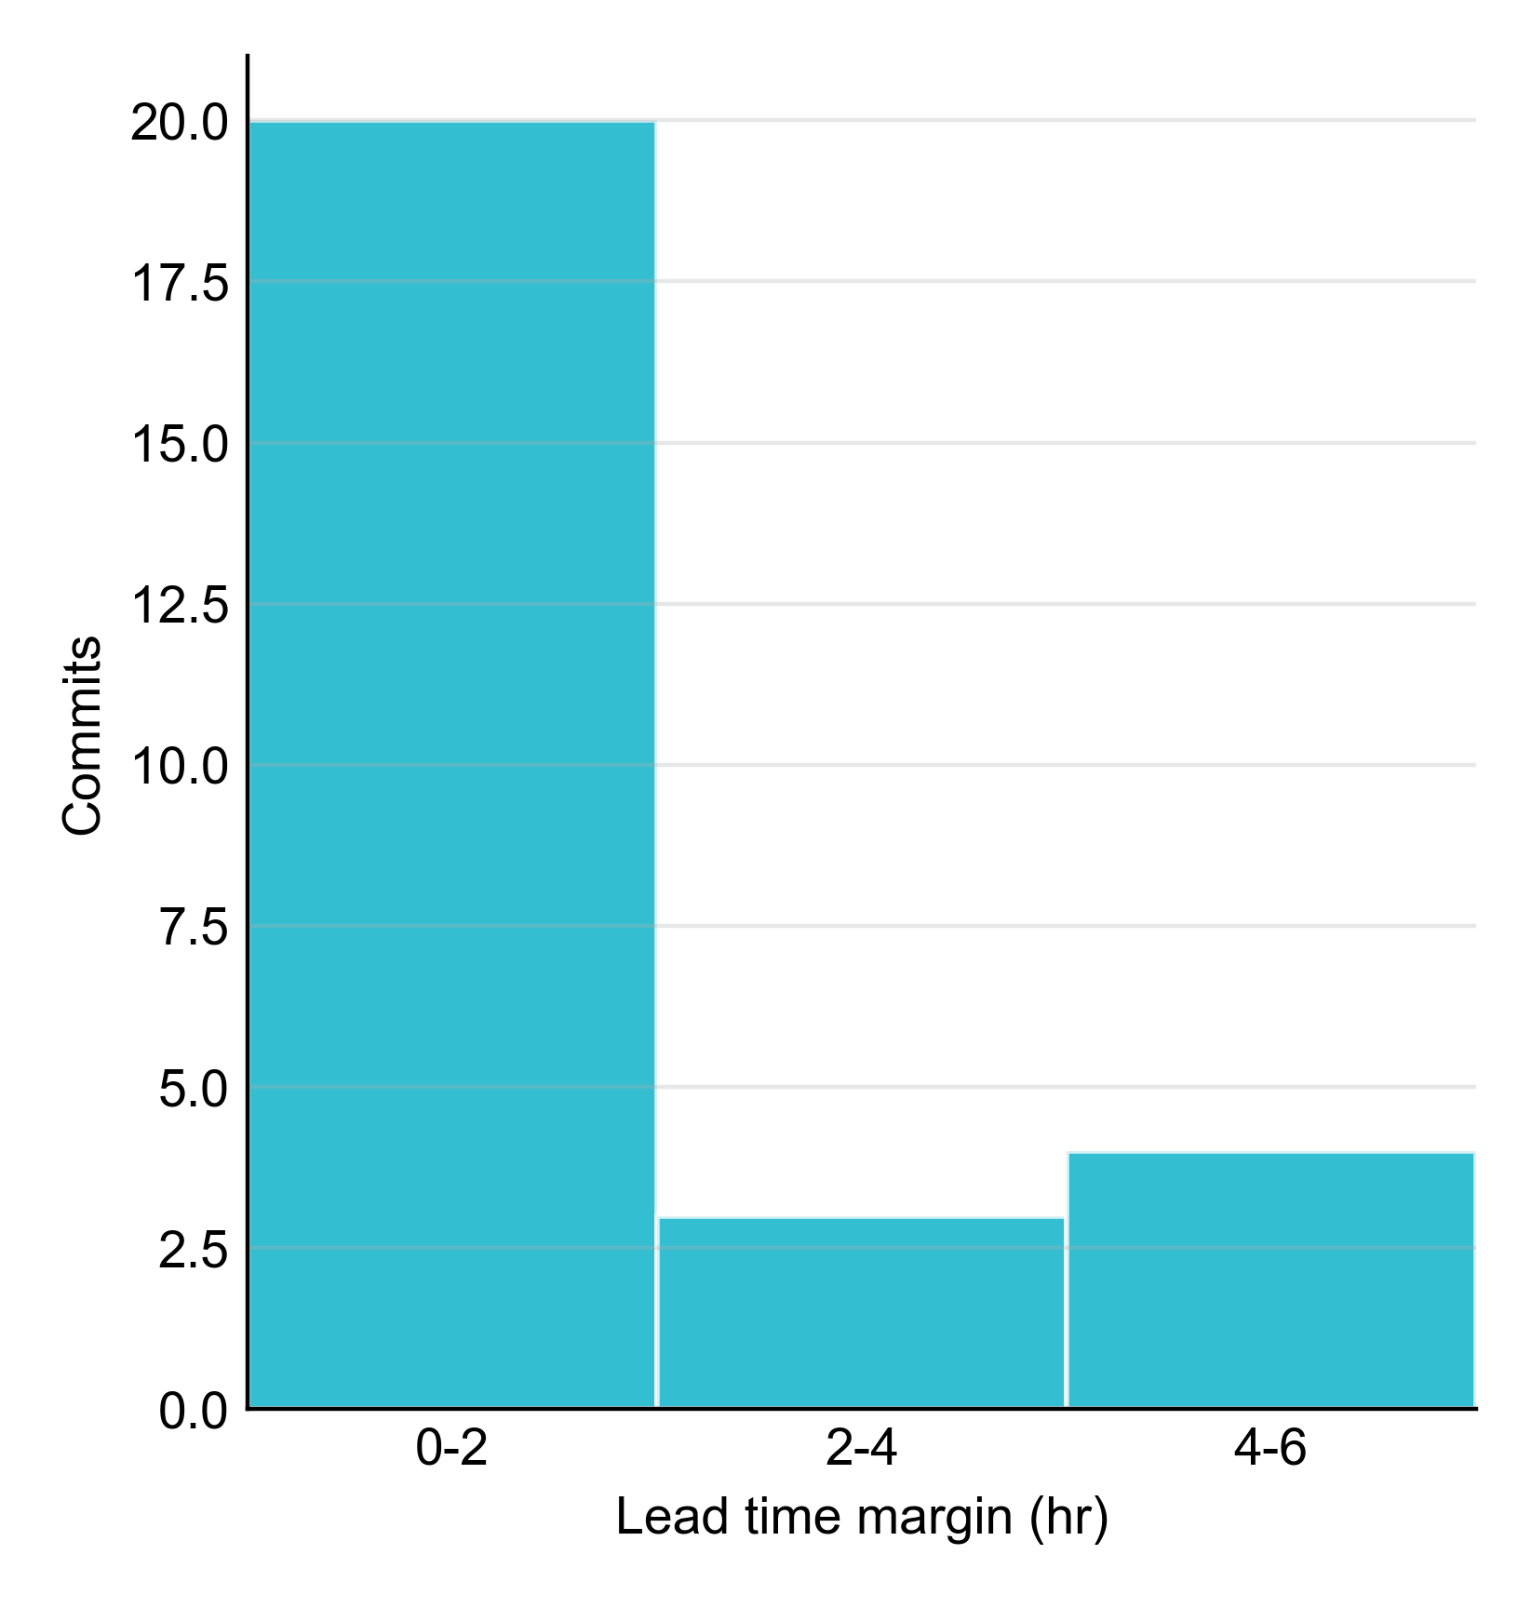
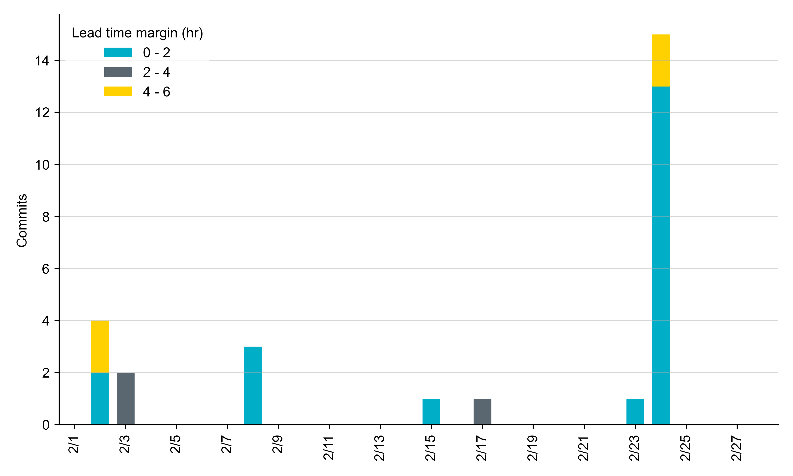
RUC Lead Time Margin: February 2023
Most RUC commit windows had lead time margin at or below 4 hours.
Lead time refers to the length of time between a RUC instruction and the start of the commitment window.
Lead time margin is the difference between lead time and the Resource’s startup time.
In cases where a Resource is committed for multiple back-to-back time blocks, lead time margin is calculated from the first instruction.
Notes:
The first bin is both-inclusive (i.e. [0, 2] ), while subsequent bins are left-inclusive (i.e. [2, 3), [3, 4), etc.).

Slide 8
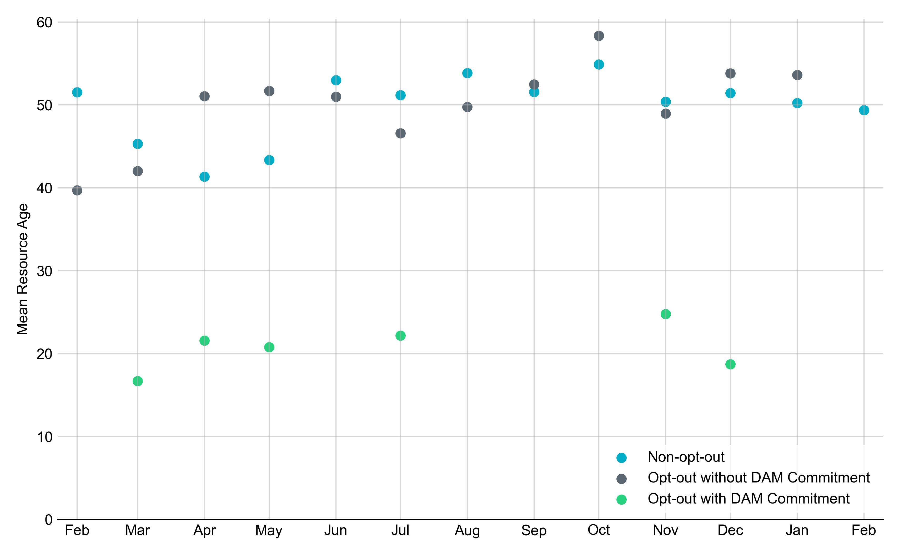
Average Resource Age
In February 2023, the mean age of RUC-committed Resources was 49.4 years for Non-Opt-Out Resource-hours.
Note: For Resource configurations with multiple physical generators, the age of the oldest generator is used.

Slide 9
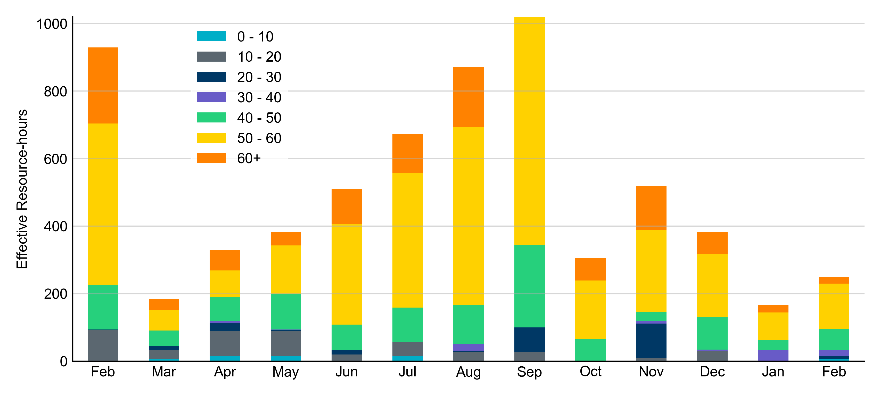
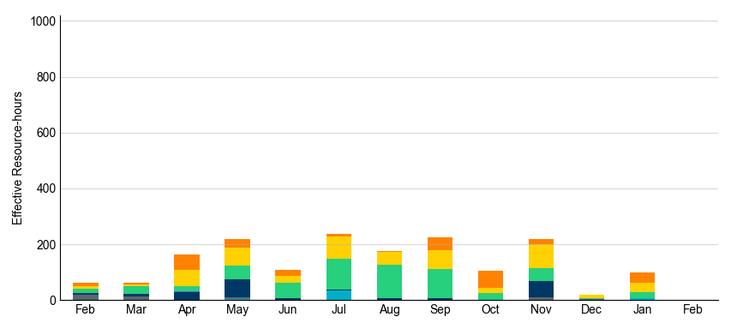
Age Category
Most RUC-Committed Resources in February 2023 were older than 40 years.
Non-opt-out
Opt-out

Slide 10
RUC-Instructed Resource Dispatch above LDL
February 2023
When Resources did not successfully opt out, there were 2.5 effective Resource-hours for which the Resource was dispatched above its LDL.
  For all of these Resource-hours, the LMP for the RUC-instructed Resource was below the RUC offer floor.
    For all these Resource-hours, the RUC-instructed Resource was mitigated.
There were no Exceptional Fuel Cost submissions for any RUC-Committed Resources in February 2023.

Slide 11
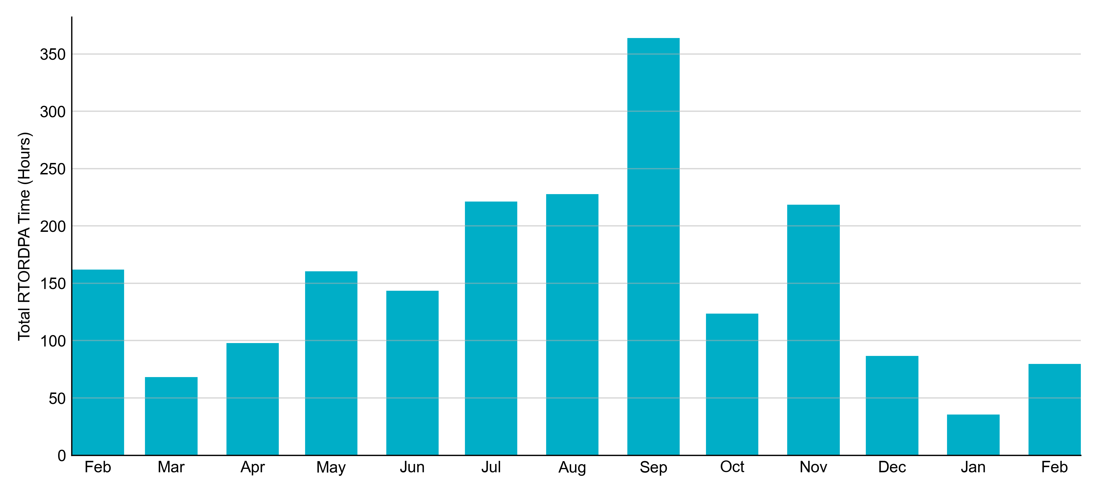
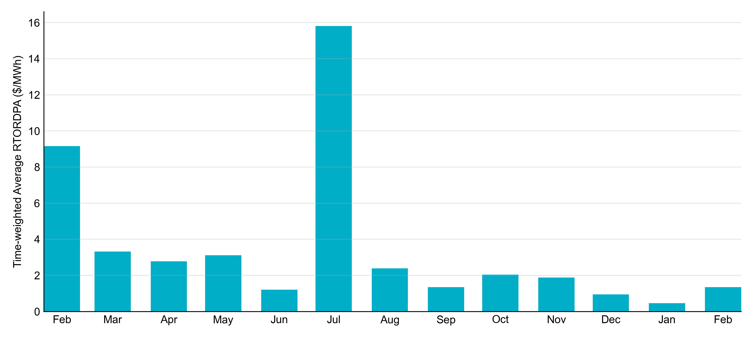
Reliability Deployment Price Adder: Last 13 Months
February 2023 had a total of 79.67 RTORDPA hours with an average value of $1.35/MWh.

Slide 12
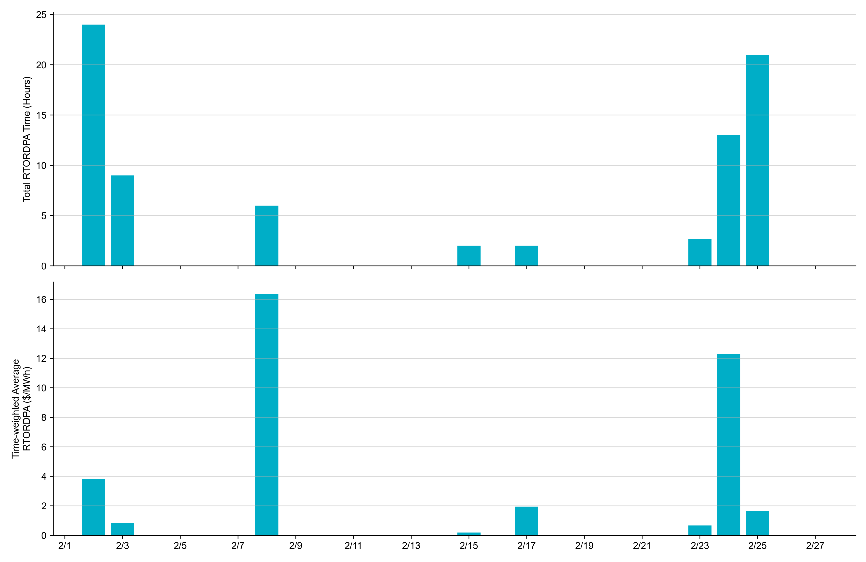
Reliability Deployment Price Adder: February 2023
OD 2/8 had the highest daily time-weighted average RTORDPA: $16.35/MWh.

Slide 13
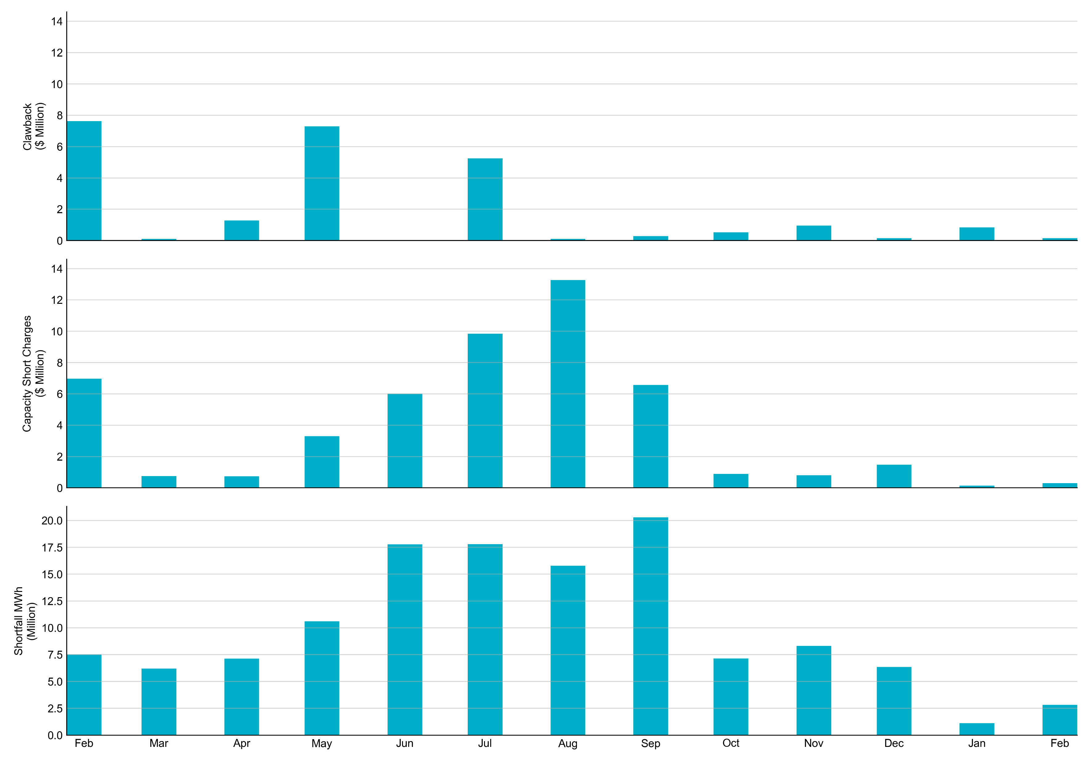
RUC Clawback, Capacity Short Charges, and Shortfall
For February 2023, the total Clawback charge was $0.2M. The total Make-Whole payment was $0.3M, which was almost entirely covered through capacity-short charges.
In February 2023, $0.295M in Make-Whole was paid out. There was a total amount of $2.46 uplifted to load this month due to rounding.
Data as of March 8th, 2023

Slide 14
RUC Make-Whole by Settlement Type
Month | Initial Settlement ($) | Final Settlement Change ($) | True-up Settlement Change ($) | Net as of March 8, 2023 ($)
Feb '22 | -3,102,122 | 0 | -3,868,287 | -6,970,408
Mar '22 | -636,118 | 0 | -113,323 | -749,442
Apr '22 | -742,010 | 0 | 0 | -742,010
May '22 | -1,366,293 | 658 | -1,936,192 | -3,301,827
Jun '22 | -1,474,085 | 0 | -4,540,116 | -6,014,201
Jul '22 | -1,282,874 | 0 | -8,558,242 | -9,841,116
Aug '22 | -3,464,254 | 0 | -9,809,538 | -13,273,792
Sep '22 | -4,666,217 | 0 | - | -4,666,217
Oct '22 | -851,291 | -37,747 | - | -889,038
Nov '22 | -809,352 | 0 | - | -809,352
Dec '22 | -1,479,207 | 0 | - | -1,479,207
Jan '23 | -141,639 | - | - | -141,639
Feb ‘23 | -295,131 | - | - | -295,131
Negative dollars represent a payment from ERCOT to a market participant
“-” indicates settlement has yet to be completed.

Slide 15
RUC Clawback by Settlement Type
Month | Initial Settlement ($) | Final Settlement Change ($) | True-up Settlement Change ($) | Net as of March 8, 2023 ($)
Feb '22 | 9,396,481 | 0 | -1,768,344 | 7,628,138
Mar '22 | 244,125 | 0 | -142,617 | 101,508
Apr '22 | 1,284,735 | 0 | 0 | 1,284,735
May '22 | 8,167,123 | 19,018 | -892,817 | 7,293,324
Jun '22 | 12,379 | 0 | 0 | 12,379
Jul '22 | 6,500,951 | 0 | -1,255,520 | 5,245,432
Aug '22 | 985,985 | 0 | -876,395 | 109,590
Sep '22 | 364,507 | 0 | - | 364,507
Oct '22 | 544,601 | -16,449 | - | 528,152
Nov '22 | 951,568 | 0 | - | 951,568
Dec '22 | 148,277 | 0 | - | 148,277
Jan '23 | 835,738 | - | - | 835,738
Feb ‘23 | 158,319 | - | - | 158,319
Negative dollars represent a payment from ERCOT to a market participant
“-” indicates settlement has yet to be completed.

