Slide 1
Phase 1 of the Aggregate Distributed Energy Resource (ADER) Pilot Project Update
David Maggio
Sr. Director, Market Design & Analytics
ERCOT
ADER Task Force Workshop
March 8, 2023
ERCOT Public

Slide 2
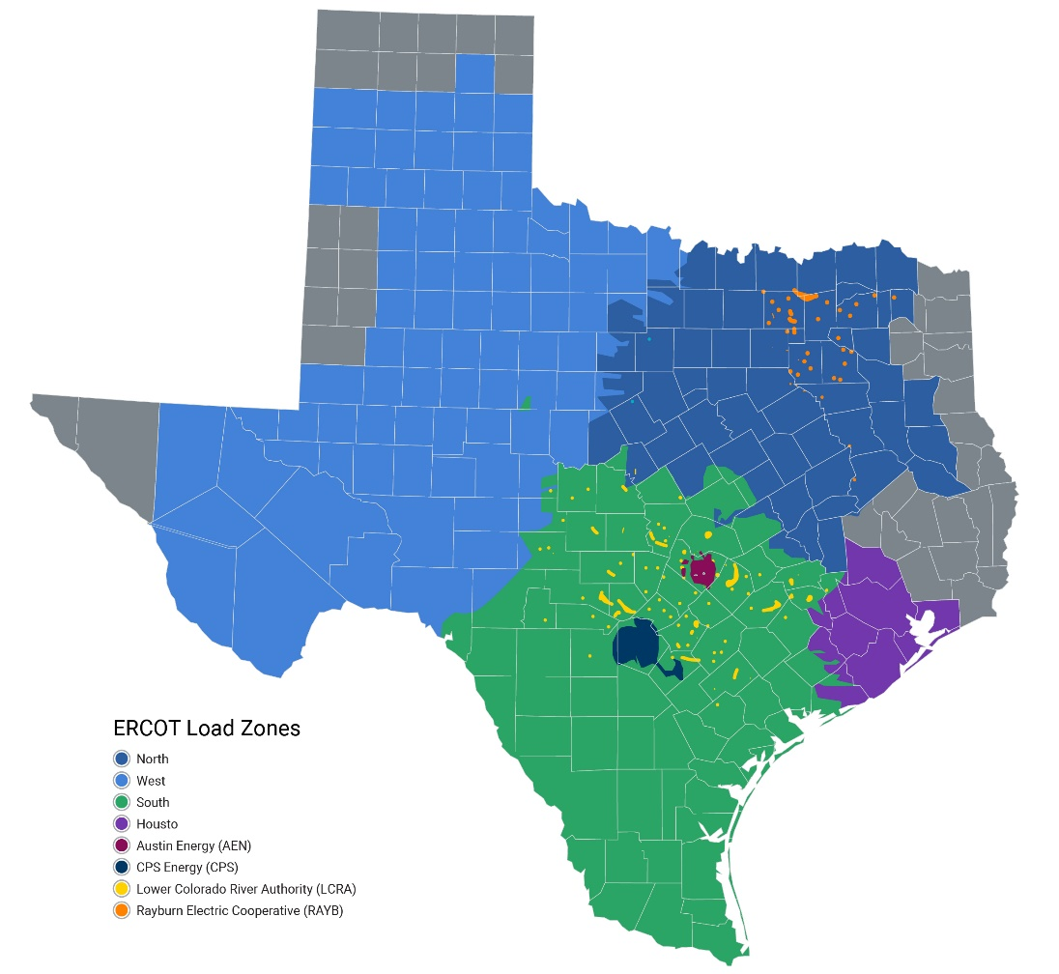
Pending pilot participation as of March 7, 2023
Prospective participants in the pilot have been engaging with end-use customers, Distribution Service Providers (DSPs), and ERCOT staff.
ERCOT has accepted seven Details of the Aggregation (DOTA) forms:
Aggregated devices include synchronous generators, stationary batteries, and HVAC systems.
All ADERs intend to provide some amount of Non-Spin, based on DOTA submissions.
ERCOT-Wide Energy: 6.5 MW
ERCOT-Wide Non-Spin: 2.2 MW
2.0 MW (1)
0.8 MW (2)
3.7 MW (4)
These aggregate values have decreased slightly from what ERCOT presented on to the Reliability & Markets Committee on February 27, 2023. These decreases are based on updated DOTA forms.

Slide 3
Participation limits tracking as of March 7, 2023
 |  | LZ_AEN | LZ_CPS | LZ_HOUSTON | LZ_LCRA | LZ_NORTH | LZ_RAYBN | LZ_SOUTH | LZ_WEST | ERCOT-WIDE
Energy | Limit (MW) | 2.8 | 5.3 | 20.3 | 3.1 | 28.7 | 1.2 | 10.3 | 8.2 | 80.0
 | Approved (MW) | 0 | 0 | 3.7 | 0 | 2.0 | 0 | 0.8 | 0 | 6.5
 | Unused (MW) | 2.8 | 5.3 | 16.6 | 3.1 | 26.7 | 1.2 | 9.5 | 8.2 | 73.5
 | % Full | 0% | 0% | 18% | 0% | 7% | 0% | 8% | 0% | 8%
Non-Spin | Limit (MW) | 1.4 | 2.7 | 10.1 | 1.6 | 14.3 | 0.6 | 5.2 | 4.1 | 40.0
 | Approved (MW) | 0 | 0 | 1.3 | 0 | 0.6 | 0 | 0.3 | 0 | 2.2
 | Unused (MW) | 1.4 | 2.7 | 8.8 | 1.6 | 13.7 | 0.6 | 4.9 | 4.1 | 37.8
 | % Full | 0% | 0% | 13% | 0% | 4% | 0% | 6% | 0% | 6%
A single QSE is not allowed to register more than 20% of a system-wide limit.

Slide 4
Questions and issues around the DOTA form and ADER registration
ERCOT staff is expecting the full package of material associated with the DOTA to come from the Qualified Scheduling Entity (QSE).
This includes the DOTA form itself, the signed DSP acknowledgment and the supplement to the Standard Form Agreement (SFA) from the QSE.
SFA need to be signed by an authorized signatory for the company.
The “Station Code” and “CIM Load Name” must be filled out in coordination with the DSP and Transmission Service Provider (TSP).
For premises/devices included in an aggregation, the meter must be associated with the Load Serving Entity (LSE).
The premise/device can’t be participating in other programs, such as Emergency Response Service (ERS)

Slide 5
Questions and issues around the DOTA form and ADER registration
Rows that have been rejected by the DSP should not remain in the final form that is sent to ERCOT and should not count toward any aggregation-level information in the form.
The values entered in columns with “withdrawal” information are expected to be zero or negative.
Participating entities may account for some level of expected growth and “churn” in registration for the ADER, but the numbers in the submitted DOTA form are expected to reflect physical capability expectations given the current set of devices in the aggregation.
Participating entities should be aware of QSE acknowledgement and Decision-Making Entity (DME) forms that are part of the process for fully registering the Resource.

Slide 6
Other general questions and topics around the pilot
Questions on various registration processes associated with establishing a Resource with particular focus on Resource Entities, QSEs, LSEs, and the associated relationships between these entities and the ADER.
Overall questions on the pilot project and where to find material.
Questions on market submission expectations, particularly Current Operating Plan (COP) and real-time telemetry requirements for ADERs.
Further discussion is needed regarding how ADER pilot participation can be publicly disclosed. May need further clarification in governing document for future phases.

Slide 7
Next steps for Resources with approved DOTA forms
Resource registration through Resource Integration and On-going Operations (RIOO):
ADERs will be registered as Controllable Load Resources (CLRs).
Note that the model load date is at least 45 days after submission into RIOO.
Parameters of the CLR should be based on the expected size of the DER, although a reasonable cushion may be included in the MW size to account for amount of aggregation churn and growth.
Setup of telemetry between ERCOT and the designated QSE.
Qualification testing for participation in Security-Constrained Economic Dispatch (SCED) and Non-Spin.
Monthly updates, as needed, to the DOTA forms as premises/devices are added, removed, or updated.
Expected that updates will come from the DSP following their approval.

