Slide 1
Update on NPRR 1146 – Impact on TPE of Eliminating URTA vs. Invoice exposures
Sanchir Dashnyam
ERCOT Market Credit Manager
ERCOT Public
March 14, 2023

Slide 2
TPE/EAL Impact of Eliminating URTA
The group requested ERCOT staff to layer in the invoice exposures (including credits) into TPE calculations with and without URTA. Prior definition of invoice exposures was based on M1 days actual invoices + RTLCNS + UDAA.
New invoice exposures
  M1 days forward invoices + 7 days look back actual invoices
  M1 days could range from 10 to 21 days depending on weekends/holidays, MP activity
  Invoices exclude M&N securitization invoices, CRR auction invoices and miscellaneous invoices relating to $2B distributed to market for Sec N on 6/21/22
TPEA excludes Uri invoices and PUL uplift
The following pages present overall TAO portfolio.
TPEA – Invoice exposures = Gap
Negative gap is when invoice exposures exceed TPEA (less than -$10,000)
Positive gap is when TPEA exceeds invoice exposures (more than $10,000)

Slide 3
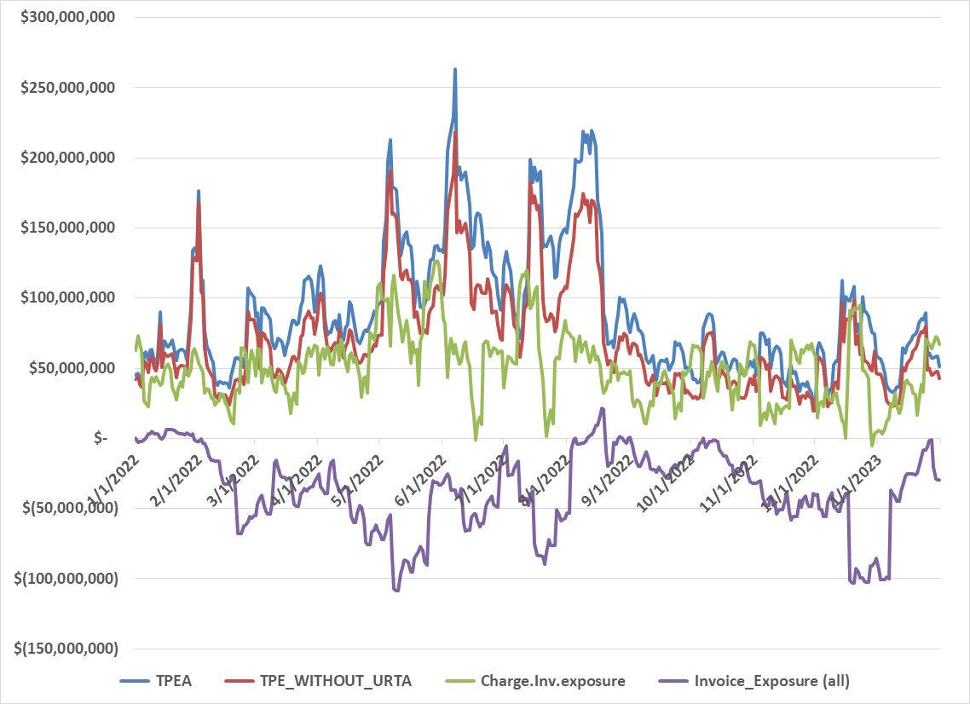
Invoice exposures vs. TPE without URTA vs. current TPE
Trade-Only entities portfolio
TPEA without URTA will be generally lower than TPEA with URTA (existing framework)
Invoice exposures including all credits will be lower than invoice exposures, which include charges only
However, to understand the actual impact we need to take a more granular approach and look at individual days for each TAO market participant

Slide 4
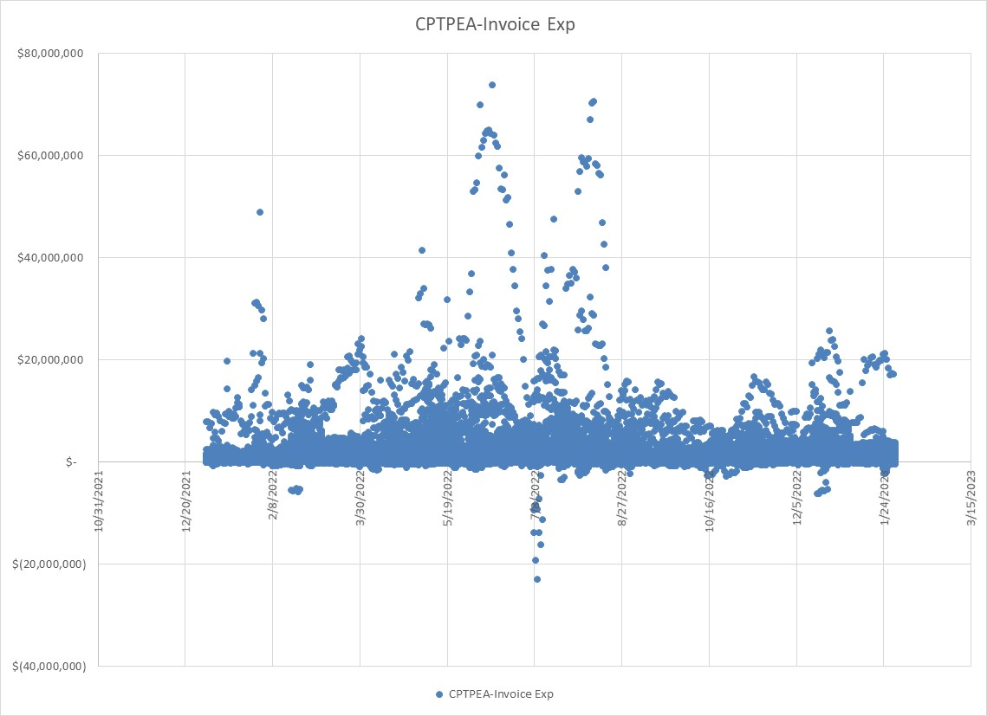
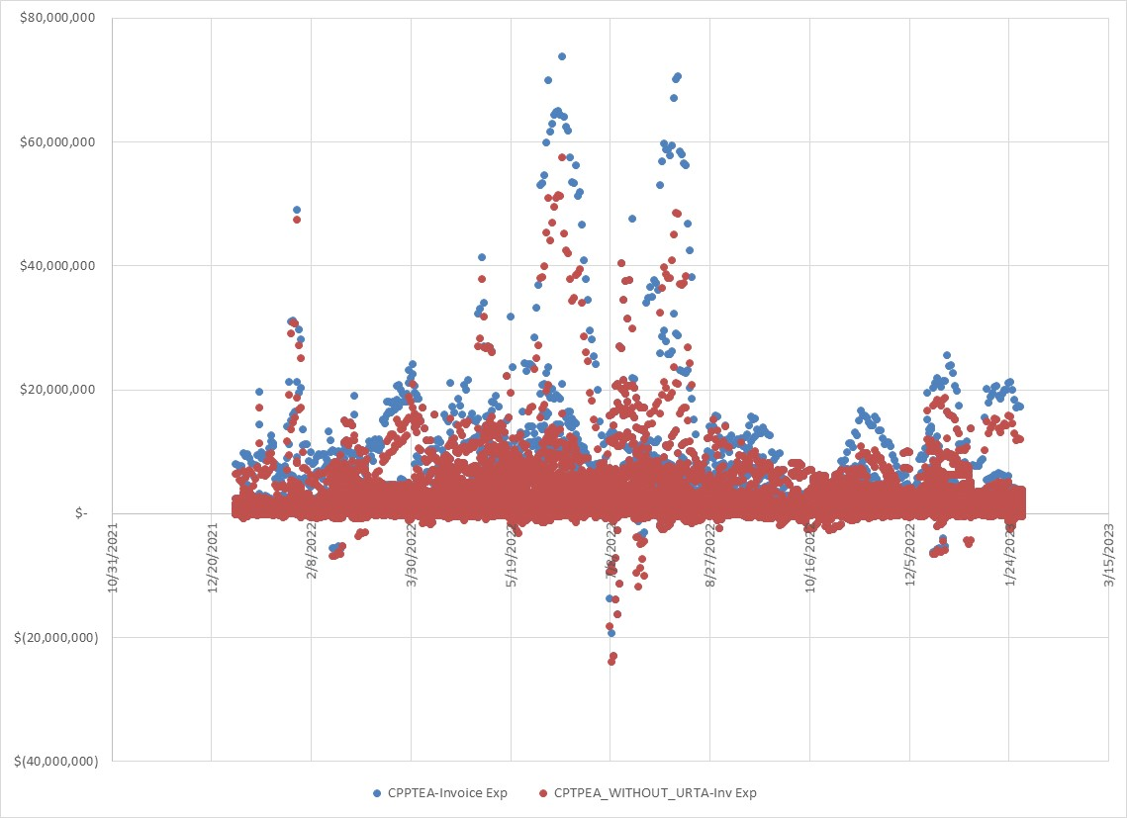
Existing gap occurrences
Impact of Eliminating URTA
* The above data would be higher if the $10K threshold has not been applied.
Removing URTA will result in lower positive gap occurrence, but, deeper negative gap occurrences.

Slide 5
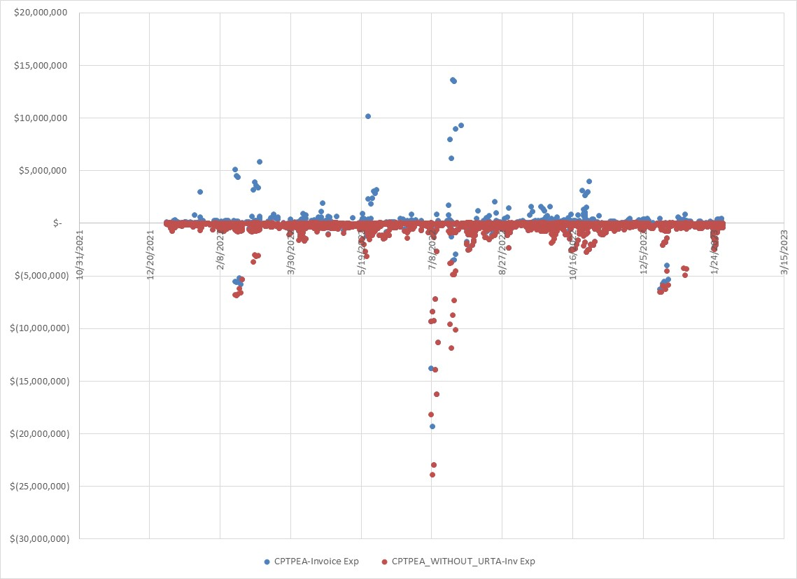
Eliminating URTA will lead to more negative gap occurrences

