Slide 1
IAS Stats by REP
As of 03/06/2023
David Michelsen
Manager Retail Operations
Retail Market Subcommittee
03/07/2023

Slide 2
Agenda
December 2022 - IAG/IAL Statistics
Top 10 – December 2022 - IAG/IAL
Top 10 - 12 Month Average IAG/IAL
Explanation of IAG/IAL Stats
Top - 12 Month Average Rescission
Explanation of Rescission Stats
18 Month Running Market Totals
Questions

Slide 3
December 2022 - IAG/IAL Statistics
Total IAG+IAL % of Total Enrollments: 1.13%
IAG/IAL % Greater Than 1% of Enrollments
Total IAG+IAL Count: 2,332
IAG/IAL % Less Than 1% of Enrollments
Total IAG+IAL Count: 1,089
Retail Electric Provider Counts
 | Percent of Enrollments Resulting in IAG/IAL
Enrollment Total | .00% to .25% | .26% to .50% | .51% to .75% | .76% to 1.00%
<= 500 | 0 | 1 | 2 | 1
> 500 and <= 2500 | 3 | 4 | 4 | 4
> 2500 | 1 | 1 | 7 | 5
Retail Market Subcommittee
03/07/23

Slide 4
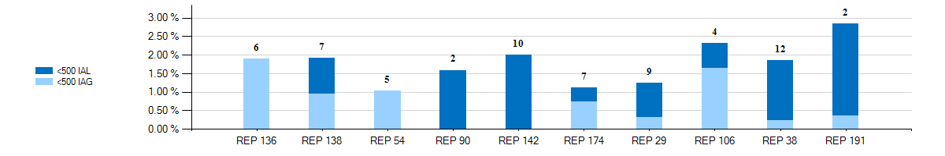
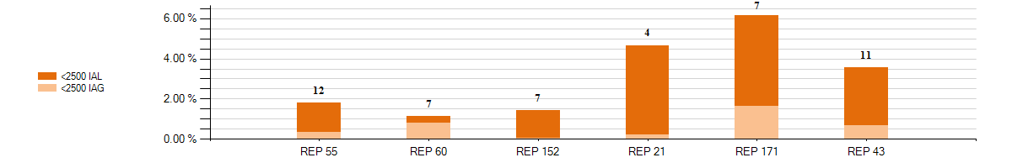
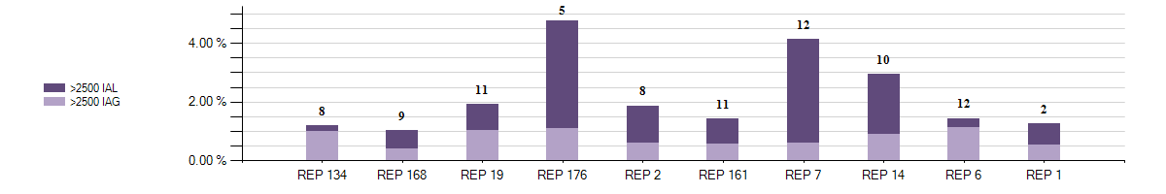
Top 10 - December 2022 - IAG/IAL % Greater Than 1% of Enrollments With number of months Greater Than 1%
Retail Market Subcommittee
03/07/23

Slide 5
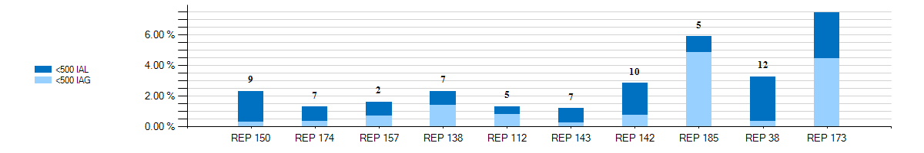
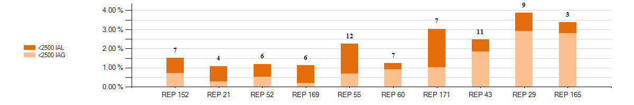
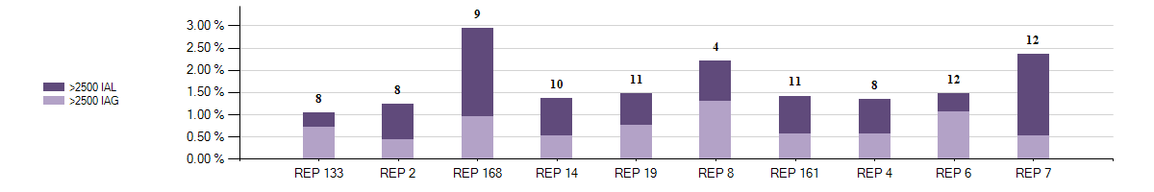
Top 10 - 12 Month Average IAG/IAL % Greater Than 1% of Enrollments thru December 2022 With number of months Greater Than 1%
8
Retail Market Subcommittee
03/07/23

Slide 6
Explanation of IAG/IAL Slides Data
NOTE:
The IAG/IAL totals and percentages in this presentation are calculated using the counts of the Acknowledged Inadvertent Gaining REP Only in both IAG and IAL issues. If the Gaining REP in a submitted IAL issue does not agree they are the Gaining REP, that issue will not be counted. The losing REP is not represented in any of the Totals or Percentages in any data contained in this presentation.
NOTE:
A 10% chart range limit has been set. REPs data points that exceed 10% will be bordered in yellow. Please see the spreadsheet on page 3 for actual percentages of these REPs.
The page 3 chart shows a count of REPs whose IAG/IAL percentage of their total enrollments is below 1%.
Blue row shows counts of REPs that have less than 500 total enrollments by their percentage ranges
Orange row shows counts of REPs that have between 500 and 2500 total enrollments by their percentage ranges
Purple row shows counts of REPs that have greater than 2500 total enrollments by their percentage ranges
Retail Market Subcommittee
03/07/23

Slide 7
Explanation of IAG/IAL Slides Data (Cont)
The page 4 charts show the top 10 REPs whose IAG/IAL percentage of their total enrollments is above 1%.
The blue chart shows enrollment totals of less than 500 for the month being reported
The orange chart shows enrollment totals between 500 and 2500 for the month being reported
The purple charts show enrollment totals of over 2500 for the month being reported
REPs with the lowest AG/IAL totals start on the left, and move to the highest counts on the right
Number labels represent the number of months the REP has been over 1% during the 12 month period
The page 5 charts show the top 10 REPs whose 12 month average IAG/IAL percentage of their total enrollments is above 1%.
The blue chart shows enrollment total averages of less than 500 for the month being reported
The orange chart shows enrollment total averages between 500 and 2500 for the month being reported
The purple charts show enrollment total averages of over 2500 for the month being reported
REPs with the lowest IAG/IAL averages start on the left, and move to the highest counts on the right
Number labels represent the number of months the REP has been over 1% during the 12 month period
Retail Market Subcommittee
03/07/23

Slide 8
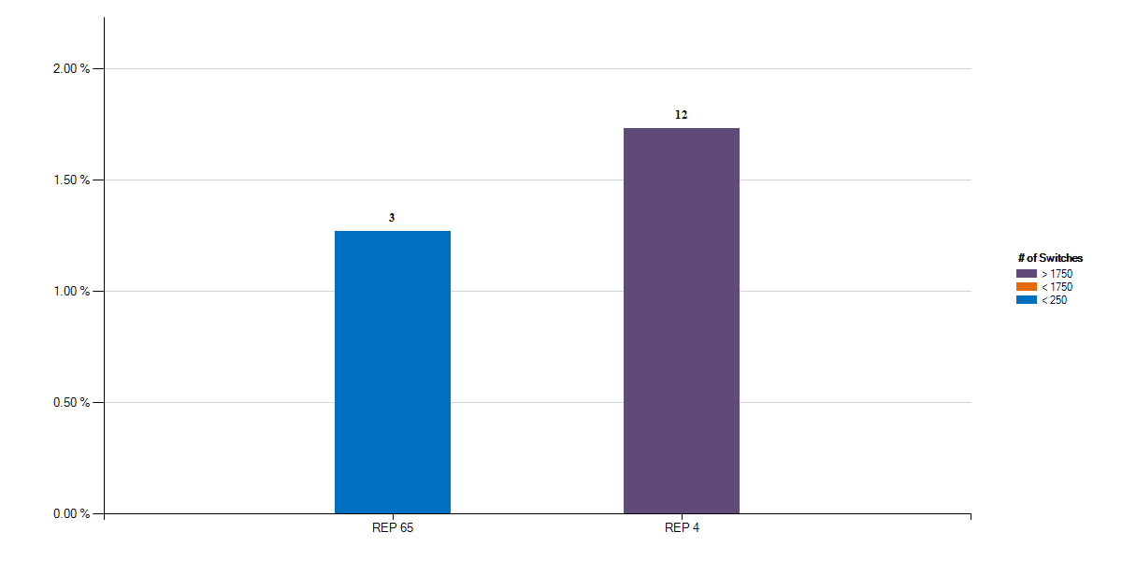
Top - 12 Month Average Rescission % Greater Than 1% of Switches thru December 2022 With number of months Greater Than 1%
Retail Market Subcommittee
03/07/23

Slide 9
Explanation of Rescission Slide Data
NOTE:
A 10% chart range limit has been set. REPs data points that exceed 10% will be bordered in yellow. Please see the spreadsheet on page 3 for actual percentages of these REPs.
The page 8 charts show the top REPs whose 12 month average Rescission percentage of their total Switches is above 1%.
The blue shades show switch totals of less than 250 for the month being reported
The orange shades show switch totals between 250 and 1750 for the month being reported
The purple shades show switch totals of over 1750 for the month being reported
The REPs with the lowest count of rescission totals start on the left, and move to the highest counts on the right
Number labels represent the number of months the REP has been over 1% during the 12 month period
Retail Market Subcommittee
03/07/23

Slide 10
18 Month Running Market Totals
 | Enrollments |  |  | IAG, IAL, Rescission |  |  |  |  | Days to Resolution
Month | SWI | MVI | Total | IAG | IAL | Rescission | IAG,IAL,Res Total | Overall % | IAG | IAL | Rescission
2021-07 | 87,752 | 291,498 | 379,250 | 2,112 | 3,107 | 326 | 5,545 | 1.46% | 13 | 14 | 10
2021-08 | 112,901 | 264,683 | 377,584 | 1,771 | 2,237 | 289 | 4,297 | 1.14% | 11 | 13 | 9
2021-09 | 68,915 | 243,881 | 312,796 | 1,571 | 2,054 | 294 | 3,919 | 1.25% | 10 | 11 | 8
2021-10 | 56,991 | 233,687 | 290,678 | 1,441 | 1,729 | 229 | 3,399 | 1.17% | 9 | 11 | 7
2021-11 | 356,986 | 215,282 | 572,268 | 1,388 | 1,892 | 207 | 3,487 | 0.61% | 10 | 11 | 9
2021-12 | 70,637 | 214,374 | 285,011 | 1,906 | 1,669 | 214 | 3,789 | 1.33% | 11 | 10 | 8
2022-01 | 104,313 | 221,439 | 325,752 | 1,567 | 1,675 | 248 | 3,490 | 1.07% | 9 | 9 | 6
2022-02 | 105,063 | 208,309 | 313,372 | 1,350 | 1,765 | 296 | 3,411 | 1.09% | 8 | 10 | 6
2022-03 | 112,865 | 269,490 | 382,355 | 1,932 | 2,206 | 358 | 4,496 | 1.18% | 9 | 11 | 8
2022-04 | 128,697 | 247,896 | 376,593 | 2,009 | 2,006 | 426 | 4,441 | 1.18% | 10 | 12 | 8
2022-05 | 131,481 | 257,179 | 388,660 | 2,780 | 2,488 | 667 | 5,935 | 1.53% | 10 | 14 | 10
2022-06 | 103,647 | 286,099 | 389,746 | 1,712 | 2,370 | 597 | 4,679 | 1.20% | 13 | 16 | 13
2022-07 | 96,502 | 277,038 | 373,540 | 1,652 | 2,363 | 633 | 4,648 | 1.24% | 12 | 15 | 10
2022-08 | 102,478 | 320,856 | 423,334 | 2,126 | 2,572 | 575 | 5,273 | 1.25% | 13 | 17 | 13
2022-09 | 81,440 | 284,323 | 365,763 | 1,727 | 2,257 | 292 | 4,276 | 1.17% | 12 | 16 | 9
2022-10 | 75,040 | 261,008 | 336,048 | 1,535 | 1,899 | 327 | 3,761 | 1.12% | 12 | 14 | 10
2022-11 | 70,446 | 231,597 | 302,043 | 1,503 | 1,936 | 232 | 3,671 | 1.22% | 11 | 14 | 11
2022-12 | 70,513 | 232,968 | 303,481 | 1,391 | 2,030 | 215 | 3,636 | 1.20% | 12 | 13 | 9
Retail Market Subcommittee
03/07/23

Slide 11
IAS Stats by REP
Questions?
Retail Market Subcommittee
03/07/23

