Slide 1
PDCWG Report to ROS
Chair: Jimmy Jackson, CPS
Vice Chair: Vacant
ROS
March 2nd, 2023

Slide 2
Report Overview & Notes
Report Overview
Meeting Minutes
BAL-001-TRE-2 FMEs and IMFR
2 FMEs in the month of Jan
Frequency Control Report

Slide 3
Meeting Minutes
PDCWG Meeting 2/15/2023
Spring/Summer Implementation Refresher – Including ECRS
ERCOT Reports
TRE Report

Slide 4
Frequency Measurable Events Performance

Slide 5
Frequency Measurable Events
There were 2 FMEs in January
1/2/2023 04:35:53
Reduction of 537 MW of load
Interconnection Frequency Response: 1,041 MW/0.1 Hz
288 Resources were evaluated. These includes,
253 Generation Resources
0 Controllable Load Resources
35 Energy Storage Resources
138 of 288 Evaluated Resources had less than 75% of their expected Initial Primary Frequency Response.
118 of 288 Evaluated Resources had less than 75% of their expected Sustained Primary Frequency Response.

Slide 6
Frequency Measurable Events
1/24/2023 14:27:10
Loss of 966 MW of generation
Interconnection Frequency Response: 1,725 MW/0.1 Hz
117 Resources were evaluated. These includes,
60 Generation Resources
1 Controllable Load Resource
56 Energy Storage Resources
14 of 117 Evaluated Resources had less than 75% of their expected Initial Primary Frequency Response.
10 of 117 Evaluated Resources had less than 75% of their expected Sustained Primary Frequency Response.

Slide 7
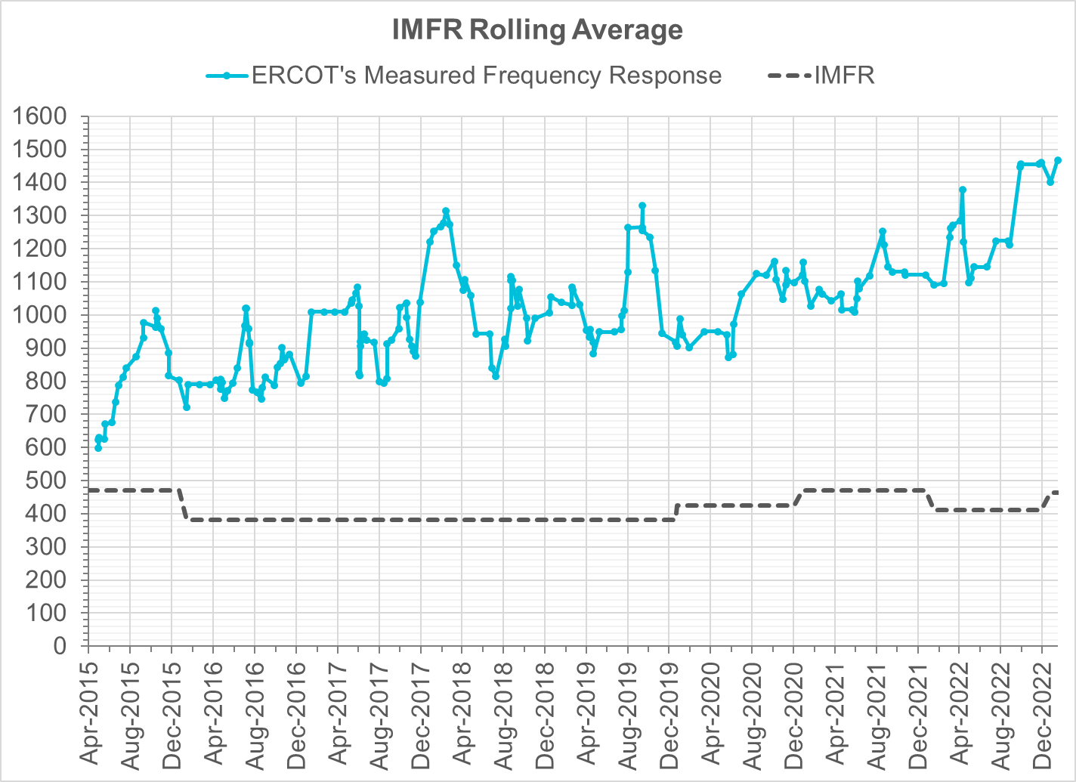
Interconnection Minimum Frequency Response (IMFR) Performance
IMFR Performance currently
1468.17 MW/0.1HZ
Frequency Response Obligation (FRO): 463 MW/0.1 Hz

Slide 8
Questions?

Slide 9
Frequency Control Report
Jan 2023

Slide 10
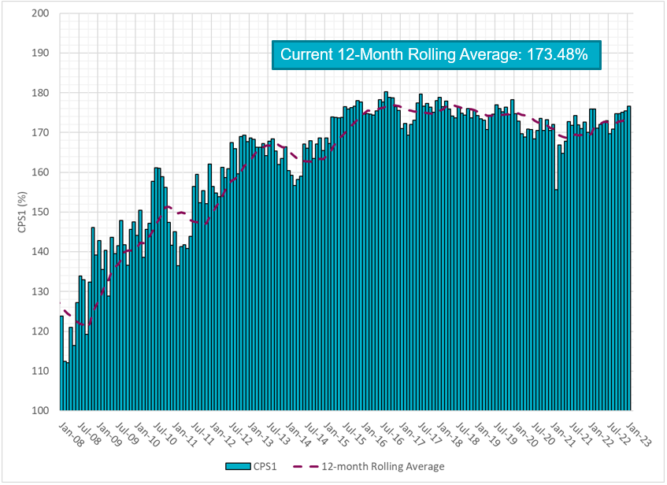
CPS1 Performance

Slide 11
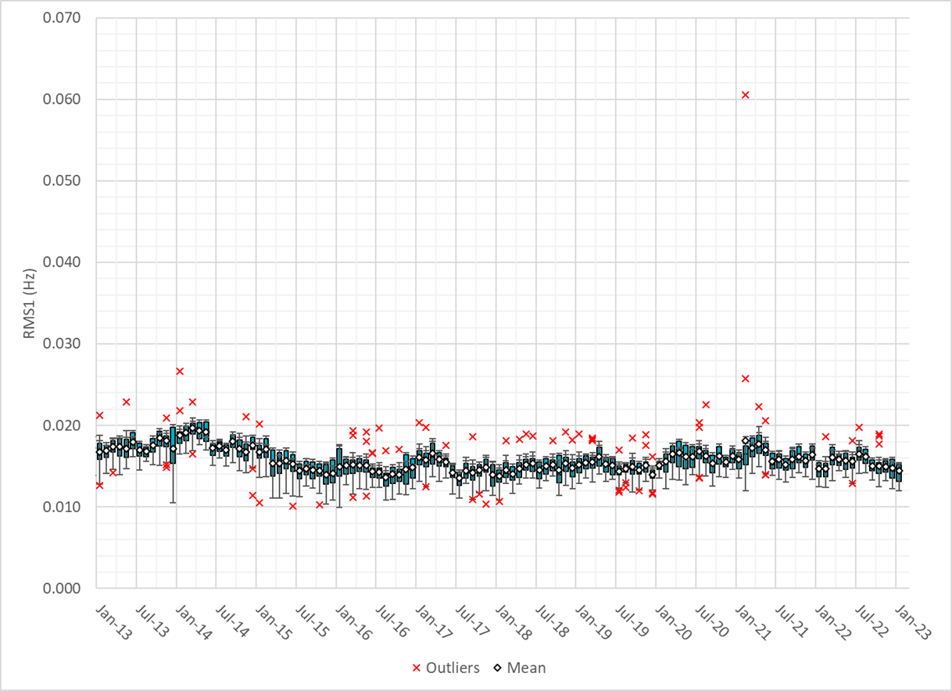
RMS1 Performance of ERCOT Frequency
Notes:
14.46Mhz on avg for Jan 2023

Slide 12
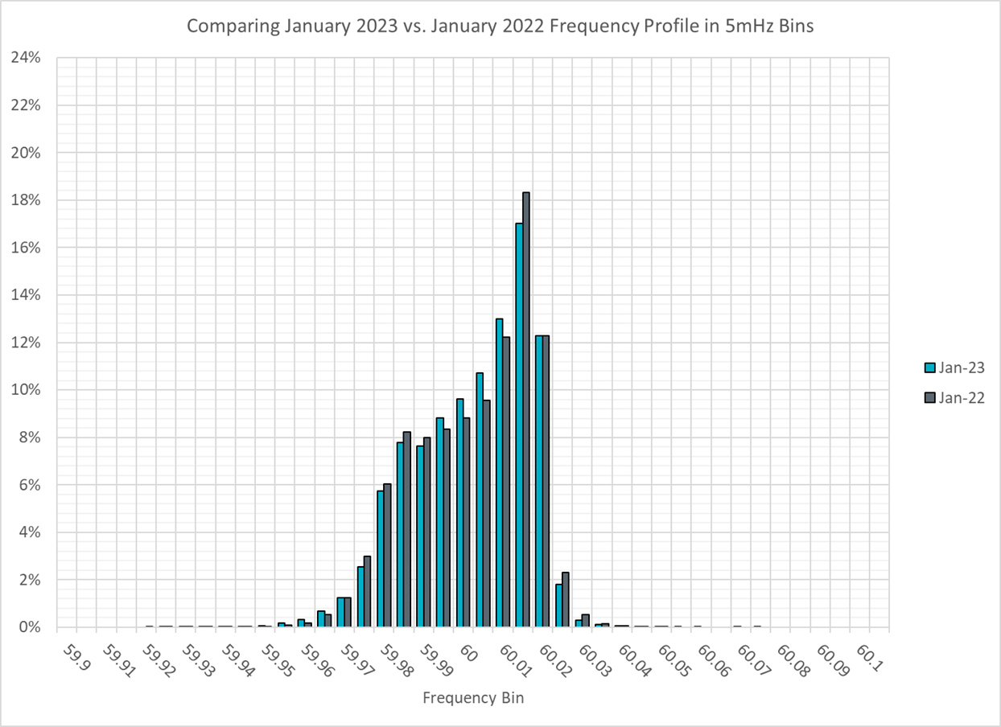
Frequency Profile Analysis

Slide 13
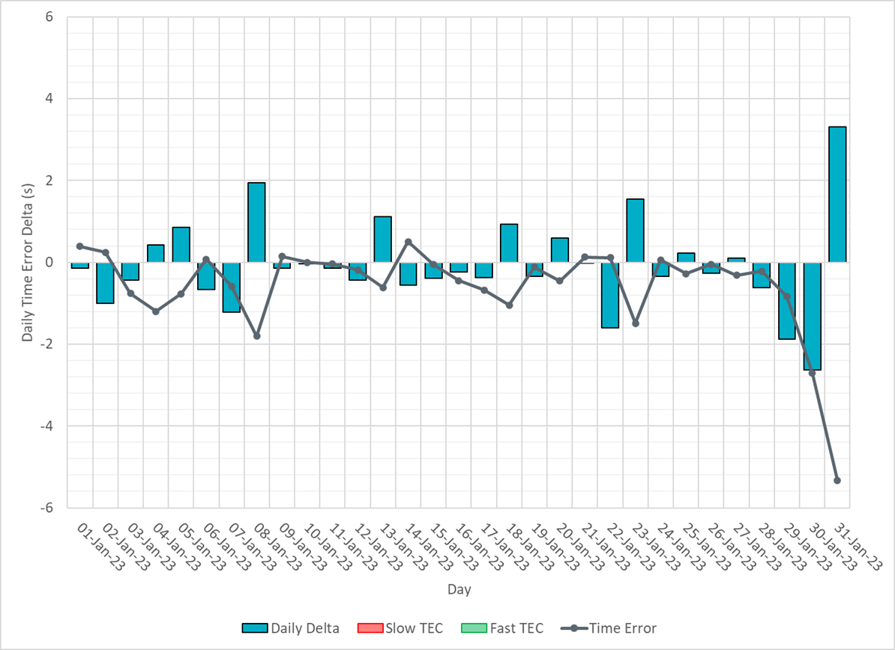
Time Error Corrections

Slide 14
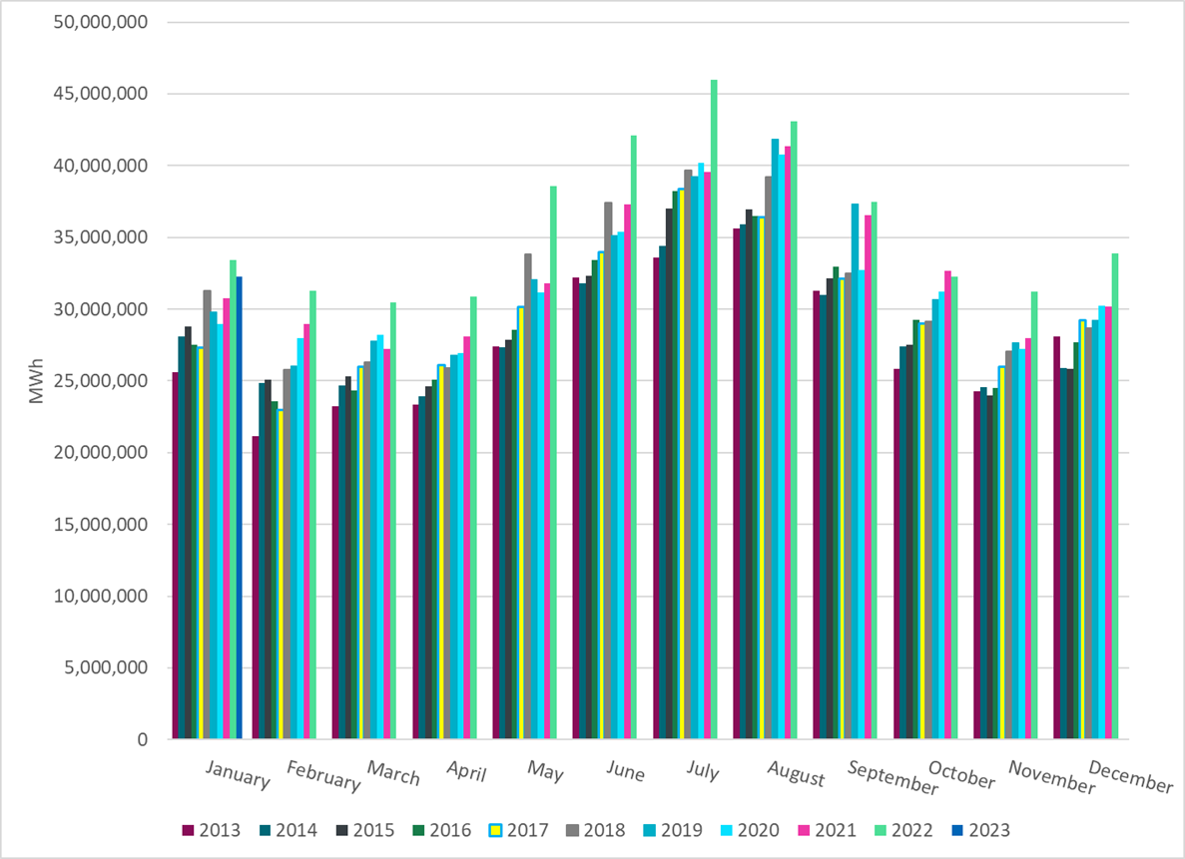
ERCOT Total Energy
Notes:
32,277,477 MWh

Slide 15
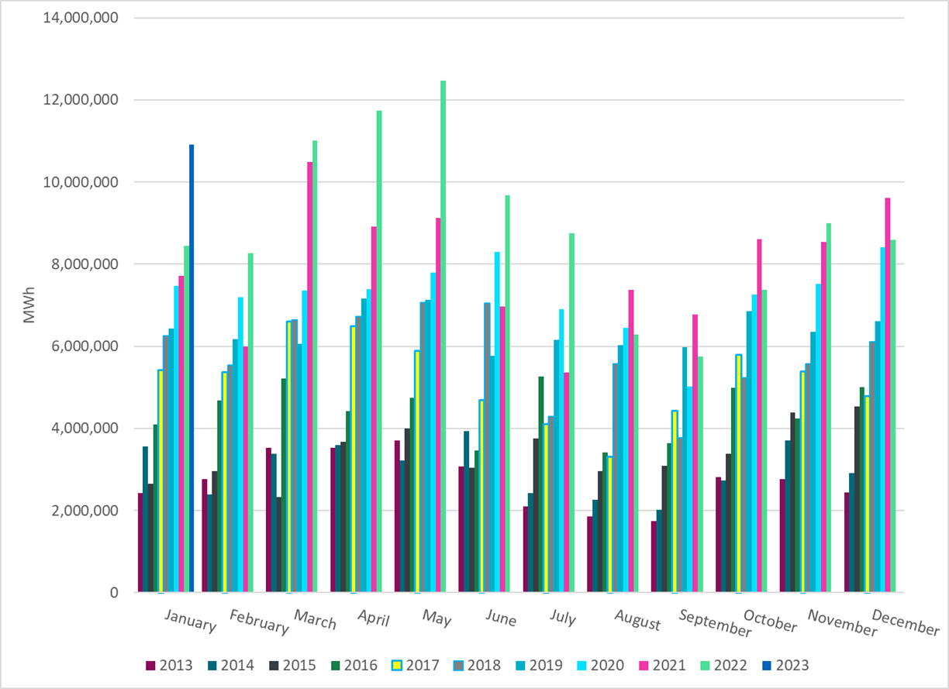
ERCOT Total Energy from Wind Generation
Notes:
10,909,355 MWH

Slide 16
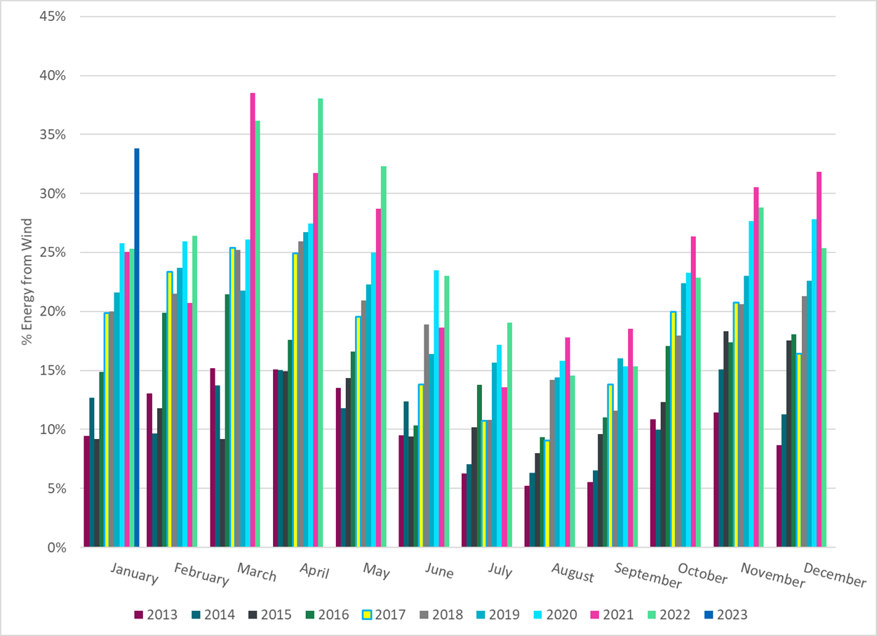
ERCOT % Energy from Wind Generation
Notes:
33.80%
of total energy was provided by wind generation

Slide 17
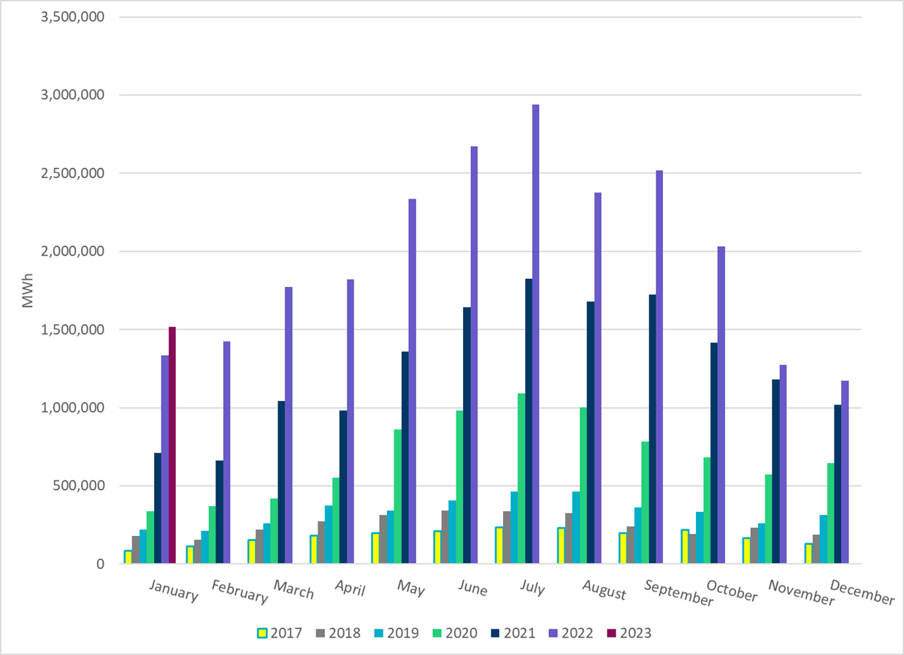
ERCOT Total Energy from Solar Generation
Notes:
1,516,586 MWh

Slide 18
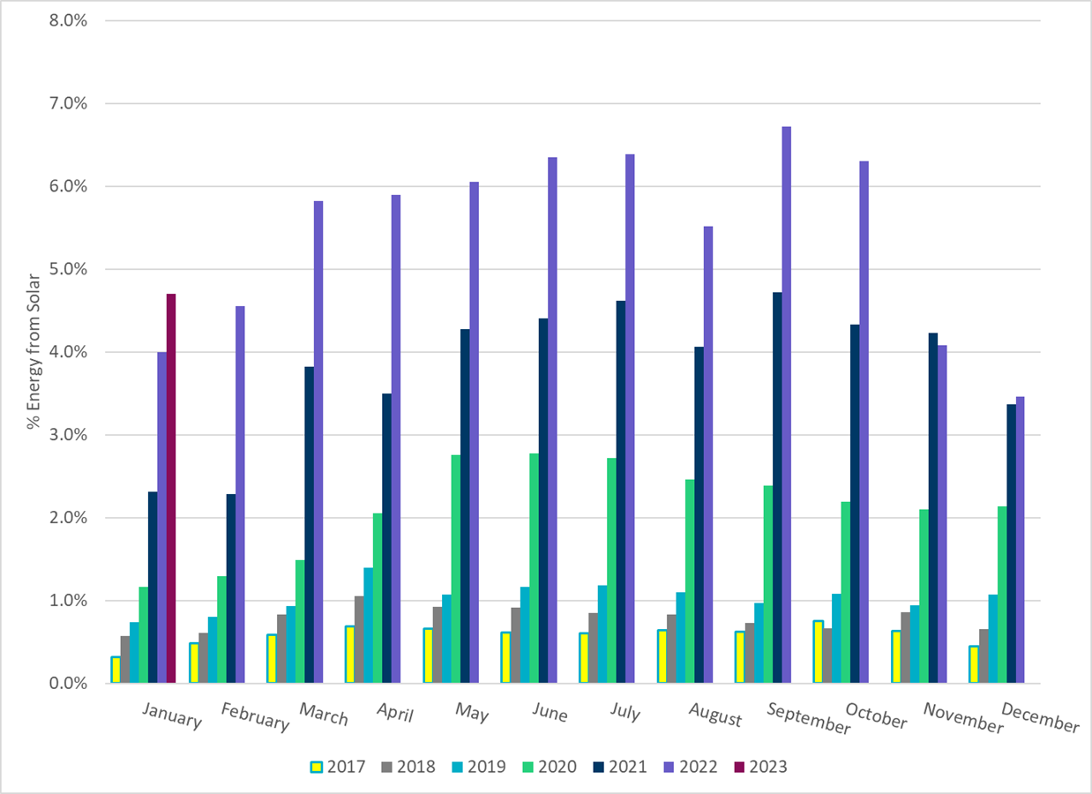
ERCOT % Energy from Solar Generation
Notes:
4.70%

Slide 19
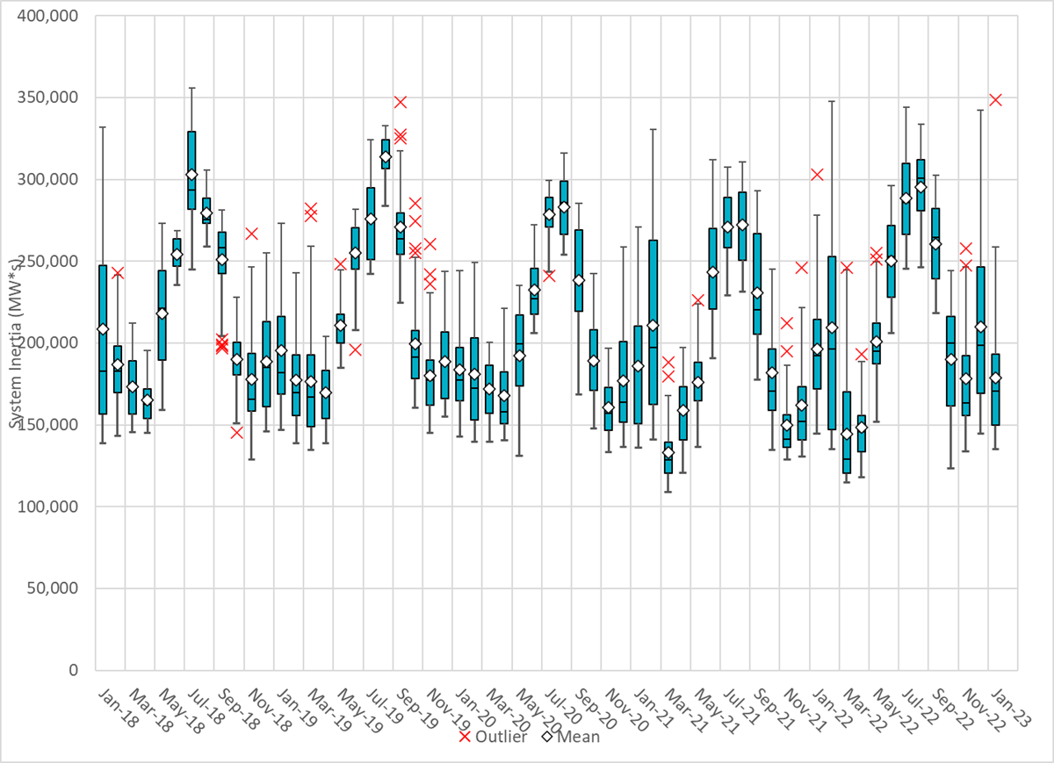
ERCOT Daily Minimum System Inertia
Notes:
Minimum Inertia =135,268 MW*s on 1/15/2023
Absolute Minimum remains 109,029 MW*s on 3/22/2021
Data:
Mean: 178,997 MW*s
Max: 348,505 MW*s on Jan 31st
Min: 135,268 MW*s on Jan 15th

Slide 20
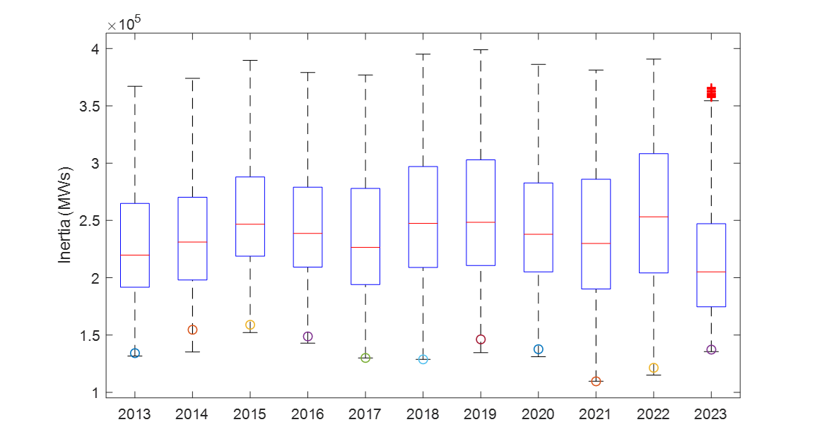
ERCOT Inertia Trend
Notes:
For each box, the central mark (red line) is the median, the edges of the box (in blue) are the 25th and 75th percentiles, the whiskers correspond to +/- 2.7 sigma (i.e., represent 99.3% coverage, assuming the data are normally distributed. The corresponding lowest inertia in each year is given in the table.
The circle on each boxplot is showing inertia during time when highest portion of load was served by wind/solar generation in that year.

