Slide 1
2022 Analysis of REP and NOIE Demand Response
Carl L Raish
Principal Load Profiling and Modeling
Retail Market Subcommittee – Feb 7, 2022

Slide 2
Overview
  Summer 2021 Analysis Update
  Total System-level Demand Response
    Total ERCOT Demand Response
    Responding NOIE and ESIID counts
  4CP Participation Trends
  DR/PR Events

Slide 3
Total System-Level Demand Response

Slide 4
Load Reductions by Category/System Level
HE 17:00 MW Reductions
Table shows Days with Total System DR > 3,000 MW (59 days > 50 MW)
Overlap = Category Total – Total System DR (To eliminate double counting)

Slide 5
ESIIDs/NOIEs by Category/System Level
HE 17:00 ESIIDs/NOIEs with Reductions
Table shows Days with Total System DR > 3,000 MW (59 days > 50 MW)
Overlap = Category Total – Total System DR (To eliminate double counting)

Slide 6
Responding ESIIDs and Reductions
Table Shows Days with Total System DR > 3,500 MW

Slide 7
Responding NOIEs and Reductions
Days with Total System DR > 3,500 MW

Slide 8
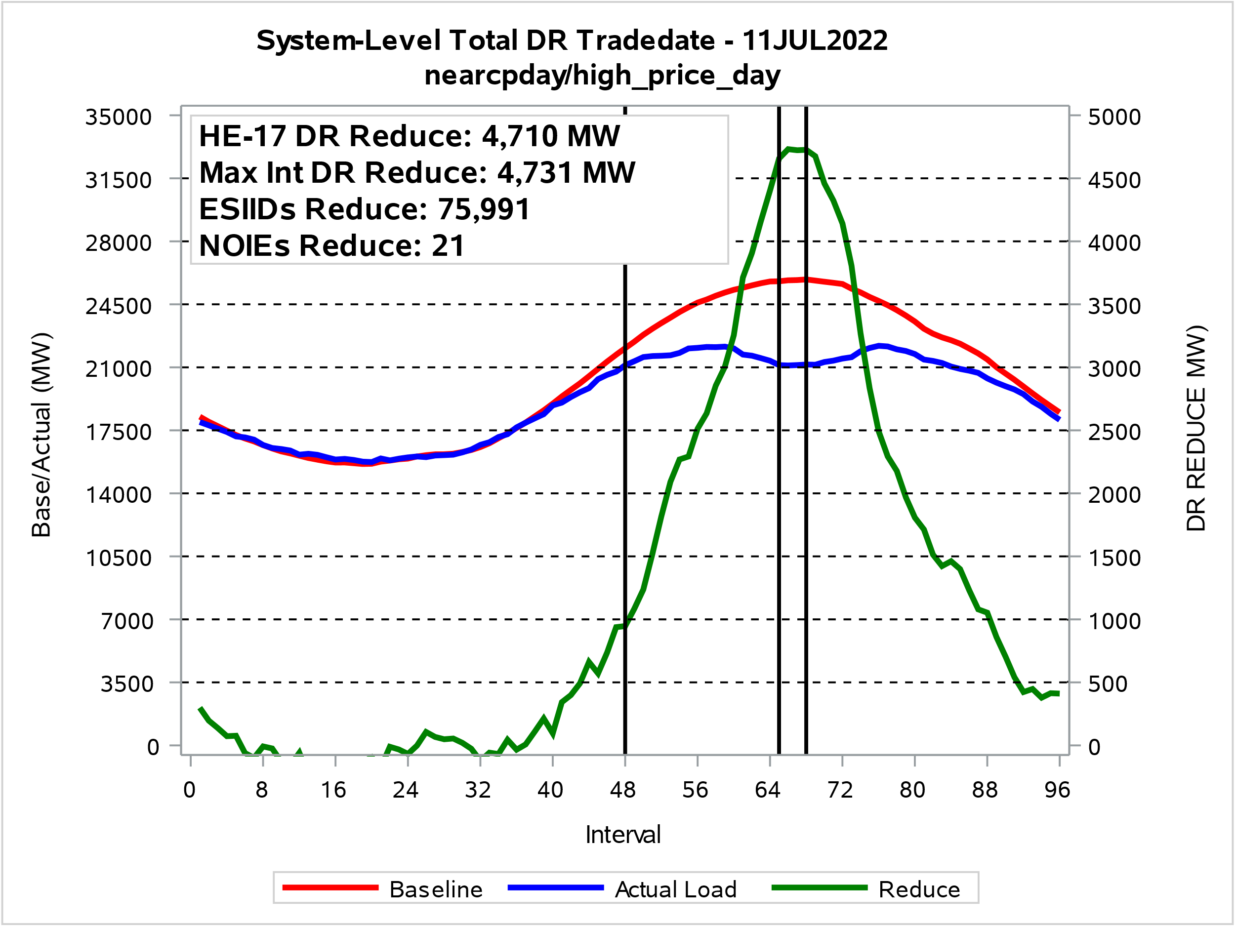
Total Competitive and NOIE Demand Response
Day with Highest Total System DR

Slide 9
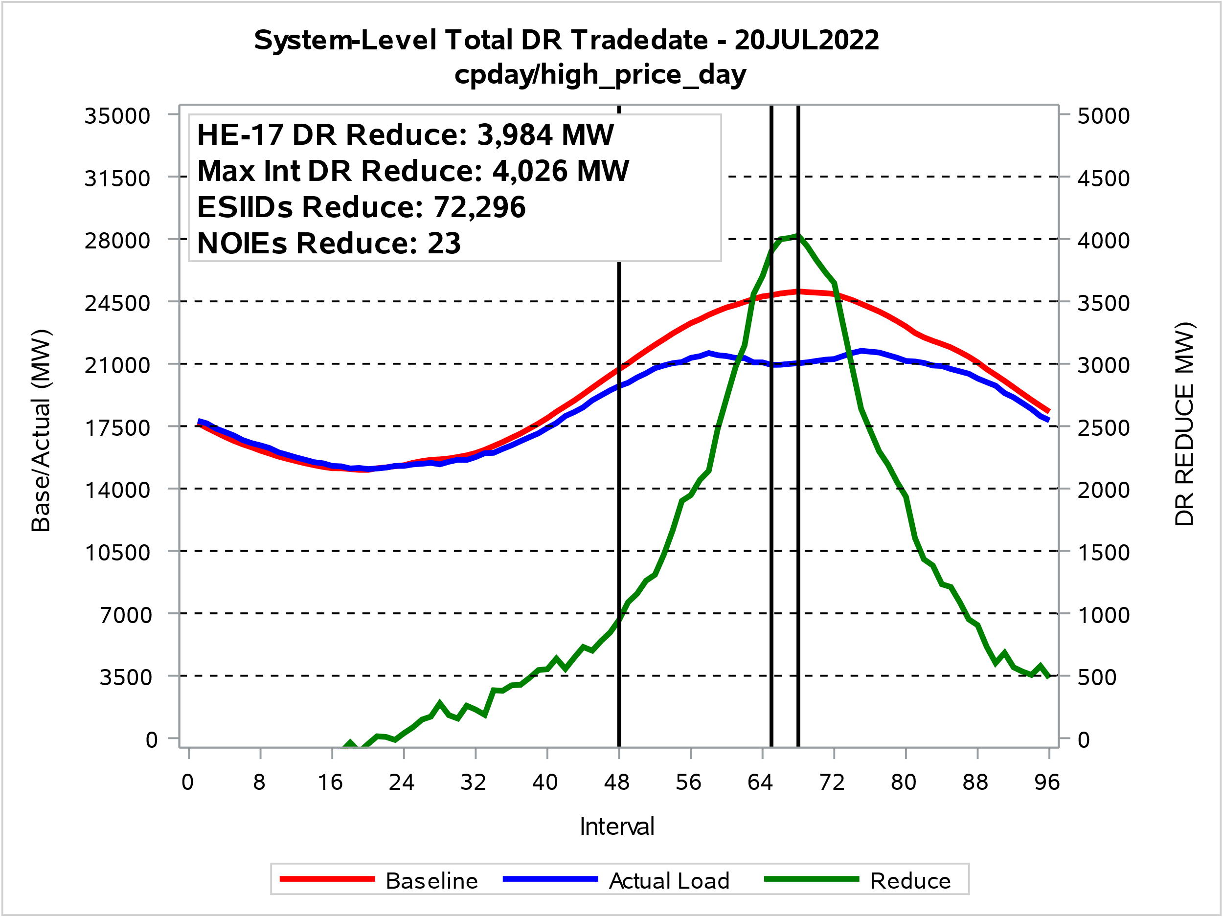
Total Competitive and NOIE Demand Response
Day with 2nd Highest Total System DR - ERCOT Peak Day

Slide 10
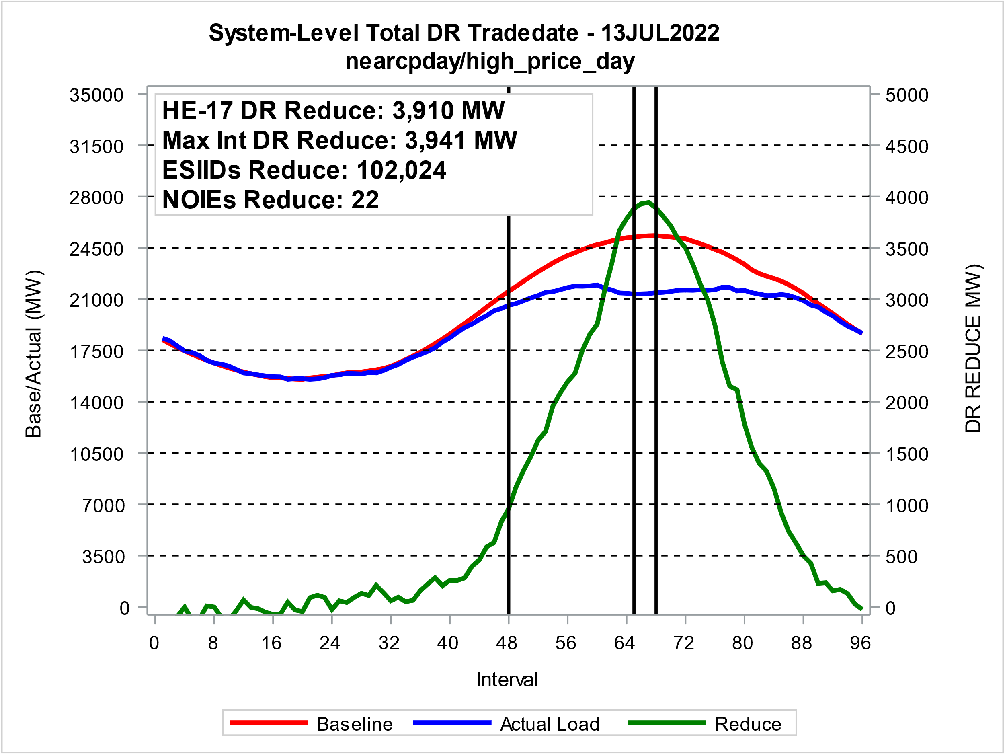
Total Competitive and NOIE Demand Response
Day with 3rd Highest Total System DR – ERS Deployed

Slide 11
Price Response and Retail DR Participation Trends

Slide 12
4CP Response Trend
2014
2015
2016
2017
2018
2019
2020
2021
2022
Blue Squares: 4CP Days Red Circles: HE17 Price > $500
Red Arrows: HE17 Price > $1,000

Slide 13
4CP Response Trend

Slide 14
Indexed Real Time Response Trend
2019
2020
2021
2022

Slide 15
NOIE Real Time Response Trend
2019
2022
2020
2021

Slide 16
DR/PR Events

Slide 17
4CP Events 2022
4CP Days
Date | ESIIDs | HE 17 Reduce MW | NOIEs | HE 17 Reduce MW | Total
23-Jun | 4,005 | 1,863 | 18 | 1,275 | 3,138
20-Jul | 3,525 | 1,915 | 21 | 1,771 | 3,687
2-Aug | 3,326 | 1,616 | 15 | 1,068 | 2,684
20-Sep | 4,602 | 2,002 | 17 | 978 | 2,980

Slide 18
4CP/NearCP Events 2022
Near-CP Days
Date | ESIIDs | NOIEs | HE 17 Reduce MW
6-Jun | 3,755 | 11 | 2,013
7-Jun | 3,654 | 18 | 2,500
8-Jun | 4,820 | 10 | 1,877
9-Jun | 3,302 | 11 | 2,081
10-Jun | 4,231 | 20 | 3,364
13-Jun | 4,735 | 22 | 3,394
16-Jun | 4,258 | 20 | 3,189
20-Jun | 3,613 | 15 | 2,821
21-Jun | 4,217 | 14 | 2,012
24-Jun | 4,423 | 17 | 3,399
Date | ESIIDs | NOIEs | HE 17 Reduce MW
6-Jul | 3,590 | 16 | 1,842
7-Jul | 3,588 | 19 | 2,635
8-Jul | 4,019 | 20 | 3,427
11-Jul | 4,289 | 21 | 4,453
12-Jul | 3,794 | 18 | 3,299
13-Jul | 3,787 | 20 | 3,449
18-Jul | 3,132 | 17 | 2,550
19-Jul | 3,434 | 20 | 3,640
27-Jul | 3,711 | 13 | 1,522
28-Jul | 3,773 | 13 | 1,645
41 Near-CP Days, reductions 1,051 – 4,453 MW

Slide 19
4CP/NearCP Events 2022
Near-CP Days (cont.)
Date | ESIIDs | NOIEs | HE 17 Reduce MW
3-Aug | 3,322 | 19 | 2,643
4-Aug | 3,655 | 20 | 2,735
5-Aug | 4,708 | 4 | 1,233
9-Aug | 4,357 | 8 | 1,683
10-Aug | 3,858 | 5 | 1,637
11-Aug | 2,756 | 4 | 1,238
12-Aug | 3,771 | 16 | 1,388
16-Aug | 3,165 | 7 | 1,427
17-Aug | 2,970 | 9 | 1,838
23-Aug | 3,882 | 5 | 860
26-Aug | 3,718 | 7 | 1,497
Date | ESIIDs | NOIEs | HE 17 Reduce MW
1-Sep | 5,425 | 15 | 2,394
2-Sep | 5,793 | 12 | 1,593
6-Sep | 3,106 | 7 | 1,894
7-Sep | 3,651 | 15 | 3,272
8-Sep | 4,055 | 10 | 1,724
16-Sep | 4,348 | 4 | 1,352
19-Sep | 4,655 | 13 | 2,651
21-Sep | 4,236 | 17 | 3,039
22-Sep | 4,308 | 14 | 2,533
23-Sep | 4,432 | 10 | 2,317
41 Near-CP Days, reductions 1,051 – 4,453 MW

Slide 20
Indexed Real-Time High Price Events
Date | ESIIDs | HE 17 Reduce MW | Avg Price $/MWh
13-Jun | 5,709 | 262 | $308
14-Jun | 6,779 | 171 | $357
15-Jun | 6,130 | 274 | $551
16-Jun | 6,435 | 248 | $435
8-Jul | 18,153 | 1,007 | $421
11-Jul | 18,016 | 1,018 | $308
12-Jul | 15,077 | 1,009 | $706
13-Jul | 18,240 | 1,066 | $2,810
18-Jul | 15,030 | 831 | $886
Table lists Days with Event Average Price > $300
20 Days with High Real-Time Prices (>$200) Reductions: 51 – 1,066 MW

Slide 21
Indexed Real-Time High Price Events
(Cont.)
Date | ESIIDs | HE 17 Reduce MW | Avg Price $/MWh
20-Jul | 15,496 | 974 | $940
3-Aug | 15,276 | 807 | $338
8-Aug | 16,575 | 481 | $426
9-Aug | 21,170 | 554 | $565
11-Aug | 14,183 | 517 | $353
17-Aug | 15,058 | 697 | $415
22-Aug | 21,801 | 288 | $345
23-Aug | 20,083 | 301 | $369
25-Aug | 15,247 | 279 | $302
6-Sep | 15,604 | 898 | $365
Table lists Days with Event Average Price > $300
20 Days with High Real-Time Prices (>$200) Reductions: 51 – 1,066 MW

Slide 22
Indexed Day-Ahead High Price Events
Date | ESIIDs | HE 17 Reduce MW | Avg Price $/MWh
High DA Only
10-Jun | 325 | 51 | $325
23-Jun | 304 | 58 | $401
14-Jul | 395 | 49 | $545
15-Jul | 378 | 54 | $353
19-Jul | 311 | 52 | $430
4-Aug | 299 | 53 | $314
10-Aug | 269 | 49 | $318
16-Aug | 291 | 52 | $306
Table lists Days with Event Average Price > $300
26 Days with High Day-Ahead Only Prices (>$200) Reductions: 2 – 60 MW

Slide 23
Indexed Day-Ahead High Price Events
Date | ESIIDs | HE 17 Reduce MW | Avg Price $/MWh
High RT Only
13-Jun | 22 | 8 | $308
14-Jun | 37 | 7 | $357
29-Jun | 49 | 7 | $260
3-Aug | 319 | 57 | $338
22-Aug | 350 | 53 | $345
23-Aug | 354 | 69 | $369
6-Sep | 294 | 51 | $365
Table lists All Days with Response
7 Days with High Real-Time Only Reductions: 7 – 69 MW

Slide 24
Indexed Day-Ahead High Price Events
Date | ESIIDs | HE 17 Reduce MW | Avg Price $/MWh
High DA & RT
6/15/2022 | 32 | 6 | $551
6/16/2022 | 24 | 8 | $435
7/8/2022 | 346 | 46 | $743
7/11/2022 | 355 | 31 | $1,131
7/12/2022 | 328 | 50 | $706
7/13/2022 | 355 | 48 | $2,810
7/18/2022 | 313 | 42 | $886
7/20/2022 | 319 | 55 | $940
8/8/2022 | 293 | 41 | $426
8/9/2022 | 399 | 45 | $565
8/11/2022 | 285 | 52 | $353
8/17/2022 | 339 | 52 | $415
8/25/2022 | 311 | 70 | $302
Avg Event Price: Greater
of DA or RT
All Days with Response
Reductions: 6 – 70 MW

Slide 25
NOIE High Price Response Events
Date | NOIEs | HE 17 Reduce MW | Avg Price $/MWh
29-Jun | 1 | 59 | $260
8-Jul | 19 | 1,595 | $743
11-Jul | 17 | 2,370 | $421
12-Jul | 16 | 1,341 | $706
13-Jul | 13 | 1,301 | $2,810
18-Jul | 15 | 877 | $886
19-Jul | 1 | 225 | $391
20-Jul | 19 | 1,699 | $940
25-Jul | 1 | 144 | $378
Date | NOIEs | HE 17 Reduce MW | Avg Price $/MWh
3-Aug | 12 | 376 | $338
8-Aug | 5 | 208 | $426
9-Aug | 5 | 256 | $565
11-Aug | 4 | 189 | $353
17-Aug | 6 | 321 | $415
22-Aug | 14 | 678 | $345
23-Aug | 3 | 45 | $369
25-Aug | 2 | 28 | $302
6-Sep | 6 | 160 | $365
Table lists All Days with Response
18 Days with High Real-Time Only Reductions: 28 – 2,370 MW

Slide 26
Direct Load Control Events
Date | ESIIDs | HE 17 Reduce MW | Avg Price $/MWh
13-Jun | 4,666 | 82 | $308
15-Jun | 10,932 | 84 | $551
23-Jun | 7,629 | 79 | ⃰ $71
8-Jul | 12,839 | 90 | $743
11-Jul | 12,166 | 89 | $421
12-Jul | 5,291 | 77 | $706
13-Jul | 12,191 | 86 | $2,810
18-Jul | 12,074 | 81 | $886
20-Jul | 13,446 | 90 | $840
4-Aug | 7,970 | 88 | ⃰ $73
⃰ Not High Price Day
Table lists Event Days with Reductions > 75 MW
47 Event Days with Reductions > 10 MW Reductions: 10 –90 MW

Slide 27
Peak Rebate Events
Date | ESIIDs | HE 17 Reduce MW | Avg Price $/MWh
24-Jun | 36,510 | 41 | ⃰ $58
8-Jul | 41,111 | 51 | $743
11-Jul | 42,285 | 57 | $421
13-Jul | 42,735 | 54 | $706
14-Jul | 47,199 | 62 | ⃰ $55
18-Jul | 34,984 | 39 | $886
20-Jul | 40,507 | 49 | $391
4-Aug | 36,664 | 38 | ⃰ $73
10-Aug | 33,052 | 36 | ⃰ $74
16-Aug | 36,359 | 37 | ⃰ $97
17-Aug | 37,428 | 40 | $415
⃰ Not High Price Day

Slide 28
ERS Event – Competitive Load Only
Date | ESIIDs | HE 17 Reduce MW | Avg Price $/MWh
13-Jul | 27,839 | 713 | $2,810
Differences from ERS Performance:
  Includes response from deployed ESIIDs:
    with no Time-Period 4 obligations
    in deployed Generator only Resources
  Best baseline by ESIID … weather sensitivity determined at ESIID-level
  Baseline days limited to non-4CP/high price days for ESIIDs responding on such days
  Event day-of-adjustment factor calculated using intervals 1 through the interval ending 1 hour prior to beginning of high price event
  MBMA baseline based on intervals prior to beginning of high prices
  Non-responding ESIIDs (<3% Load reduction) excluded

Slide 29
Next Steps
Suggested OBDRR and possible NPRR (next month?)
  Discontinue NAESB submissions
  Modify ESIID List Provide
    Automatic (currently by request)
    Add dates for 4CP beginning
    Identify Crypto ESIIDs
    Add a solar buy-back category
    Other ???
Possible Winter Survey - snapshot date Feb 1.
Update Residential Consumption Analysis
Update Residential PV Analysis.
Training Session (timing? After Aug 1 so participation is locked down)

Slide 30
Questions?
ON
OFF
craish@ercot.com 512/248-3876

