Slide 1
LFL Analysis
Evan Neel
Resource Adequacy
ERCOT
Large Flexible Load Task Force
February 17, 2023
ERCOT Public

Slide 2
Contents
Winter Storm Elliot LFL Response
Voluntary Curtailment Program Back Cast

Slide 3
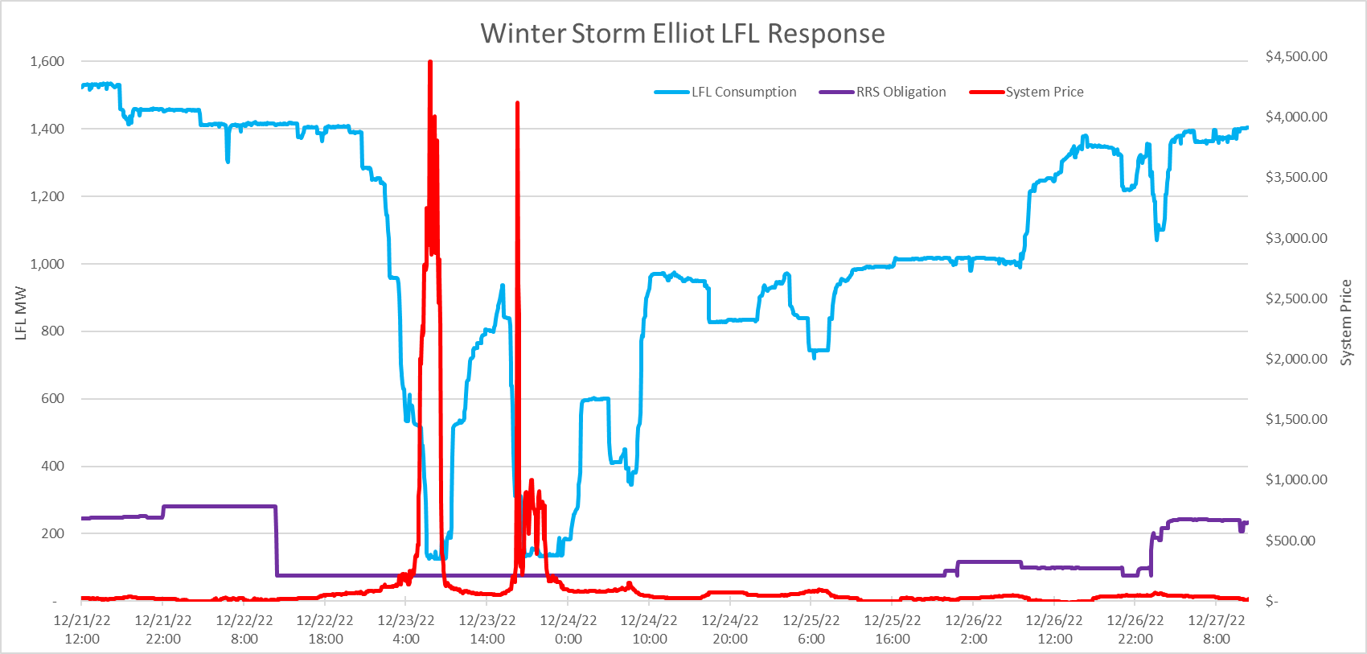
Winter Storm Elliot LFL Response

Slide 4
Winter Storm Elliot LFL Response
Prior to curtailment beginning on 12/21 there was 1,530 MW of LFL consumption on the system (250 MW RRS).
At times of peak prices, LFL consumption fell to 130 MW (75 MW RRS).
Including RRS, the total response from LFLs was 1,475 MW (96.4%).
Of the 20 LFLs tracked, all demonstrated a curtailment in load to some extent.
6 LFLs curtailed their load for the entire duration of Elliot, independent of market prices.
The remaining 14 LFLs behaved in a manner which suggested they were responding to real-time prices.

Slide 5
Voluntary Curtailment Program Back Cast
In response to the new Interim Voluntary Load Curtailment program, we received a request inquiring about how often this program would be called upon by ERCOT.
Language in the market notice sent out on 12/6/22 noted that this voluntary program would be deployed “during times of low or declining PRC after Non-Spinning Reserve Service has been deployed, but before ERS has been deployed.”
ERCOT has performed a back cast with this criteria in order to identify how often the interim service would have been called upon had it existed in 2022.

Slide 6
Voluntary Curtailment Program Back Cast
Identified 5 min intervals in 2022 which satisfied two criteria:
  All offline Non-Spin had been deployed
  System PRC was below 3,200 MW
It is estimated that in 2022 the Voluntary Load Curtailment program would have been called on for approximately 9 hours (~ 0.1% of the year)

Slide 7
Questions?
Questions?
Email: evan.neel@ercot.com

