Slide 1
Project Update
February 9, 2023
Troy Anderson
ERCOT Portfolio Management

Slide 2
Project Update Agenda
  Recent / Upcoming Project Highlights
  2023 Release Targets
    Includes initial draft of key projects by system
  Additional Project Status Information
  Priority/Rank Options for Revision Requests with Impacts
    None
  Technology Working Group (TWG)
    Next meeting is 2/16/2023
Location of Revision Request Project Information: http://www.ercot.com/services/projects

Slide 3
Recent / Upcoming Project Highlights
2023 February Release – R1 – 1/31/2023-2/2/2023 Complete
  NPRR1020(a) – Allow Some Integrated Energy Storage Designs to Calculate Internal Loads
    EPS Metering portion
2023 March Release – R2 – 3/28/2023-3/30/2023 In Flight
  NPRR1040 – Compliance Metrics for Ancillary Service Supply Responsibility
2023 June Release – R3 – 6/6/2023-6/8/2023 In Flight
  NPRR863 – Creation of ERCOT Contingency Reserve Service (ECRS) and Revisions to Responsive Reserve
  NPRR1085 – Ensuring Continuous Validity of PRC and Dispatch through Timely Changes to Resource Telemetry and COPs
  NPRR1096(b) – Require Sustained Two-Hour Capability for ECRS
  NPRR1148 – Language Cleanup Related to ERCOT Contingency Reserve Service (ECRS)
  OBDRR043 – Related to NPRR1148, Language Cleanup Related to ECRS
Note: Projected Go-Live dates are subject to change.
Please watch for market notices as the effective dates approach.

Slide 4
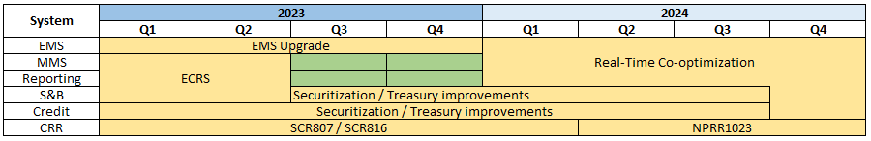
2023 Release Targets – Approved NPRRs / SCRs / xGRRs
R1
R3
R5
February 1/31 – 2/2 | March 3/28 – 3/30 | June 6/6 – 6/8 | July 7/25 – 7/27 | October 10/3 – 10/5 | December 12/5 – 12/7
NPRR1020(a) SCR789 Ph2 | NPRR1040 | ECRS (NPRR863) NPRR1085 NPRR1096(b) NPRR1148 OBDRR043 | SCR789 Ph2 | NPRR945 NPRR1090 NPRR1112 NPRR1121 NPRR1154 SCR807 SCR816 | Securitization Phase 2A – Maine Invoice and Credit Exposure EMS Upgrade
R2
R4
R6
E
E
E
E
E
E
E
E
NS
NS
NS
NS
NS
P
P
P
July
3/10
11/15
EMS Upgrade Freeze – May 2023 – Jan. 2024
TBD | NPRRs: 484,825(b),826,829,841,857,879,885,904,918,930,936,941,962,963,965,975,987,995,1004,1006,1007,1019,1023,1026,1030,1032,1034,1057, 1077,1092(b),1105 SCRs: 799,805,810,813,818,819 PGRRs: 066,076,088,091,094,099 Other: OBDRR009,OBDRR017,RRGRR028
Go-live dates can differ from Protocol effective dates – Please refer to market notices for more details
APPENDIX
Red Text: New additions and target release changes
Strike-Through Text: Previous target release
(a), (b), etc.: Multiple phase release
Project Status Codes
NS = Not Started
I = Initiation
P = Planning
E = Execution
H = On Hold
NPRR1020(a) – EPS Metering portion
NPRR1096(b) – ECRS portion
Release targets are subject to change

Slide 5
Additional Project Status Information
Page 1 of 2
Revision Request | Description | Project Phase | Additional Detail
NPRR1095 SCR817 SCR823 | Texas SET V5.0 Changes MarkeTrak Validation Revisions Aligning w/TX SET 5.0 ERCOT Mass System “County Name” File Updates | Planning | Expected completion in 2024
NPRR945 | Net Metering Requirements | Not Started | Reporting piece - Project approved to start in Q2 – R5 2023 Go-Live target
NPRR962 | Publish Approved DC Tie Schedules | Not Started | Evaluating for a Q1 Q2 2023 start
NPRR1004 | Load Distribution Factor Process Update | Not Started | Mid-2023 start candidate
NPRR1006 | Update RT On-Line Reliability Deployment Price Adder Inputs to Match Actual Data | On Hold | Assessing restart date options
NPRR1090 | ERS Winter Storm Uri Lessons Learned Changes and Other ERS Items | Not Started | Project approved to start in Q2 2023 – R5 2023 Go-Live target
NPRR1092 | Limit RUC Opt-Out Provision | Not Started | Mid-2023 start candidate
NPRR1112 | Elimination of Unsecured Credit Limits | Not Started | Project approved to start in Q2 2023 – R5 2023 Go-Live target
NPRR1121 | Add a Posting Requirement to the Exceptional Fuel Cost Submission Process | Not Started | Project approved to start in Q2 2023 – R5 2023 Go-Live target
NPRR1131 | Controllable Load Resource Participation in Non-Spin | Not Started | Assessing start date options 2023 candidate
NPRR1136 | Updates to Language Regarding a QSE Moving Ancillary Service Responsibility Between Resources | Not Started | Mid-2023 start candidate
Red Text: New additions and updates

Slide 6
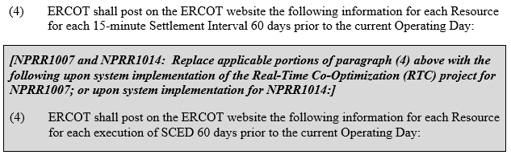
Additional Project Status Information
Page 2 of 2
Revision Request | Description | Project Phase | Additional Detail
NPRR1007 NPRR1014 | SCED Postings Gray-boxed in Section 3.2.5(4) Publication of Resource and Load Information | Not Started | Potential implementation of the gray box in this section, specifically the increasing of granularity for SCED disclosure reporting Evaluating for a Q2 2023 start
SCR819 NPRR1111 | Improving IRR Control to Manage GTC Stability Limits | Not Started | 2023 candidate
SCR820 | Operator Real-Time Messaging During Emergency | Not Started | Project approved to start in March 2023 – Go-Live target is TBD
PGRR066 | Interconnection Request Cancellation and Creation of Inactive Status | Not Started | 2023 start candidate for next bundle of RIOO enhancements
PGRR076 | Improvements to Generation Resource Interconnection or Change Request (GINR) Process | Not Started | 2023 start candidate for next bundle of RIOO enhancements
Red Text: New additions and updates

Slide 7
Priority / Rank Options for Revision Requests with Impacts
Options for…
Revision Request | Description | Priority | Rank | Comments
 | None this month
PPL Rank Information
Next available 2023 Rank in Business Strategy = 3800
Next available Rank in Regulatory = 360

Slide 8
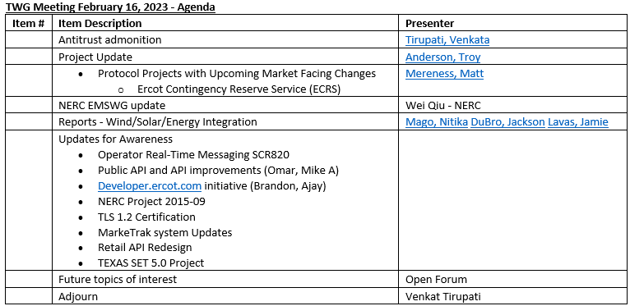
Technology Working Group (TWG)
Next TWG meeting will be February 16, 2023
Draft agenda:

