Slide 1
MTLF
Winter Storm Elliott Review
Calvin Opheim
Load Forecasting & Analysis
OWG
2/16/2023

Slide 2
Agenda
MTLF Model Review
Software Upgrade
Winter Storm Elliott
Corrective Action Plan

Slide 3
MTLF Models

Slide 4
MTLF Models
Two Independent Forecasting Systems
Itron (creates the E, E1, E2, and E3 forecasts)
GE (creates the A3, A6, and M forecasts)
Residing on separate computer systems provides redundancy in case one system is unavailable

Slide 5
MTLF Models
E, E1, E2, E3
Based on neural network and linear regression models with a separate model for each hour
49 weather stations (expanded set)
Can easily switch between any available weather forecast provider

Slide 6
MTLF Models
A3 Notes
Uses recent history to update the model coefficients
Limited to a single weather forecast provider
Requires coding changes to switch to alternative weather forecast
Provides a reasonable backup to the Itron models during the normal range of weather conditions

Slide 7
MTLF Models
A6 Notes
Uses recent history to update the model coefficients
Only uses one weather station per weather zone
Limited to a single weather forecast provider
Requires coding changes to switch to alternative weather forecast
Provides a reasonable backup to the Itron models during the normal range of weather conditions

Slide 8
MTLF Models
M Notes
The weighted average of the 6 other models
Historically has shown to be the most accurate Day Ahead forecast
Provides a good benchmark for other models
For more details
https://www.ercot.com/calendar/04042022-SAWG-Meeting-by-Webex
https://www.ercot.com/calendar/06242022-SAWG-Meeting-by-Webex

Slide 9
MTLF Available Weather Forecasts
The following weather forecasts are available for the Itron models:
European Model (Euro)
Global Forecast System (GFS)
Global Forecast System Ensemble (GENS)
North American Model (NAM)
3 vendor models
ERCOT was the first ISO that incorporated raw weather forecasts into their operational load forecasts
ERCOT is actively working on increasing the number of raw weather forecasts to those mentioned above
Particularly of interest are the Canadian and HRRR models

Slide 10
Software Upgrade

Slide 11
Software Upgrade and Impacts
A software upgrade for Itron went live on 12/6/2022
A change in how holidays are accounted for was not uncovered during testing
Resulted in holidays being significantly under-forecasted
Rendered E, E1, E2, and E3 unusable for most of the week
All enhancements/improvements previously implemented in the Itron created MTLFs were unavailable because these forecasts were unusable
Ability to select from any available raw weather model (like Euro, GFS, NAM)
Ability to apply error correction
Extreme weather forecasting improvements

Slide 12
Software Upgrade and Impacts

Slide 13
Winter Storm Elliott

Slide 14
Weather Forecasts
NAM was the preferred forecast but was unavailable to the A3 and A6 forecasts

Slide 15
Weather Forecasts
NAM was the preferred forecast but was unavailable to the A3 and A6 forecasts

Slide 16
Weather Forecasts
NAM was the preferred forecast but was unavailable to the A3 and A6 forecasts

Slide 17
Load Forecasts
Forecasts were created at 8:02 am each day

Slide 18
Forecast Error Sources During Elliott
Using the A3 model resulted in an increase in forecast errors
Ramifications of using A3
Based on MDA’s weather forecast instead of the weather forecast (NAM) recommended by our meteorologists
Seeing that the NAM forecast was better than MDA’s forecast in the days leading up to 12/23, the result was higher forecast errors than if the Itron models had been operational
Limited features/flexibility as compared to the Itron models
Limited historical data on cold weather events
Uri data after 2/14/21 was of no value due to system outages
Weather forecast error
Load forecasting model error

Slide 19
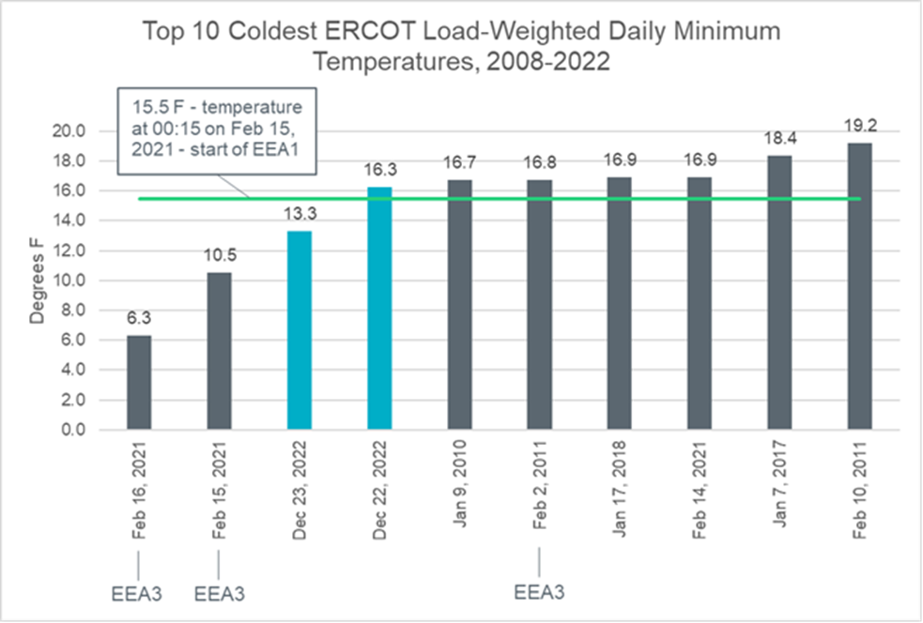
ERCOT Load-Weighted Temperatures

Slide 20
Corrective Action Plan

Slide 21
Corrective Actions Currently Planned
Objective 1 – Reduce forecast errors from the alternative load forecasting source (currently the GE models A3, A6)
Add an external load forecast that will complement ERCOT’s Itron models
Must have the ability to seamlessly switch weather forecasts
Objective 2 – Develop an innovative process for developing extreme cold weather forecasts
Develop a process for creating specialized extreme cold weather models
Based on a robust set of historical cold weather data

Slide 22
Corrective Actions Currently Planned
Objective 3 – Reduce weather forecast error
Add more raw weather forecasting models
If the Canadian forecast was available, the day(s) ahead forecast would have been better
If the HRRR forecast was available, the intraday forecast would have been better
Objective 4 – Improve Itron software upgrade testing process
Create a more robust testing environment
Update testing procedures to include holidays and other outlier phenomena

Slide 23
Questions?

