Slide 1
ERCOT Frequency Control Report
January 2023
ERCOT
Operations Planning
PDCWG | February 15th, 2023

Slide 2
Summary of January 2023
CPS1: 176.58%
Current CPS1 12-Month Rolling Average: 173.48%
0 BAAL Exceedance(s)
2 hourly CPS1 score below 100%
BAAL-003 Events have updated through 2021
2021 BAAL-003 FRM Performance: -913.56
2023 RMS1 Statistics
Mean: 14.46 mHz
Min: 12.0 mHz
Max: 17.3 mHz
Energy Statistics
Total Energy: 32,277,477 MWh
Wind Energy: 10,909,355 MWh
Percent Energy from Wind: 33.80%
Solar Energy: 1,516,586 MWh
Percent Energy from Solar: 4.70%
Minimum System Inertia
Mean: 178,997 MW*s
Max: 348,505 MW*s on Jan 31st
Min: 135,268 MW*s on Jan 15th

Slide 3
Frequency Control
CPS1, BAAL, & RMS1

Slide 4
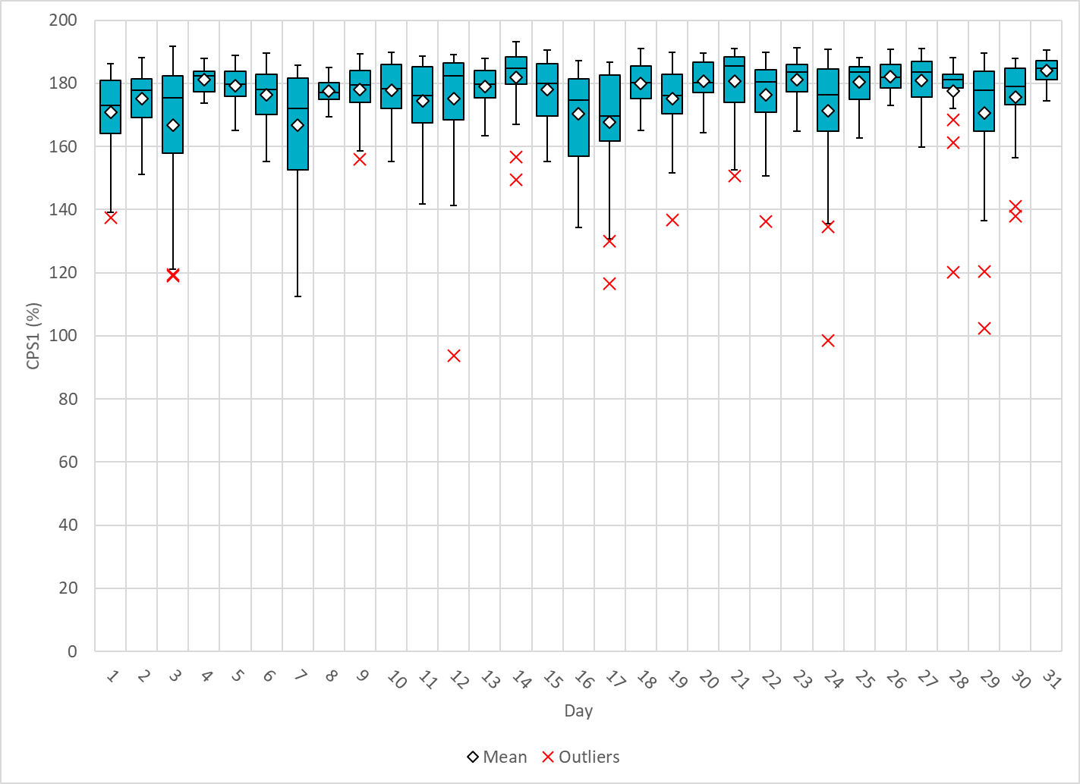
Hourly CPS1 by Day
Jan-23 CPS1 (%): 176.58
Notes:
93.80%@ 1/12/2023 HE 2:00
Between 1:00-2:00, frequency had an extended period sitting above the high dead band due to a site failing to follow curtailment flags due to a control error. Due to this failure to control, the breakers for the site were eventually opened, bringing frequency back below the high dead band. This failure to follow base points carried a greater impact due to the time of day, when load was near its nadir and system inertia was lower.
Regulation: Regulation down was exhausted for the entire period above the high dead band (roughly half of the hour).
2. 98.60%@ 1/24/2023 HE 2:00
Between 1:00-2:00, frequency had an extended period sitting below the low dead band due to a significant and rapid decline in wind generation in the west weather zone (117 MWs/min), which carried a greater impact due to the time of day, when load was near its nadir and system inertia was lower.
Regulation: Regulation up was exhausted for the majority of the hour, and a 250 MW manual offset was inserted for ~ 6 minutes from 01:24 to 01:30. Manual SCED runs were initiated at 01:22 and 01:28.

Slide 5
BAAL Exceedances & Violations
There were 0 BAAL exceedance(s) in December.

Slide 6
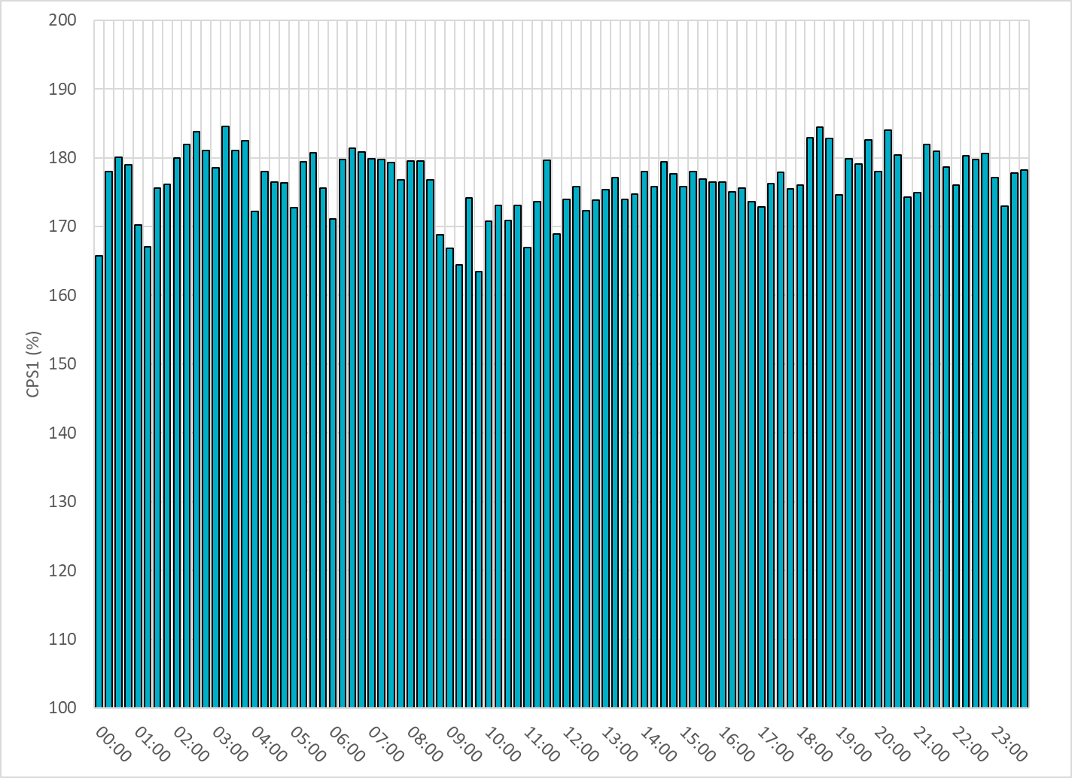
15-Minute Average CPS1%
Jan-23 CPS1 (%): 176.58
Notes:
Overall the 15 min CPS1 score is consistently above 160

Slide 7
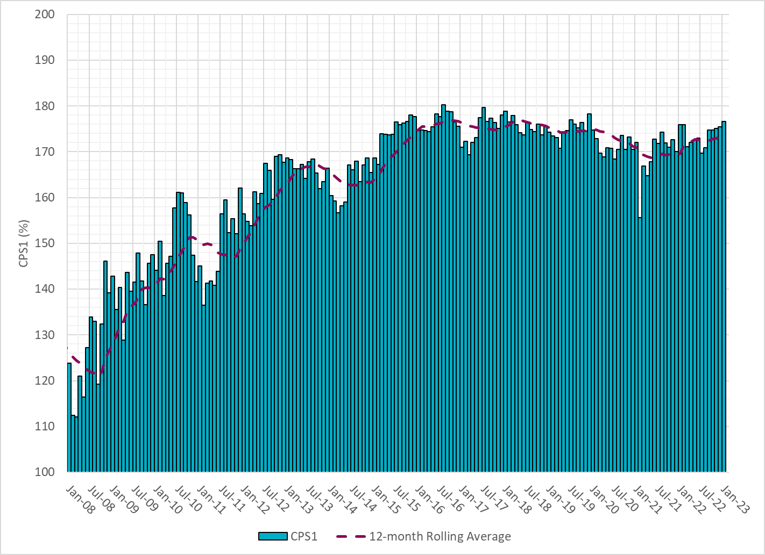
12-Month Rolling Average CPS1
Current 12-Month Rolling Average: 173.48%
Notes:
12 month rolling average CPS1 score is 173.48, which is in line with expectations, and the CPS1 score for Jan is slightly higher than the last month.

Slide 8
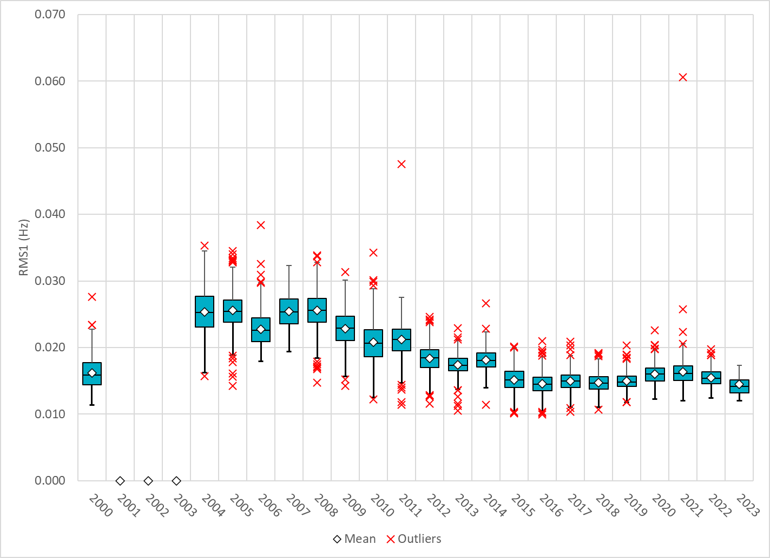
Daily RMS1 of ERCOT Frequency by Year
Notes:
Daily RMS1 frequency by year is so far slightly smaller overall compared with the 2021.
Mean: 14.46 mHz
Min: 12.0 mHz
Max: 17.3 mHz

Slide 9
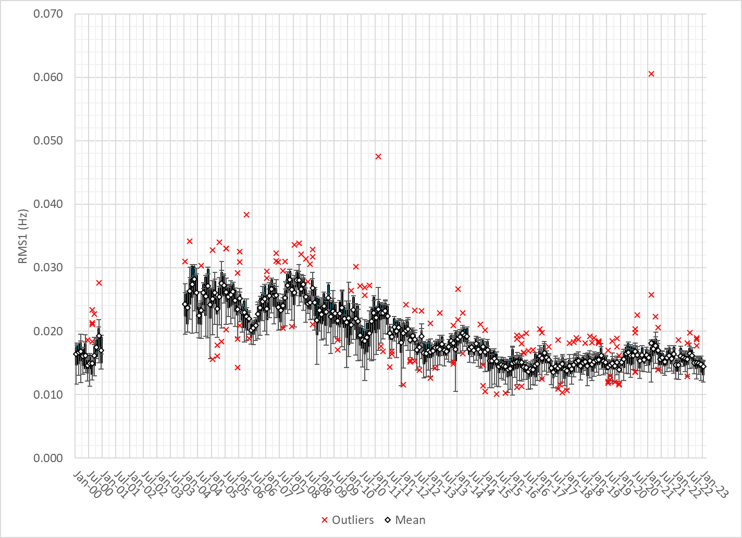
Daily RMS1 of ERCOT Frequency by Month
Notes:
A More granular look at last 15 years of RMS1 by month
14.46Mhz on avg for Jan 2023

Slide 10
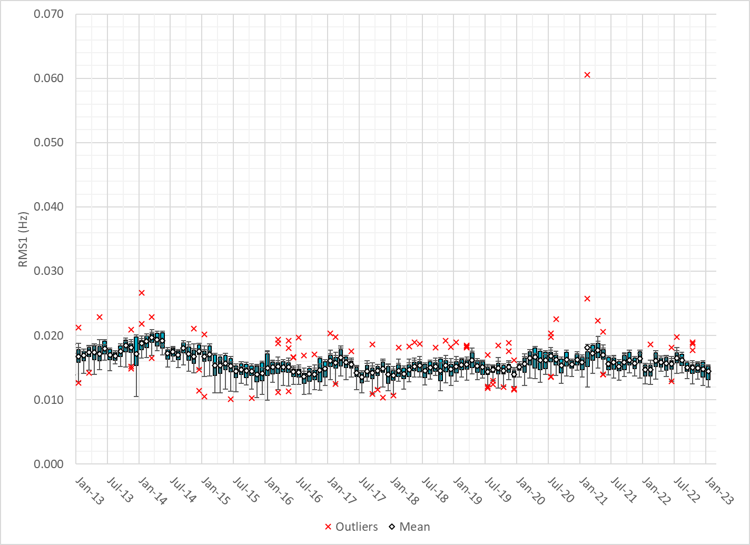
Daily RMS1 of ERCOT Frequency by Month
Notes:
Same data with 10 years shown instead of 15

Slide 11
Frequency Profile Comparison

Slide 12
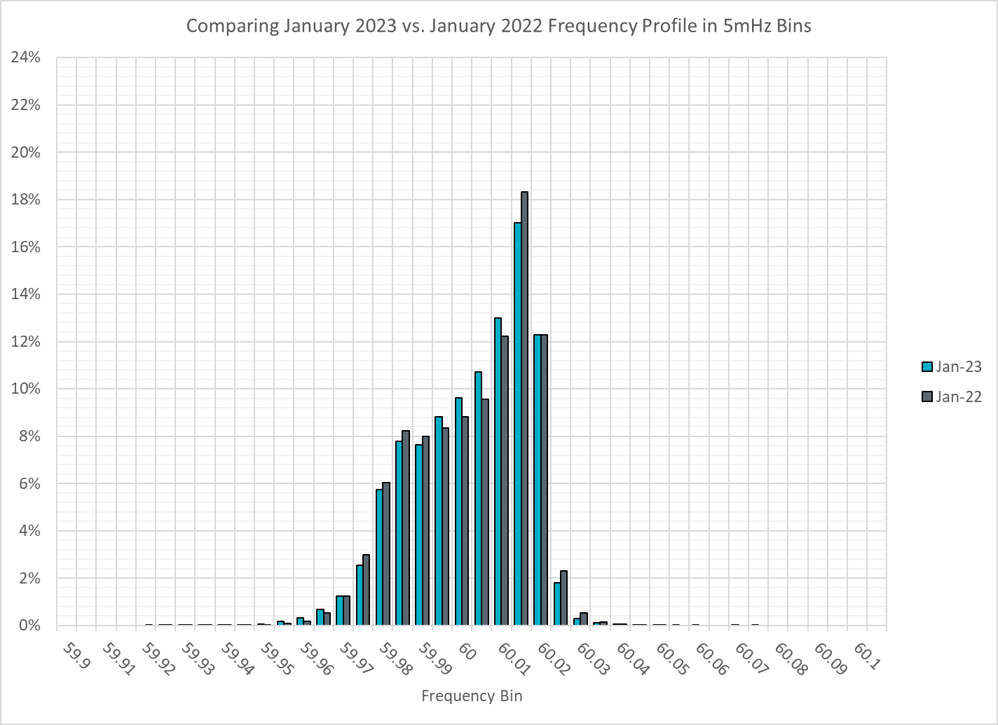
Frequency Profile Comparison
Notes:
Comparison of frequency profile between Jan 2022 and Jan 2023, we see fewer instances of frequency hovering at or below the lower deadband in Jan 2023.

Slide 13
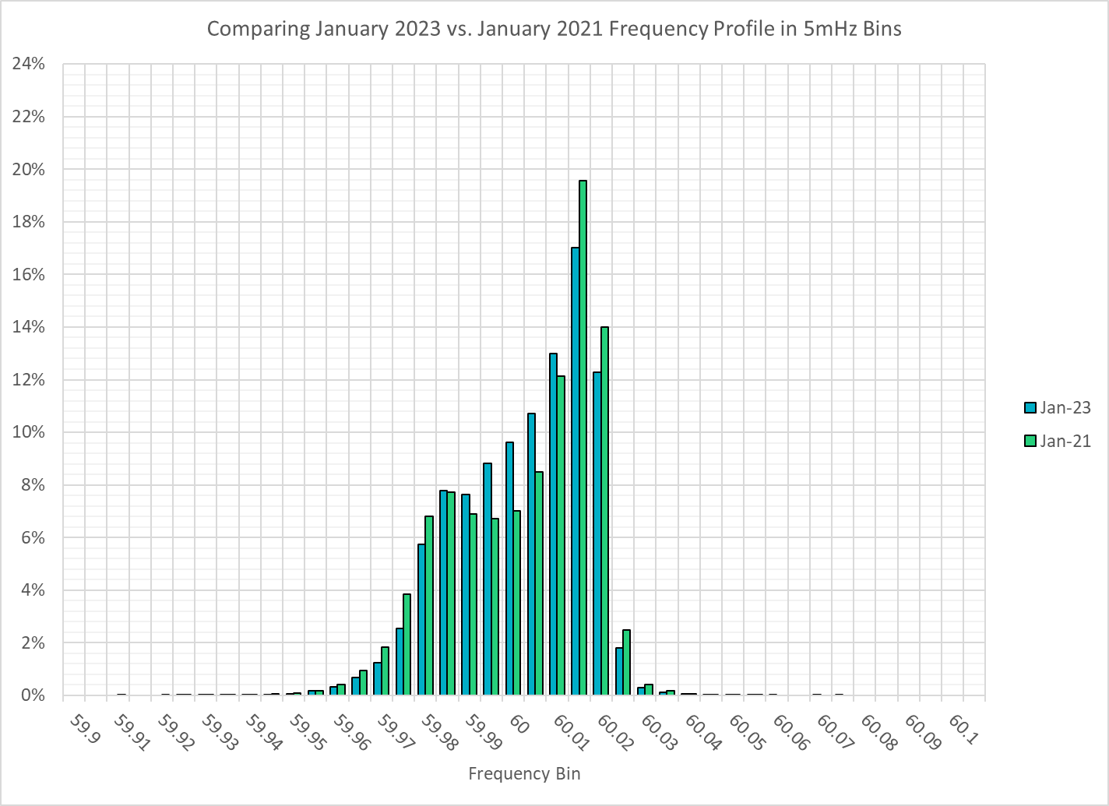
Frequency Profile Comparison
Notes:
Comparison of frequency profile between Jan 2021 and Jan 2023, we see fewer instances of frequency hovering at or below the lower deadband in Jan 2023.

Slide 14
Time Error Correction

Slide 15
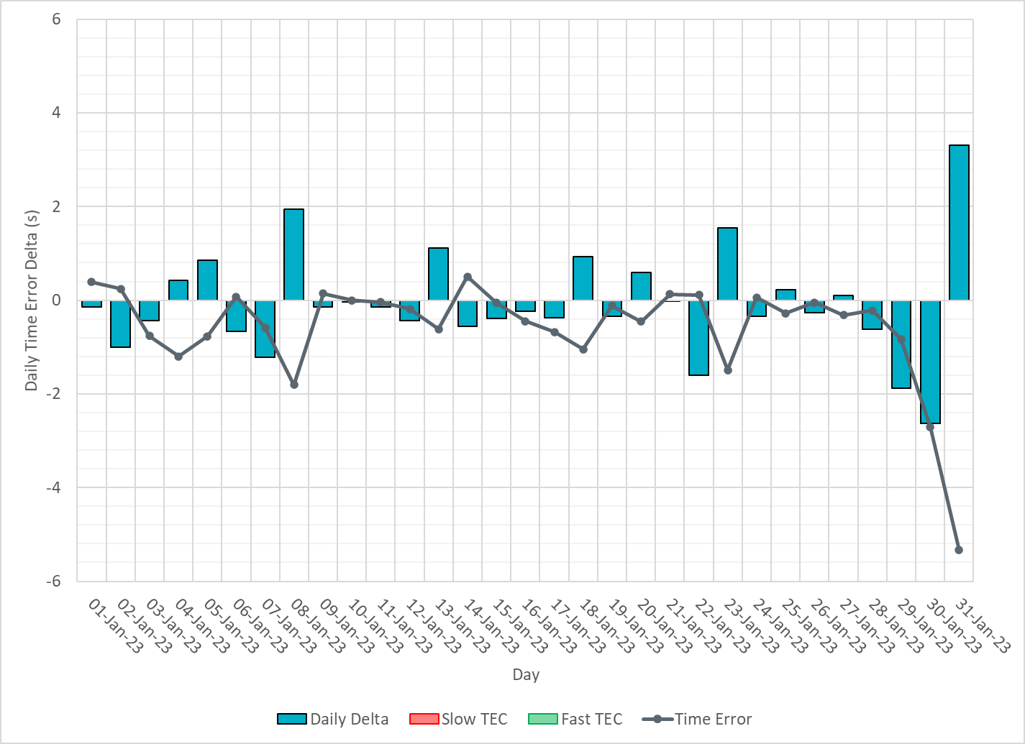
ERCOT Daily Time Error
Notes:
We did not make time error corrections and the time error was fairly small during the entire month of Dec.

Slide 16
Time Error Corrections Log Summary
There have been no time error corrections since December 2016

Slide 17
BAL-003 Performance

Slide 18
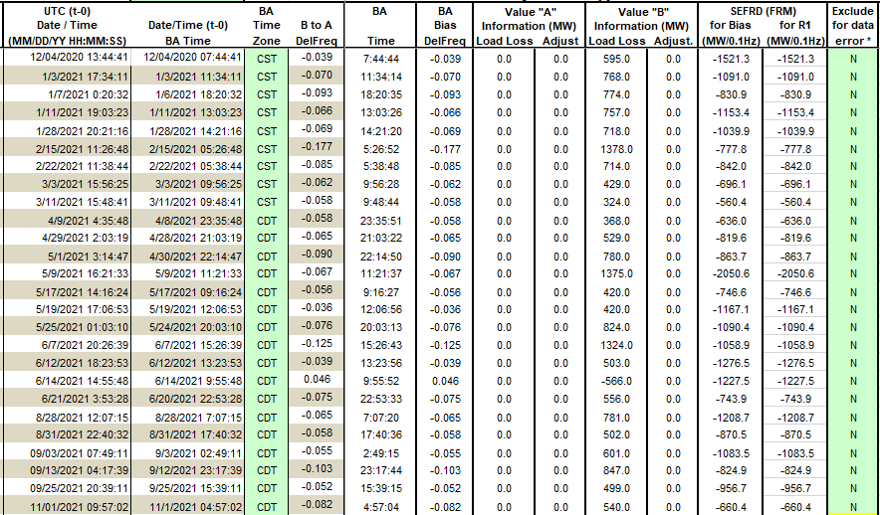
Op. Year 2021 BAL-003 Selected Events – Update
Notes:
BAL-003

Slide 19
Op. Year 2021 BAL-003 FRM Performance - Update
Notes:
OP2018: FRO = -381.0, FRM_median = -843.17, FRM_average = -959.7
OP2019: FRO = -381.0, FRM_median = -811.14, FRM_average = -892.5
OP2020: FRO = -425.0, FRM median = -789.34, FRM average = -879.0
OP2021: FRO = -471.0, FRM median = -913.56, FRM average = -992.

Slide 20
ERCOT Energy Statistics

Slide 21
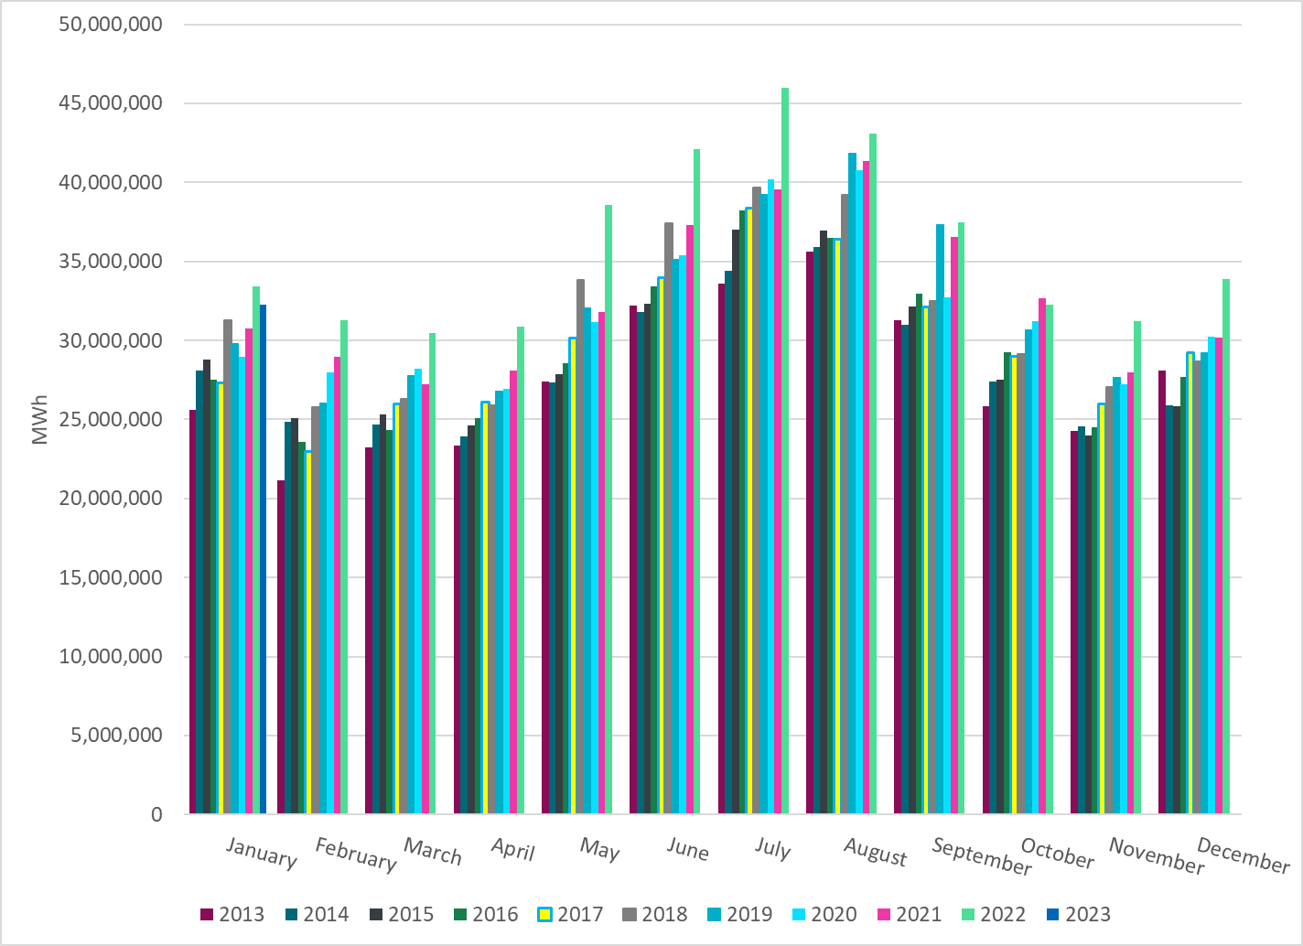
Total Energy
Notes:
32,277,477 MWh

Slide 22
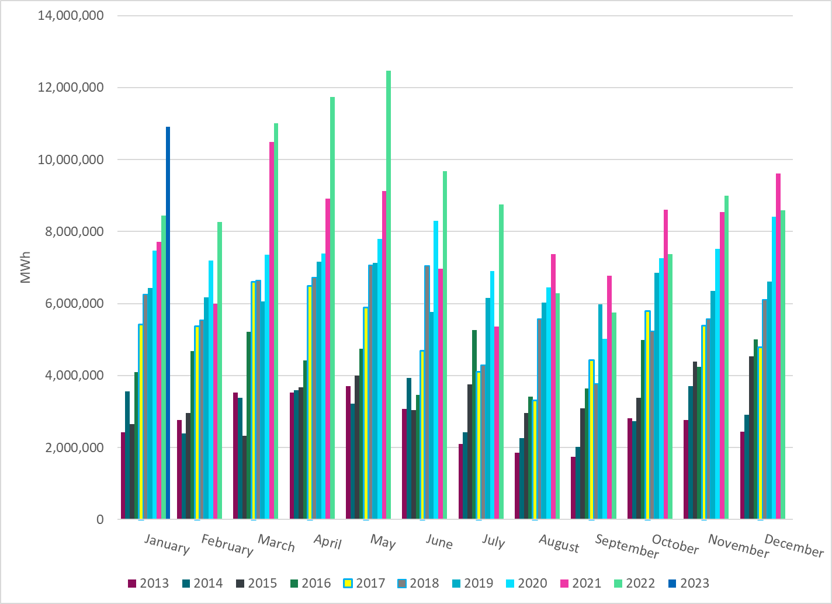
Total Energy from Wind Generation
Notes:
10,909,355 MWH

Slide 23
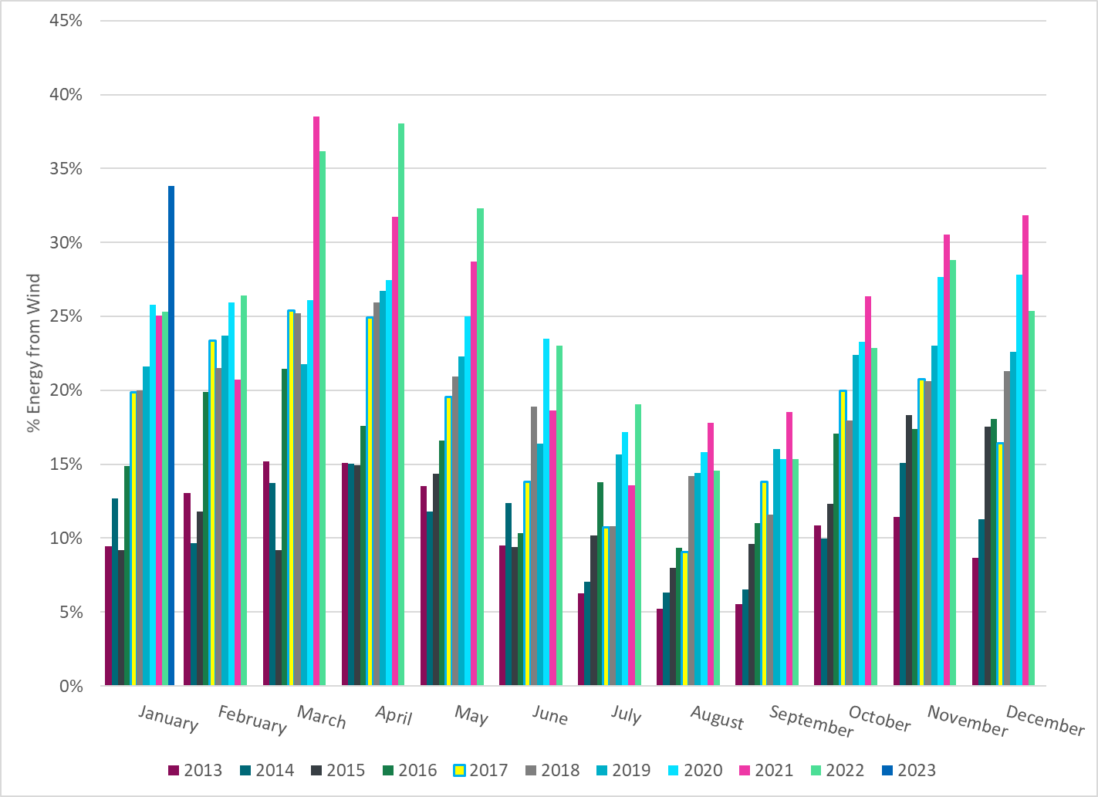
% Energy from Wind Generation
Notes:
33.80%
of total energy was provided by wind generation

Slide 24
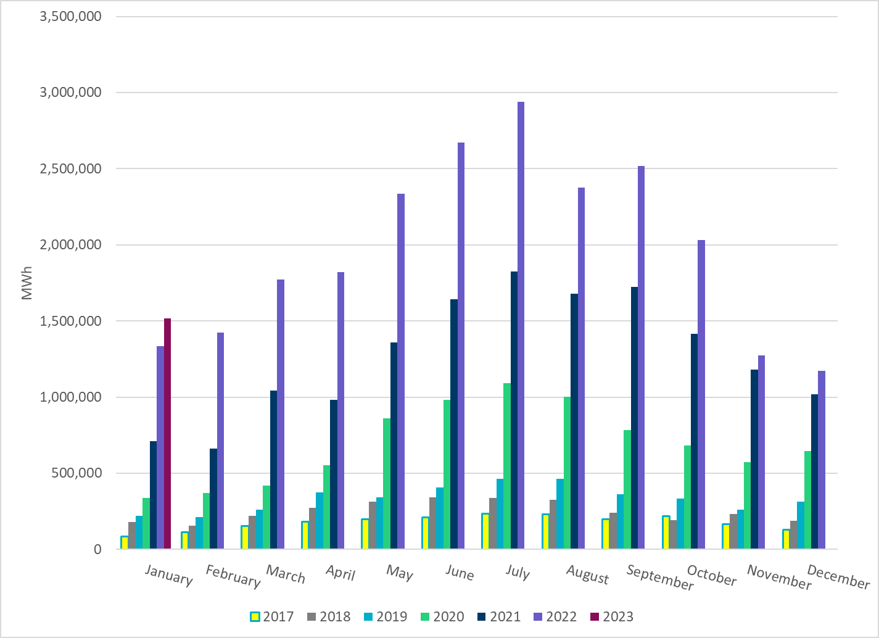
Total Energy From Solar Generation
Notes:
1,516,586 MWh

Slide 25
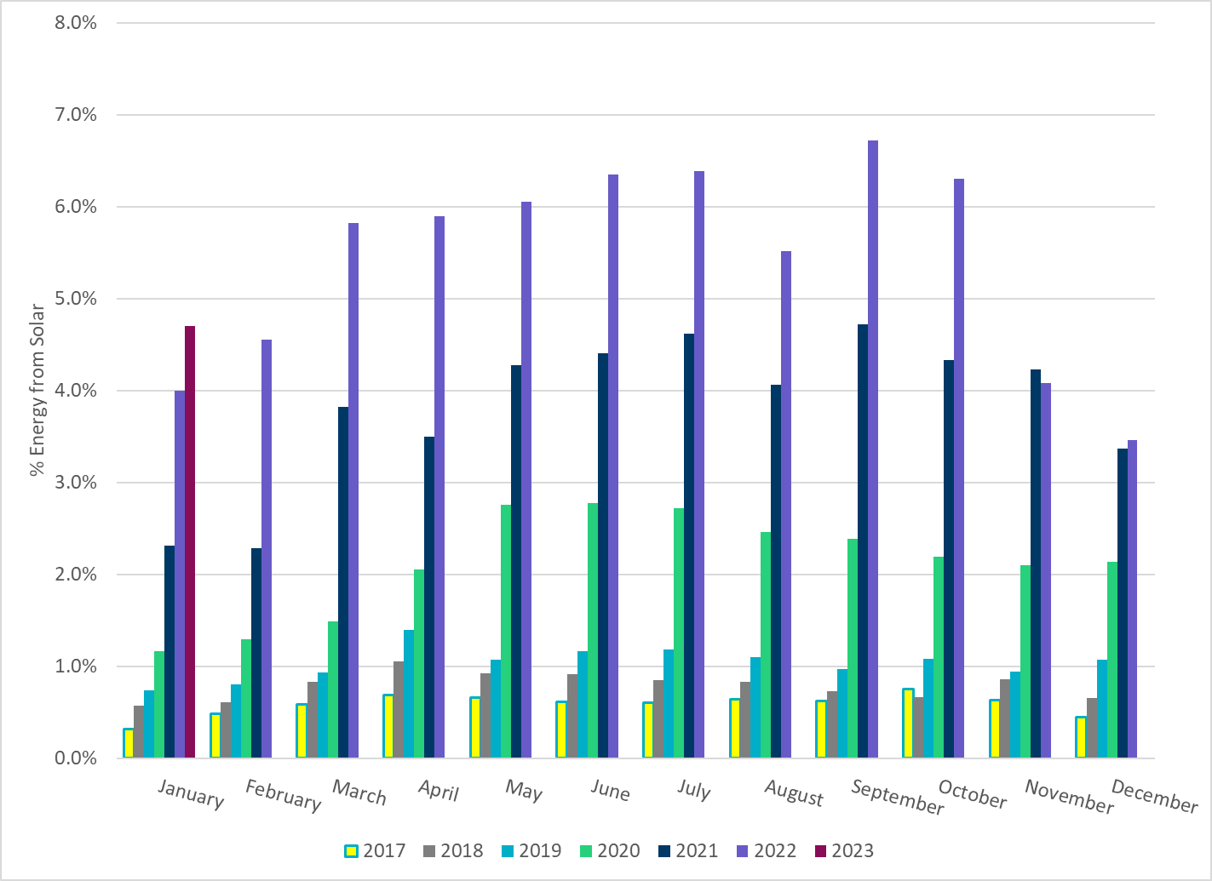
% Energy from Solar Generation
Notes:
4.70% of total
energy was provided by solar generation, which is highest solar penetration level so far.

Slide 26
ERCOT System Inertia

Slide 27
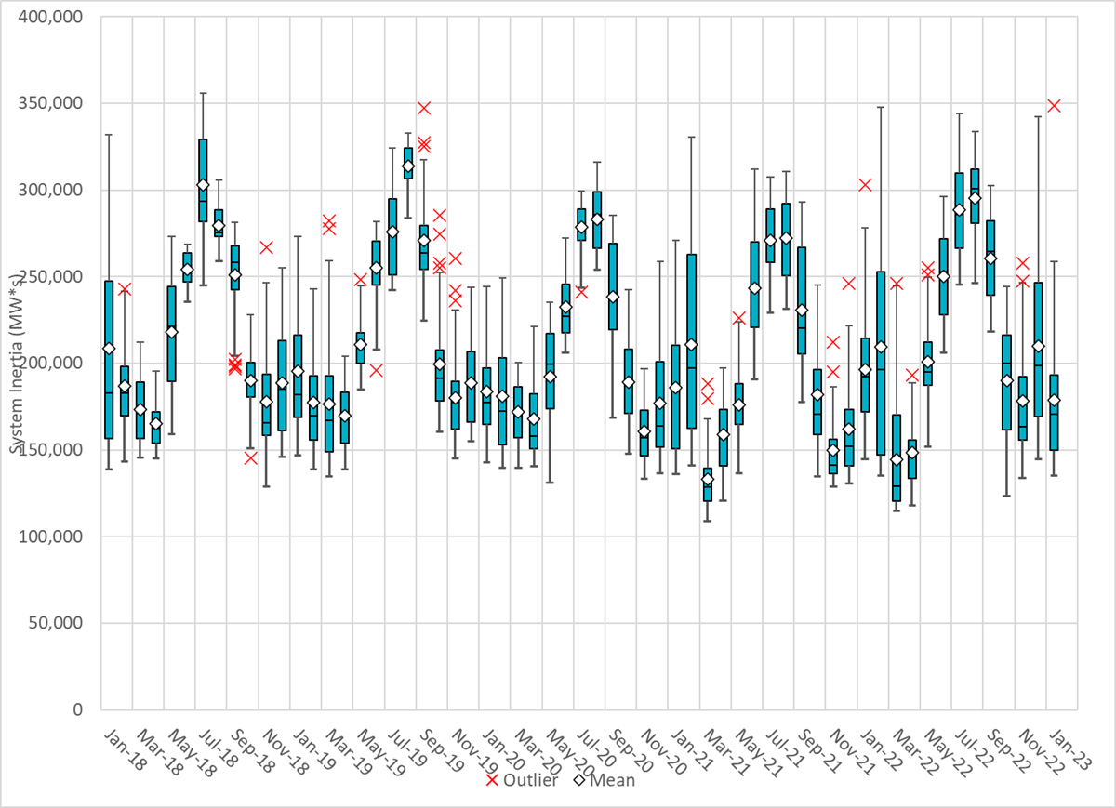
Daily Minimum System Inertia
Notes:
Minimum Inertia =135,268 MW*s on 1/15/2023
Previous Minimum was 109,029 MW*s on 3/22/2021
Data:
Mean: 178,997 MW*s
Max: 348,505 MW*s on Jan 31st
Min: 135,268 MW*s on Jan 15th

Slide 28
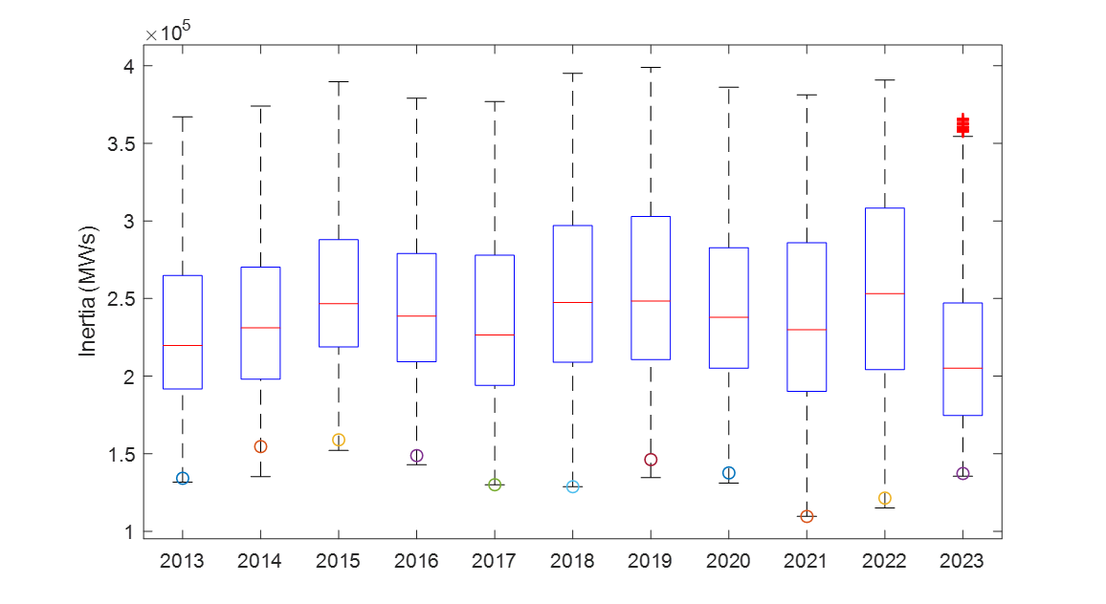
ERCOT Inertia 2013-2022
Notes:
For each box, the central mark (red line) is the median, the edges of the box (in blue) are the 25th and 75th percentiles, the whiskers correspond to +/- 2.7 sigma (i.e., represent 99.3% coverage, assuming the data are normally distributed. The corresponding lowest inertia in each year is given in the table.
The circle on each boxplot is showing inertia during time when highest portion of load was served by wind/solar generation in that year.

Slide 29
Questions?
Thank you!

