Slide 1
ERCOT Frequency Events
January 2023
ERCOT
Operations Planning
PDCWG | February 15th, 2023

Slide 2
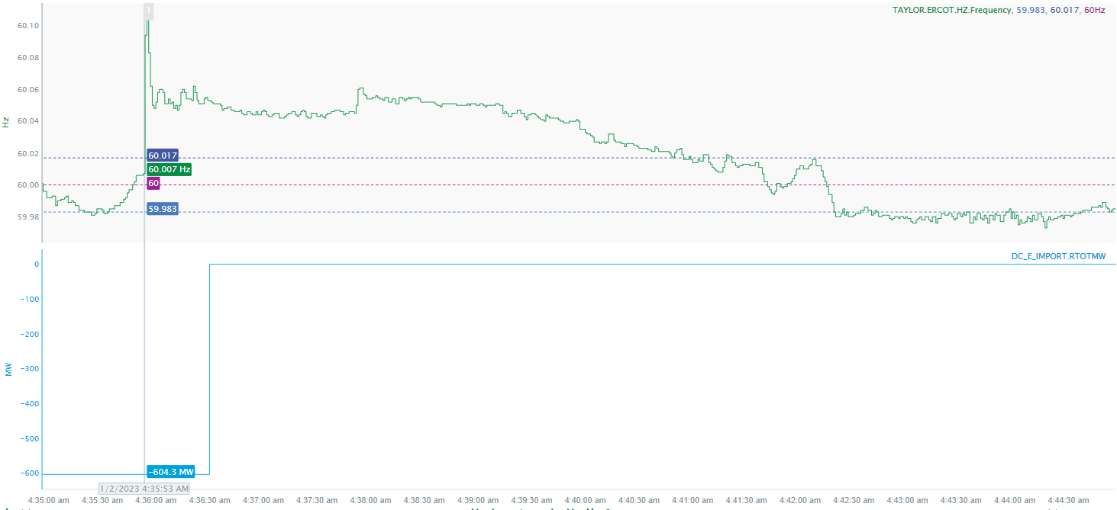
1/2/2023 4:35:53(FME)
Notes:
DC Tie East tripped while exporting approximately 604 MW
Starting Frequency: 60.007 Hz
Maximum Frequency: 60.105 Hz
A-C Time : 3 seconds
Recovery Time(back to deadband): 5 minutes 3 seconds
RRS Released: 0 MW
Trip Reason: Unknown at this time
Contextual Information: A total of 106 MW of regulation down was deployed there was a manual SCED run during the event

Slide 3
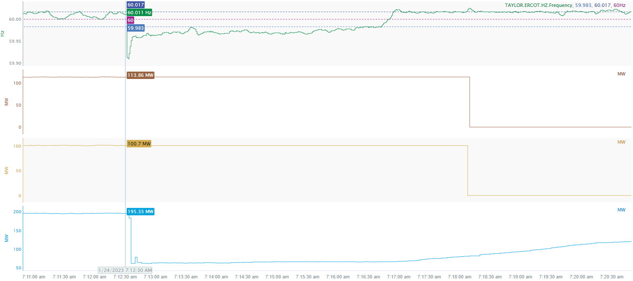
1/24/2023 7:12:30(Non-FME)
Notes:
Two wind units tripped offline and one wind unit tripped partially for a combined loss of approximately 348 MW
Starting Frequency: 60.011 Hz
Minimum Frequency: 59.91 Hz
A-C Time : 3 seconds
Recovery Time(back to deadband): 3 minutes 53 seconds
RRS Released: 0 MW
Trip Reason: Loss of transmission line
Contextual Information: A total of 172 MW of regulation up was deployed during this time
No Selection Reason: Small event(MW loss = 348 MW)

Slide 4
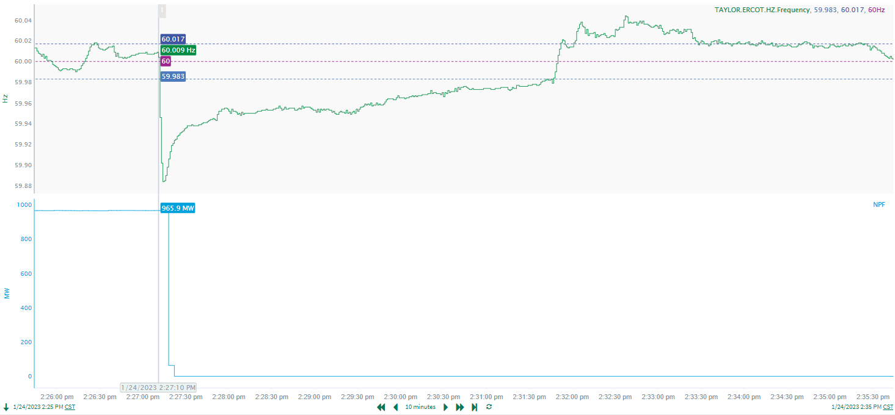
1/24/2023 14:27:10(FME)
Notes:
Thermal unit tripped offline while carrying approximately 966 MW
Starting Frequency: 60.009 Hz
Minimum Frequency: 59.884 Hz
A-C Time : 4 seconds
Recovery Time(back to deadband): 4 minutes 37 seconds
RRS Released: 570 MW
Reason: Loss of 345 kV transmission line
Contextual Information: A total of 155 MW of regulation Up was deployed and manual offset of 200 MW was applied during the event.

Slide 5
Questions?
Thank you!

