Slide 1
Credit Exposure Update
Market Credit Work Group
ERCOT Public
February 2023

Slide 2
Monthly Highlights Dec 2022 – Jan 2023
Market-wide average Total Potential Exposure (TPE) increased from $1.44 billion in December 2022 to $1.60 billion in January 2023
  TPE increased mainly due to the higher Real-Time and Day-Ahead Settlement Point prices in late December 2022 factoring into the RTLE in January 2023.
    Discretionary Collateral is defined as Secured Collateral in excess of TPE,CRR Locked ACL and DAM Exposure
  Average Discretionary Collateral decreased from $3.78 billion in December 2022 to $3.34 billion in January 2023
  The decrease in Discretionary Collateral is largely due to decrease in Secured Collateral
No unusual collateral call activity

Slide 3
TPE and Forward Adjustment Factors Jan 2022- Jan 2023
*TPE adjusted to exclude short pay entities eliminating data skew

Slide 4
TPE/Real-Time & Day-Ahead Daily Average Settlement Point Prices for HB_NORTH January 2022- January 2023
* TPE adjusted to exclude short pay entities eliminating data skew

Slide 5
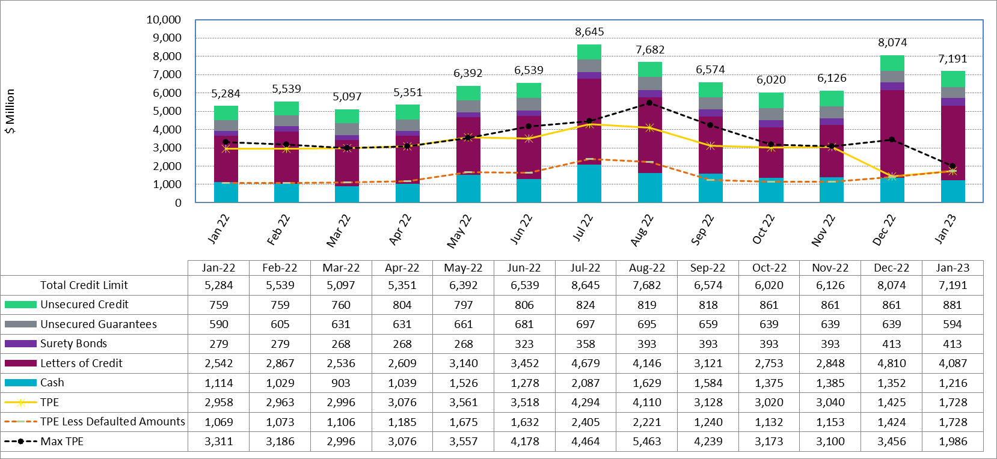
Available Credit by Type Compared to Total Potential Exposure (TPE) Jan 2022- Jan 2023
Numbers are as of month-end except for Max TPE
Max TPE is the highest TPE for the corresponding month
TPE less Defaulted Amounts: TPE – Short-Paid Invoices

Slide 6
Discretionary Collateral December 2022 - January 2023
* Discretionary collateral doesn’t include Unsecured Credit Limit or parent guarantees
* TPE adjusted to exclude short pay entities eliminating data skew

Slide 7
TPE and Discretionary Collateral by Market Segment- January 2023*
Load and Generation entities accounted for the largest portion of discretionary collateral
*Discretionary collateral doesn’t include Unsecured Credit Limit or parent guarantees
* TPE adjusted to exclude short pay amounts eliminating data skew

Slide 8
Discretionary Collateral by Market Segment January 2021 - January 2023
* Discretionary Collateral adjusted to exclude short pay amounts eliminating data skew

Slide 9
TPEA Coverage of Settlements December 2021– December 2022
*TPEA closely approximates actual/invoice exposure
*TPEA adjusted to exclude short pay entities eliminating data skew

Slide 10
TPEA Coverage of Settlements December 2021– December 2022
*TPEA exceeds invoice exposure
*TPEA adjusted to exclude short pay entities eliminating data skew

Slide 11
TPEA Coverage of Settlements December 2021– December 2022
*TPEA generally exceeds invoice exposure

Slide 12
TPEA Coverage of Settlements December 2021– December 2022
Invoice exposure generally exceeds TPEA
TPEA adjusted to exclude short pay entities eliminating data skew

Slide 13
TPEA Coverage of Settlements December 2021– December 2022
* TPEA generally exceeds Invoice exposure

Slide 14
TPES Coverage of Settlements December 2021– December 2022
*TPES exceeds actual/invoice exposure

Slide 15
Questions

