Slide 1
Feedback from ERCOT staff on EAL-RFAF lookback proposal from NRG Energy
Sanchir Dashnyam
ERCOT Market Credit Manager
ERCOT Public
February 15, 2023

Slide 2
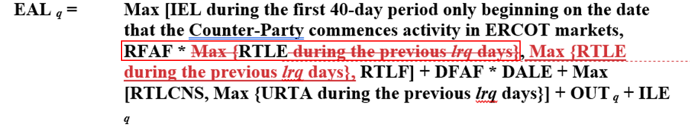
EAL/RFAF Lookback discussion
The group requested ERCOT staff to layer in the invoice exposures into a proposed TPE calculations from NRG vs. existing TPE formula. The proposal is as follows:
Invoice exposure is defined as “Invoices * M1 days + RTLCNS + UDAA”. Invoices include charges only and do not include credits.
The period covered included December 2022 and beginning of 2023.
TPE’s exclude URI short pay invoices and PUL.

Slide 3
Invoice exposures vs. current TPE vs. TPE with the new proposal
Overall Market
The proposed change will apply RFAF to most recent RTLE, not MAXRTLE. MAXRTLE is calculated based on 14-day average invoices and by taking the maximum over 40-day historical lookback period.
Potentially, the proposed change will lower collateral going into the high price events and increases the collateral requirement when the prices are falling.
We do not support the proposed change because it lowers the collateral cushion afforded by the existing methodology going into the high price environment.

Slide 4
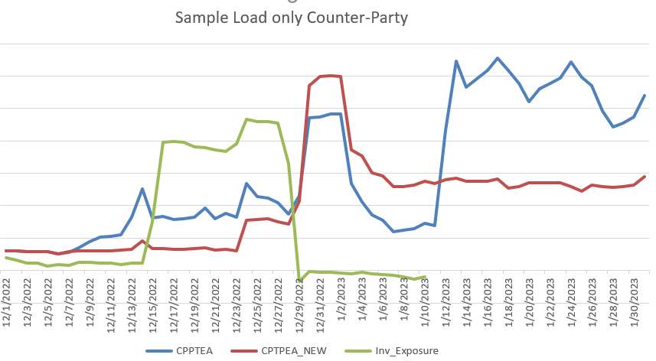
Sample Load

Slide 5
Invoice exposures vs. current TPE vs. TPE with the new proposal
Load

Slide 6
Invoice exposures vs. current TPE vs. TPE with the new proposal
Load & Gen

Slide 7
Invoice exposures vs. current TPE vs. TPE with the new proposal
Generation

Slide 8
Invoice exposures vs. current TPE vs. TPE with the new proposal
Trader

