Slide 1
Solar Generation Loss Event
January 23, 2023
Patrick Gravois
Operations Engineer – Operations Analysis
IBRTF Meeting
February 10, 2023

Slide 2
January 23 Event Overview
On January 23, 2023, @ 12:19 PM CST, Phase-A-to-ground fault occurred on 138 kV line in West Texas
Fault cleared normally in 3 cycles
Preliminary analysis shows approximate non-consequential loss of 298 MW of solar generation from 8 different facilities
Aggregate MW loss includes facilities that did not return to pre-disturbance output within 1 second
7 of 8 facilities involved in Odessa events
~208 MW of load reduction occurred at four different LFL sites immediately following fault
System frequency dropped to 59.955 Hz and recovered in 6 seconds
PMU/ relay event data requested from 25 surrounding solar facilities; 20 submitted PMU data
Wind/BESS reduction insignificant
RFIs sent to 8 facilities with due date of Feb. 24
Several facilities involved in Odessa events did not see voltage excursions large enough to test mitigation actions; others initially show an improvement in performance (less inverter tripping)

Slide 3
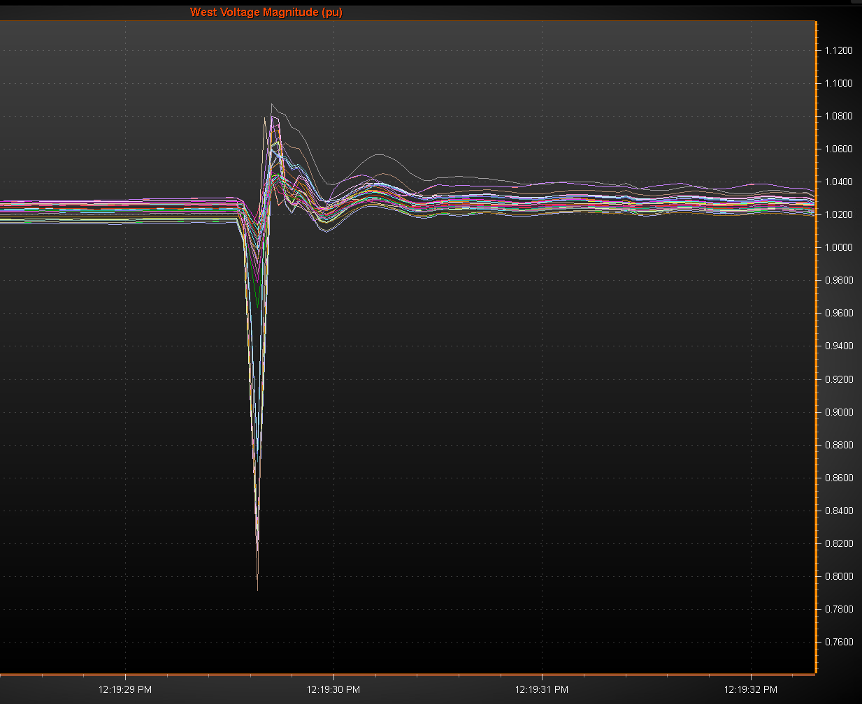
PMU Voltage During Event
Lowest voltage of 0.677 pu recorded at 138 kV station close to fault
Highest voltage of 1.088 pu recorded at 69 KV station in Far West Texas
Lowest recorded voltage on 345 kV system was 0.878 pu; highest was 1.07 pu
Voltage remained within NOG VRT “No Trip Zone”
Phase angle jumps in West Texas in the 10-to-15-degree range

Slide 4
Questions?

