Slide 1
ERCOT IBRTF: NERC and Other Industry Updates
Julia Matevosyan
Chief Engineer
ESIG
02/10/2023

Slide 2
Agenda
FERC Notice of Proposed Rulemaking (NOPR) E-2, Update
NERC EMT Guideline, Update
Upcoming Events

Slide 3
FERC NOPR E-2, Docket Number RM22-12-000
Item E-2 is a NOPR preliminarily finding that the Reliability Standards do not fully address the impacts of IBRs on the reliable operation of the BPS.
The NOPR proposes to direct NERC to develop new or modified Reliability Standards that address four reliability gaps related to IBRs.
  Data sharing: currently, IBR owners and operators do not consistently share IBR planning and operational data, and the information that is shared is often inaccurate or incomplete.
  Model validation: once planners have IBR data, they must ensure the accuracy of such data to create valid system models.
  Planning and operational studies: once planners and operators validate system models, they must include those models in planning and operational studies to assess the reliability impacts—both of individual and collective IBRs—on Bulk-Power System performance.
  Performance requirements, such as IBRs’ ability to ride through system disturbances.
https://www.ferc.gov/news-events/news/joint-presentation-items-e-1-registration-inverter-based-resources-and-e-2
https://elibrary.ferc.gov/eLibrary/search

Slide 4
Reliability Guideline: EMT Modeling and Simulation - in 2 parts
Vol. 1: EMT Model Requirements and Quality Control
Enable TP, PC, GO obtain and verify high quality EMT models
- Modeling requirements
- Model quality assessment
- Screening for EMT study need
- Assess ride-through capability and performance
- Resourcing for EMT studies
- Different flavors of EMT models
EMT Guideline, Vol.1 out for Industry Comments
Vol. 2: EMT Studies
- Scoping detailed EMT studies
- Building EMT study models
- Interconnection studies
- Transmission planning studies
- Material modification and model updates during
interconnection study process and post COD
https://www.nerc.com/comm/RSTC_Reliability_Guidelines/Draft_Reliability_Guideline-EMT_Modeling_and_Simulations_Vol_1.pdf
Comment is due back by Feb 20, but please send it over as soon as you can,
NERC IRPS have to turn around back to RSTC by Feb 24.

Slide 5
Vol 1 - Schedule
Schedule for Vol 1 Publication
Key Dates | Milestones
Dec 15, 2022 | Consensus to post for public comment at IRPS monthly meeting
Dec 16, 2022 | Draft out to RSTC for review to authorize via email ballot posting for comment
Feb 2023 | Incorporate comments
Mar 2023 | RSTC final approval and publication

Slide 6
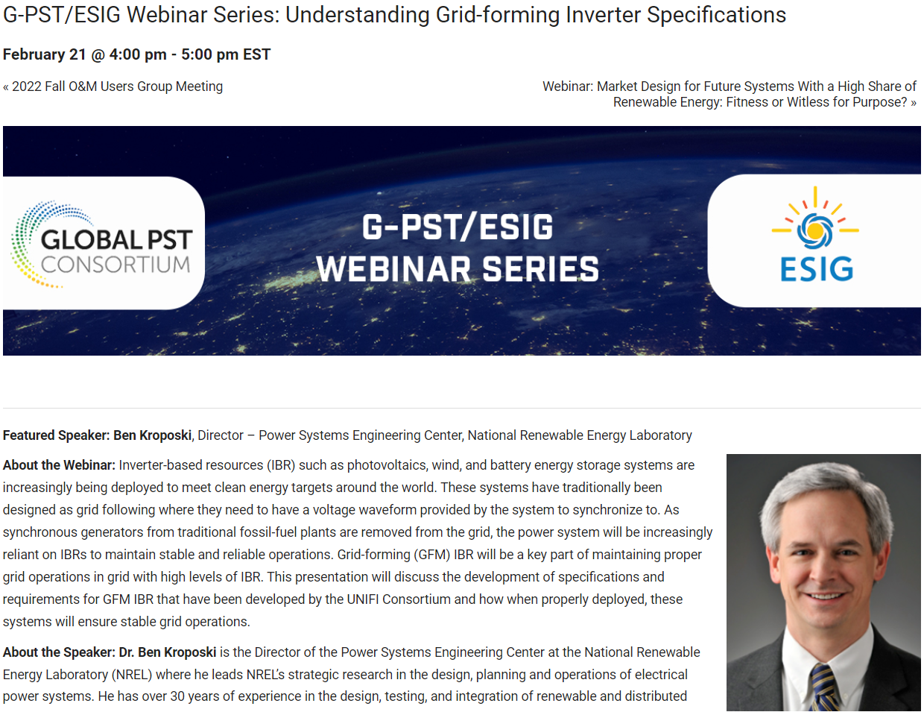
Upcoming G-PST/ESIG Webinar on UNIFI specs
At the upcoming G-PST/ESIG webinar on 02/21/2023 Ben Kroposki (NREL) will cover the UNIFI specifications in more detail

Slide 7

ESIG Spring Technical Workshop, March 27-30
Sessions of interest to ERCOT IBRTF:
GFM Requirements and Specifications
  ENTSO-E Requirements for Generators 2.0 Including GFM Specifications, Mario Ndreko, TenneT (Germany)
  GFM Batteries: A Unique Window of Opportunity, Julia Matevosyan, ESIG
  UNIFI GFM Performance Requirements Deepak Ramasubramanian, EPRI
  NG ESO GFM Specification Best Practice Application Guide, Nick Harvey, National Grid ESO (United Kingdom)
  AEMO Draft Grid Forming Specifications Nilesh Modi, Specialist, AEMO (Australia)
IBR Studies and Tools
  Dynamic Stability Screening Approaches for High IBR Systems, Matt Richwine, Telos Energy
  Analysis of 19.5 Hz Oscillation on Kaua’I Island System Jin Tan, NREL
  Dynamic Performance Optimization for 100% Inverter-based Power Systems: Experiences from Hawai’i Island, Ulrich Münz, Siemens
  New System Strength Metrics, Tim Green, Imperial College London (UK)
  NERC EMT Modeling Guide, Alex Shattuck, NERC
More information and Registration here: https://www.esig.energy/event/2023-spring-technical-workshop/

Slide 8
Julia Matevosyan
julia@esig.energy

