Slide 1
NPRR1156, Priority Revision Request Process
Jonathan Levine
Assistant General Counsel
Kim Rainwater
Corporate Counsel
Protocol Revision Subcommittee Meeting
February 9, 2023

Slide 2
Issue Statement
To reach a resolution regarding paragraph (1)(a) of proposed new Protocol Section 21.5.2, Priority Revision Requests, which sets forth how the PUCT or ERCOT Board may direct ERCOT to file a Priority Revision Request or designate an existing Revision Request as a Priority Revision Request

Slide 3
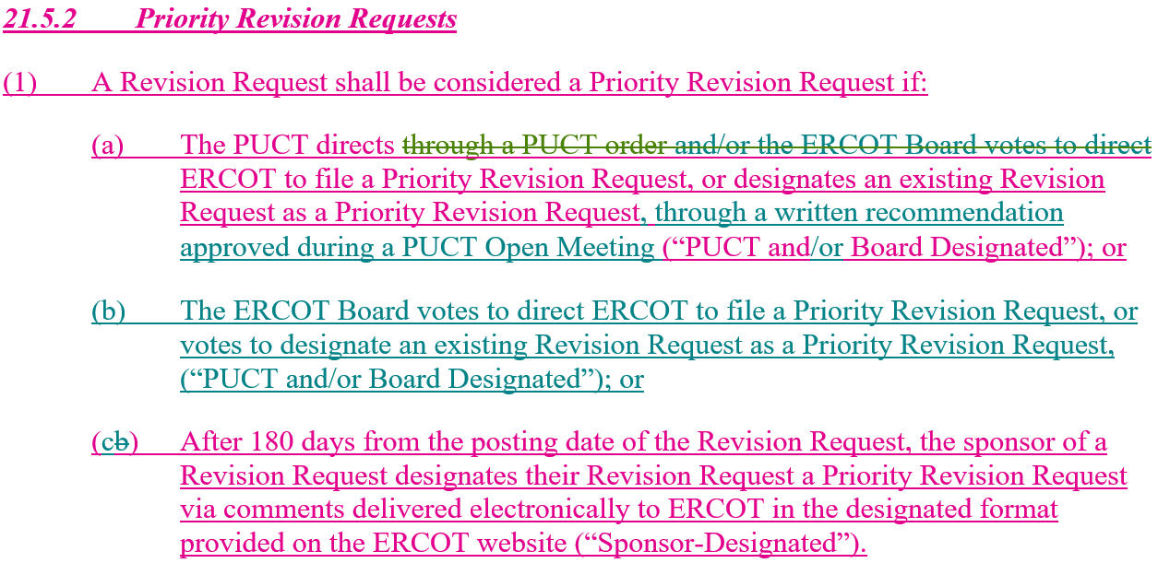
Joint TDSP Comments

Slide 4
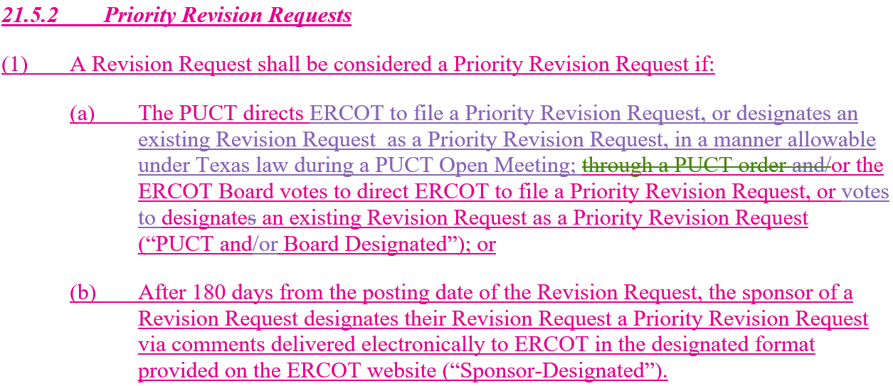
ERCOT Comments

Slide 5
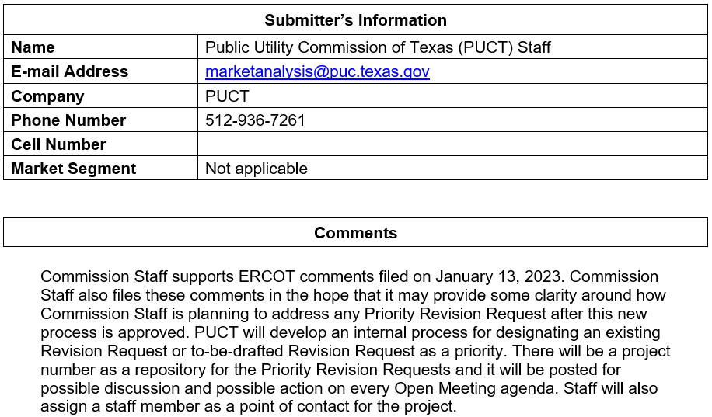
PUCT Staff Comments

Slide 6
Priority Revision Request Process Flow
Urgent Status vs. Priority Status Process Flow
Nodal Protocol Revision Request (Urgent status)
TAC Consideration
PRS Urgency & Language Consideration
PUCT
Consideration
ERCOT Board Consideration
Nodal Protocol Revision Request (Priority Status)
ERCOT Board Consideration
TAC Language Consideration
PUCT Consideration
*Urgency Status and Priority Status are separate. Urgency does not imply Priority.

Slide 7
Examples
NPRR | Title | Filed | Actual Approval Date | Potential Priority Approval Date | Potential savings w/ Priority (days)
1084 | Improvements to Reporting of Resource Outages, Derates, and Startup Loading Failures | 6/30/2021 | 11/3/2022 | 7/29/2021 | -462
1097 | Create Resource Forced Outage Report | 9/29/2021 | 3/31/2022 | 10/28/2021 | -154
1090 | ERS Winter Storm Uri Lessons Learned Changes and Other ERS Items | 7/28/2021 | 10/28/2021 | 8/19/2021 | -70
1103 | Securitization – PURA Subchapter M Default Charges | 11/1/2021 | 12/16/2021 | 12/16/2021 | 0
1108 | ERCOT Shall Approve or Deny All Resource Planned Outage Requests | 11/9/2021 | 5/12/2022 | 12/16/2021 | -147
1114 | Securitization – PURA Subchapter N Uplift Charges | 12/29/2021 | 3/31/2022 | 1/26/2022 | -64
1120 | Create Firm Fuel Supply Service | 1/31/2022 | 3/31/2022 | 2/25/2022 | -34
Urgent NPRRs filed after Winter Storm Uri
Potential Priority Approval Date represents earliest possible approval if NPRR was designated Priority by PUCT and/or Board (with Special TAC meetings, if necessary)

