Slide 1
PDCWG Report to ROS
Chair: Jimmy Jackson, CPS
Vice Chair: Vacant
ROS
Feb 2nd, 2023

Slide 2
Report Overview & Notes
Report Overview
Meeting Minutes
BAL-001-TRE-2 FMEs and IMFR
1 FME in the month of Dec
Frequency Control Report

Slide 3
Meeting Minutes
PDCWG Meeting 1/18/2023
PDCWG Administrative Business
IFRO OY2023 Change
Updates to Business Practice Manual for QSEs Regarding ESRs
ERCOT Reports
TRE Report

Slide 4
Frequency Measurable Events Performance

Slide 5
Frequency Measurable Events
There was 1 FME in December
12/7/2022 03:50:10
Reduction of 1,400 MW of load
Interconnection Frequency Response: 1,207 MW/0.1 Hz
294 Resources were evaluated. These includes,
262 Generation Resources
0 Controllable Load Resources
32 Energy Storage Resources
114 of 294 Evaluated Resources had less than 75% of their expected Initial Primary Frequency Response.
99 of 294 Evaluated Resources had less than 75% of their expected Sustained Primary Frequency Response.

Slide 6
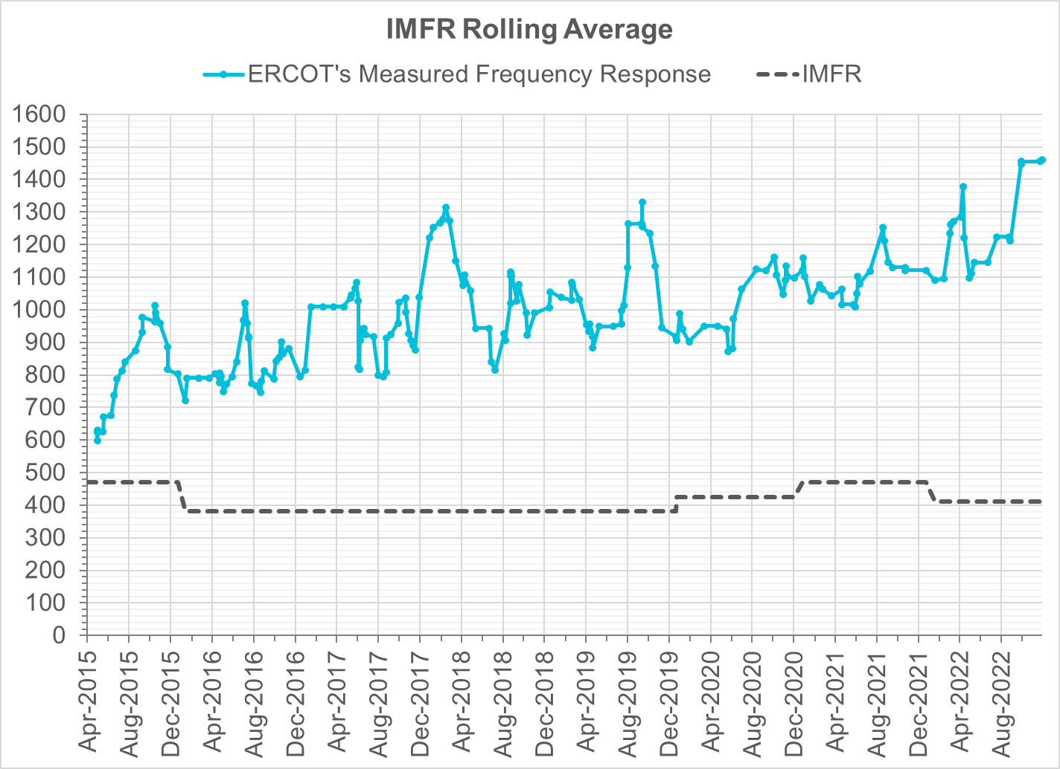
Interconnection Minimum Frequency Response (IMFR) Performance
IMFR Performance currently
1461.27 MW/0.1HZ
Frequency Response Obligation (FRO): 412 MW/0.1 Hz

Slide 7
Questions?

Slide 8
Frequency Control Report
Dec 2022

Slide 9
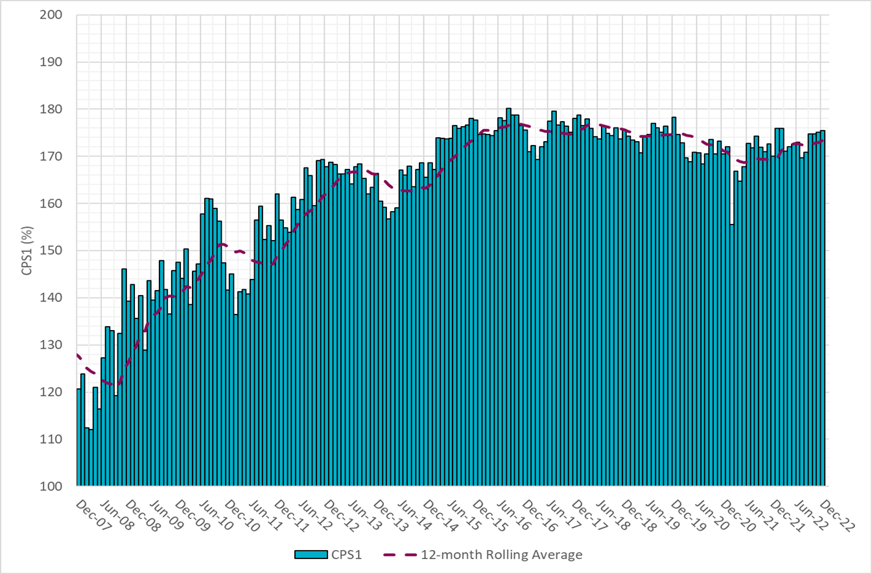
CPS1 Performance
Current 12-Month Rolling Average: 173.42%

Slide 10
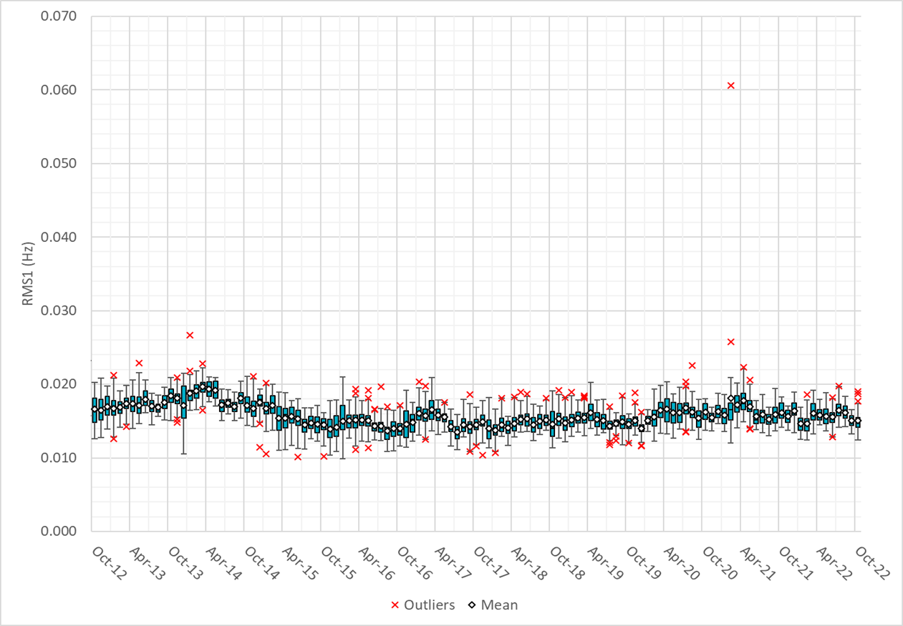
RMS1 Performance of ERCOT Frequency
Notes:
14.80Mhz on avg for Dec 2022

Slide 11
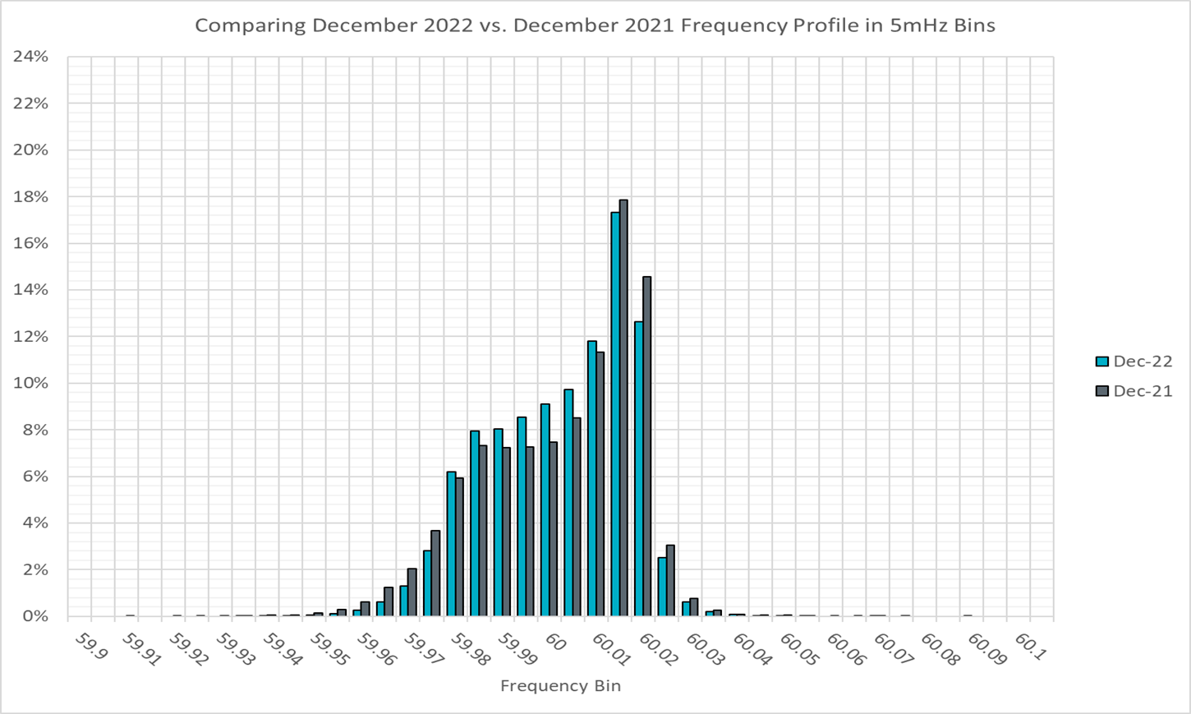
Frequency Profile Analysis

Slide 12
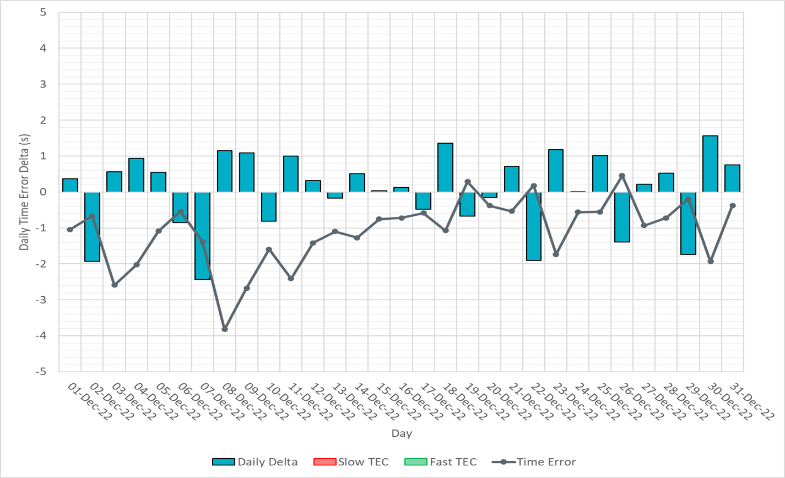
Time Error Corrections

Slide 13
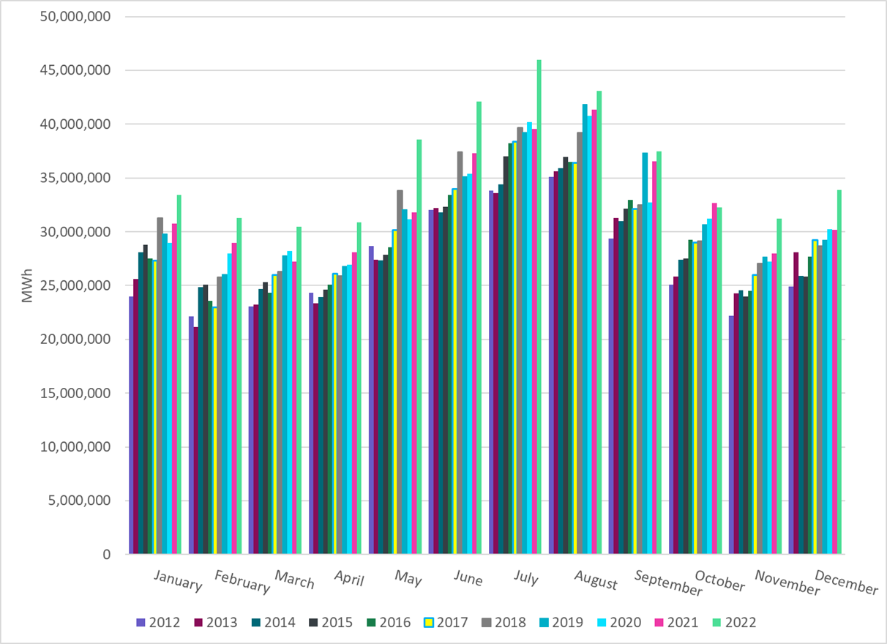
ERCOT Total Energy
Notes:
33,862,352 MWh

Slide 14
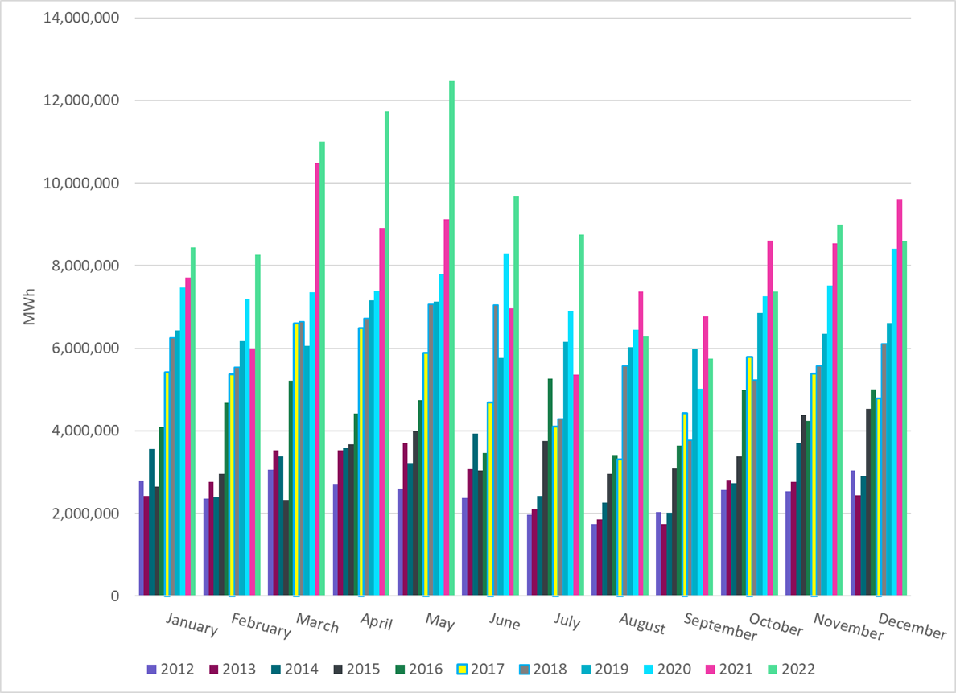
ERCOT Total Energy from Wind Generation
Notes:
8,586,488 MWH

Slide 15
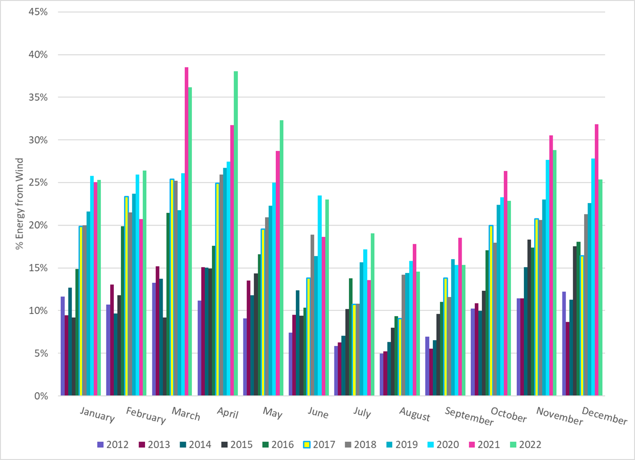
ERCOT % Energy from Wind Generation
Notes:
25.36%

Slide 16
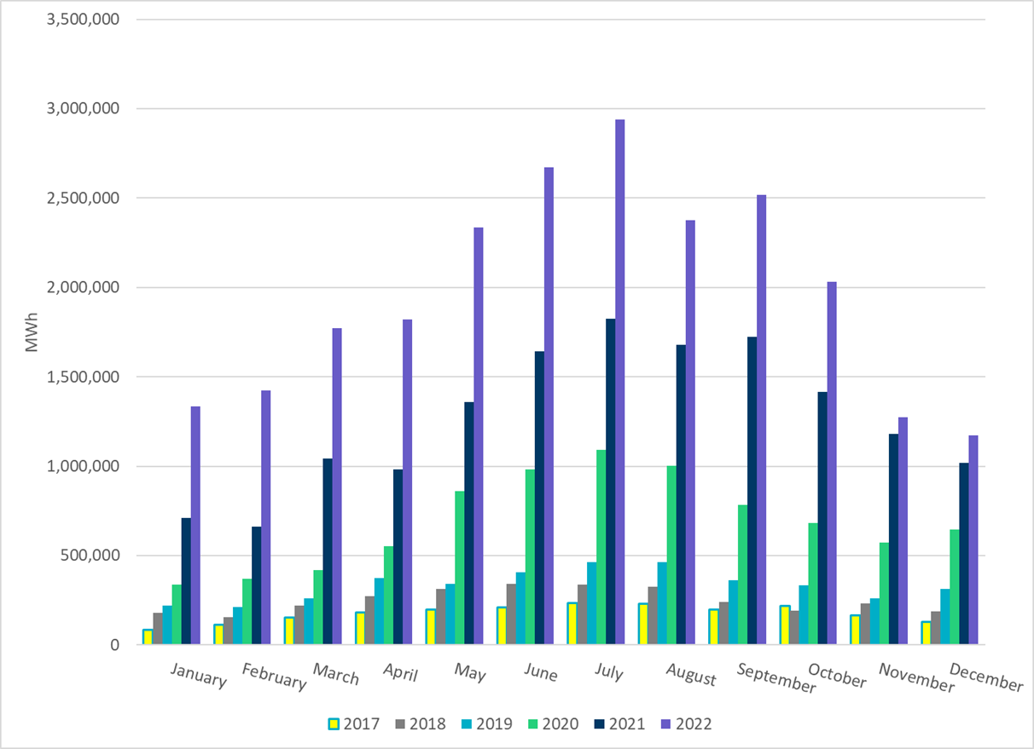
ERCOT Total Energy from Solar Generation
Notes:
1,171,432 MWh

Slide 17
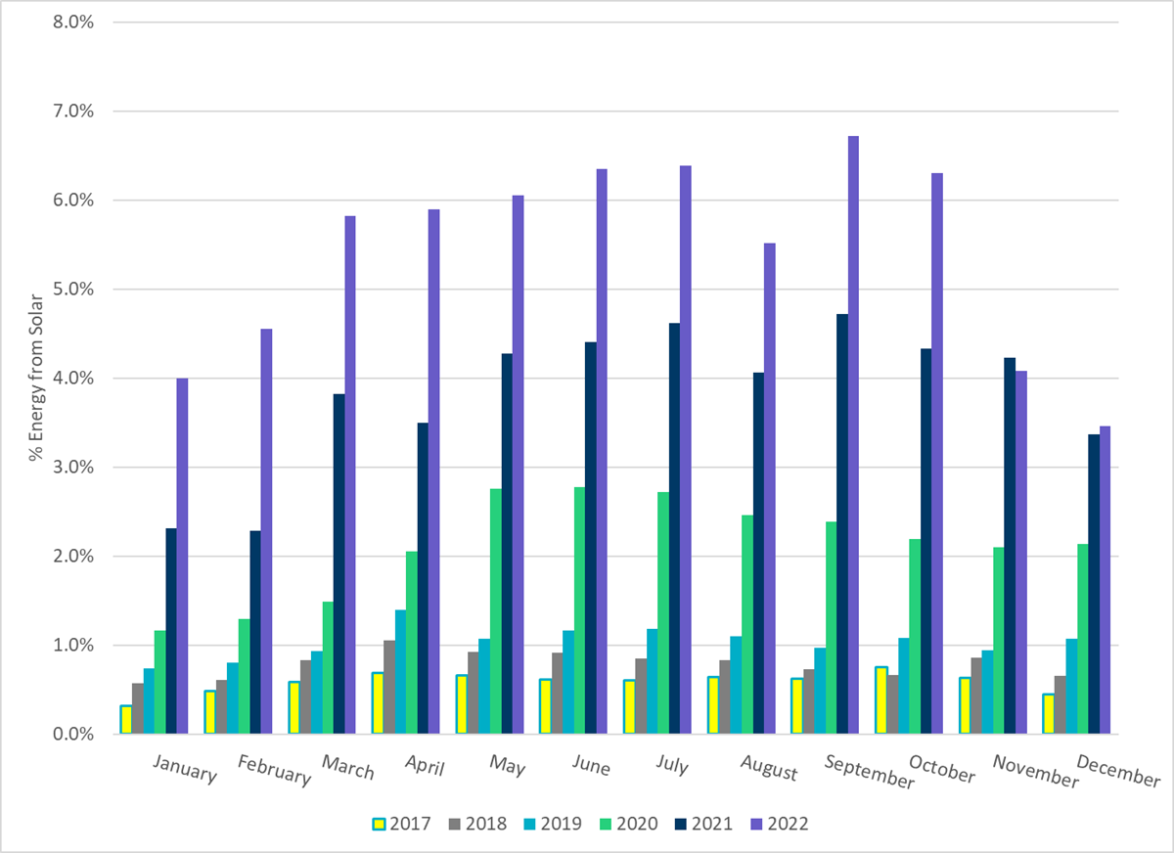
ERCOT % Energy from Solar Generation
Notes:
3.46%

Slide 18
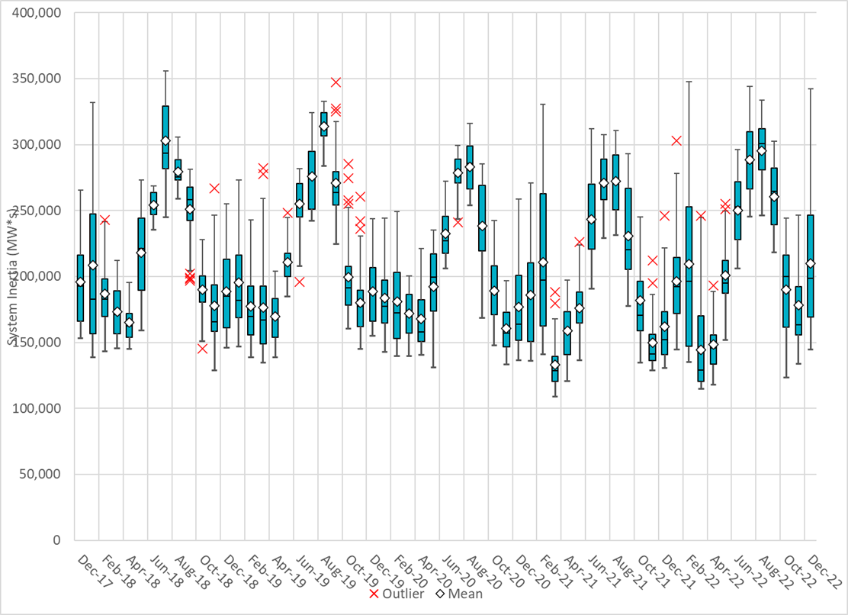
ERCOT Daily Minimum System Inertia
Notes:
Minimum Inertia =123,509 MW*s on 10/22/2022
Previous Minimum was 109,029 MW*s on 3/22/2021
Data:
Mean: 209,794 MW*s
Max: 342,396 MW*s on Dec 23rd
Min: 144,718 MW*s on Dec 13th

Slide 19
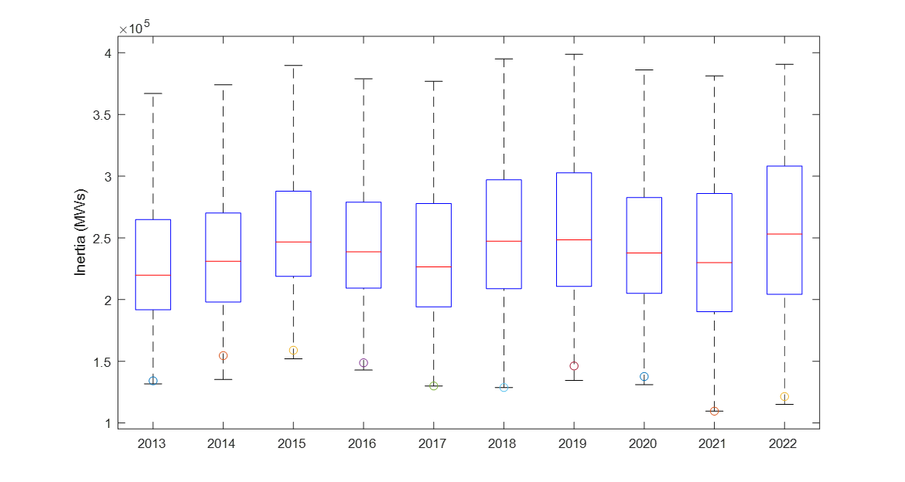
ERCOT Inertia Trend
Notes:
For each box, the central mark (red line) is the median, the edges of the box (in blue) are the 25th and 75th percentiles, the whiskers correspond to +/- 2.7 sigma (i.e., represent 99.3% coverage, assuming the data are normally distributed. The corresponding lowest inertia in each year is given in the table.
The circle on each boxplot is showing inertia during time when highest portion of load was served by wind/solar generation in that year.

